Slide 1
CS 6476 Project 6
Shuvo Newaz
shuvo.newaz@gatech.edu
snewaz3
903614132

Slide 2
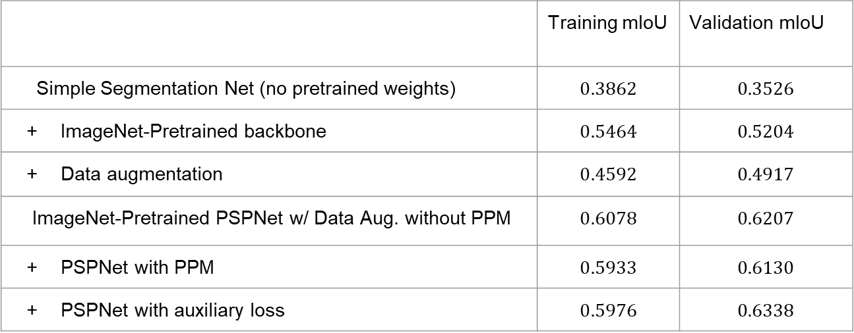
Parts 4 & 5: mIoU of different models
Add each of the following (keeping the changes as you move to the next row):
 | Training mIoU | Validation mIoU
Simple Segmentation Net (no pretrained weights) | $$0.3862$$ | $$0.3526$$
ImageNet-Pretrained backbone | $$0.5464$$ | $$0.5204$$
Data augmentation | $$0.4592$$ | $$0.4917$$
ImageNet-Pretrained PSPNet w/ Data Aug. without PPM | $$0.6078$$ | $$0.6207$$
PSPNet with PPM | $$0.5933$$ | $$0.6130$$
PSPNet with auxiliary loss | $$0.5976$$ | $$0.6338$$

Slide 3
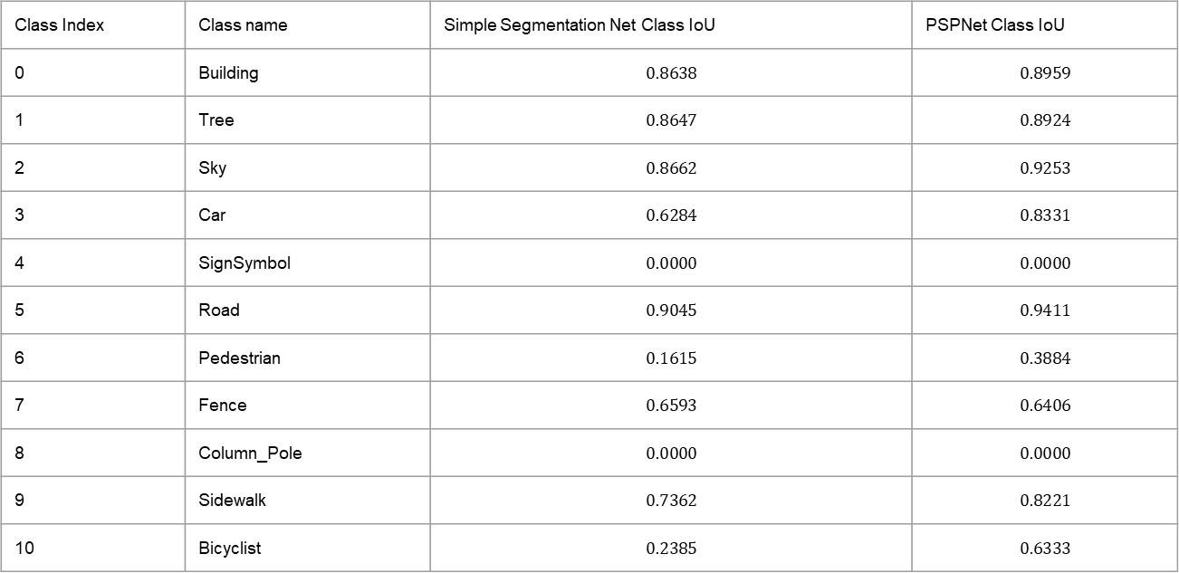
Parts 4 & 5: Per class IoUs
Report your model’s IoU for the 11 Camvid classes (you can find the order they are listed in at dataset_lists/camvid-11/camvid-11_names.txt):
Class Index | Class name | Simple Segmentation Net Class IoU | PSPNet Class IoU
0 | Building | $$0.8638$$ | $$0.8959$$
1 | Tree | $$0.8647$$ | $$0.8924$$
2 | Sky | $$0.8662$$ | $$0.9253$$
3 | Car | $$0.6284$$ | $$0.8331$$
4 | SignSymbol | $$0.0000$$ | $$0.0000$$
5 | Road | $$0.9045$$ | $$0.9411$$
6 | Pedestrian | $$0.1615$$ | $$0.3884$$
7 | Fence | $$0.6593$$ | $$0.6406$$
8 | Column_Pole | $$0.0000$$ | $$0.0000$$
9 | Sidewalk | $$0.7362$$ | $$0.8221$$
10 | Bicyclist | $$0.2385$$ | $$0.6333$$

Slide 4
Parts 4 & 5: Most difficult classes
[Which classes have the lowest mIoU? Why might they be the most difficult? Provide an example RGB image from Camvid that illustrates your point]
SignSymbol and Column_Pole have the lowest mIoU. Poles and Signs are thin and small (not be confused with short). They contribute less to the segmentation loss than larger objects. An image from CamVid is shown in the next page. The boxed object is small compared to the car or the road.

Slide 5
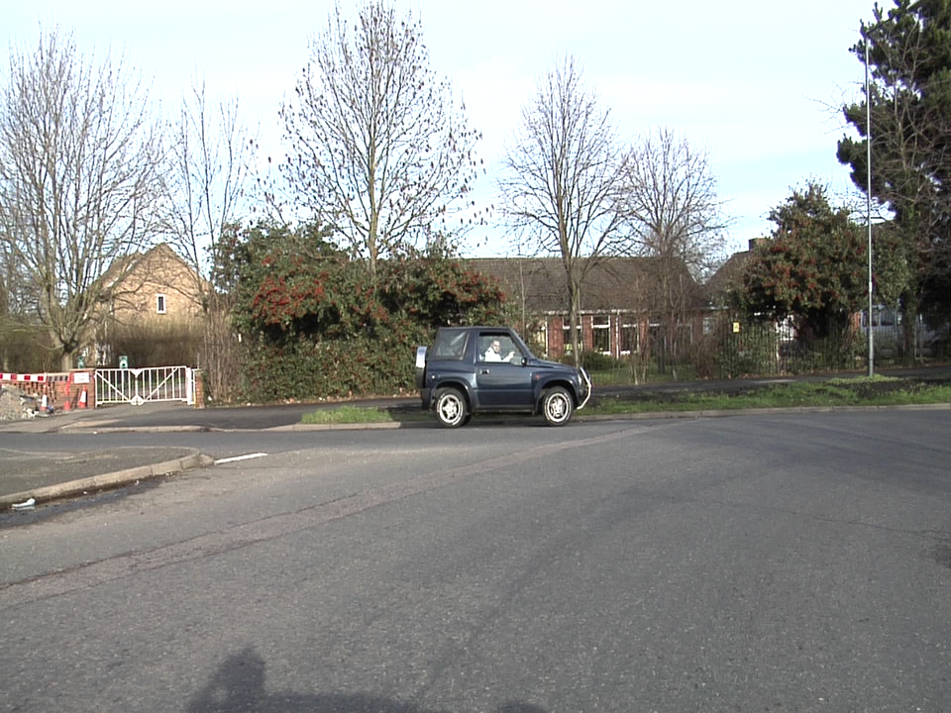
Parts 4 & 5: Most difficult classes

Slide 6
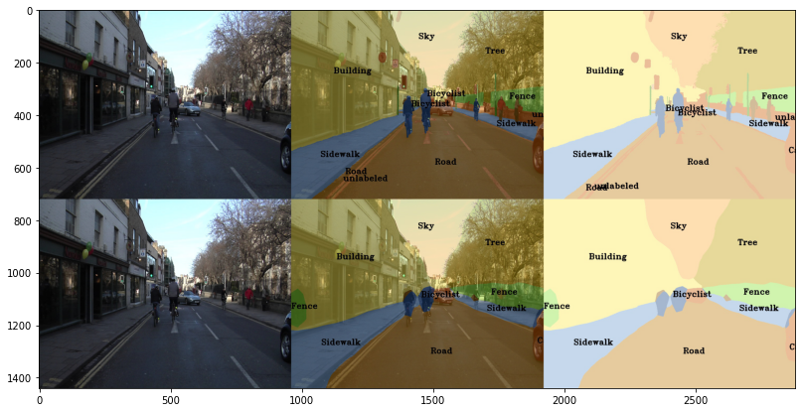
Part 4: Simple segmentation net qualitative results
[Paste a figure of the generated semantic segmentation from Colab. It should be a 2x3 grid, with ground truth on the top row, and your predictions on the bottom row.]

Slide 7
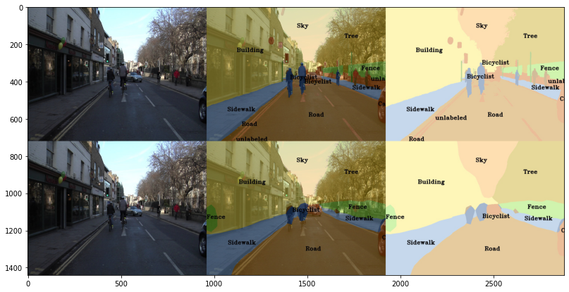
Part 5: PSPNet qualitative results
[Paste a figure of the generated semantic segmentation from Colab. It should be a 2x3 grid, with ground truth on the top row, and your predictions on the bottom row.]

Slide 8
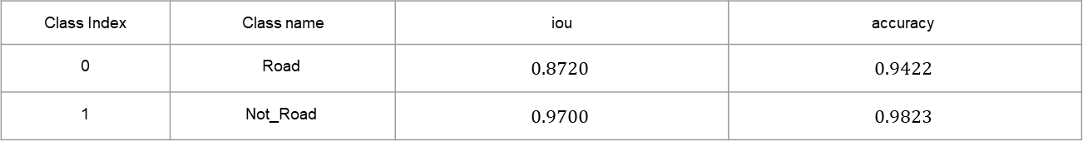
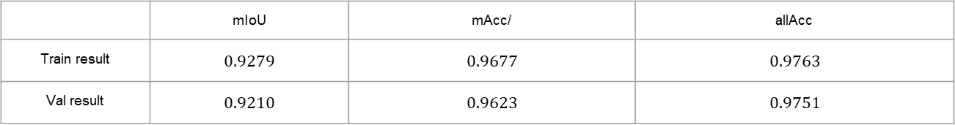
Part 6: Transfer Learning
Report your model’s IoU for the Kitti Dataset.
 | mIoU | mAcc/ | allAcc
Train result | $$0.9279$$ | $$0.9677$$ | $$0.9763$$
Val result | $$0.9210$$ | $$0.9623$$ | $$0.9751$$
Class Index | Class name | iou | accuracy
0 | Road | $$0.8720$$ | $$0.9422$$
1 | Not_Road | $$0.9700$$ | $$0.9823$$

Slide 9
Part 6: Transfer Learning
Compare the training loss generated when training on Kitti dataset and Camvid dataset. Which decreases at a faster rate? If Camvid or Kitti training loss decreases at a faster rate than the other, why do you think this happened? Or, if the loss decreases at a similar rate, why do you think that is so?
In percentage reduction of loss, KITTI training loss decreases faster. We are distinguishing between two cases with KITTI as opposed to 11 for CamVid, which makes it easier to reduce the loss for KITTI.

