Slide 1
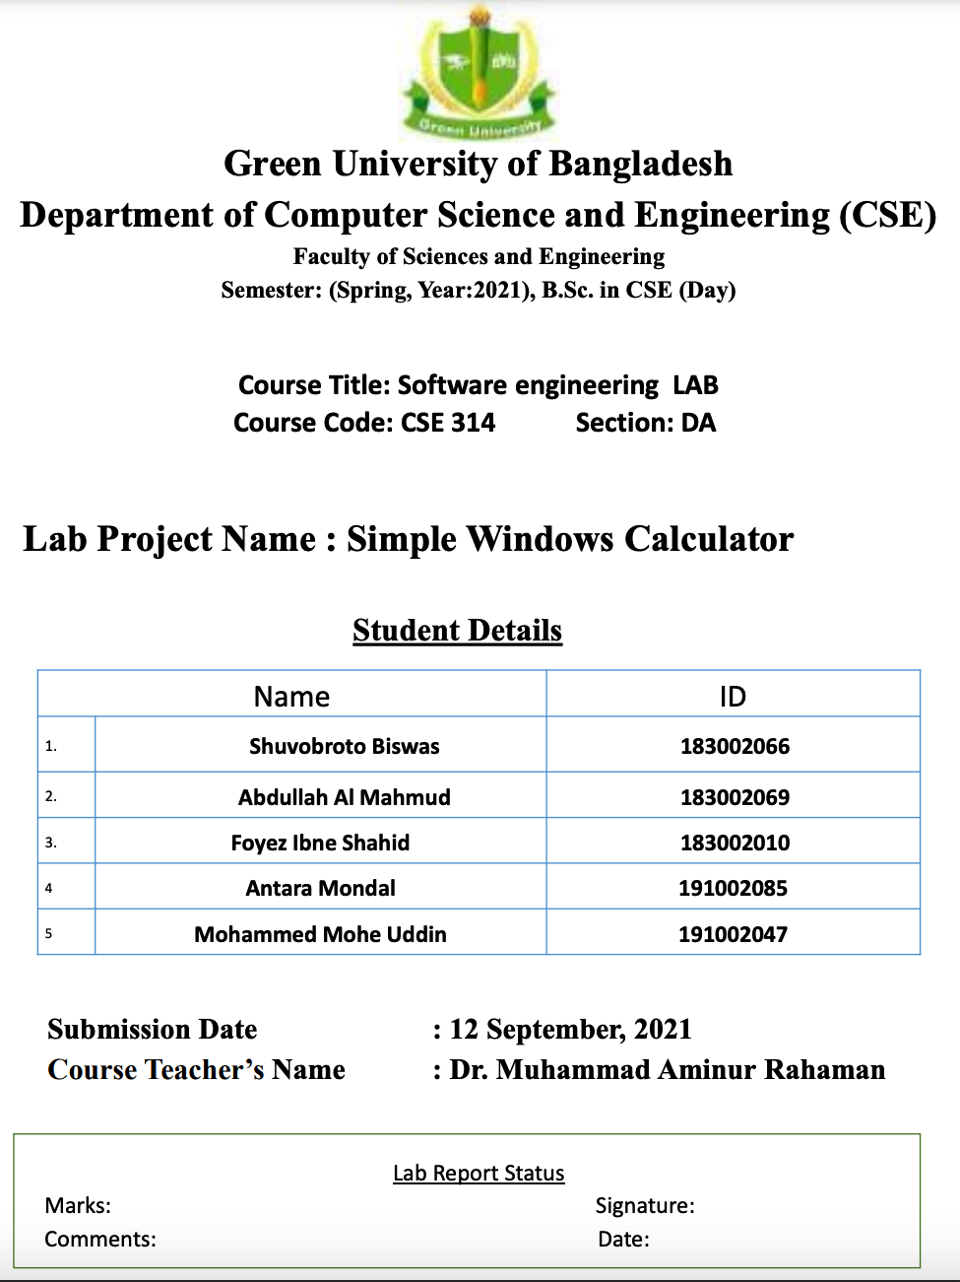
Summer
2022
Data Communications LAB
CSE 308
Networking System For Multinational
Company
16 December 2022
Sobhana Jahan

Slide 2
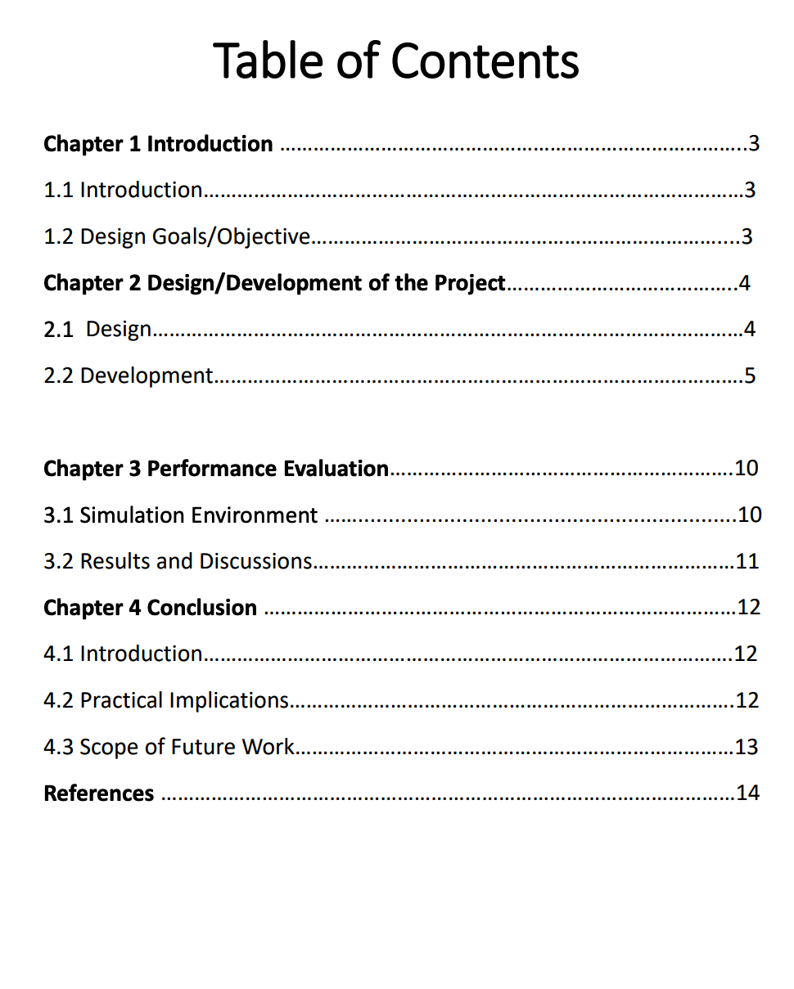

Slide 3
Chapter 1 Introduction
1.1 Introduction: Many organizations network infrastructure can affect every aspect of your business. From on premise hardware to cloud based services, it is imperative to have a reliable, effective and secure set of network components to keep your business running as efficiently as possible day in and day out. Our network Infrastructure is the tool that facilitates your business, not the other way around. If you don’t have the proper tools, you may not be conducting your business at peak efficiency. This international company network center, will always take the high level approach. We assess the core ask of your requirements and propose the solution that best fits your need, not ours.
1.2 Design Goals: We made a system that the project aim to develop A multinational company network. This project report, design and implementation of wireless local area network is written to serve as a reference book for wireless LAN in the future whenever it is desired. This report explains the survey consideration, hardware consideration, end-user consideration and principle of wireless network. Most of us have become accustomed to the limitations that come with a wired network. When we want to check our email or print a report we find ourselves confined to a certain location or cramped space. In the past few years, the growing popularity of wireless communication has caught the attention of corporate, manufacturing, and academic settings. Wireless network technology has proven it can deliver the benefits of a wired network with the added benefit of computing freedom and share resources

Slide 4
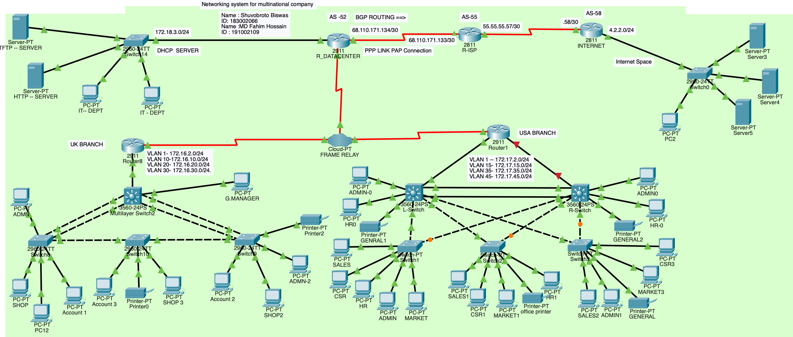
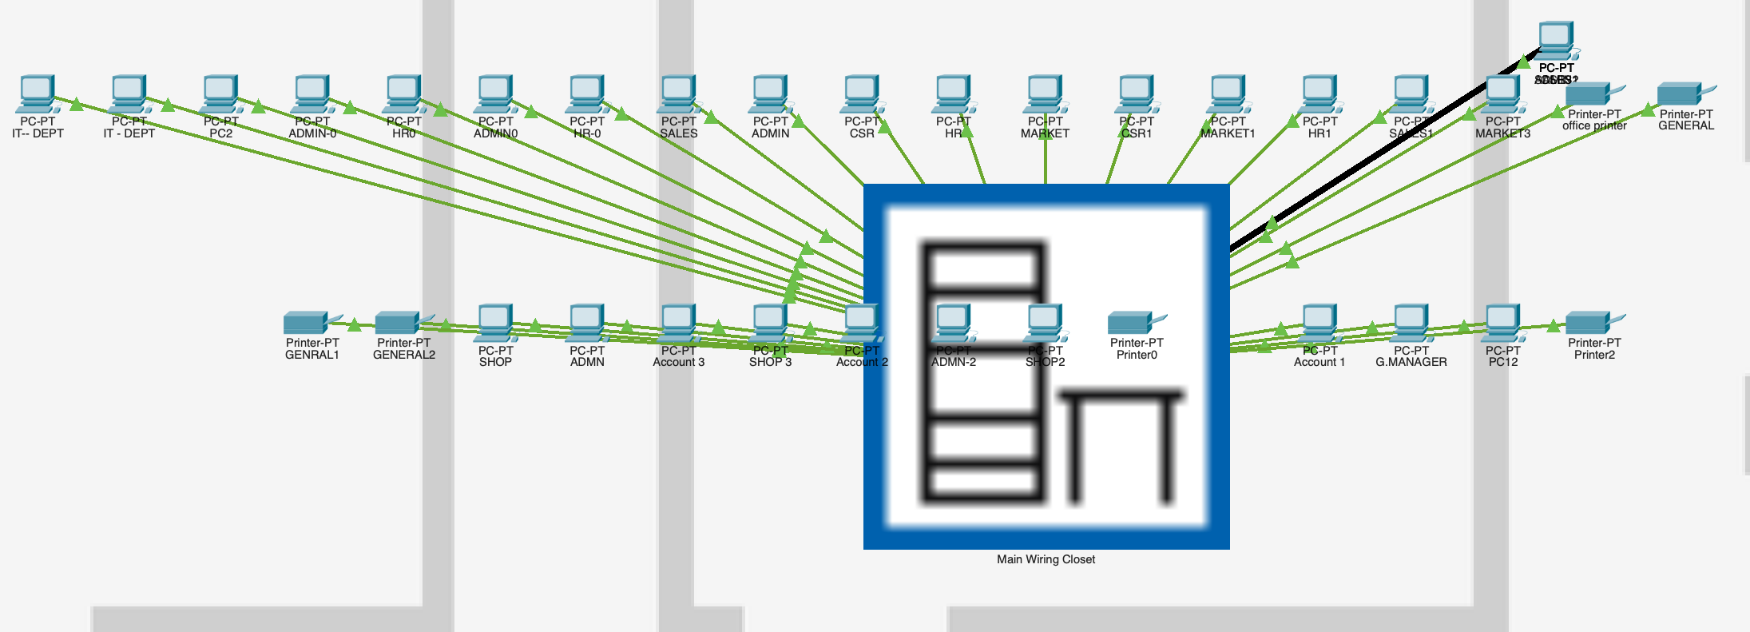
Chapter 2
2.0 Implementation of the Project
2.1 Design :
Fig: Our Network System
Fig: Physical View

Slide 5
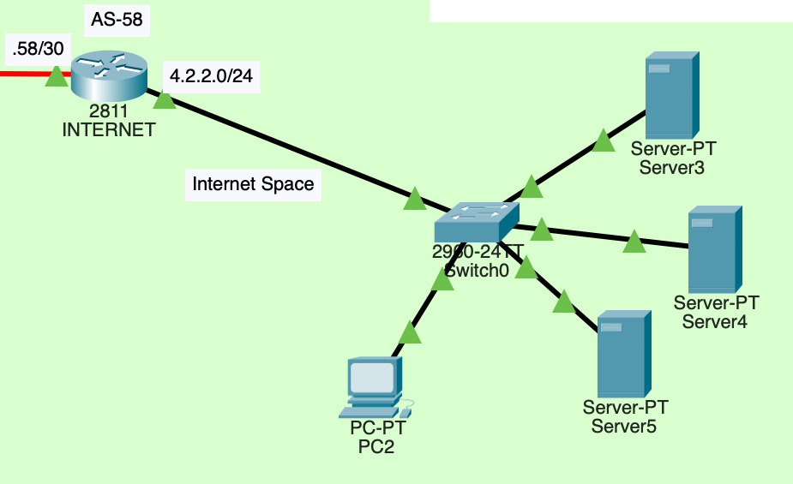
2.2 Development: Add IP dependency on our design for start networks syncing.
Fig: Internet Space

Slide 6
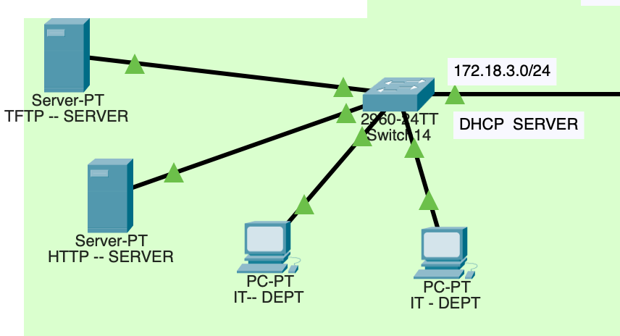
Add data center
Fig: Data Center

Slide 7
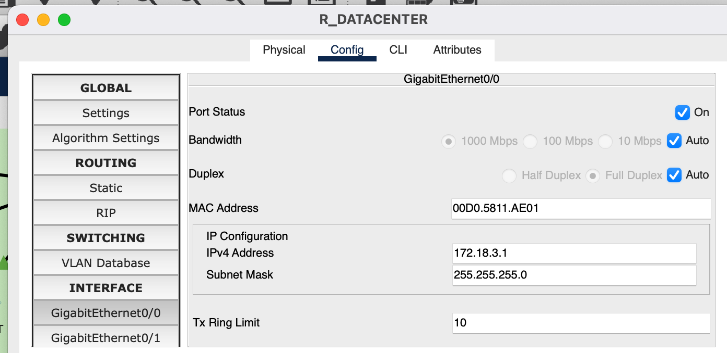
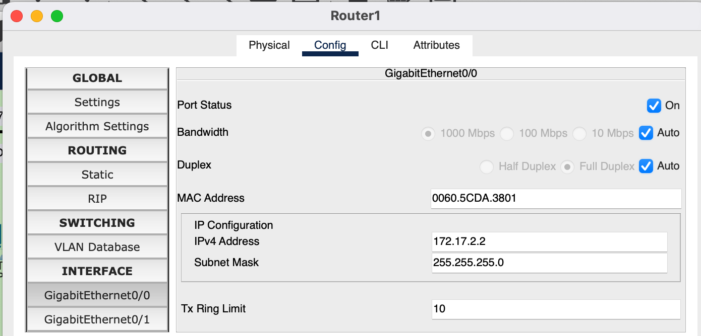
Setup networks:
Fig: IIP Showing

Slide 8
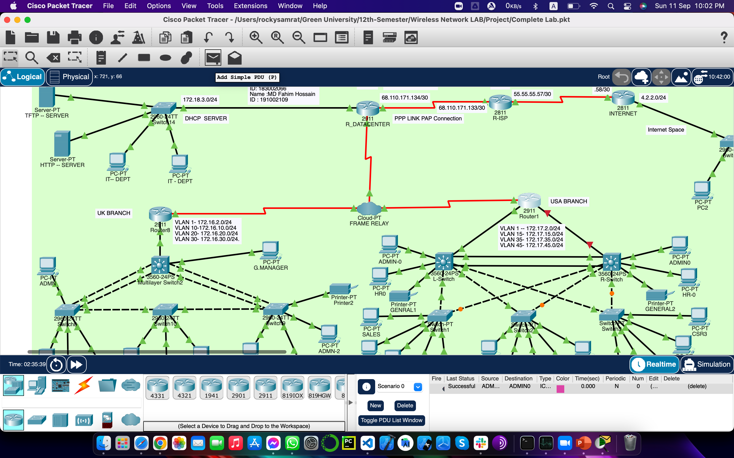
Chapter 3 Performance Evaluation
3.1 Simulation Environment
To simulation click on Start then will be showed like that snapshot and check Diagnostics Realtime status

Slide 9
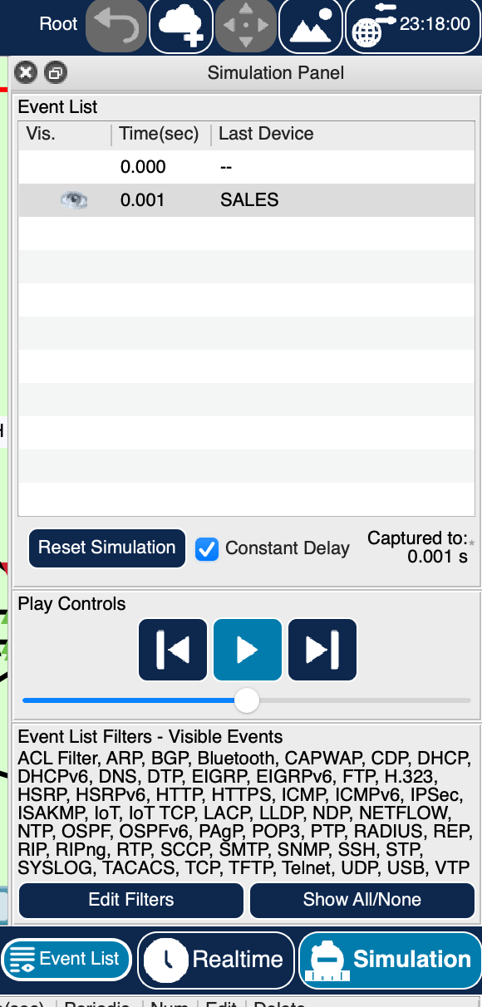
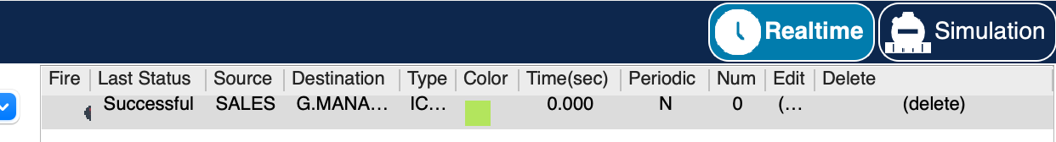
3.2 Results and Discussions:

Slide 10
Chapter 4 Conclusion
4.1 Introduction: This project has really been faithful and informative. It has made us learn and understand the many trivial concepts of wireless networking. As we have used Cisco Packet Tracer as a GUI it provides various controls, such as network to build a user friendly system.
4.2 Practical Implications: In this project, we outline the approach we have developed to construct a network system. Routers, Switches & Wireless Devices oftentimes these devices can be taken for granted to do their jobs, until they do not. Our network handles these issues for you and understanding your requirements helps them develop a technology plan for you.

Slide 11
4.2 Scope of Future Work
With the concept of Wireless system, on future we can add noise and air pollution monitoring system which experimentally tests for two parameters. It also sends sensor parameter to the cloud. The data which are going to store for future is good enough for analysis and this can be easily shared among other end users. This model can further expanded to monitor the cities which are going to be developed and manufacturing zones for pollution monitoring. To protect the people form pollution, this system provides an efficient and low cost solution for networks environment

Slide 12
References
[1] Full concept in Cisco
https://drive.google.com/file/d/G7cg9xIaD46siluVKOdIENnLP8z7/view?usp=sharing
16/12/2022 , 10:30AM , Shuvobroto Biswas

