Slide 1

Presentation/Project Topic : Smart Bulb
Subject: Digital Logic Design Lab
PRESENTED BY
SHUVOBROTO BISWAS
ID: 183002066
Department of CSE
PRESENTED TO
Md. Rajibul Palas
Lecturer
Department of CSE

Slide 2
Contents
Definations
Explaination
Concluation

Slide 3
Defination
I made an Arduino Light intensity lamp on TinkerCAD. Password based Smart Bulb. Where a light intensity lamp does is that when the photo resistor detects less light in a room or somewhere it will automatically turn on the light bulb and when it detects light it will turn off the light bulb to save energy.

Slide 4
Explaination
On TinkerCAD.com open a NEW circuit project and drag in the following items.
Keypad
Arduino micro controller /UNO3
Light bulb
Relay (since the light bulb takes 120 V and the Arduino only provides 5V)
A power source
Breadboard

Slide 5
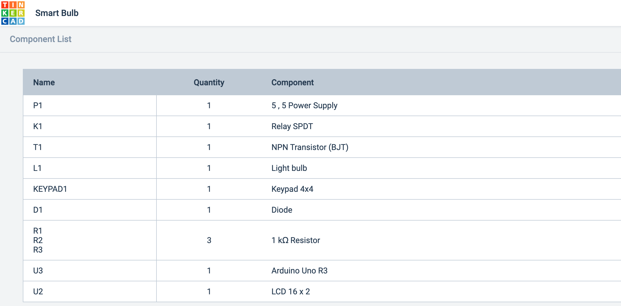
Explaination

Slide 6
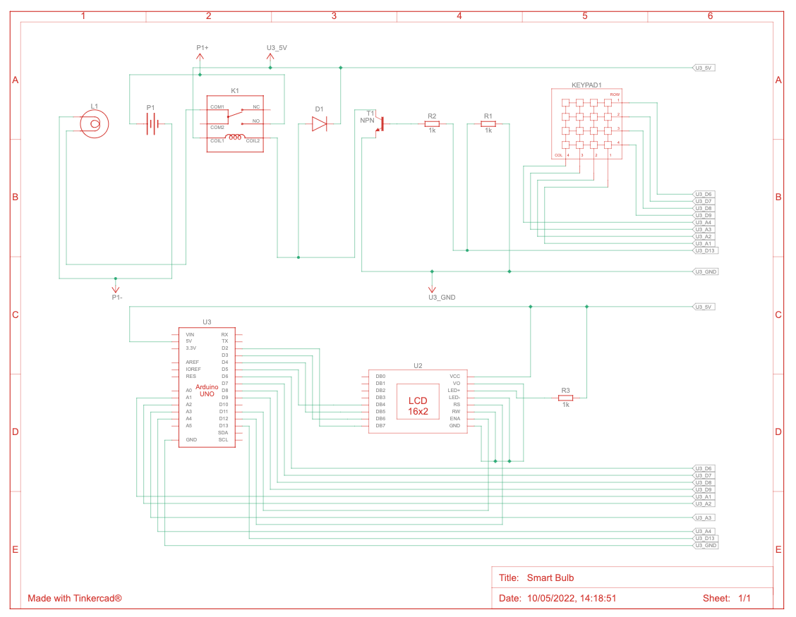
Explaination

Slide 7
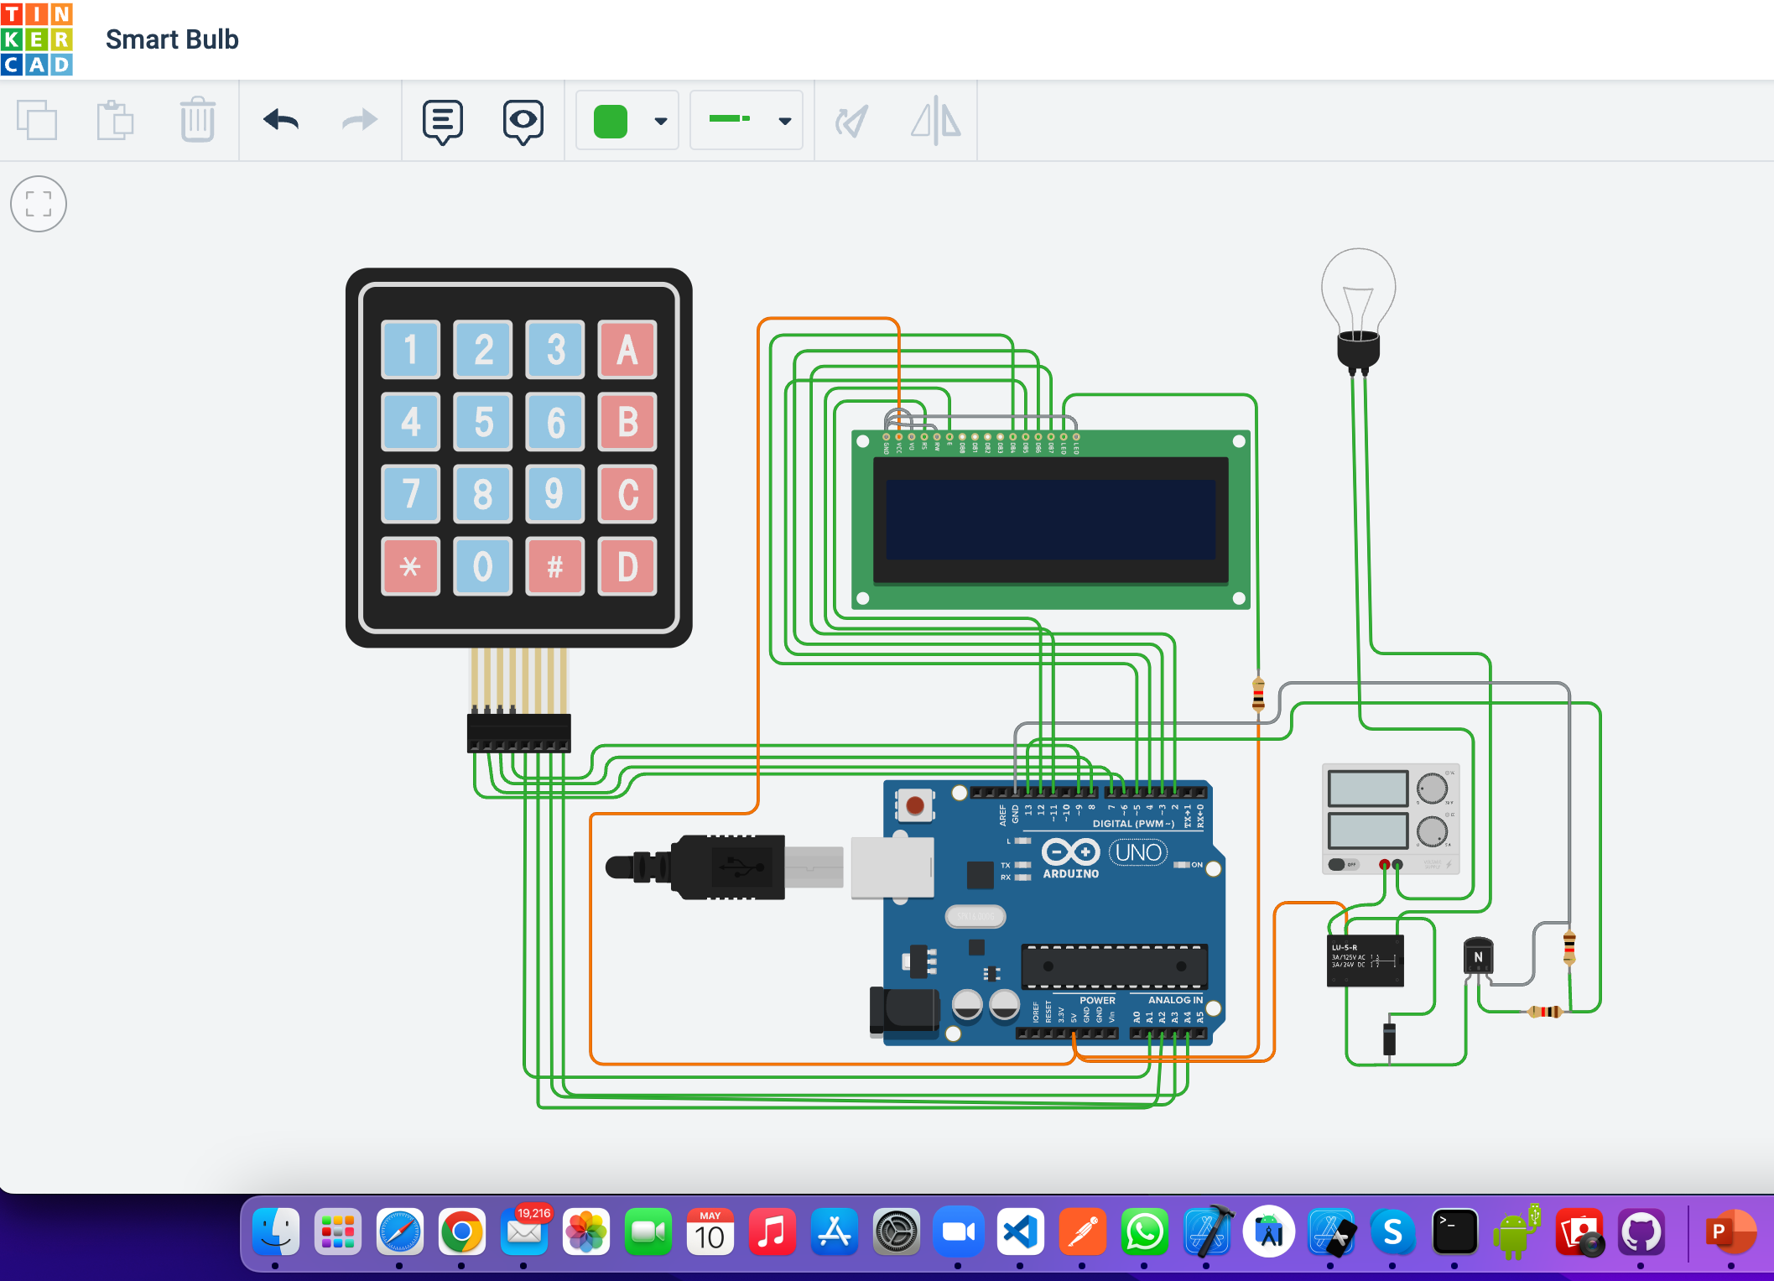
Explaination

Slide 8
Concluation
Before doing anything connect the 5V power from the Arduino to the power rail and ground from the Arduino into the ground rail. Then connect the positive end of the power supply to terminal 2 of the light bulb. Take the ground end of the power supply and connect it to terminal 1 of the relay. Connect the ground end of the Light Bulb and Connect it to Terminal 7 of the relay. Make sure that terminal 8 is connected to the ground rail. then connect terminal 5 of the relay to any of the Digital pins.

Slide 9
Thank you

