Slide 1
15.S08 Recitation 4: Nonlinear Duality
Shuvomoy Das Gupta

Slide 2
Topics to discuss
Lagrangian for a nonlinear problem
Lagrange dual function
The dual problem
Weak and strong duality
Complementary slackness
KKT conditions
Sensitivity analysis: marginal price interpretation

Slide 3
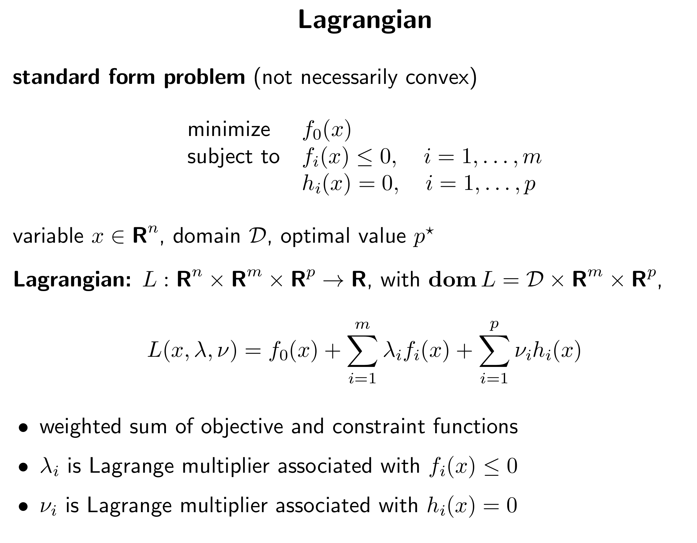

Slide 4
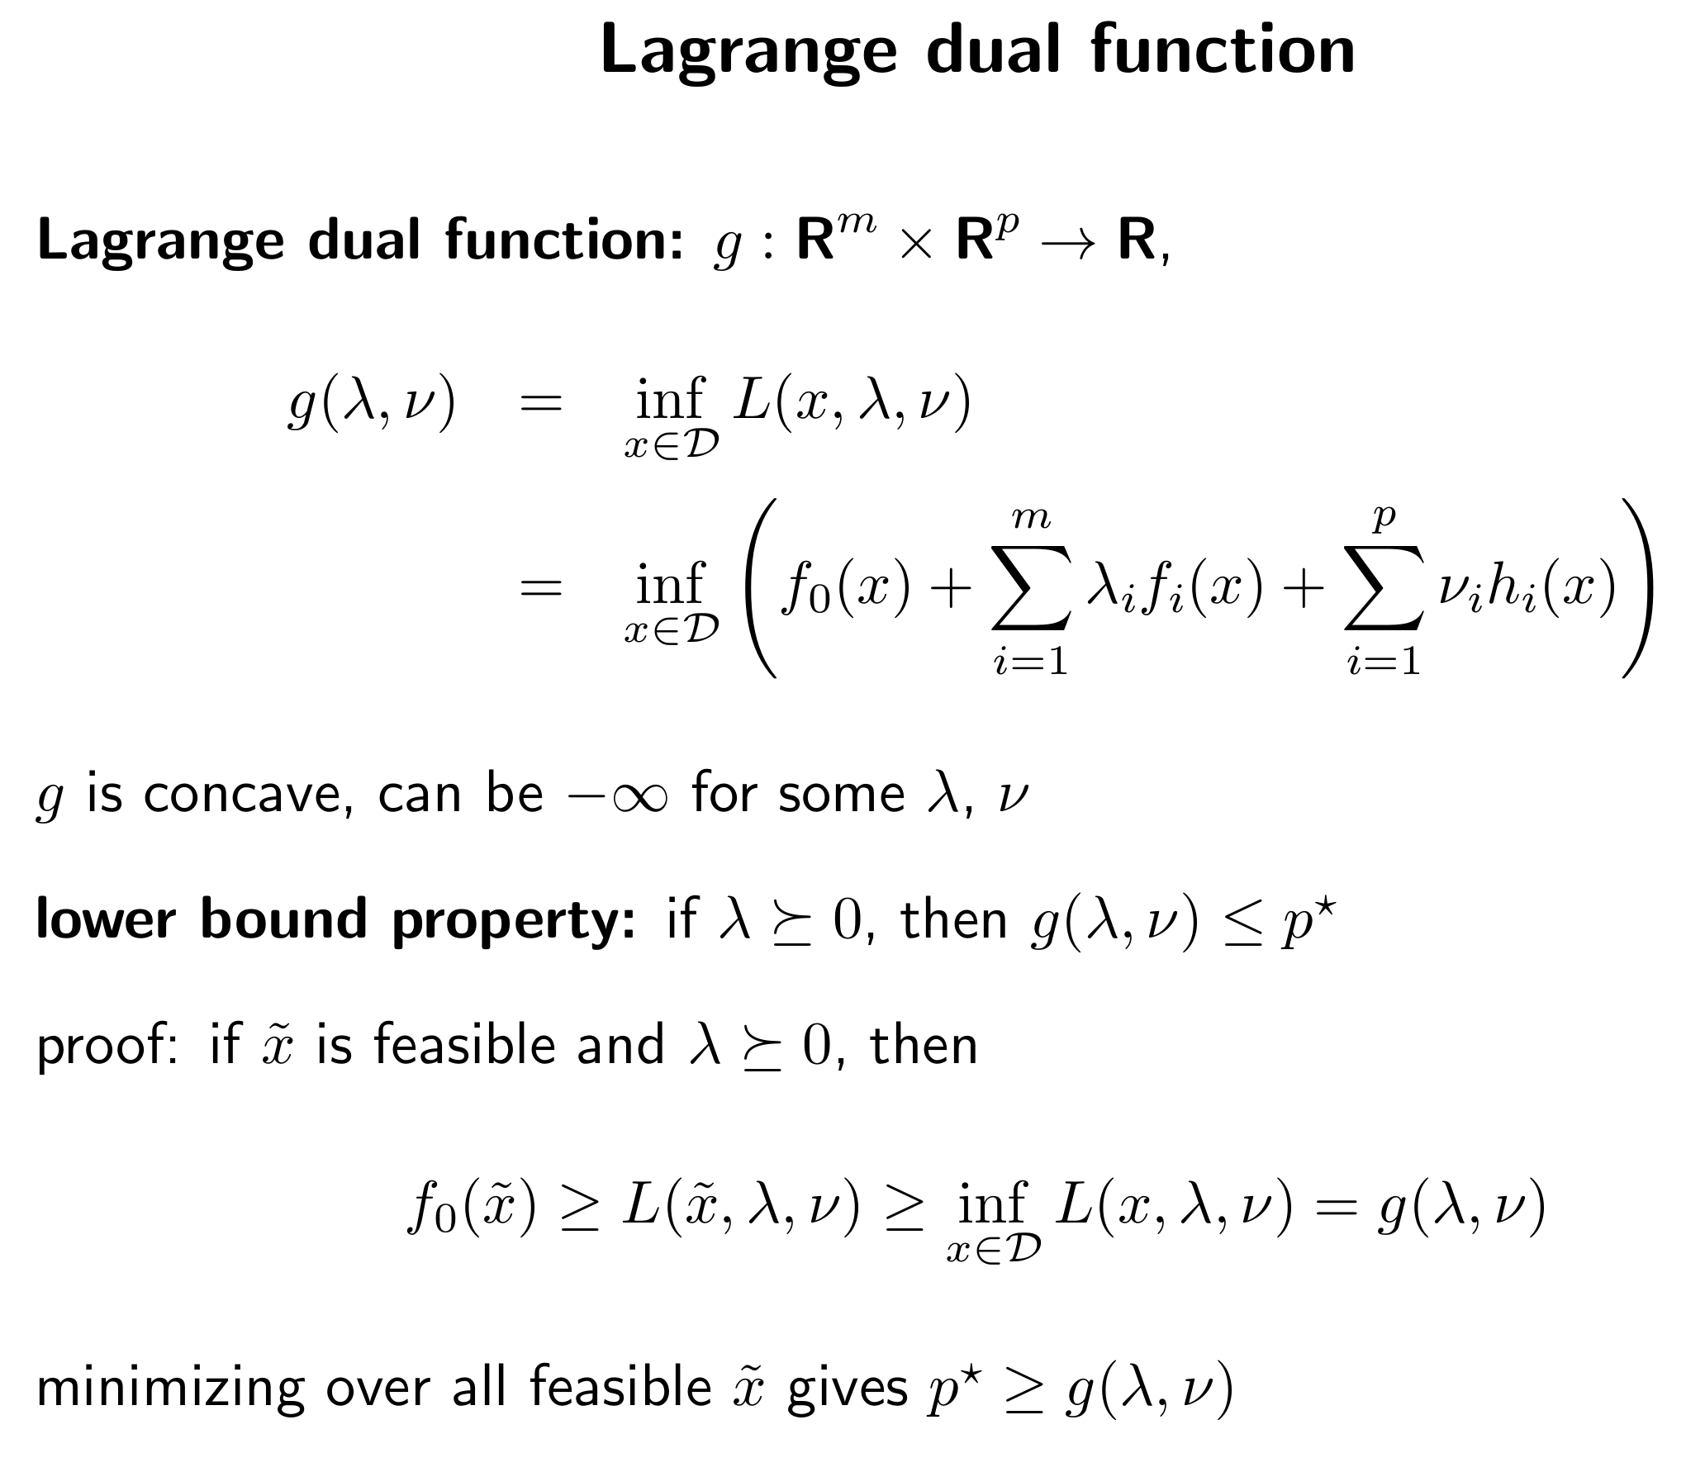

Slide 5
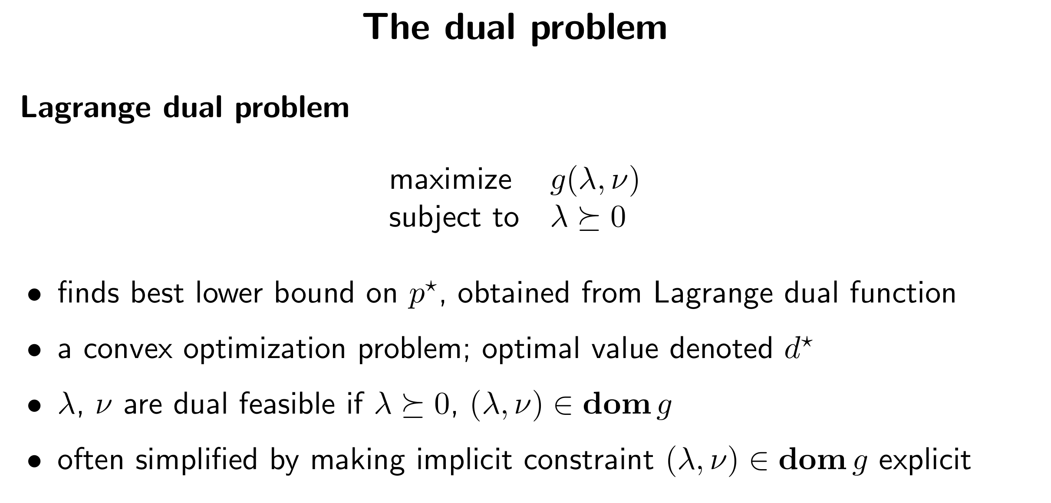
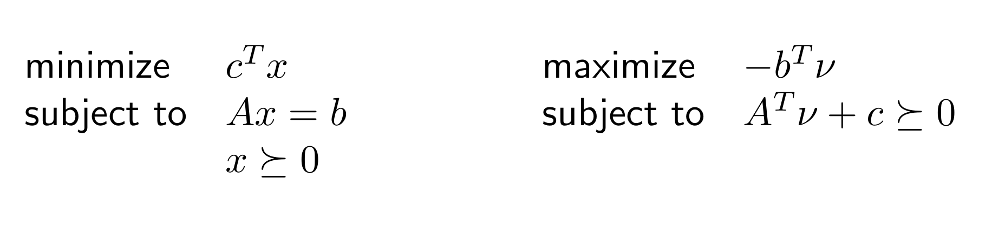
Standard form LP and its dual
Primal
Dual

Slide 6
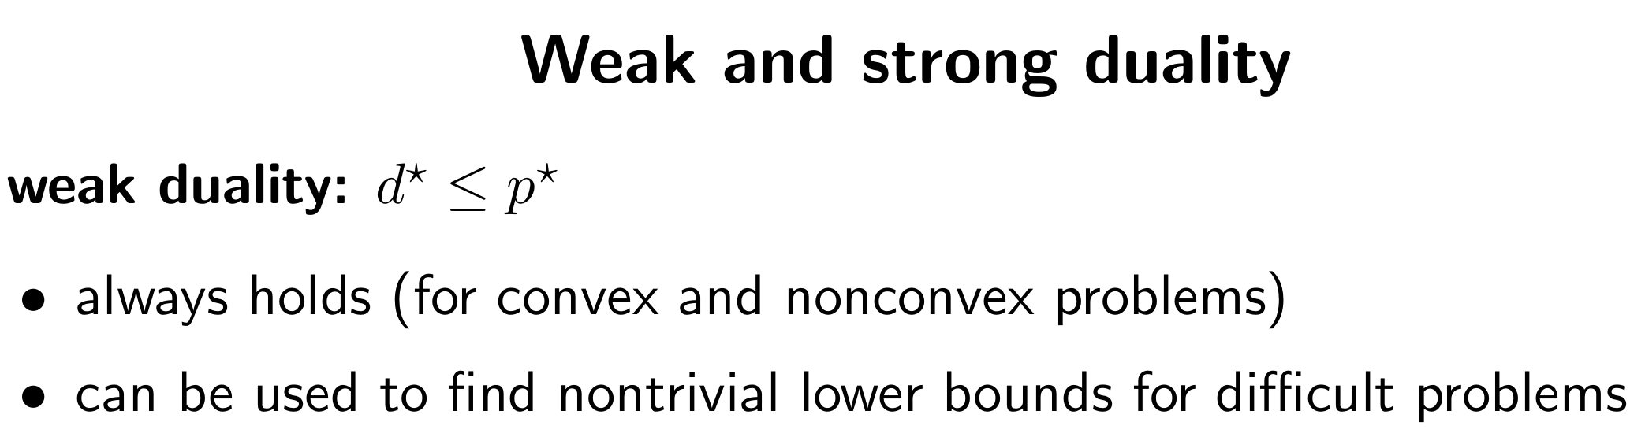
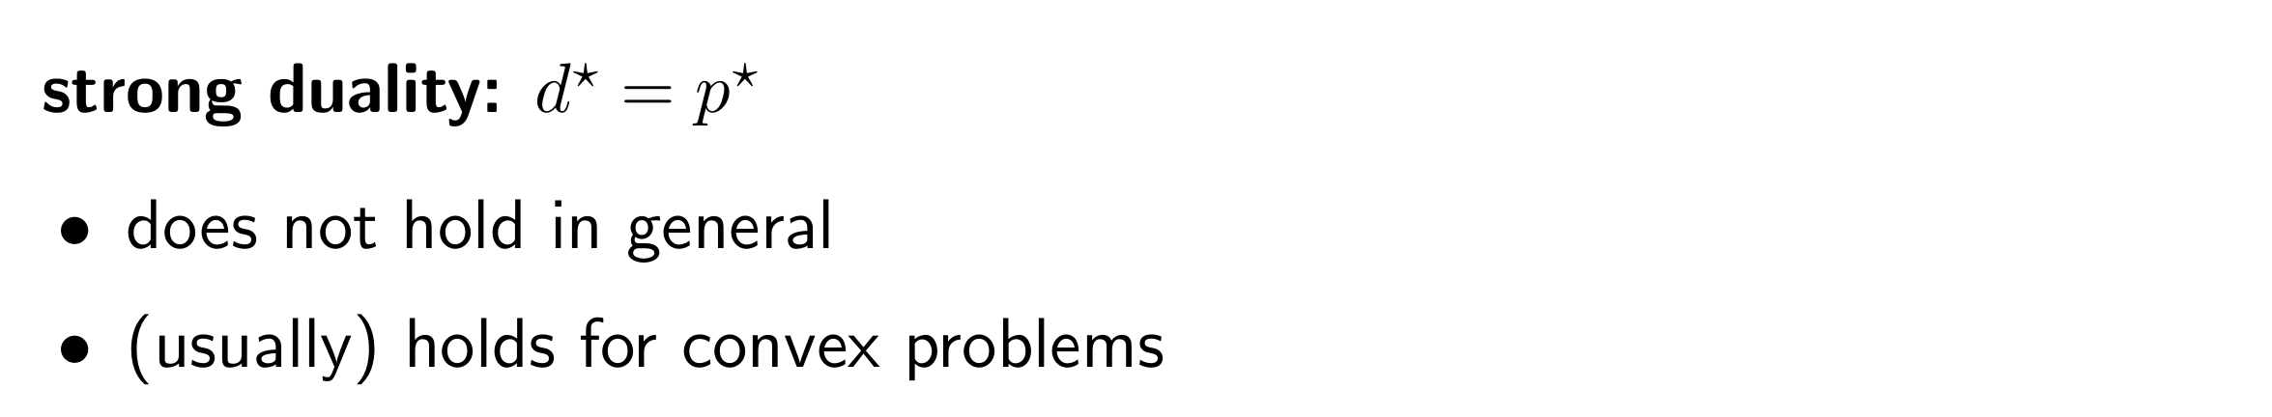

Slide 7
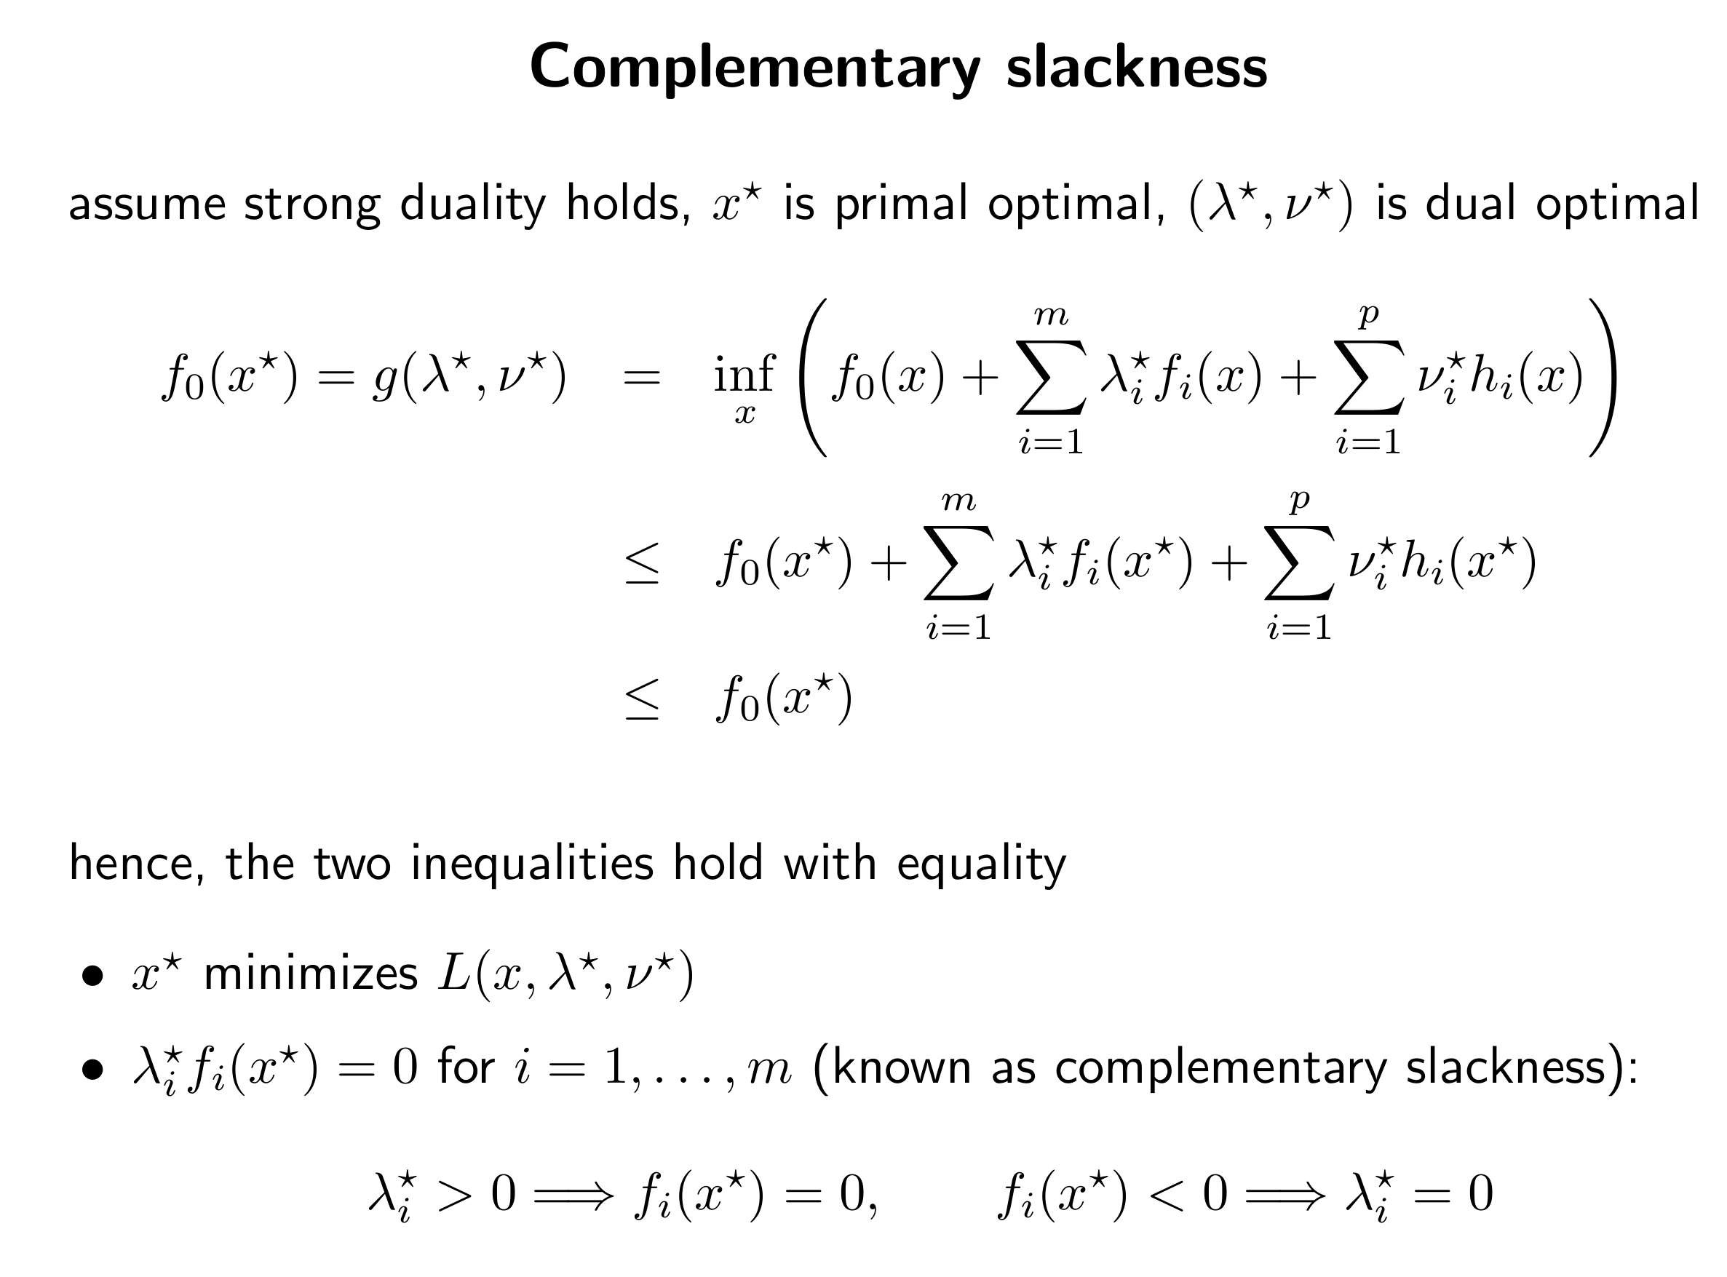

Slide 8
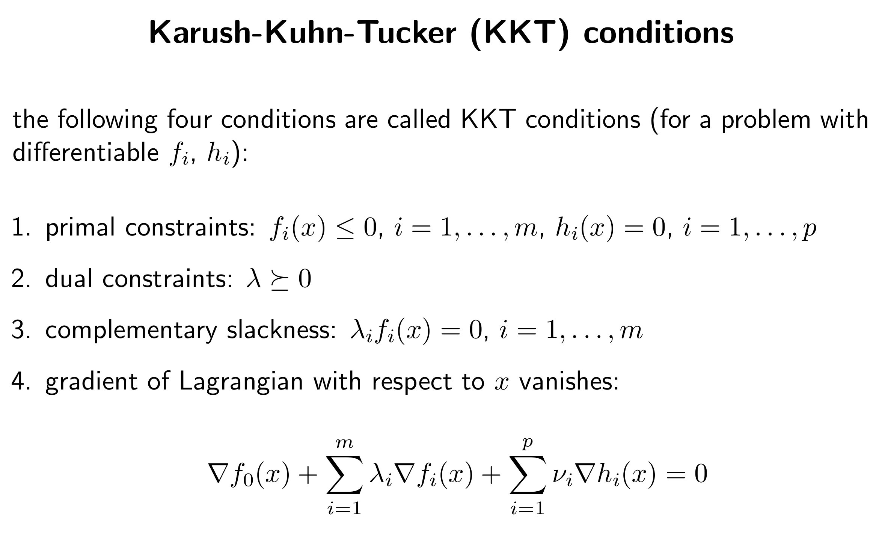

Slide 9
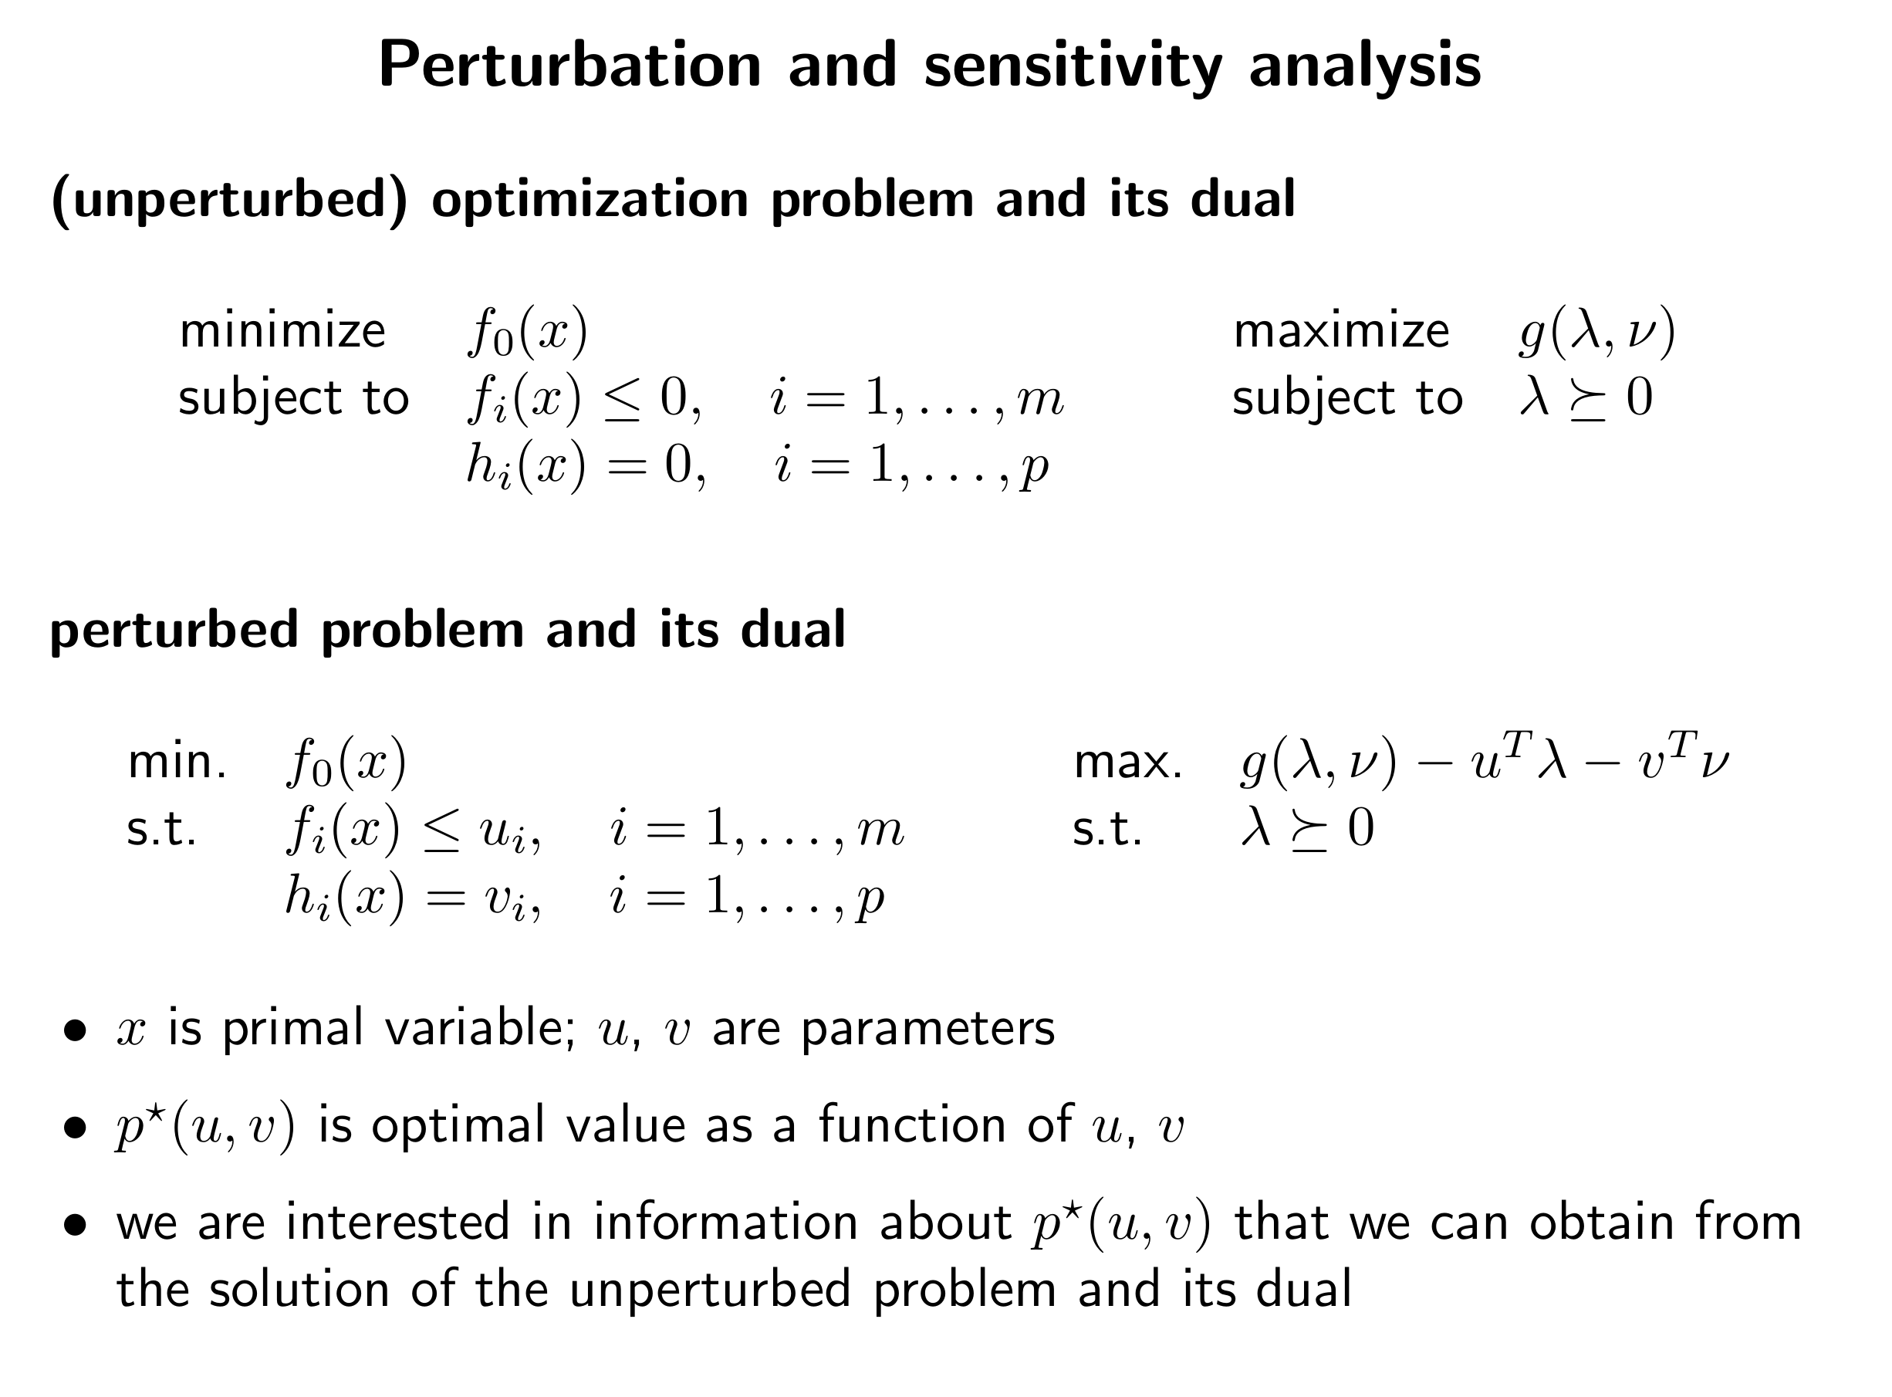

Slide 10
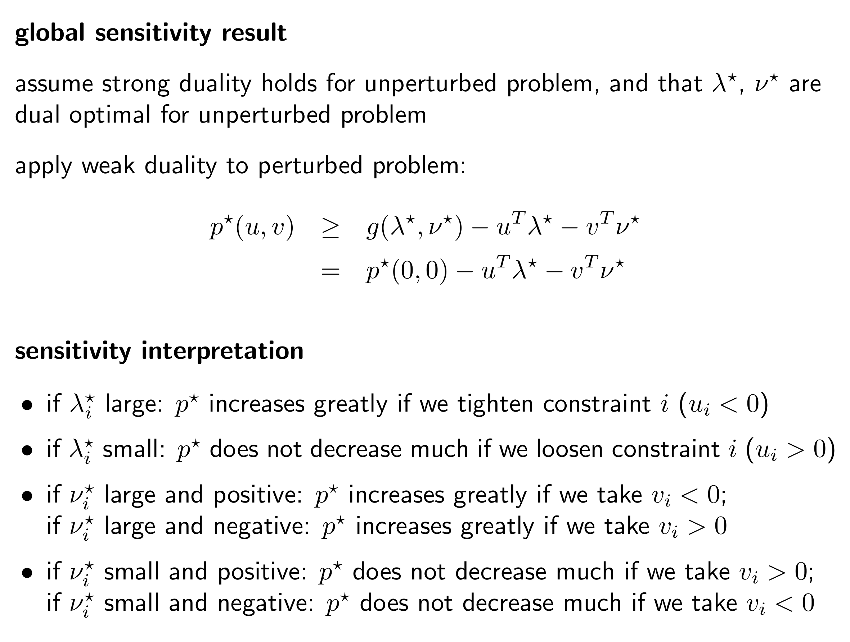

Slide 11
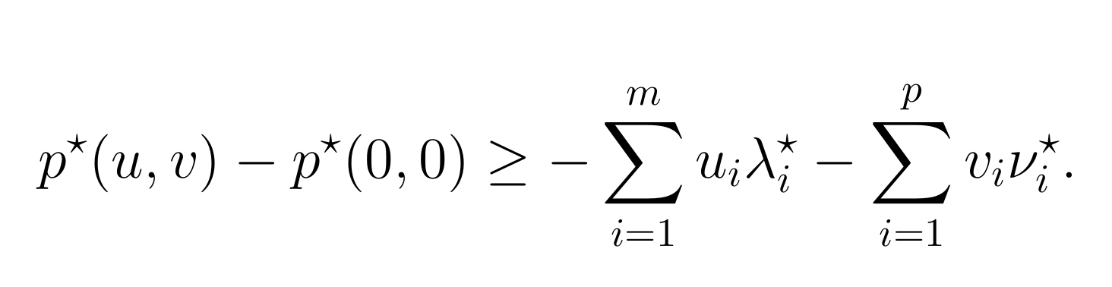
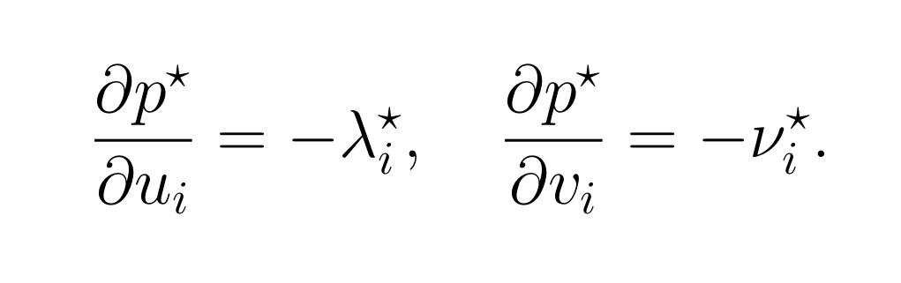
Marginal price
We have
Using differential calculus, we can show that:
This gives the marginal price interpretation of the optimal dual variables.

