Slide 1
15.S08 Recitation 5
SDP Relaxation of QCQPs
and
Integer Programming Modeling Tips
Shuvomoy Das Gupta

Slide 2
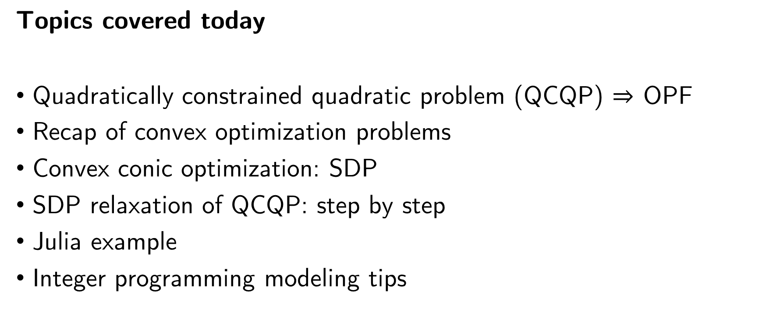
Topics covered today
Quadratically constrained quadratic problem (QCQP) $⇒$ OPF
Recap of convex optimization problems
Convex conic optimization: SDP
SDP relaxation of QCQP: step by step
Julia example
Integer programming modeling tips

Slide 3
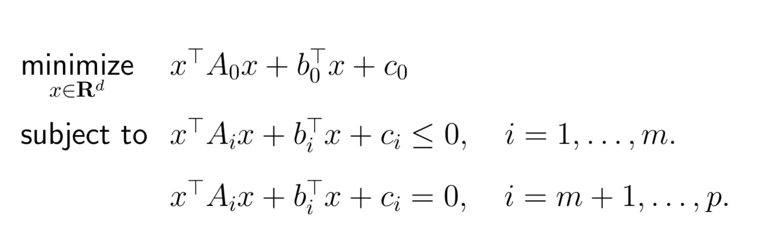
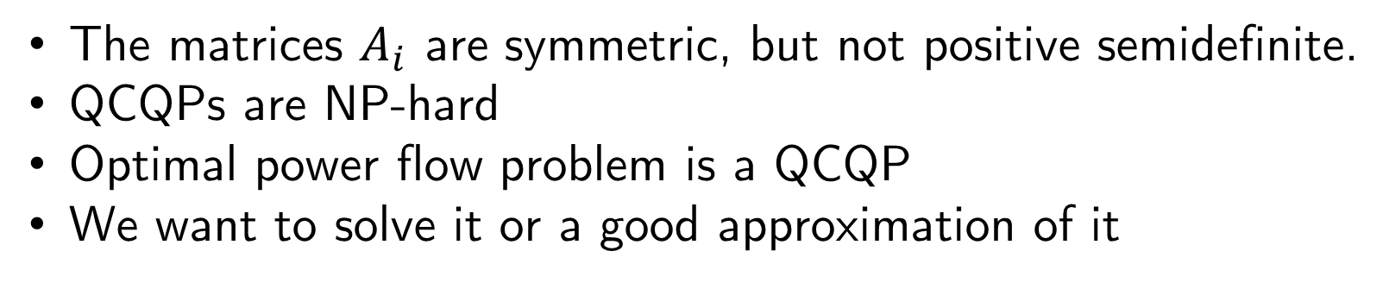
QCQP
The matrices $A_{i}$ are symmetric, but not positive semidefinite.
QCQPs are NP-hard
Optimal power flow problem is a QCQP
We want to solve it or a good approximation of it

Slide 4
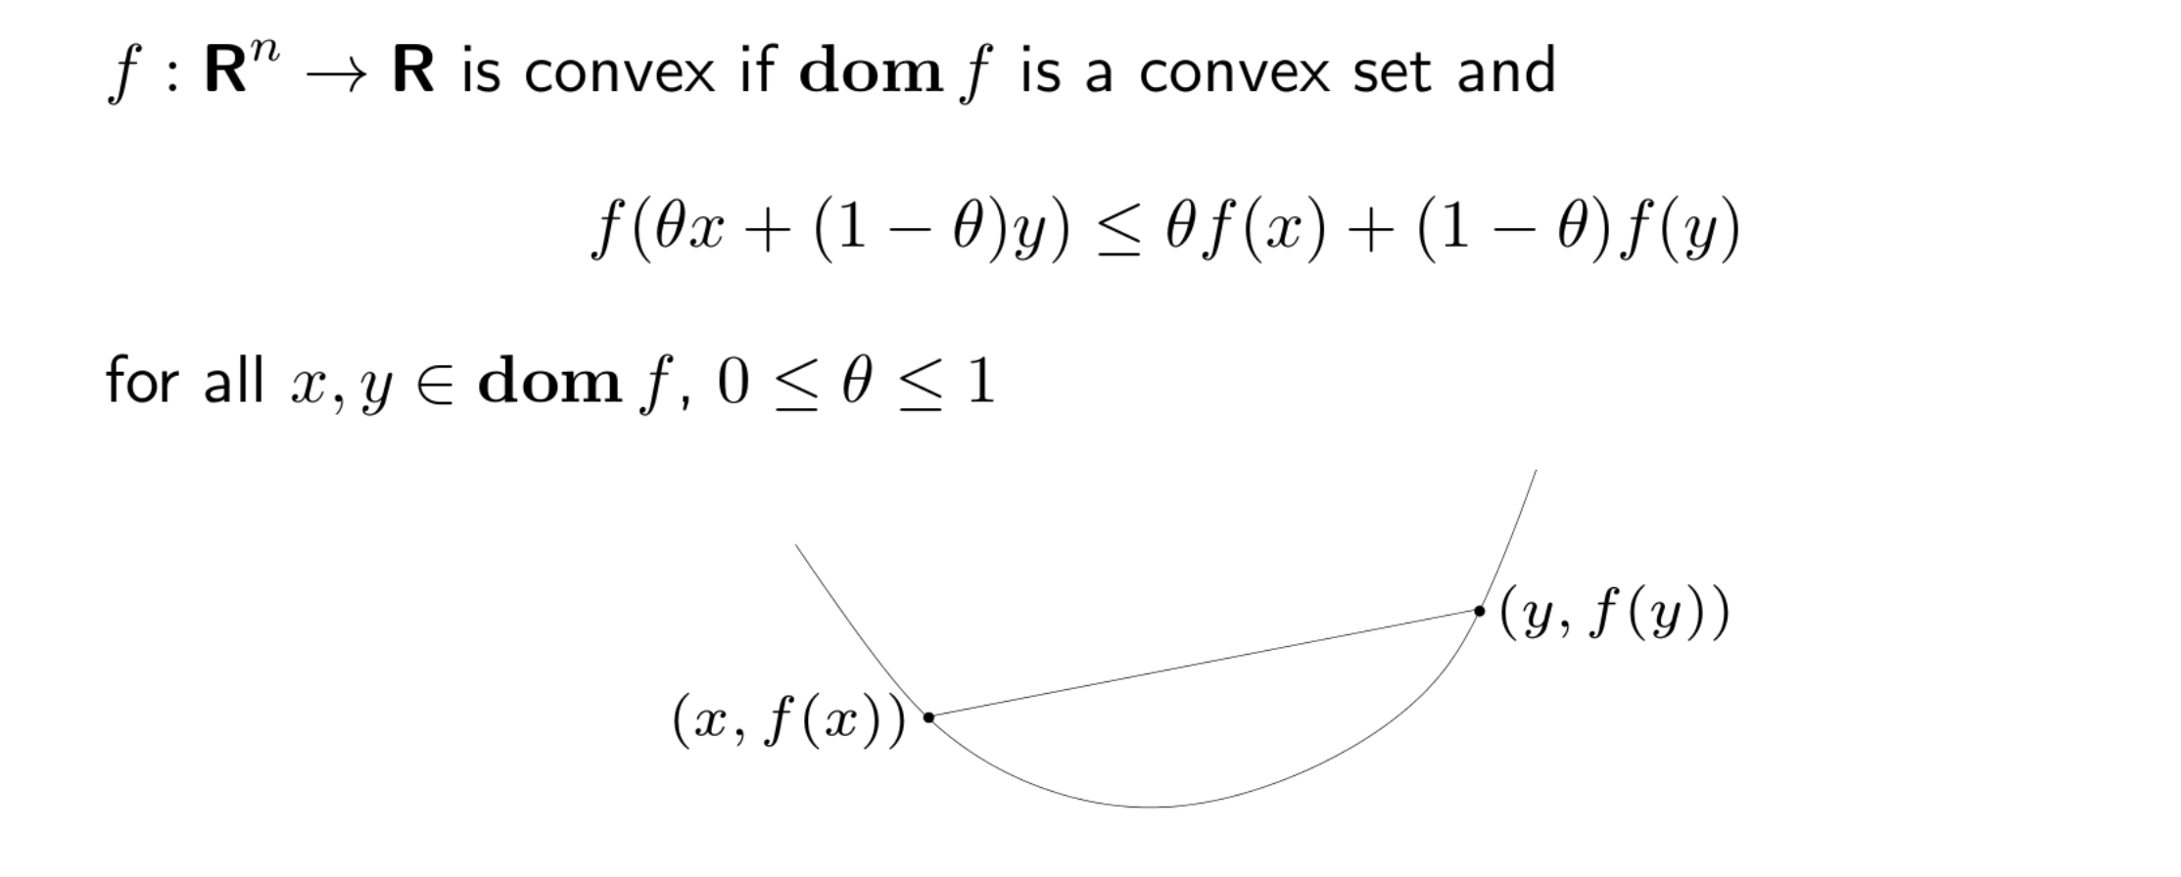
Convex function

Slide 5
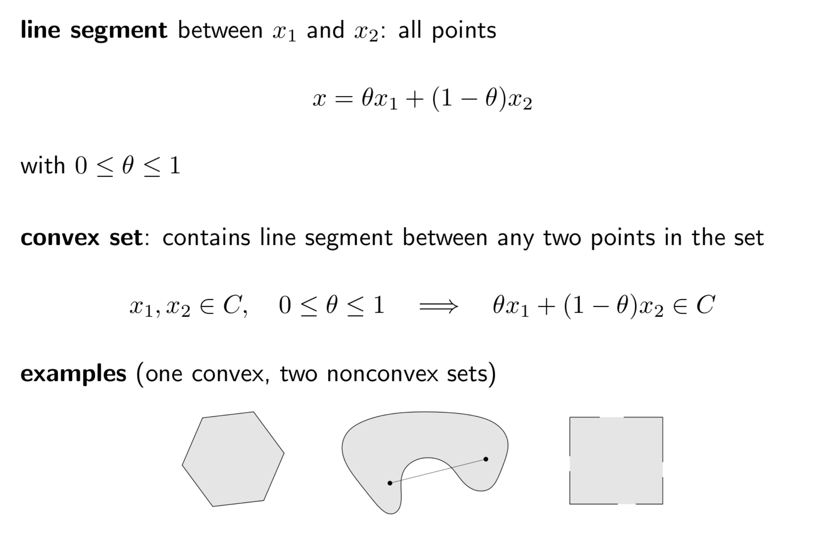
Convex set

Slide 6
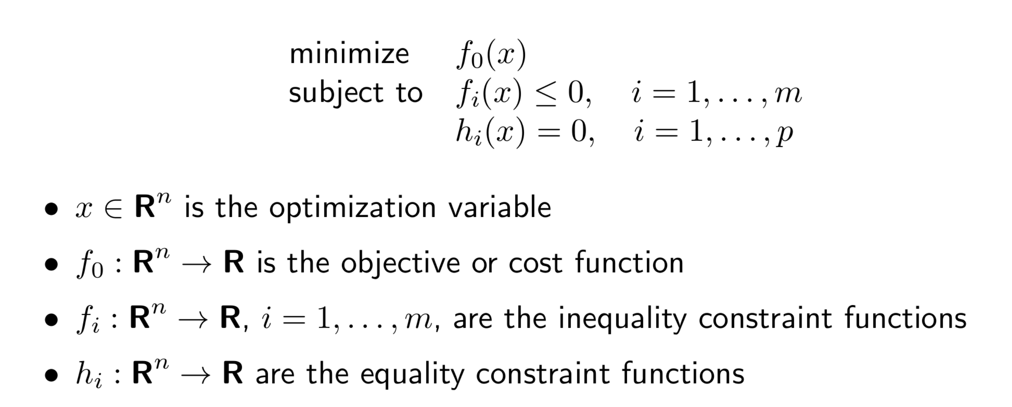
Convex optimization problem

Slide 7
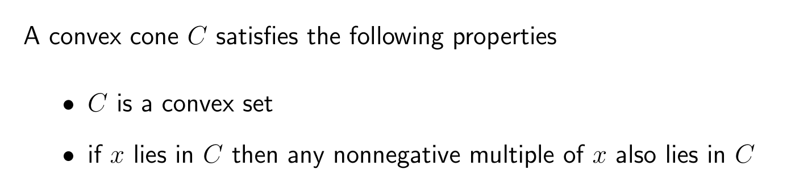
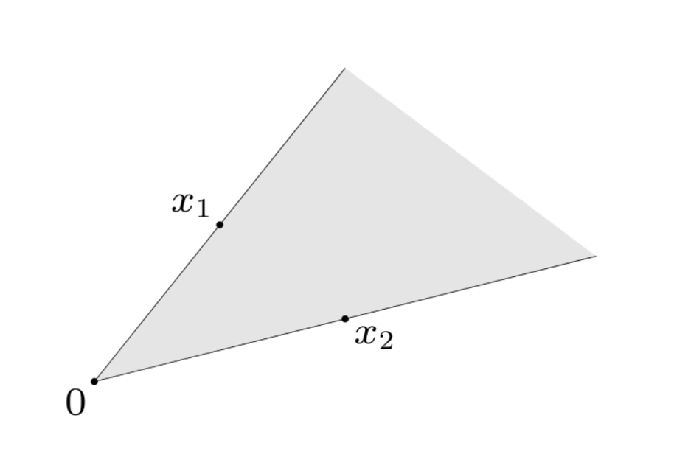
Convex cone

Slide 8
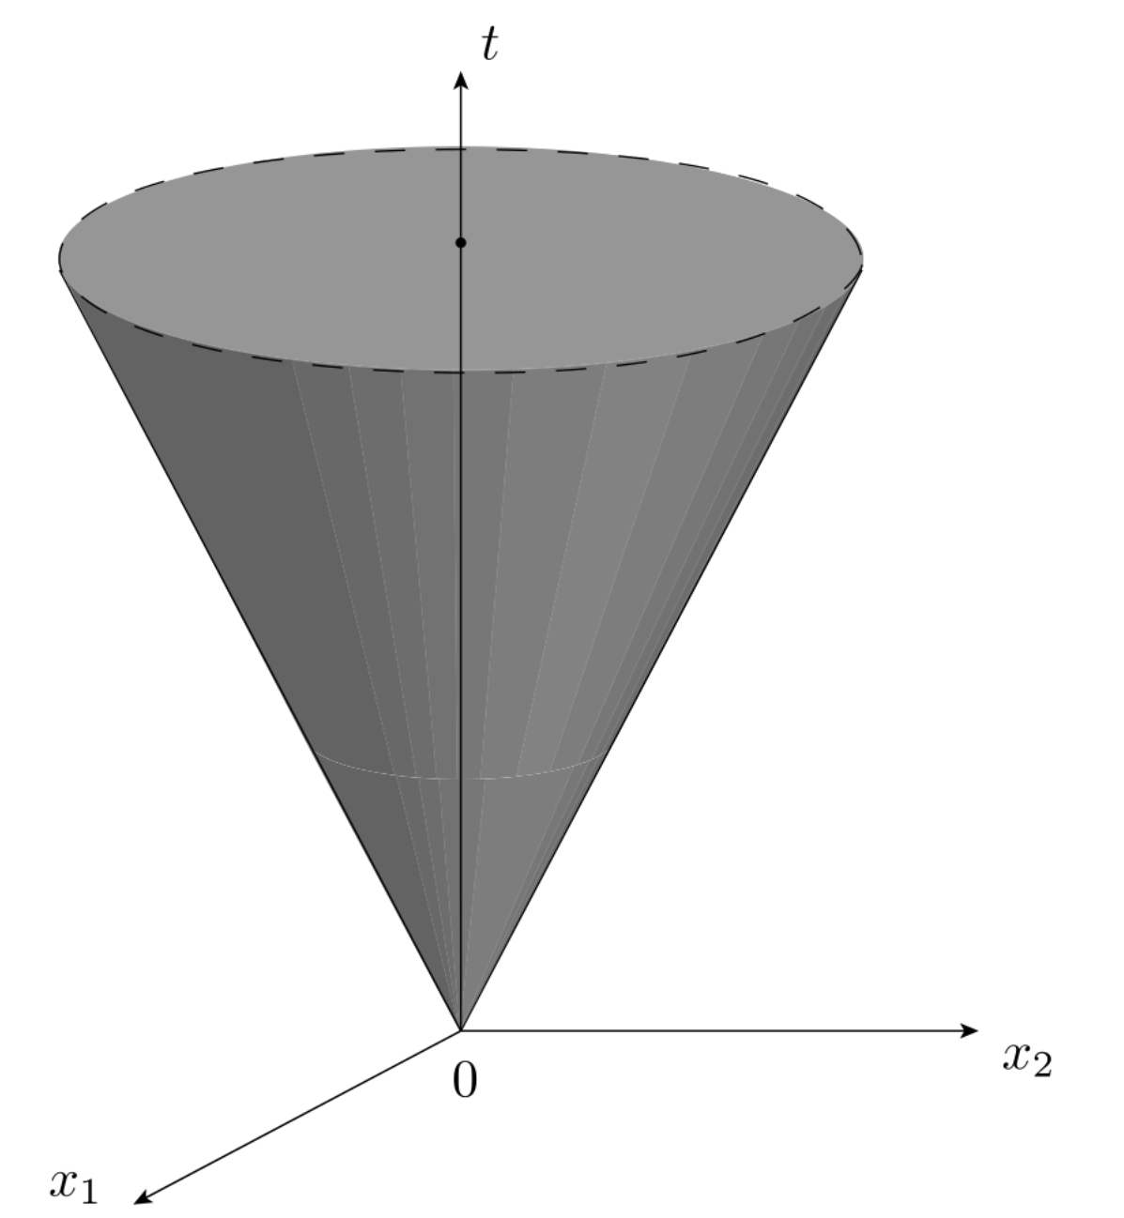
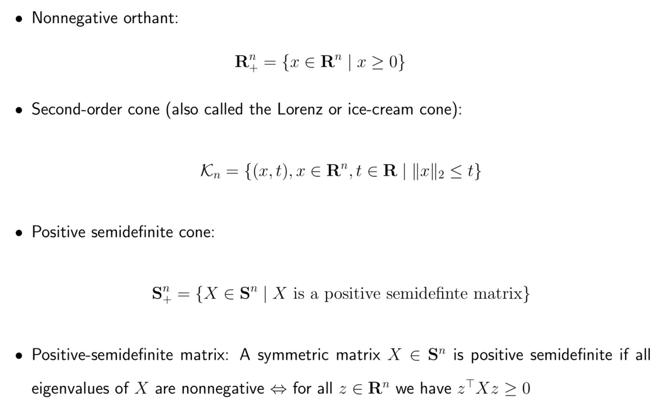


Example of convex cones

Slide 9
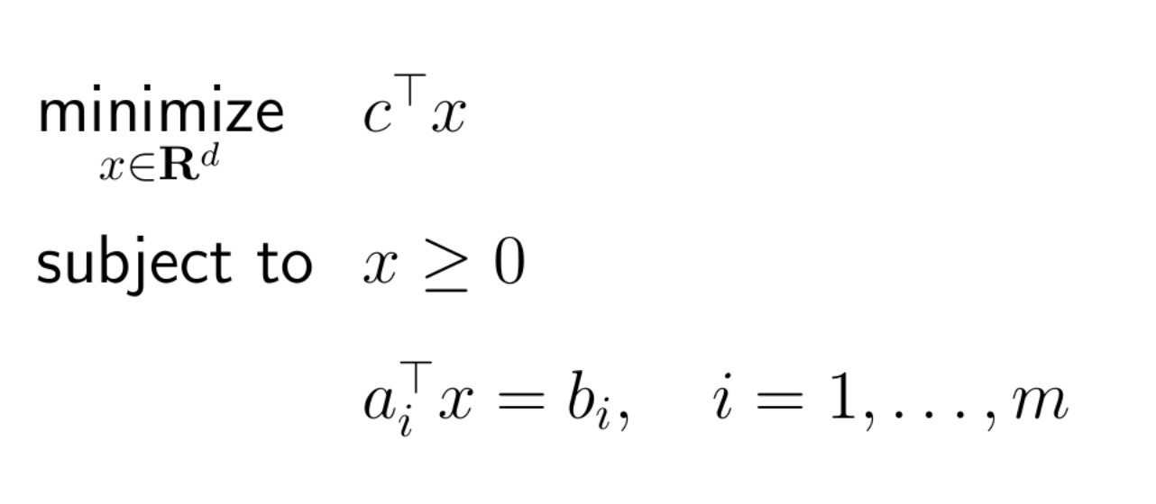
Why convex cones?
Lets go back to 1980s…
LPs could be solved very efficiently
Convex optimization theory was mature
However, as soon as a problem contained nonlinearities,
one could not replicate the practical efficiency of LP
A breakthrough came by rethinking the role of nonnegative orthant in standard form LP

Slide 10
Why convex cones?
Many of nice properties of LP can be extended as long as:
The convex problem contains some convex cones
Two such convex problem classes are
Semidefinite programming problems (SDP)

Slide 11
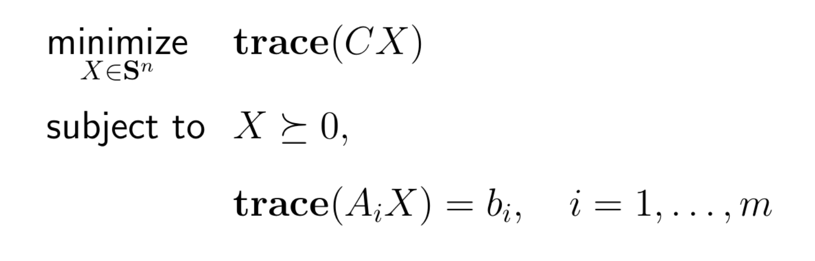
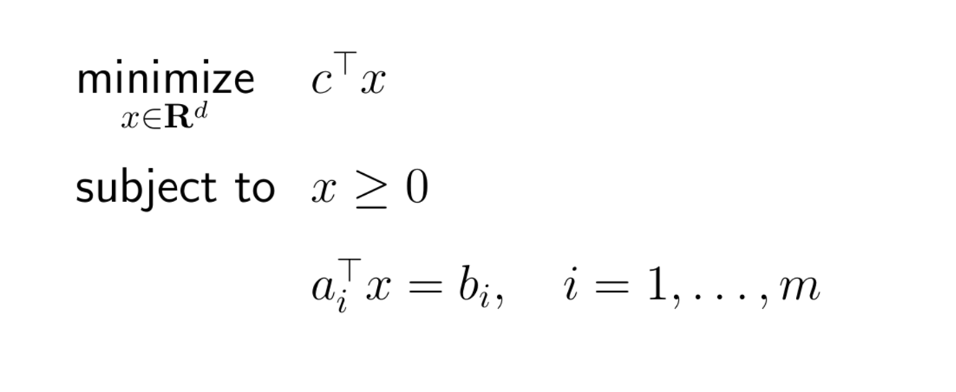
Semidefinite program

Slide 12
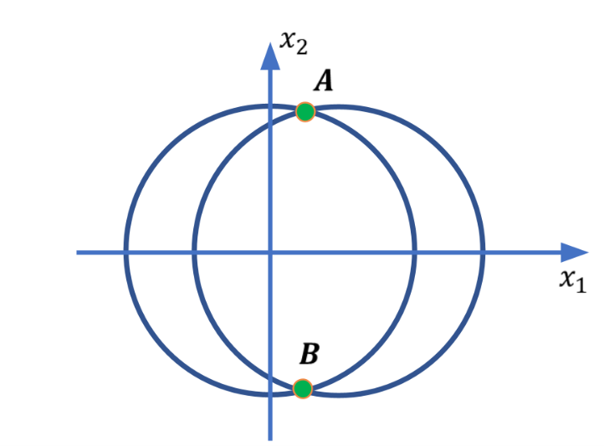
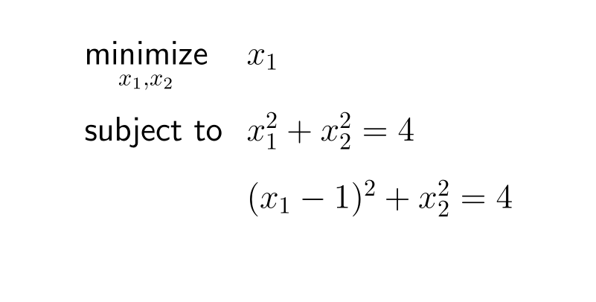
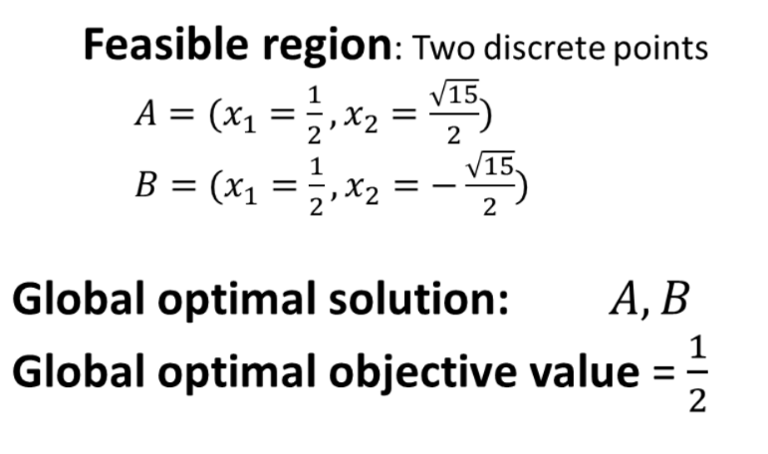
Consider the simple nonconvex QCQP:

Slide 13



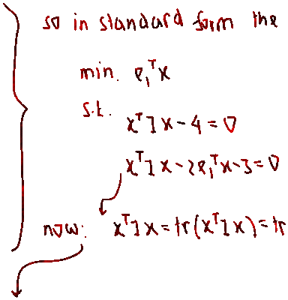







Let us construct the SDP relaxation of

Slide 14














Let us construct the SDP relaxation of

Slide 15
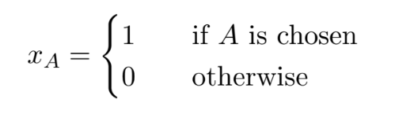
Integer programming modeling tips
We can define a binary variable $x_{A}$ to model if an even $A$ is selected as follows:
Next, we discuss some common situations that can modeled via integer programming

Slide 16




Integer programming modeling tips
If $A$ is chosen, then $B$ is chosen: Define $x_{A}$, $x_{B}$that are binary variables and relate them by:
If $A$ is chosen, then $B$ is not chosen: Define $x_{A}$, $x_{B}$that are binary variables and relate them by:
If $A$ is chosen, then both $B$ and $C$ are chosen: Define $x_{A}$, $x_{B},$ and $x_{C}$ that are binary variables and relate them by:
If $A$ is chosen, then $B$or $C$ is chosen: Define $x_{A}$, $x_{B},$ and $x_{C}$ that are binary variables and relate them by:

Slide 17


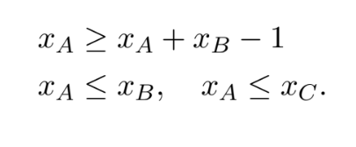
Integer programming modeling tips
If $B$ and $C$ are chosen, then $A$ is chosen: Define $x_{A}$, $x_{B},$ and $x_{C}$ that are binary variables and relate them by:
If $B$ or $C$ are chosen, then $A$ is chosen: Define $x_{A}$, $x_{B},$ and $x_{C}$ that are binary variables and relate them by:
If $A$ is chosen, then both $B$ and $C$ are chosen: Define $x_{A}$, $x_{B},$ and $x_{C}$ that are binary variables and relate them by:
$A$ is chosen if and only both $B$ and $C$ are chosen: Define $x_{A}$, $x_{B},$ and $x_{C}$ that are binary variables and relate them by:

Slide 18
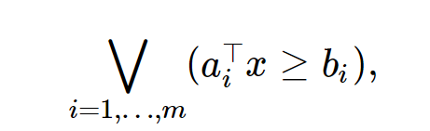
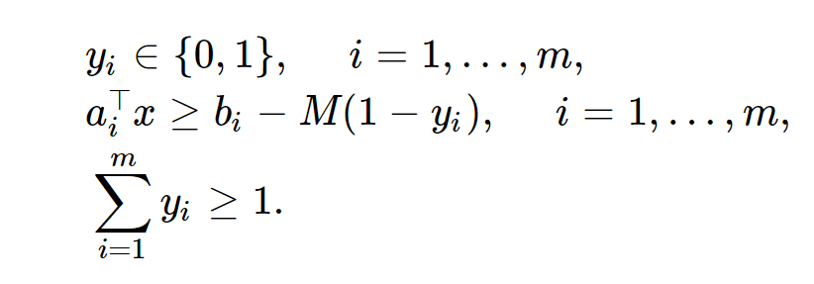
Formulation through big-$M$ constraint: or constraint
We have a constraint such as:
which means that atleast one of $a_{i}^{⊤}x≥b_{i}$ will be true. This is a logical or statement. We can model this situation
via the so-called big-$M$ constraint as follows:
Here the constant $M$ is a very large positive number. The variable $y_{i}$ corresponds to the activation of the
constraint $a_{i}^{⊤}x≥b_{i}$.

Slide 19
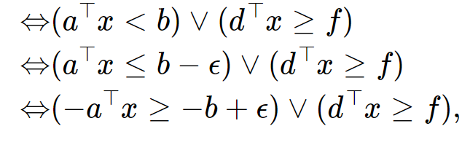
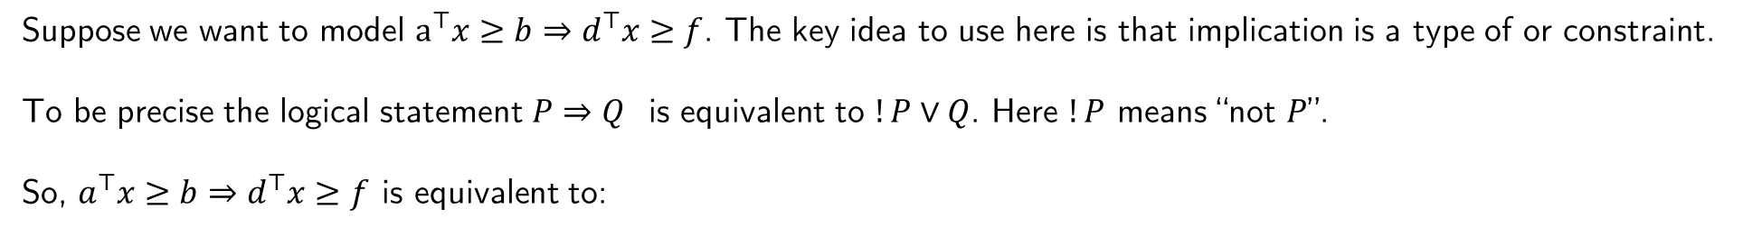
Formulation through big-$M$ constraint: implication
Suppose we want to model $a^{⊤}x≥b⇒d^{⊤}x≥f$. The key idea to use here is that implication is a type of or constraint.
To be precise the logical statement $P⇒Q$ is equivalent to $!P∨Q$. Here $!P$ means “not $P$”.
So, $a^{⊤}x≥b⇒d^{⊤}x≥f$ is equivalent to:
where $ε$ is a very small positive number. Then we proceed in a similar fashion for modeling

