Slide 1


Training Need Assessment for Prisoners of Bangladesh
Presented By
Abu Jubayer
Managing Director
Sustainable Research and Consultancy (SRC) Ltd.
+88 01711 459532
srcl.group.bd@gmail.com

Slide 2
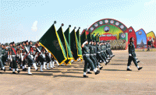


Introduction
Bangladesh Jail is working to develop the theme “Rakhibo Nirapad, Dekhabo Alor Poth” for the prisoners after release. The different training programs are already running in different trades with Bangladesh Jail. However, the modern and social activities related training program is more convenient and useful for prisoners.
SRCL is an incorporated and registered consultancy and research-based company in Bangladesh. The SRCL is working on project proposal preparation, management, submission, fund management, local and international fund liaison, project implementation, conduction of training, one stop service center and final report processing. It is serving their clients with an unparalleled service.
Social inclusion is a topic of interest today in all areas especially including former prisoners to society and labour market. By training skilled prisoners can join social and regular life with financial access. We are working to develop this type of training for social inclusion and gaining SDG goal no 8 (economic growth) and goal no 10 (reduced inequalities).

Slide 3
Goals, Objectives and Beneficiaries
Project Goals
Create trained prisoner and skilled worker for society job placement.
One stop solution for Job Placement after in-prison training for different Shops, Commercial Edifices and Corporate Premises
Training for general prisoners in ICT, Hardware & Software, Refrigeration, Electronics, General Mechanics (Motorcycle, Vehicles etc.), Wielding, Agro-Farming, Agri-Food Processing, Cattle Rearing (Cow, Goat, Duck etc.)
Ensuring the job safety after prison time
Ensuring the happy life after completing the prison time
Fund allocation for prisoners after training and starting the job/shop/business
Maintain the standard of NSDA level certification
Curriculum followed by Bangladesh Technical Education Board (CBTA)
Creating awareness among all level of stakeholders
Objectives
Prisoners
Bangladesh Jail
Commercial Edifices
Corporate Offices
Beneficiaries

Slide 4

Duration of the Project
Starting Date | January 01, 2021
Implementation Period | January 2021 to February 2023
Closing Date | February 28, 2023

Slide 5
Basic Activities of the Project
The project team will perform the following activities: -
Sl. No | Activities
01 | A feasibility study for In-prison Training Requirement
02 | Conduct Training program on Twelve (12) Trades
03 | Rehabilitation Program for the skilled prisoners
04 | Certification as national standard (NSDA/BTEB)
05 | Job Confirmation for trained prisoners in different trade association
06 | Classroom Decoration with modern facilities
07 | E-Learning training platform and curriculum development for prisoners
08 | Work under direct supervision of Bangladesh Jail
09 | Reporting & Documentation

Slide 6
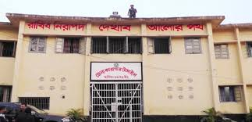
Target Working Areas
10 Central Jails:
Kashimpur Central Jail Part I,
Kashimpur Central Jail Part II,
Mymensigh Central Jail,
Chittagong Central Jail,
Sylhet Central Jail,
Comilla Central Jail,
Rajshahi Central Jail,
Rangpur Central Jail,
Jessore Central Jail and
Barisal Central Jail.
20 District Jails: Discussion Based

Slide 7
General Methods of Service
Service | Service | Method
A. | Feasibility Study | On-Spot Survey
 |  | Online Based Survey
 |  | KII and Reporting Method
B. | Classroom and Materials Development | Computer Training Lab Development
 |  | Hardware Lab Development
 |  | Workshop Development (Electrical, Mechanical, House Wearing, Motor Vehicles, Wielding and others)
 |  | Online Training Program for Hosing Societies
 |  | Offline Training Program
 |  | Course Materials Development (E-Learning)
 |  | On-Ground Practical Training with Materials
C. | Training Services | Practical Training
 |  | Online Training
 |  | Direct Job-Oriented Training
D. | Awareness Program | Central Jail and District Jail wise Awareness Program
 |  | Non-Formal Education for Job Awareness
 |  | Special Day wise Awareness Program

Slide 8
Basic Training Plan
Continue…
Sl. | Name of the Course | Duration | Number of Course | Desired Number of Participants | Total Number of Desired Participants
01 | Computer Operator (Word, Excel, PowerPoint) | 04 months | 04 | 30 | 120
02 | Affiliate and e-Commerce Marketing | 04 months | 04 | 30 | 120
03 | Digital Marketing | 04 months | 04 | 30 | 120
04 | Website Design | 04 months | 04 | 30 | 120
05 | Graphics Design | 04 months | 04 | 30 | 120
06 | Web Site Design and Development | 04 months | 04 | 30 | 120
07 | IT Support Technician | 04 months | 04 | 30 | 120
08 | IT Maintenance and Servicing | 04 months | 04 | 30 | 120
09 | Professional Freelancing | 04 months | 04 | 30 | 120
10 | Customer Support & Services | 04 months | 04 | 30 | 120
11 | Front Desk Executive | 04 months | 04 | 30 | 120
12 | Auto Mechanics | 03 Months | 4 | 40 | 160

Slide 9
Basic Training Plan
Sl. | Name of the Course | Duration | Number of Course | Desired Number of Participants | Total Number of Desired Participants
13 | Machinist | 03 Months | 4 | 40 | 160
14 | Electrical House Wiring and Electrician | 03 Months | 4 | 36 | 144
15 | Refrigeration & Air-conditioning | 03 Months | 4 | 36 | 144
16 | Welding & Fabrication | 03 Months | 4 | 36 | 144
17 | Electrical Machine Maintenance | 03 Months | 4 | 36 | 144
18 | Wood Working | 03 Months | 2 | 40 | 80
19 | Civil Construction | 03 Months | 2 | 36 | 72
20 | Consumer Electronics | 03 Months | 4 | 30 | 120
21 | Driving | 02 Months | 12 | 20 | 240
22 | Caregiver | 04 months | 3 | 30 | 90
23 | Hospital Cleaning Labor | 03 months | 3 | 30 | 90

Slide 10
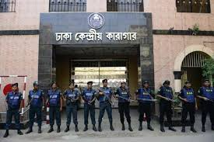
Training Target
Total Target: 20,000 nos
Category A | Central Jail | 12,000 nos
Category B | District Jail | 8,000 nos

Slide 11
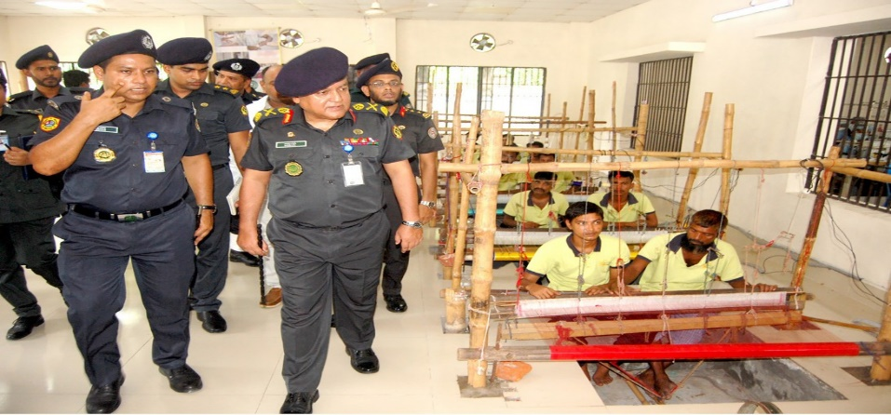
Facilities for Bangladesh Jail
Project Management Unit (PMU) control
Monitoring the full project
Remunerations for monitoring officers and PMU unit
Remunerations for trainers and master trainers.
Branding opportunity for Bangladesh Jail
Create Skilled Manpower

Slide 12

Roles and Activities of SRCL
Organize and implement the basic training program for all level stakeholders
Manage all type of training facilities
Conduct the training program with a standard manner
Supply the trainers and accessors
Assessment & Certification
Job placement
Fund allocation for skilled prisoners (startup)
Arrange workshop, seminar and certificate providing ceremony
Program reporting monthly and half yearly
Other responsibility according to discussion

Slide 13

Implementation Team
A strong team including trainer, accessor, exam management expert, certification expert, and Project Management experts are working with each other to develop the total system. Basic team members list is attached herewith.
Sl. | Name | Basic Certification
01 | Abu Jubayer (Lead Coordinator) | M.Sc. In WRD, BUET NSDA Certified, Project Management Expert
02 | Eng. S M Abdullah Al Faruq (Training Expert) | B.Sc. Engineer NFPA Certified
03 | Eng. Abdullah Al Mamun (Certification Expert) | B.Sc. Engineer NSDA Certified
04 | Eng. Manik Hossain | B.Sc. Engineer Job Placement Expert
05 | Eng. S M Saiful Islam | B.Sc. Engineer Electrical & Refrigeration Expert
06 | Eng. Siddiqur Rahman | Structural Safety Expert Assessor (NSDA Certified)
07 | Accessor (15) | B.Sc. Engineer (NSDA Certified)
08 | Trainer (20-30) | B.Sc. Engineer (NSDA Certified)

Slide 14
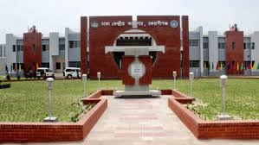
Special Involvement of SRCL
Feasibility Study for skilled prisoners
Signed MoU with different trade organization
Government certified Skilled trainer and accessor pool
Job placement confirmation pool
Previous work experience
Two-Envelope tendering process

Slide 15

Publicity of the Project
Paper Publication
Facebook
YouTube
A Roundtable
TV Talk Show
Banner
Poster
Rally and
Workshops
Awareness Campaign

Slide 16
Team Experience of Relevant Programs
Sl. | Project Name | Organization
01 | Skill Manpower Development | BAIRA
02 | 4th Industrial Revolution | BTA
03 | 4th Industrial Revolution | BFLLFEA
04 | Fire Safety Training Program | FSCD
05 | Online Education System Development | ICT Bangladesh
06 | Online Education System Development | Ministry of Education
07 | Training for Future Program | SEIP

Slide 17
Tentative Costing for Training Program
Continue…
Component A
Basic Training Operation
Item | Cost in BDT
Per Trainee Cost | 5500.00
Breakdown
Trainers Cost | 1000.00
Food and Travel, Venue | 1000.00
Materials (Development, Printing and Distribution) | 500.00
Online Class, Activities and CBLM Development | 500.00
Assessment, Certificates and Remuneration | 1500.00
Publicity | 500.00
Overhead | 300.00
Others | 200.00
Sub-Total | 5500 per person
Sub-Total A (for 20,000 person) | 11,00,00,000.00

Slide 18
Tentative Costing for Training Program
Continue…
Component B
Project Management Unit (PMU)
Sl. No. | Item | Cost in BDT
01 | Remuneration (Govt. Staff) | 2,00,00,000.00
02 | Remuneration (Project Staff) | 1,20,00,000.00
03 | Office Rent & Utility | 30,00,000.00
04 | Field Visit & Others | 30,00,000.00
05 | Transportation | 30,00,000.00
06 | Electronics Item | 20,00,000.00
07 | Furniture | 15,00,000.00
08 | Stationery and Others | 5,00,000.00
09 | Vat & Tax | 1,00,00,000.00
Sub-Total B |  | 5,50,00,000.00

Slide 19
Tentative Costing for Training Program
Continue…
Component C
Infrastructure Management
Sl. No. | Item | Cost in BDT
01 | Computer Lab Development | 1,00,00,000.00
02 | Workshop Development | 2,00,00,000.00
03 | Online Class Development | 60,00,000.00
04 | Security Structure Development | 25,00,000.00
05 | Report & Documentation | 15,00,000.00
Sub-Total C |  | 4,00,00,000.00

Slide 20
Tentative Costing for Training Program
Continue…
Component D
Awareness Building & COVID-19 Preparedness
Sl. No. | Item | Cost in BDT
01 | COVD-19 Preparedness Training | 20,00,000.00
03 | Promoting Awareness via Social Media | 15,00,000.00
04 | TV Talk Show, Rally & Campaign | 15,00,000.00
05 | Work Shop & Seminar | 20,00,000.00
08 | Research and Development | 30,00,000.00
Sub-Total D |  | 1,00,00,000.00

Slide 21
Tentative Costing for Training Program
Total Financial Proposal
Sl. | Components | Item | Cost in BDT
01 | Component A | Basic Training Operation | 11,00,00,000.00
02 | Component B | Project Management Unit (PMU) | 5,50,00,000.00
03 | Component C | Infrastructure Management | 4,00,00,000.00
04 | Component D | Awareness Building & COVID-19 Preparedness | 1,00,00,000.00
Grand-Total |  |  | 21,50,00,000.00
In Words: Twenty-One Crore and Fifty Lac Taka Only

Slide 22
Our Application to Your Authority
A general feasibility study for Training Need Assessment for Prisoners Project
To conduct Basic Skilled Training for prisoners
Official cooperation and set up
Awareness program for prisoners in different jails

Slide 23
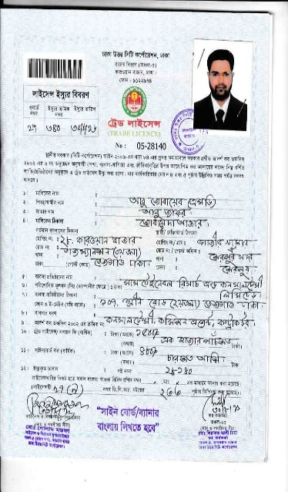
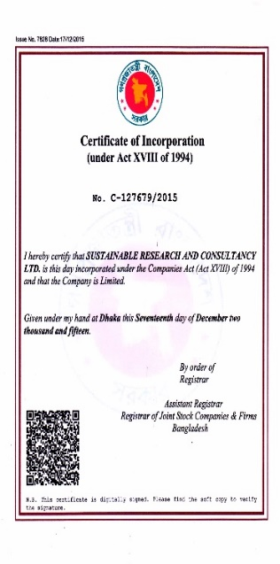
Legal Entity
Sustainable Research and Consultancy (Ltd.) is a registered and legal consultancy firm in Bangladesh
Established year: 2015
Available documents (Incorporation Certificates, TIN, Trade license and others)

Slide 24


