Slide 1

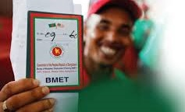

Safe migration from Bangladesh (sa-MI)

Slide 2

Interested Association
Bangladesh Association of International Recruiting Agencies (BAIRA)

Slide 3
Background of BAIRA
BAIRA is an association of national level with its international reputation of co-operation and welfare of the migrant workforce as well as its approximately 1300 member agencies in collaboration with and support from the Government of Bangladesh. BAIRA believes in the ultimate goal of reaching the stage for a "NO VISA" world, where any member of human race could move to any place in pursuit of his trade or employment. But we are hopeful that the human civilization will emerge in a new world, where peace and prosperity will prevail.
At present BAIRA is interested to work with different skill projects in Bangladesh with running and advance level skill trades like as Nursing, caregiving, medical technologist, caregivers, old care, SMART delivery man, security guards, babysitters and similar others programs. We expect your support to conduct these program smoothly in Bangladesh to gain more foreign currencies.

Slide 4

modern Training Center Number
Category | Capacity | Number
Type A | ≥ 1000 nos | 10
Type B | 500 – 900 nos | 15
Type C | 350 – 499 nos | 05
Type D | ≤ 349 nos | 07
Contractual Nursing Institution (MoU Based) |  | 15-20
Paramedical Institute (MoU Based) |  | 20 (Under Processing)

Slide 5
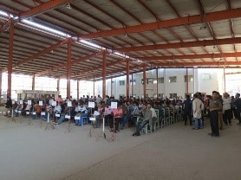
Training Center Facilities
International Standard
Training in different Trades
Accommodation Facilities
On-spot Recruitment from International Buyers
Visa Support, Ticketing, Dress and other facilities
Direct Job Placement

Slide 6
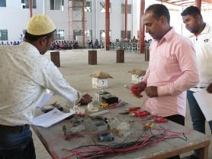
Specialty of baira
Job Confirmation
International Standard Remuneration
Equipped Training Center
On-Spot Recruitment
High Salary
Higher Remittance Return
Organized Management

Slide 7
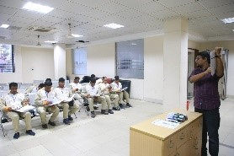
General Training Activities Format
1 Semester = 4 months
1 Year = 3 Semesters (Summer, Fall and Spring)
*** Trade wise differ for semester

Slide 8
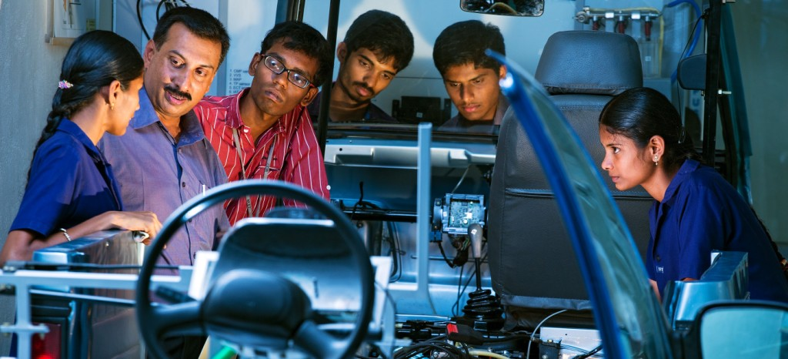

our Programs
Regular Program
Special program
Auto Mechanics
Machinist
Electrical House Wiring
Refrigeration & Air-Conditioning
Welding & Fabrication
Architectural Drafting with Auto CAD
Electrical Machine Maintenance
Mechanical Fitter
Quality Control Management
Wood Working
Civil Construction
Civil Drafting with Auto CAD
Mechanical Drafting with Auto CAD
Computer Office App lication
Graphics Design
CNC Machine Operator
Micro Controller Application
Programmable Logic Control (PLC)
Consumer Electronics
Japanese Language
Korean Language
Driving
Woven Garments Machine Operator
Caregiver (Nurse, Old Care Unit)
Community Nurse Training
Baby Sitter (Caregiving)
Hospitality Management

Slide 9
International donors project
Name of the Program | International Donor | Organization Status | Members Status
Skills for Employment Investment Program (SEIP) | ADB | Under Processing | Running
SUDOKKHO | Swiss Contact | Under Processing | Running
Different Project | ILO | Done | Running
Different Project | BMET | Under Processing | Running
Different Project | Others | Under Processing | Running

Slide 10
Present Employee Demand
Sl. No. | Present Employee Demand |  | Training |  | Employment Process (Parallel)
 | Country | Trade | Number | Training
01 | Japan | Care Giver (Nurse and other Trades) | 40000 | Basic and Language | On Spot Recruitment Passport Processing Visa Processing BMET Clearance Smart Card Airport Pass Joining
 |  | Construction | 45000 | Basic and Language | That
 |  | Electromechanical | 50000 | Basic and Language | That
 |  | Welder and Ship Building | 40000 | Basic and Language | That
02 | England | Care Giver (Nurse and other Trades) | 25000 | Basic and Language | On Spot Recruitment Passport Processing Visa Processing BMET Clearance Smart Card Airport Pass Joining
 |  | Construction | 30000 | Basic and Language | That
03 | Singapore | Care Giver (Nurse and other Trades) | 25000 | Basic and Language | On Spot Recruitment Passport Processing Visa Processing BMET Clearance Smart Card Airport Pass Joining
 |  | Construction | 30000 | Basic and Language | That
Source: BMET, Paper Cutting, Internet and Others.

Slide 11
Methodology of Total training and employment
Sl. | Trade Name | Rough Cost (BDT) | Training Applicable
01 | Civil Construction | 30000-50000 | Only Basic Training Basic and COVID Safety Professional Communication
02 | Electrician | 40000-60000 | Only Basic Training Basic and COVID Safety Professional Communication
03 | Welder | 40000-60000 | Only Basic Training Basic and COVID Safety Professional Communication
04 | Refrigeration & Air-Conditioning | 35000-50000 | Only Basic Training Basic and COVID Safety Professional Communication
05 | Care Giver | 75000-120000 | Basic ToT Language Basic and COVID Safety Professional Communication

Slide 12
Opportunities for return migrant
They already know the communication language of these countries
Having a visa and experience about the weather of these areas
A great opportunity for returning their investment
Just they need another trade training for joining
Some people are enough educated for working as a care giver
Other occupation trades like assistant nursing, old care giver, security guard, hospital cleaner, delivery man is highly demanded due to COVID-19 crisis all over the world.
These mentioned trades are easy to train and support the immigrants.
So, if they got a relevant training about these trades, they can perform better rather than other countries.
We have significant number of active training centers, good number of MoU based Medical Training centers and other facilities.
Different professional personnel for relevant training program are available.
Relevant country expert for training and Master ToT professionals are also connected.
That’s why we can train a significant number of RE-MI for getting their job back and earn a regular figure of foreign remittance.

Slide 13
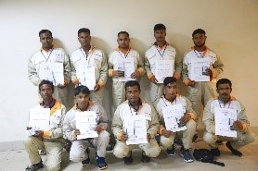
certification
Local Certification
National Skills Development Authority (NSDA) Certification (Up to Level 4)
Institutional Certification (RTO)
Occupational Health & Safety Certification
PPE Certification
International Certification
Direct Employer Certification
Online based Training Program Certification
Different Professional Certification
Sector Wise International Association Certification (NFDA, OSHA, IIW etc.)

Slide 14
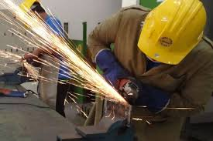
Tentative costing
Total Trade – 05 nos
Target Trainee – 20,000 nos per year
Target Country – Japan, Singapore, Thailand, European & Middle East Countries
Present Training Capacity – 30,000 nos per year

Slide 15
Schedule of training
Name of the Course | Duration | Number of Course | Desired Number of Participants (each course) | Minimum Acceptable Number of Participants (each course) | Maximum Acceptable Number of Participants (each course) | Total Number of Desired Participants
Welding & Fabrication | 03 Months | 4 | 36 | 36 | 36 | 144
Civil Construction | 03 Months | 2 | 36 | 36 | 36 | 72
Electrical | 03 Months | 4 | 36 | 36 | 36 | 144
Refrigeration & Air-Conditioning | 03 Months | 4 | 36 | 36 | 36 | 144
Caregiver | 04 months | 3 | 30 | 30 | 30 | 90

Slide 16
Tentative costing
Training Cost (Per Trainee)
Name of the Course | Duration | Number of Course | Costing in BDT
Welding & Fabrication | 03 Months | 4 | 30,000-40,000
Civil Construction | 03 Months | 2 | 30,000-40,000
Electrical | 03 Months | 4 | 30,000-50,000
Refrigeration & Air-Conditioning | 03 Months | 4 | 30,000-40,000
Caregiver | 04 months | 3 | 50,000-60,000
PMU Cost (Tentative)
Per Trainee 8,000-10,000 BDT

Slide 17
Return on Investment
Sl. | Trade | Country | Total Investment (BDT/Trainee) | Visa (Time) | Monthly Return (BDT/Trainee) | Total Return (BDT/Trainee) | Return Ratio
01 | Civil Construction | Japan England Thailand Singapore Middle East | 50,000 – 60,000 | 5 years | 50,000 – 60,000 | 30,00,000 | 50 times
02 | Electrician | Japan England Thailand Singapore Middle East | 50,000 – 60,000 | 5 years | 50,000 – 60,000 | 30,00,000 | 50 times
03 | Welder | Japan England Thailand Singapore Middle East | 50,000 – 60,000 | 5 years | 50,000 – 60,000 | 30,00,000 | 50 times
04 | Refrigeration & Air-Conditioning | Japan England Thailand Singapore Middle East | 50,000 – 60,000 | 5 years | 50,000 – 60,000 | 30,00,000 | 50 times
05 | Caregiver (RE-MI Program) | Japan England Thailand Singapore Middle East | 1,00,000 – 1,20,000 | 5 years | 1,20,000 – 1,50,000 | 70,00,000 | 50 times

Slide 18
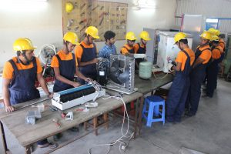
Demand from seip
Office Set Up at BAIRA (PMU)
Training Support
Training Institute Strengthening
Training Payment
Equipment Support
Transport Support
Curriculum Development
Foreign Job Placement Cell Development
International Recruiting Center Development
International Certification Process Development
One Stop Service center Development
Online Classroom Set Up Development
Awareness and Program Campaign Support

Slide 19
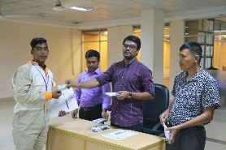
Justification of SA-MI program
Due to COVID-19 impact most of migrant worker are in danger for losing their job. Especially Middle east and European migrants are facing a lot of problem. That’s why a big number migrant back to country and another big number is waiting for return. These near about million working people will be jobless after return and no way to earn. Most of them already lost their significant amount of money for joining to these countries.

Slide 20
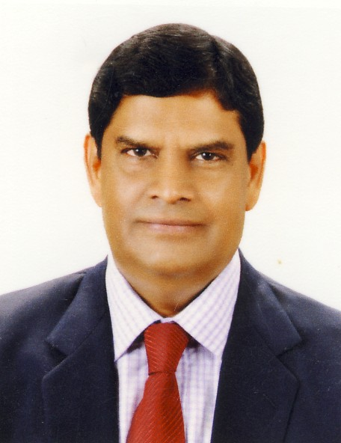
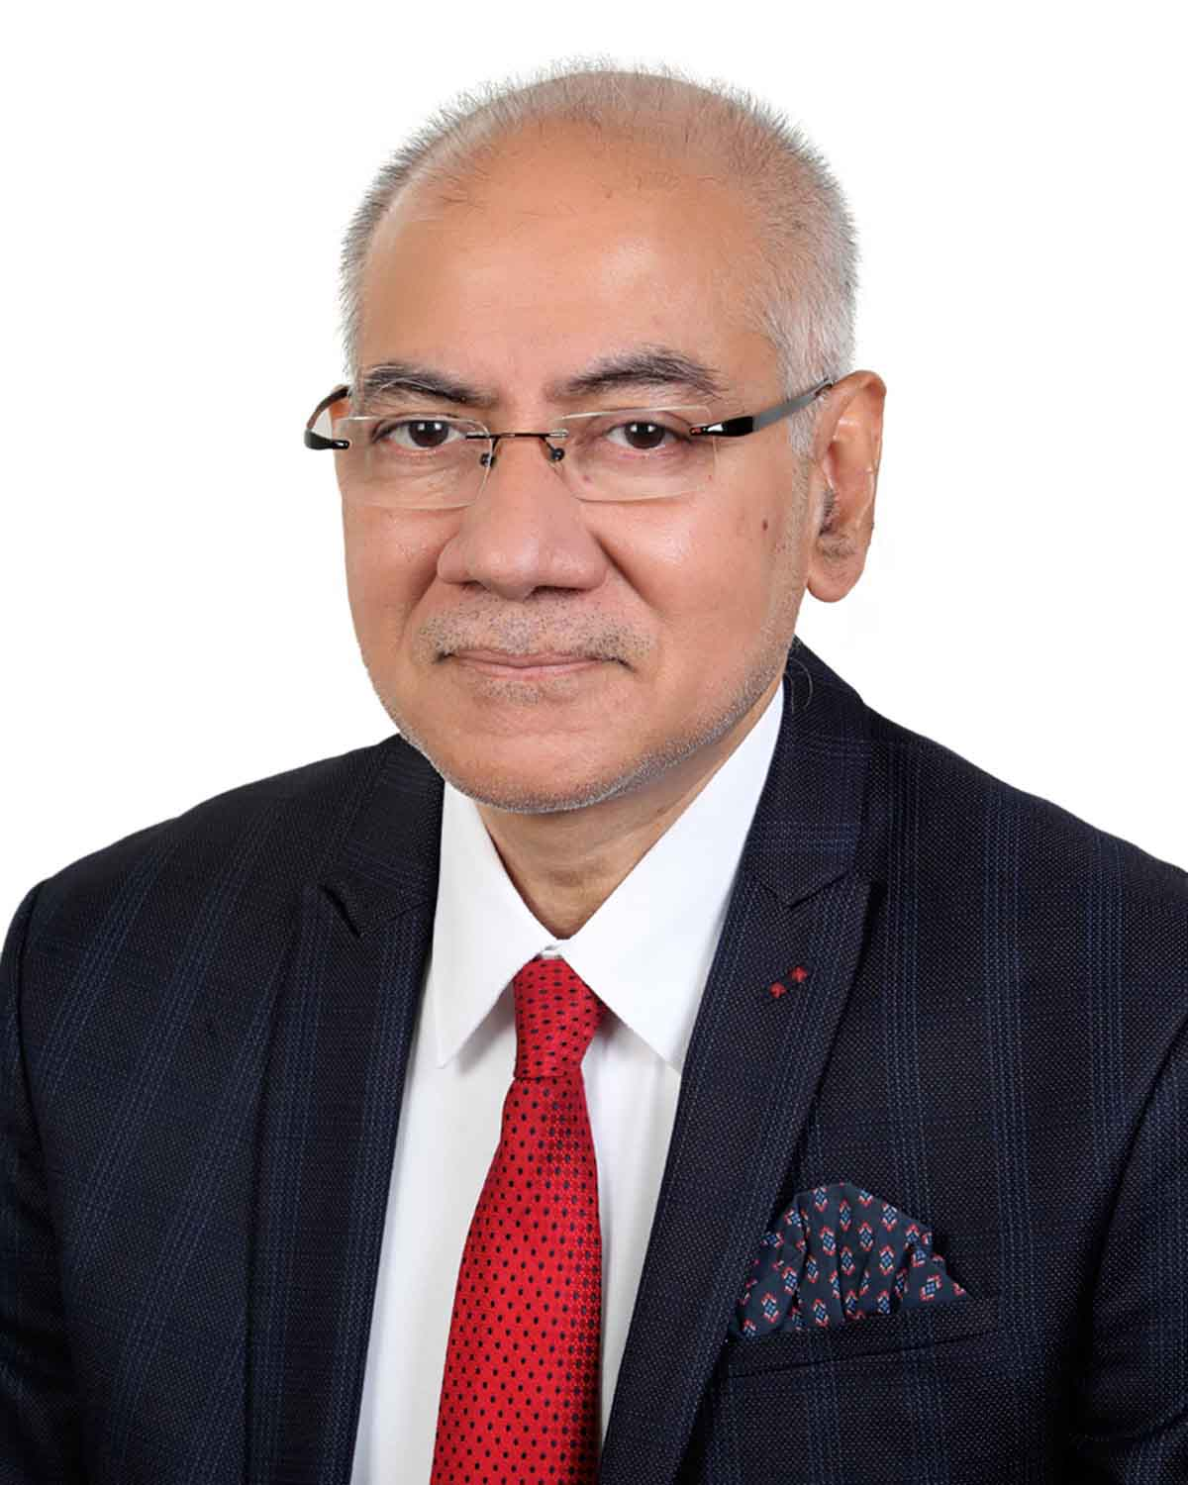

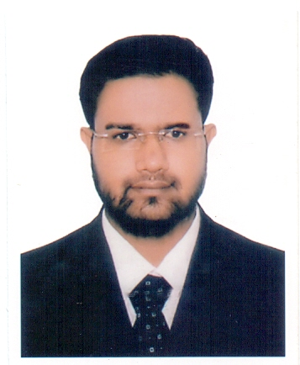
team
Mr. Benjir Ahmed, M.P.
Mr. Shameem Ahmed Chowdhury Noman
Mr. Muhammad Maqsudur Rahman
Abu jubayer
Honorable President
Bangladesh Association of International Recruiting Agencies (BAIRA)
Secretary General
Bangladesh Association of International Recruiting Agencies (BAIRA)
Secretary (Administration)
Bangladesh Association of International Recruiting Agencies (BAIRA)
Chief Coordinator
Project Management Unit
Bangladesh Association of International Recruiting Agencies (BAIRA)

Slide 21


Thank you!
baira1984@gmail.com
http://www.baira.org.bd/
+880 1711 459 532

