Slide 1

Background
Small and Medium Enterprises (SMEs) play an important role in the developing economy of a country like Bangladesh. Their role in terms of sustainable economic growth, production, development of entrepreneurs, employment generation, contribution to exports and facilitating equitable distribution of income is very critical for a developing country. Thus, the government has identified the SMEs as a key element and considered as the backbone of the economy of Bangladesh. In this corona pandemic many informal SMEs are being developed through online based system (Facebook, YouTube, etc.).
www.srclbd.com

Slide 2
Objectives
To develop hygienic and safe food & products supply system first in Bangladesh;
To develop direct marketing linkup with buyers with a sustainable supply chain;
To develop a sustainable agriculture & product supply chain all over Bangladesh;
To reform an online based digital market system, engage wholesale agent at kawran bazar, khatunganj, shyambazar etc.;
To make a breakthrough in our wholesale supply chain market;
To develop farmer to consumer (F2C) system;
Paradigm shift of general shop to live shop system
www.srclbd.com

Slide 3
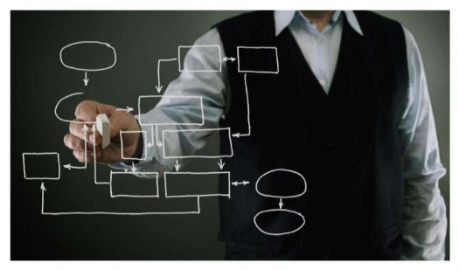
Basic Plan
Production
Online Purchase with Agent Engagement
Sustainable & Customized Transport System with GPS Tracking and software use
Warehouse input (8 locations)
Disinfecting, Cleaning, Hygienic and Vacuum Packaging
Online pre-order and sale
Delivery within 6 hours
Artificial Intelligence (AI) based customer need analysis
Demand calculation and storing with seasonal calendar
Profit sharing with regular customer
www.srclbd.com

Slide 4
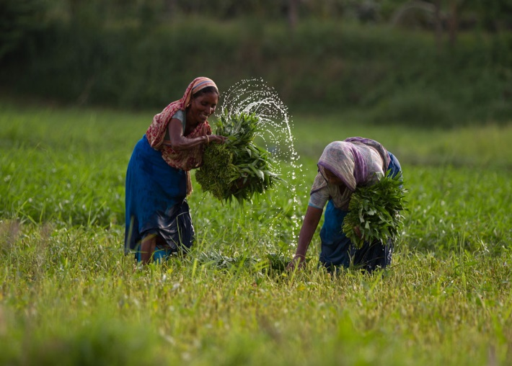
Production Point
Engaging informal farmers and SMEs as our basic production house
Perform as a direct buyer
Provide advance amount for cultivating crops and agricultural products
High yield varieties seed supply
Provide small scale bank loan for suppliers and agents as part of cultivation and supply
Provide training for cultivation and harvesting of crops
www.srclbd.com

Slide 5
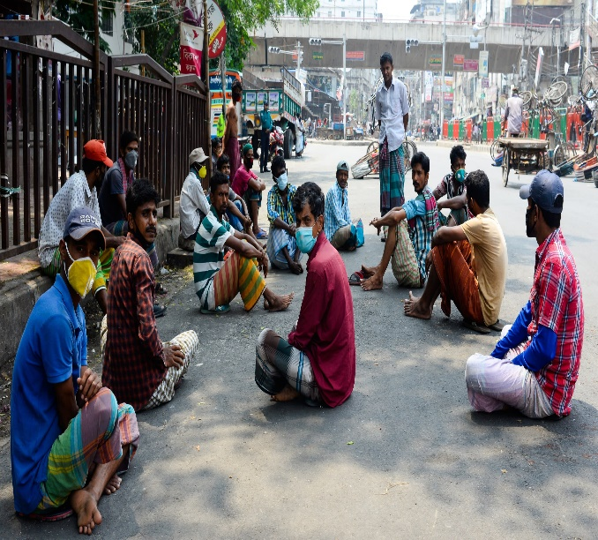
Support to Terminated Employee Due to COVID-19 Point
Make a list for employees who lost their job due to COVID-19 pandemic
Communicate with different trade organizations (BKMEA, BAIRA, BTA, BFLLFEA, BDMS etc.)
Trained the dismissed employees with different trades (according to DoY, GoB)
Purchase their products with advance payment and sale to present employees with hygiene condition
Support all kinds of technical (seed supply, training, packaging, hygienic etc.) and financial management (product buying, selling, bank loan, land leasing, and pesticide supply)
Develop a SMART supply chain and delivery system
Develop mobile app and webpage-based market system
www.srclbd.com

Slide 6
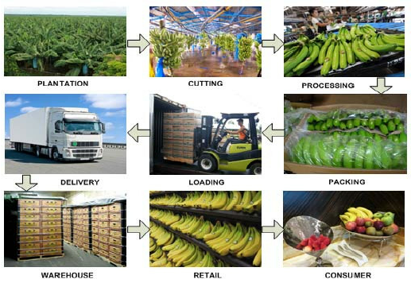
Transportation System
Customized vehicle (vegetables, fish, fruits, crops, liquid etc.)
Circular and radius-based transportation collection system (Toyota, Nishan, Japanese collection model)
Three types of vehicle (collection, transportation, and delivery) use
Mobile app-based vehicle tracking system
Manage ten (10) ferry ghats with agent for quick transportation
Anti-trip management system development all over Bangladesh
Sustainable Express Courier Service development in 2500 unions
24/7 technical support for logistic management
Engage with BRTC and postal logistic delivery system
Use digital economy system (Nogod, Bkash, Rocket, Sure Cash etc.)
www.srclbd.com

Slide 7
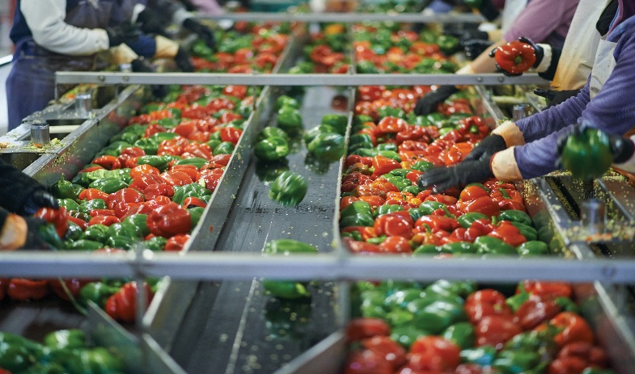
Hygiene Food
Product collection with hygienic practice (PPE and polybag usage)
In-house disinfection (water heating, spraying, & cleaning) process
Grading and sorting
Grade-wise special treatment for category of products
www.srclbd.com

Slide 8
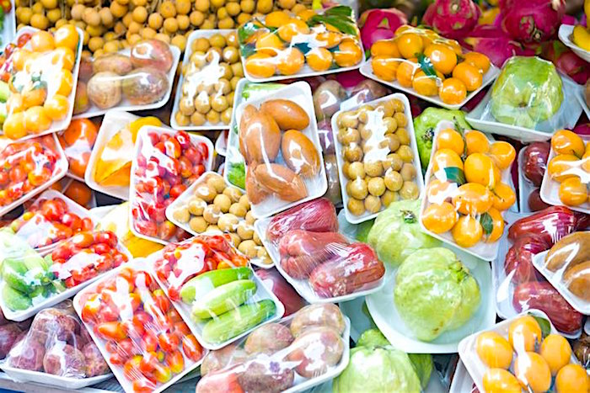
Smart Packaging
General packing for vegetables and quick perishable goods
Vacuum packing for grade-wise product
Product auto labeling
Manufacturing & expire date enabling
Weight-wise packing (2kg, 5kg, 10kg etc.)
QC pass system development
Respray for final delivery
www.srclbd.com

Slide 9
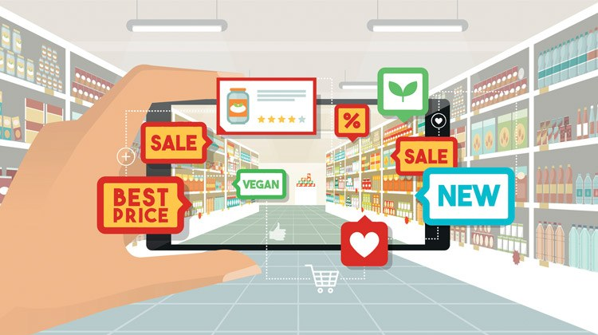
Online Sales
Mobile app development
Website development
Fixed customer (present worker of BKMEA, BAIRA, BTA, BFLLFEA, BDMS Etc.)
General customer development with branding
Social media marketing
www.srclbd.com

Slide 10
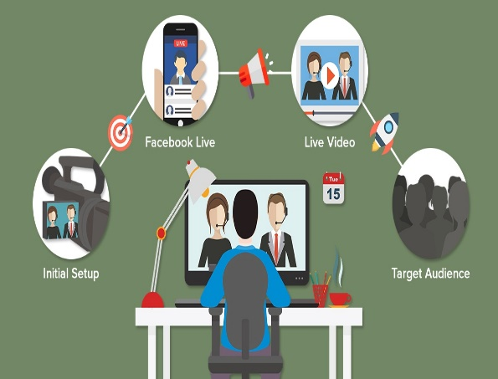
Live Market
Live shopping mall development
Shop number wise separate live link
Live consumer-shopkeeper-consumer link development
Direct purchase from every shop
Live wholesale market (kawran bazar, khatunganj etc.) development
Local hut (market) management through agent
www.srclbd.com

Slide 11
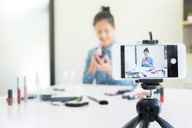
Live Shops
Mohallas/Paras/Goli wise live shop development
Market wise live shop development
House wise live shop development (different items based on FB group)
Wholesale market wise live shop development
Barcode scanning poster shop development
Flat & housing society wise live shop development
www.srclbd.com

Slide 12
Garments/Trade Body wise Sales point
General grocery shop development in factory (online & offline)
Delivery system development for employees & owners house
Running employee purchase system from terminated employee (RE-TE system development)
Regular demand analysis and supply system
www.srclbd.com

Slide 13
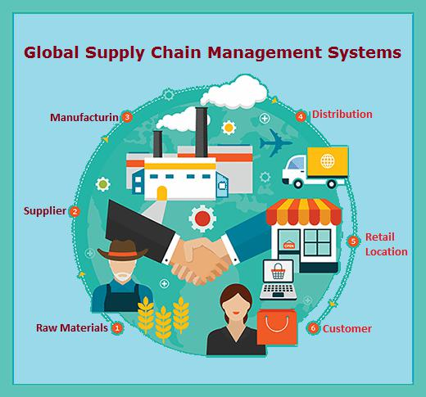
Smooth Supply Chain
Specific production house
High yield varieties production
Pre-processing hygiene maintaining
Day to day collection
Hygiene packaging
4-tier delivery system (bike, bicycle, small pickup van, large supply van)
Online payment gateway (general & mobile banking)
Agent engagement & supply system
SMART transport system
Bank loan, micro-credit loan, and other financial services
Many production houses and one direct buyer
Advance payment during production against post sale
www.srclbd.com

Slide 14
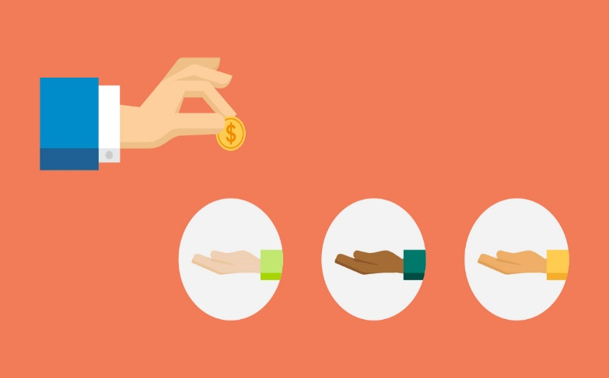
Beneficiaries
Terminated employees due to COVID-19
Association members
General hygiene food supplier
General shop keepers
Market owners
Chain shop owners
Different institutions
Safe food suppliers
Gender involvement
Non-formal SMEs
Regional farmers
Commission agent
Transport system
Youth development
www.srclbd.com

Slide 15
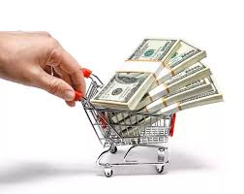
Major Spent
System development
Training
Hygiene & cleaning machineries
Packaging machineries
Online shop development
Transportation
Seed and pesticides supply
Advance payment
Bank loan interest
Marketing
Branding
Labeling
Delivery system
www.srclbd.com

Slide 16

Our Strength
MoU and strong communication with different trade organizations in Bangladesh (BKMEA, BAIRA, BTA, BFLLFEA, BDMS etc.)
Listing the terminated employees from different factories
Already experienced with live projects (www.socheton.com)
ICT ministry affiliation (iDEA project, Startup Bangladesh, ICT, GoB)
Communication with transport regulatory body (private)
Mutual agreement with Bangladesh Dokan Malik Somity (BDMS)
Communication with 2500+ union parishad areas
Strong IT support team
24/7 support team
Online based sales platform
Donor based communication
www.srclbd.com

Slide 17
Winning Team
Sl. No. | Name | Qualification and Special Fields | Year of Experience
01 | Dr. Md. Mazedul Haque | PhD, Netherland, Educationalist and Researcher | 18
02 | Dr. Sayed Md. Nazim Uddin | PhD, Canada, University Professor, Online Class Expert and Researcher | 13
03 | Dr. Razib Amirul Islam | PhD, Canada, Educationalist and Researcher | 12
04 | Dr. Zahanara Parvin | PhD, Japan, Educationalist and Researcher | 12
05 | Abu Jubayer | M. Sc. (BUET), NSDA L-4 in IT, Project Management Professional Trained, Online Class Expert and Researcher | 12
06 | Sadequr Rahman | M. Sc. (BUET), Project Management Professional Trained | 10
07 | Emdad Ali | M. Sc. (JU), College Teacher and Online Class Expert | 18
08 | Jinnat Ara Khatun | M. ED (DU), College Teacher and Online Class Expert | 14
09 | Mehedi Hassan | M. S. S. (DU), IT | 10
10 | Nazmul Hassan | B. SC. In CSE, (UAP), IT | 8
11 | Sanjida Rahman | B. SC. In CSE, (CUET), IT | 8
12 | Tanvir Rahman | B. SC. In CSE, (CUET), IT | 5
13 | Salim Ahmed | B. SC. In CSE, (BUET), IT | 5
14 | IT Support Technician (6) | Various | Various
15 | Office Staff (70) | Various | Various
www.srclbd.com

Slide 18
Technology Required
Mobile app
E-commerce website
Online payment gateway (card & mobile banking)
GPS tracking system
4G router for rural areas
Web Camera (1080p) for high resolution videos
HDMI Cable (10 Meters)
Sound System for customer communication
Internet stabilizers for poor connection
42’ LED TV for customer Monitoring
Voltage stabilizers
Moveable Camera Stands
Broadband connection with LAN facilities
Multiplug
USB Hub and customized connector
Super soft lighting for showroom
Audio Card USB Connector
Moveable stand table
YouTube Channel for every shop
Boya for clear voice communication
Facebook group
Bluetooth Mouse and key board
Online server for every shop
Laptop, Desktop or Smart phone
www.srclbd.com

Slide 19
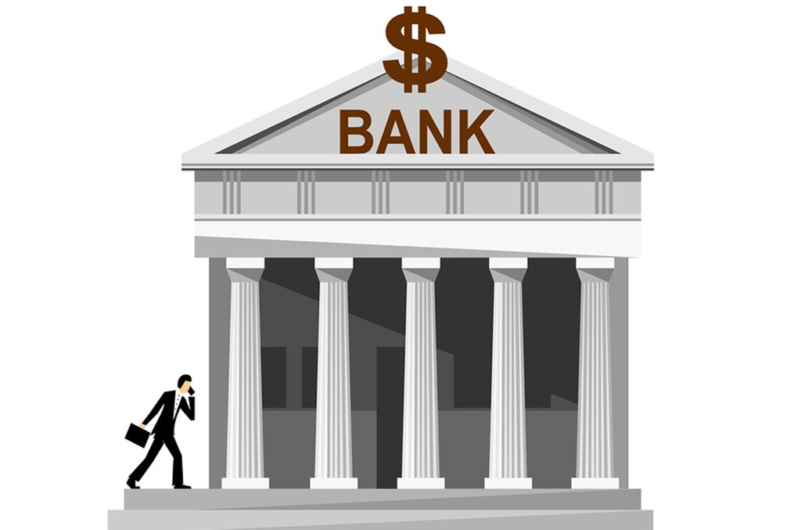
Equity Required
Office set up
Transportation management
Online e-commerce management
Bank loan support for supply chain SMEs, farmers and shopkeepers SMEs
Agricultural product support (seed, pesticides etc.)
Running capital
Delivery system
Hygiene and packing machineries
Certification
Long-term financial support
Shop decoration (online & offline)
Shopping mall wise equipment set up
www.srclbd.com

Slide 20
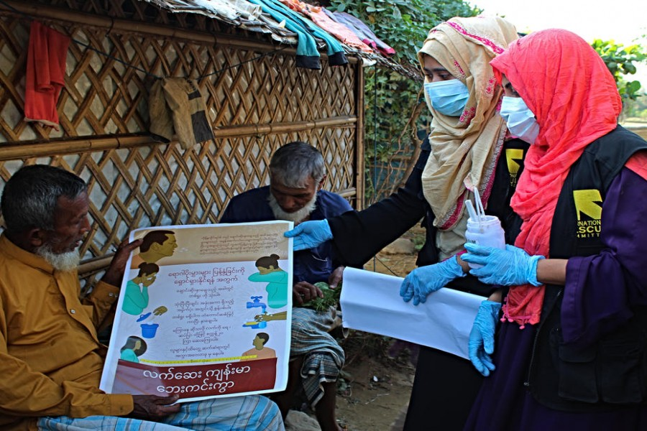
COVID-19 Preparedness
People used to online marketing and purchasing due to COVID-19
SMART delivery system
Mobile banking payment
Terminated employee support
Ensure hygiene
Production date wise labeling
Support to non-formal SMEs
COVID affected people’s support
Support to business paradigm shift due to COVID
Initiate Fourth Industrial Revolution (4IR) practices
www.srclbd.com

Slide 21

Sustainability
Regular product demand
Eco-Friendly
Trend increasing for online purchasing
Support to new entrepreneurs
Support to running SMEs
Different association involvement
Present demand of SME sector
Automated software
Supplier-customer live relationship
Government-TO-Association-NGO and public relationship
Season and area wise product diversification and supply
Strong market research
www.srclbd.com

Slide 22

Poverty Reduction
Creating new market opportunities
Employment generation for expatriates, terminated employee and other affected people due to COVID-19
Non-formal SME development
Supply chain establishment with producer, agent, supplier, and consumer
Product diversification from one place to all over Bangladesh
Contribution on national economic growth
Proper distribution of area wise product
www.srclbd.com

Slide 23

SDG Target
No Poverty (SDG-1)
Good-Health and Well-being (SDG-3)
Decent work and economic growth (SDG-8)
Industry, Innovation and Infrastructure (SDG-9)
Responsible consumption and production ((SDG-12)
Climate action (SDG-13)
www.srclbd.com

Slide 24
Funding Request
It’s a continuous project and need to support in different parts. Primarily, our first funding request is $5,000,000.00 (five million US dollars) in the context of equity and running capital.

