Slide 1

Startup Bangladesh
D-Learning Enhancement Project
Socheton Academic Care

Slide 2

Introduction
Company Name: Sustainable Research and Consultancy Ltd. (SRCL)
Project Name: D- Learning Enhancement Project (Socheton Academic Care) –www.socheton.com
Company Logo:
Tag Line: Real Education Online

Slide 3
Company Information
Establishment Area: Dhaka North City Corporation
Location of Operations: 8 divisions of the Bangladesh
Incorporation Certificate No.: 127679-2015 (Annex-1)
Trade License No.: 05-28140 (BNCC) (Annex-1)
TIN Certificate No.: 839930663812 (Annex-1)
Mission and Objectives of the Startup:
The mission is to establish Socheton as the number one online platform in the country that will be affordable and sustainable.
The objective is to meeting the country's academic, vocational and technical demand for distance learning activities as well as adapting to national and international markets.

Slide 4
Objectives
To provide High Speed Internet for rural areas school, colleges and institutions and resolve internet problems for supply smooth online education as well as other internet based services for every corner of Bangladesh.
To provide new online based education system with a unique and SMART classroom set up.
To provide Online based technical training is essential for teachers, IT personnel, company employee and other technical level.
Different Pandemic situation like COVID-19, Flood, Storm Surge situation cope up with online based system.
Start Work-Training-Work (WTW) practices with flexibility for industry level through E-Learning way.
World is going for E-learning platform for every level of education and we need to join this mob as soon as possible for entering the international markets.

Slide 5
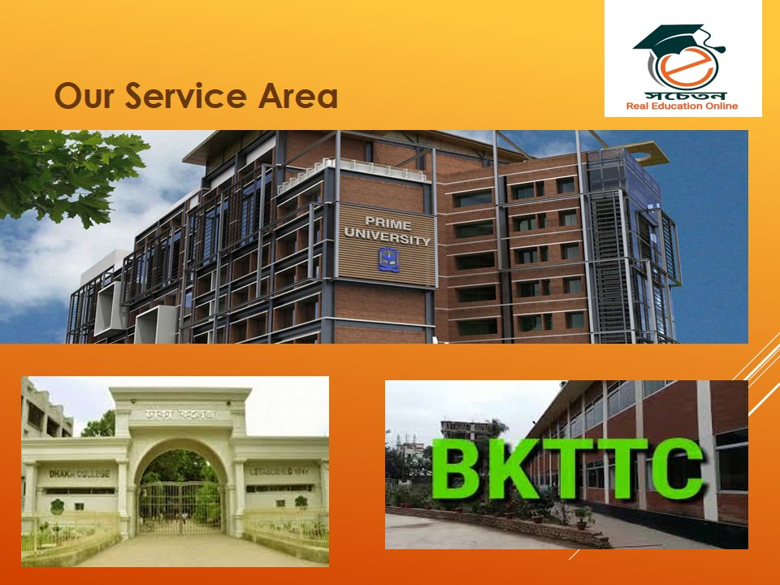
Description of Product or Service

Slide 6
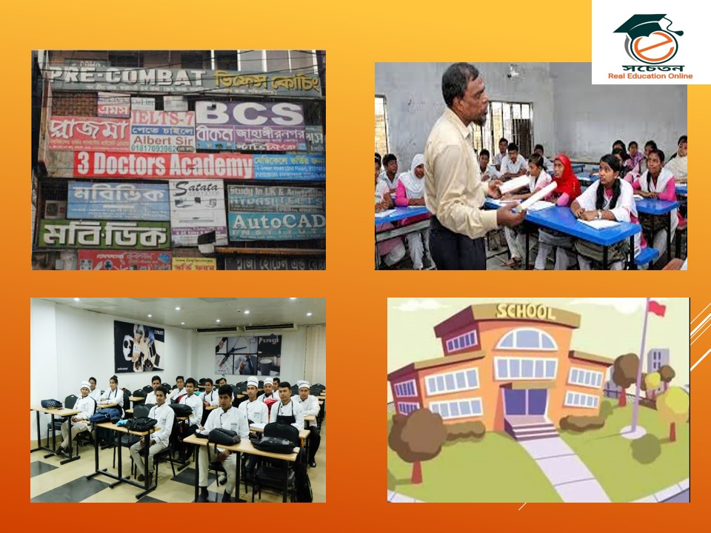
Continue..

Slide 7
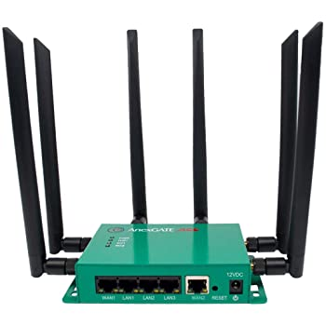
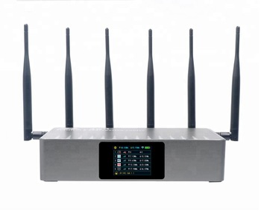
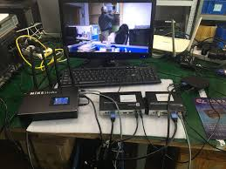
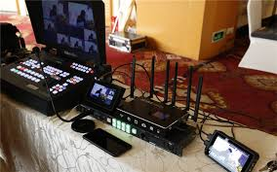
Portable High Speed Connector (Captain-3 Mini)

Slide 8
Our Prime Services
Portable High Speed Internet
Internet Bonding Router with 3-5 SIM cards and High speed internet for rural areas
Internet Stabilizer for rural areas for online activities
Without electricity backup for internet service (Upto 8 hours)
Online Class Room
Online Based Live classroom preparation
IT Support for class operations and maintenance
Online based Live Exam System (MCQ & Written) Development
Online homework submission and checking
Teachers Training for SMART Class use and operations
Gamification and Social Media Management
Educational game preparation for joy full education program
Social media live program (You tube channel, Facebook live for classes, Likee, Tiktok video for student education) management
Communication with different international institute for educational development
Teacher training (online and offline)

Slide 9
Problem Statement
What is the problem you are trying to solve?
Sl. No. | Items | General Services Problems
01 | Internet Speed | Poor condition of internet speed in rural areas of Bangladesh due to lack of frequency spectrum and poor infrastructure
02 | Available Network | 2G, maximum 3G in rural areas
03 | Required network | Minimum 1 MBPS uplink and 2 MBPS downlink for online class
04 | Free Class time | Only 45 minutes and need to reconnect
05 | Entry | Need to submit user name and password
06 | MB Cost | 500 MB-700 MB for each class
07 | Remote Areas | Only Available for 4G network
08 | Class Sound | Sometimes missing and not clear from teacher
09 | Live Exam System | No exam system
10 | Home Work | No Home Work System
11 | Student Payment | No payment gateway and restriction
12 | IT Support | No IT support from company
13 | Training for Teachers | No training Opportunities from company
14 | Online Purchase | Sometimes tough to purchase for general teachers

Slide 10
Solution Statement
To establish an affordable and sustainable online platform to meet the demand for conducting training, educational and day-to-day administrative activities smoothly in case of epidemics and emergencies as well as general times. At present it’s a time demand for future development.
General Solutions:
Sl. No. | Items | General Services Problems | Socheton Solution Services
01 | Internet Speed | Internet speed is very poor in rural areas | We will provide “CAPTAIN-3 MINI” for internet speed solution
02 | Available Network | 2G, maximum 3G in rural areas
03 | Required network | Minimum 1 MBPS uplink and 2 MBPS downlink for online class
04 | Free Class time | Only 45 min. and need to reconnect | Free up to 120 Min
05 | Entry | Need to submit user name and password | Direct entry for live class
06 | MB Cost | 500 MB-700 MB for each class | Only 180 MB- 220MB Cost for each class
07 | Remote Areas | Only Available for 4G network | Available for 2G, 3G and 4G network
08 | Class Sound | Sometimes missing and not clear from teacher | Very clear sound like as real
09 | Live Exam System | No exam system | Smooth online based Live Exam system
10 | Home Work | No Home Work System | Smart Online based home work system is available
11 | Student Payment | No payment gateway and restriction | Highly secured for student payment and entry for live classes
12 | IT Support | No IT support from company | Full IT support from us
13 | Training for Teachers | No training Opportunities from company | Full training support from company
14 | Online Purchase | Sometimes tough to purchase for general teachers | Free from purchasing

Slide 11
Innovative Solutions:
Internet Use Solution
Internet Bandwidth Connector (IBC) up to 8 mbps for remote areas where the connection is poor and only mobile network is available
Internet Stabilizer for weak connectivity area
User Friendly Solution
User-friendly Mobile App for Online Education
One Click entrance for class and exam
Edu-Gamification assignment
Online Based Class Solution
Video Feedback as Home Work (VHW)
SMART Exam System and Surveys
Keep Class Schedules Online (SMART Scheduling)
Channel Videos for Teaching (Relevant Different Channels from Online)
Master Video Tutorials for eLearning
Photo Hit Social Media
Service Solutions
8 Divisions, 64 Districts & 3000+ Union Parishad Level Service Providers
24*7 Online-based It Support Facilities (Live)

Slide 12
Market Size
Description:
The Target Market: School, College, University, Madrasah, Polytechnic, Technical Education, Youth development Centers, Govt. Office Training Centers, NGO Training Centers, Corporate Offices and others.
The Total Market Size : Around 50,000 + Institutes in Bangladesh
The Market Share that the Company will Target: 15%-20% of Total Market

Slide 13
Competitive Advantage
Direct and Indirect Competitors:
Different coaching centers and you tube channels
Different IT firm working on this issues
Donor based project working people
Local computer shops for school and college advantages
Your Competitive Advantage:
50% Deducted price rather than other product around the world
Other will import and my product is in house production and assemble
Comfortable to use and available product in house
First corporate start for SMART classroom setup program
Professional IT and support management team
Modern and updated technology used
Fully online based complete solution packages
Use ability of free media for all level users
Free access and paid access for institutes
Digital Economy Payment gateway for teachers, institutes and other (Bank, bKash, Nagadh)
Teachers training program online and offline
24/7, IT support team for any operational management

Slide 14
Funding Request
Description:
Amount Requested: BDT 100,000,000.00
Industry Focus: Education and Training
Venture Stage: BDT 1,000,000.00
Timeline to Achieve Profitability: November to December 2021
Monthly Burn Rate: On Demand Basis

Slide 15
Management Team
Sl. No. | Name | Qualification and Special Fields | Year of Experience
01 | Dr. Md. Mazedul Haque | PhD, Netherland, Educationalist and Researcher | 18
02 | Dr. Sayed Md. Nazim Uddin | PhD, Canada, University Professor, Online Class Expert and Researcher | 13
03 | Dr. Razib Amirul Islam | PhD, Canada, Educationalist and Researcher | 12
04 | Dr. Zahanara Parvin | PhD, Japan, Educationalist and Researcher | 12
05 | Abu Jubayer | M. Sc. (BUET), NSDA L-4 in IT, Project Management Professional Trained, Online Class Expert and Researcher | 12
06 | Sadequr Rahman | M. Sc. (BUET), Project Management Professional Trained | 10
07 | Emdad Ali | M. Sc. (JU), College Teacher and Online Class Expert | 18
08 | Jinnat Ara Khatun | M. ED (DU), College Teacher and Online Class Expert | 14
09 | Mehedi Hassan | M. S. S. (DU), IT | 10
10 | Nazmul Hassan | B. SC. In CSE, (UAP), IT | 8
11 | Sanjida Rahman | B. SC. In CSE, (CUET), IT | 8
12 | Tanvir Rahman | B. SC. In CSE, (CUET), IT | 5
13 | Salim Ahmed | B. SC. In CSE, (BUET), IT | 5
14 | IT Support Technician (6) | Various | Various
15 | Office Staff (70) | Various | Various

Slide 16
Organogram of the Company
Chairman
Managing Director/CEO
Team Leader
(IT)
Team Leader
(Admin & Compliance)
Advisory Pannel
Team Leader
(Operation)
Team Leader
(Project Management)

Slide 17
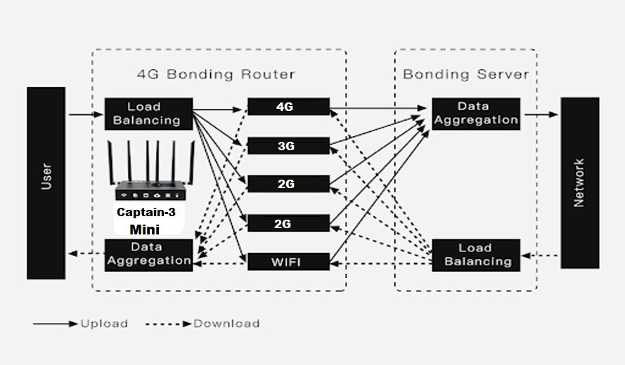
Product Architecture Overview

Slide 18
Topics | Technical Specification (Int.) | Our Product
Network Bonding: | 4 SIM & 1 Ethernet | 3-5 SIMs & 1 Ethernet (Use and Requirement Wise)
Network Provided: | Wi-Fi | Wi-Fi (30 Meters Range)
Outdoor Work Duration: | 5-6 Hours | 8 Hours
Support Self-Built Server: | Linus Debain 9.0 OS Required | Linus Debain 9.0 OS Required
Topics | Technical Specification | Topics | Technical Specification
Cellular Network Mode | TDD-LTE, FDD-LTE, DC-HSPA+/HSPA+/HSPA/UMT, STD-SCDMA | Support Daisy Chain | Yes
Node Bands | Based on region | Management | Web Control
Lan Rate, WAN rate, & Wi-Fi frequency | 1000Mb/s, 1000Mb/s & 2.4GHz - 5.8 GHz | Battery Capacity | 9600 MA (built-in)
 |  | Working Duration | 5-6 hours / 8 hours
Wi-Fi & Wi-Fi Range | 802.11b/g/n 300 Mb/s, 30 meters | Power Supply & Power Consumption | 12V 3A & 5W
 |  | Server Binding Option | Customized Server for clients
Antenna | External | Storage & Working Temperature | -40⁰C~70⁰C & -10⁰C~40⁰C
Uplink Speed & Downlink Speed | 80Mb/s Max | Storage & Working Humidity | 5%-90% no condensation & 10%-90% no condensation
Protocol | TCP/IP, UDP. FTP, HTTP

Slide 19
Key Technologies and Platforms
Basic Technologies
Basic Media:
Google Meet
Google Classroom
Wu-Commerce
YouTube, Facebook, Tiktok, Likee and others
Bkash / Nagadh, bank
SSL e-commerce.
Online and Offline 24*7 IT Service for Institutes
Training program for Teacher and officials (Online and Offline)
Network Bonding: | 4 SIM & 1 Ethernet
Network Provided: | Wi-Fi
Outdoor Work Duration: | 5-6 Hours
Support Self-Built Server: | Linus Debain 9.0 OS Required
Cellular Network Mode
Node Bands
Lan Rate
Wan Rate
Wi-Fi Frequency
Wi-Fi
Wi-Fi Range
Antenna

Slide 20
Classroom Decoration Technology
Bandwidth connector (Rose -3 Mini)
Web Camera (1080p) for high resolution videos
Sound System for student communication
42’ LED TV monitoring Screen for student Monitoring
Moveable Camera Stands,
Whiteboard, marker and multiplug
USB Hub and customized Connector
Audio Card USB Connected,
Video Recording and class live equipment (1 Set)
Boya for clear voice communication
Bluetooth Mouse and key board
HDMI Cable (10 Meters)
Internet stabilizers
Voltage stabilizers
Broadband connection with LAN facilities
Projector with multimedia
Super soft lighting for clear class
Moveable stand table
YouTube Channel for every school
Facebook group
Online server for every classroom
Online classroom facilities from Google
Laptop or Desktop

Slide 21
Scalability/Security/Deployment Plan
Scalability:
Around 30,000 Schools and Colleges in Bangladesh (Source: DSHE) and most of them are out of these types of smart facilities. It’s highly scalable project for these institutes.
Security:
Web pages are secured as built and provide security for institutes.

Slide 22
Deployment Plan:
Incorporation
Tag with Idea Project and ICT Ministry
Apply and Documentation
Resubmission of Proposal to DSHE, DME, DTE and Other Institutes
Final Implementation
Branding promotion, installation , support and final implementation according to order.

Slide 23
Integration with other Products/Services
ICT Service Integration
Digital Economy Bkash and Nagadh
Google Meet, Google Classroom, WU-Commerce
Online class Equipment
Educational Improvement

Slide 24
Product Plan
Product Package Plan:
BASIC: (For Small Class)
Standard: (School/College Classroom)
Smart: (English Medium and Kindergarten Classroom)
Ultra: (University and National Level Training Room)
Advance: (International NGO, Liaison Office, International Training Classroom)

Slide 25
Proposed Partnerships
Basic Partner: Company Directors (07)
Strategic Partners: IDEA Project, A2I Project, ICT ministry
Implementation Partners: DHSE, DME, DTE, INGOS, BMET, TTC NGOS and Different Training Centers
Field Operational Partners: Socheton Academic Care,
Media Partner: ATN News, ETV, The Daily Prothom Alo, The Daily Star, The Bangladesh Protidin, Radio Today, Jago FM amd BBC Bangla.
Field Partners: Different School, college, madrasah, technical institutes, polytechnic, NGO training centers and others.
Foreign Partners: International Business Expert (b-Ex) Group, UK
Donor Partners: USAID, DFID, Swiss Contact, Embassy of Netherland
International Certification Partners: ISO, UKAS, 3 Plum Certification

Slide 26
Marketing Plan (Web/Social/Electronic/Print)
Web Page: A smart HTML based Integrated Webpage
Social Media: Facebook Boosting (Daily $100), YouTube Branding (Daily $100)
Electronic Media: 5 Talk shows, 2 Round Tables, Special Interviews 10, 1 advertisement
Print Media: Inauguration Program (Full Page), Daily Advertisement (20 Times in 5 National Dailies)

Slide 27
Sales Plan (Direct/Indirect/Channels)
Direct Sales: School, College, Madrassa, Technical Institutes, NGO Training Centers, Govt. training centers, Skill Programs in Bangladesh. (Work order collection and implementation)
Indirect Sales: Collect permission from different departments and according to project cycle implementation
Channels: Government, Donors, Foreign Donation, Teachers Associations and others channels will be used as Sales purposes.

Slide 28
Financial Strategy
Description:
Direct Funding Sources (Institute) Approximate Idea:
1. Yearly Allocation (): BDT 100,000 to 500,000
2. Guest Cost: BDT 50,000
3. Meeting Cost: BDT 50,000
4. Repairment Cost: BDT 60,000
5. Miscellaneous Cost: 5-10 percent on total budget
Note: Every year these budgets are available. However, due to COVID-19 situation all the budget have been reserved. Institute can use this budget as their funding source as well.
Funding Sources: IDEA Project, A2I Project, Personal, Directors funds and donors fund
Fund Amount: Preliminary BDT 10,000,000 for project startup
Use of Funds: Product Purchase, Demo Setup, Operational Cost, Overhead, Web page development, financial framework development, Mobile App development, Consultancy and others.
Notes:
Dubai Futures Foundation:
http://gulfnews.com/news/uae/government/huge-global-response-for-dubai-future-accelerators-programme-1.1880339

Slide 29
Revenue Model
Project Funding/Institutional Fund
Work Order
Implementation
Monthly IT Management Charge
Profit Allocation

Slide 30
Cash Flow Projection
1st Phase:
3500 Class room Set Up
Total cash flow projected around BDT 454,354,600
2nd Phase:
20% Increase
3rd Phase:
15% Increase

Slide 31
Implementation Plan
Description:
Quarterly Plan (4 Qtrs.) – Business
1st Quarter: Communication and Project Submission in Different Authorities
2nd Quarter: Corrections and Resubmission according to instructions
3rd Quarter: Fund Collection, Work Order collection and Start Implementation
4th Quarter: Monitoring, Evaluation, Management and Development
Notes:
Dubai Futures Foundation:
http://gulfnews.com/news/uae/government/huge-global-response-for-dubai-future-accelerators-programme-1.1880339

Slide 32
Implementation Plan
Quarterly Plan (4 Qtrs.) – Technical
1st Quarter: Web Page Development with integrated facilities
2nd Quarter: Demo Classroom Preparation, Test Class start, Virtual coaching start, Problems identifications and solutions for clear live class productions.
3rd Quarter: Classroom preparation, project running, day-to-day IT problems solutions, Digital revenue generations.
4th Quarter: Advance Technology adding, Game Development, Monitoring, Evaluation, Management and Development

Slide 33
Implementation Plan
Quarterly Plan (4 Qtrs.) – Financial
1st Quarter: Application for fund, contact for personal fund, Collect different source of fund, Prepare a presentation and show to funding authorities
2nd Quarter: Collect project fund, work order fund, start a live coaching center for regular activities, fund use for different purposed
3rd Quarter: Revenue collections and fund generation.
4th Quarter: Advance Technology adding, Research and Development investment, Monitoring, Evaluation, Management and Training program

Slide 34
Thank You

