Slide 1

Background
The nursing profession is undoubtedly a very important part of the health care infrastructure of a country. A developed health care system is impossible without a smoothly functioning nursing sector. Bangladesh must ensure health care to protect its human resources and fulfil a basic human need. The profession requires qualified leadership able to empower nurses and improve their professional competence. Bangladesh’s public health challenges require a skilled health care work force to provide or improve access to quality care. Gaps in quantity and quality of nurse and midwife services and education will have an impact on attaining the health related MDGs, especially 4 and 5, by the deadline of 2015. Health care issues, such as the increased need to deal with current and future health effects of climate change, have merged to create the sense of urgency that now catalyzes work to improve nursing and midwifery.
There is a severe shortage of skilled nursing personnel in the country. Bangladesh is one of a few countries in the world that has more medical doctors than nurses: about 3 medical doctors to one nurse. Furthermore, due to the shortage of nurses and a challenging working environment with few exceptions, the quality of nursing care has been called into question. To address these challenges, the Government of Bangladesh (GoB) is increasing efforts to raise the image; improve the quality of services and education; and meet the shortage of nurses and midwives. The government has pledged to achieve these goals by upgrading the status of nurses and midwives, creating midwifery posts, establishing more nursing and midwifery educational institutions, increasing the seats for students, and increasing capacity development of nursing and midwifery professionals, improving the health systems that will create the positive practice environment necessary for provision of quality nursing and midwifery services. Although nurses are the essential part of health care system, there are very little initiatives to promote this noble profession. Thousands of patients are not getting proper medical care due to deficiency of skilled nurse.
The WHO nursing and midwifery programme provides support to the Government of Bangladesh (GoB) via the Directorate of Nursing Services (DNS) and the Bangladesh Nursing Council (BNC) in order to alleviate the severe nursing and midwifery shortage, and to improve quality of education of and services provided by nurses and midwives in order to address the multiple urgent needs for a strong health care work force.
https://www.baira.org.bd

Slide 2

Institutional Facilities
Continued.......
Job Related Facilities:
International Standard
Online and Offline Training in different trades
Accommodation Facilities
On-spot Recruitment from International Buyers
Visa Support, Ticketing, Dress and other Facilities
Direct Job Placement
https://www.baira.org.bd

Slide 3
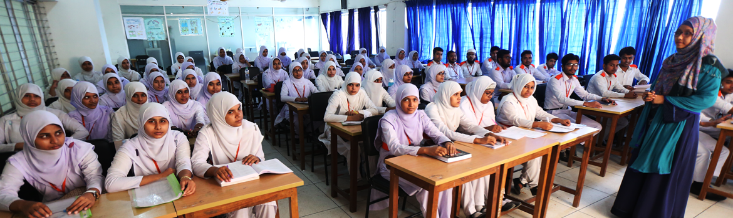
Institutional Facilities
Classroom Facilities:
International Standard
Training in different trades
Accommodation Facilities
On-spot Recruitment from International Buyers
Visa Support, Ticketing, Dress and other Facilities
Direct Job Placement
https://www.baira.org.bd

Slide 4

Special Recognized Training Courses
Caregiver (Child & Old care Unit) – 04 months
Assistant Nurse (Clinical and Royal Houses) – 04 months
Community Nurse Training – 04 months
Babysitter (Caregiving) – 04 months
Hospitality Management – 04 months
First Aid Support Nurse – 03 months
Physiotherapy Assistant Nurse – 06 months
Nutrition – 06 months
Autism and Dementia Management Nurse – 06 months
Housekeeping – 03 months and
Spoken English, Arabic, Japanese Program – (03 – 06) months
https://www.baira.org.bd

Slide 5
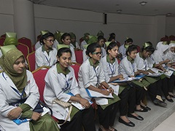
Course Curriculum
Continued.......
Basic Course Module:
Basic Language Training
Care and support to infants and toddlers. Bathing Procedure
Care and support to children
Foster the social, intellectual, creative and emotional development of children
Foster the physical development of children
Care and support to elderly with procedures
Care and support to people with special needs
Maintain a healthy and safe environment
Respond to emergencies
Clean living room, dining room, bedrooms, toilets, bathrooms and kitchen
Wash and iron clothes, linen and fabric
Hot and cold meals
Professionalism at work place
Therapeutic Massage
Skin test and vital signs taking
https://www.baira.org.bd

Slide 6

Course Curriculum
Continued.......
Practical Training Online:
Infants and toddlers Support and Care – 5 hours practical
Care and support to elderly (including understanding the aging process, assisting with mobility, personal hygiene, mental health issues, and assisting someone who is dying) – 20 hours practical
Household Management (Living rooms, dining rooms, bedrooms, toilets and bathroom) – 5 hours practical
Bed and Bathing Techniques – 5 hours practical
Vital signs taking – 10 hours practical
Therapeutic massage – 5 hours practical
https://www.baira.org.bd

Slide 7
Course Curriculum
Continued.......
Theory Training Online:
Theory – Self Study Modules and must attend exam and assessments
Care and support to infants and toddlers
Care and support to children
Foster the social, intellectual, creative, and emotional development of children. (Child development, including understanding childhood in its various stages, planning activities for the children of different ages, reading to children, etc.)
Foster the physical development of children
Care and support to elderly. (including understanding the aging process, assisting with mobility, personal hygiene, mental health issues, and assisting someone who is dying)
Care and support to people with special needs. (developing awareness of the causes and consequences of the accidents and diseases that cause disability and the care that may be required)
Healthy and safe environment/ Infection Control/Fire and Safety
Household Management (Living rooms, dining rooms, bedrooms, toilets and bathroom)
Nutrition and Food Preparation (Hot and cold meals)
https://www.baira.org.bd

Slide 8
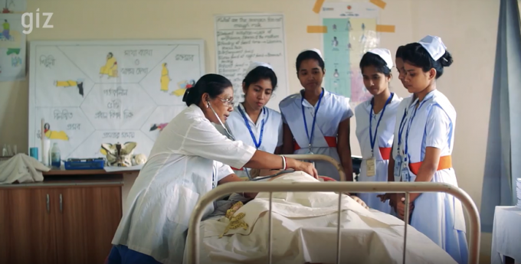
Course Curriculum
Professionalism at Workplace:
Therapeutic massage
Vital signs taking
Respond to emergencies
Ambulance CPR/First Aid Training
Dementia Awareness
https://www.baira.org.bd

Slide 9
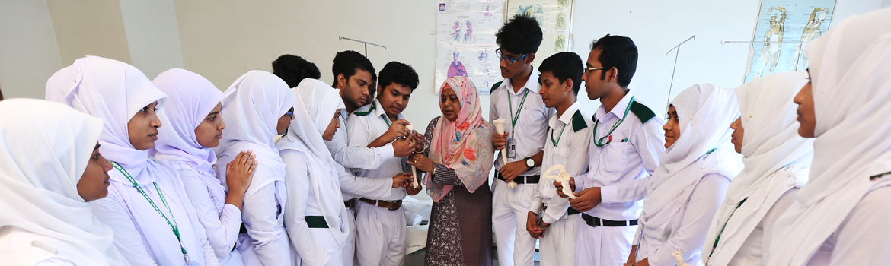
Employment Process
On Spot Recruitment
Passport Processing
Visa Processing
BMET Clearance
Basic Language Training
Smart Card
Airport Pass
Joining
https://www.baira.org.bd

Slide 10
Countries with Increased Demand
PRESENT
DEMAND
Japan
UK
USA
Thailand
Middle-East
Singapore
European
Countries
https://www.baira.org.bd

Slide 11
Tentative Costing for Every Trainee in Different Trades
Sl. No. | Trade Name | Tentative Cost (BDT) | Training Applicable
01 | Caregiver | 75000 – 200000 | Basic ToT Language COVID-19 Preparedness Professional Communication
02 | Assistant Nurse | 150000 – 200000
03 | Community Nurse Training | 75000 – 120000
04 | Babysitter | 75000 – 120000
05 | Hospitality Management | 150000 – 200000
https://www.baira.org.bd

Slide 12
Breakdown of Costing
Curriculum Development
Master ToT & ToT Preparation
Online & Offline Classroom development
Conduction of Classes (Theory & Practical)
Training on Professionalism
Consultant Fee
Admission Cost
Trainer Fee
Online Spot Admission
Agency Cost
Visa Processing
Class Equipment’s
Job Placement
https://www.baira.org.bd

Slide 13
Return on Investment (Tentative and Average)
Sl. No. | Trade | Country | Total Investment (BDT/Student) | Visa Period | Monthly Return (BDT/Student) | Total Return (BDT/Student) | Return Ratio
01 | Caregiver | Japan UK USA European Countries Singapore Middle-East Thailand | 100000 – 120000 | 5 years | 120000 – 150000 | 7000000 | 50 times
02 | Assistant Nurse |  | 100000 – 120000 | 5 years | 120000 – 150000 | 7000000 | 50 times
03 | Community Nurse Training |  | 100000 – 120000 | 5 years | 120000 – 150000 | 7000000 | 50 times
04 | Babysitter |  | 100000 – 120000 | 5 years | 120000 – 150000 | 7000000 | 50 times
05 | Hospitality Management |  | 100000 – 120000 | 5 years | 120000 – 150000 | 7000000 | 50 times
https://www.baira.org.bd

Slide 14

Present Work Plan
MoU signing with different nursing training center
Database Preparation for Nurses
Demand collection and contact with different countries
Master ToT Preparation according to principal countries with their facilitator/trainer
ToT Preparation for general training with master ToT
Training institute wise training program conduction
Training for B.Sc. Nurse, Diploma, Paramedic, Midwifery Nurses
Mandatory 100 hours language course
On spot Viva and Practical session for job placement
Finally, job appointment letter collection and
Job Placement to Abroad
https://www.baira.org.bd

Slide 15
Justification of Nurse for Future Program
Bangladesh has been suffering from an inadequate number of nurses, one of the important frontline health workforces. The shortage is being felt deeply in the ongoing Covid-19 crisis. Altogether 229 nurses have already been infected with the novel coronavirus. According to the guidelines of the World Health Organization (WHO), three nurses have to be recruited against one doctor. The health bulletin of the Directorate General of Health Services (DGHS) notes that the number of registered doctors in Bangladesh is 102,997. Against such a background, the country needs more than 3 lakh nurses. But the number of the registered nurses was 73,043 till April this year, according to the Bangladesh Nursing and Midwifery Council (BNMC).
That means the country has only 24 percent of the nurses it needs. Despite the 76 percent shortage of nurses, many of the nursing graduates do not get jobs in time. Around 10,000 nurses among more than 73,000 registered nurses are currently unemployed, according to the Bangladesh Basic Graduate Nurses Society (BBGNS).
On the other hand, in a report of WHO it is said that there is a global nursing shortage of 5.9 million. The greatest gaps are found in some of the poorest parts of the world, including countries in Africa, south east Asia and South America. The WHO also lays out a series of guidelines for how countries can prevent a nursing crisis by increasing funding for nursing education and by improving conditions for nurses. Over 1,309,623 (till November 13, 2020) people have died worldwide of COVID-19, and as the pandemic continues to claim lives nurses will continue to play an important role.
https://www.baira.org.bd

Slide 16
Opportunities of these Migrant
They already know the communication language of these countries
Having a visa and experience about the weather of these areas
A great opportunity for returning their investment
Just they need another trade training for joining
Some people are enough educated for working as a care giver
Other occupation trades like assistant nursing, old care giver, security guard, hospital cleaner, delivery man is highly demanded due to COVID-19 crisis all over the world
These mentioned trades are easy to train and support the immigrants
So, if they got a relevant training about these trades, they can perform better rather than other countries
We have significant number of active training centers, good number of MoU based Medical Training centers and other facilities
Different professional personnel for relevant training program are available
Relevant country expert for training and Master ToT professionals are also connected
That’s why we can train a significant number of RE-MI for getting their job back and earn a regular figure of foreign remittance
https://www.baira.org.bd

Slide 17
Winning Team related to the Project
Sl. No. | Name | Qualification and Special Fields | Year of Experience
01 | Dr. Reba Taslima | PhD in Advance Nursing, Malaysia International Trainer, Malaysia & Bangladesh. | 25
02 | Dr. Firoza Yeasmin | PhD in Advance Nursing, Malaysia International Trainer, London, UK, & Bangladesh. | 22
03 | Dr. Razib Amirul Islam | PhD, Canada, Human Resource Management (HRM) Expert and Researcher | 11
04 | Abu Jubayer | M. Sc. (BUET), Trained Project Management Professional | 15
05 | Sadequr Rahman | M. Sc. (BUET), Trained Project Management Professional, Trainer | 12
06 | Emdad Ali | M. Sc. (JU), International Training Coordinator | 10
07 | Jinnat Ara Khatun | B.Sc. in Nursing, Trainer | 18
08 | Mehedi Hassan | M. S. S. (DU), Trainer | 10
09 | Nazmul Hassan | B. SC. In CSE, (UAP), IT | 8
10 | Sanjida Rahman | B. SC. In CSE, (CUET), IT | 8
11 | Tanvir Rahman | B. SC. In CSE, (CUET), IT | 5
12 | Salim Ahmed | B. SC. In CSE, (BUET), IT | 5
13 | Training Support Technician (10) | Various | Various
14 | Office Staff (7) | Various | Various
https://www.baira.org.bd

Slide 18
Technical Demand:
Demand to Donor
Continued.......
Engagement with Running Projects (If any)
Capacity building according to international standards
Course curriculum development
Master & General ToT preparation
Training facilities development for institutes
International communication
International certification
Liaison with other international authorities for nursing and caregiving sector
https://www.baira.org.bd

Slide 19
Financial Demand:
Demand to Donor
Continued.......
Caregiver:
Total Semester – 4 (Evert 3 months)
Total Capacity per semester – 1020 (Every Batch 30 Trainees, Total 32 Batches)
Total Trainee in a Year – 4080
Per Trainee training cost – BDT 120,000
Total Cost for Caregiver Section – BDT 489,600,000
Assistant Nurse
Total Semester – 4 (Evert 3 months)
Total Capacity per semester – 1020 (Every Batch 30 Trainees, Total 32 Batches)
Total Trainee in a Year – 4080
Per Trainee training cost – BDT 120,000
Total Cost for Assistant Nurse Section – BDT 489,600,000
Community Nurse Training
Total Semester – 4 (Evert 3 months)
Total Capacity per semester – 1020 (Every Batch 30 Trainees, Total 32 Batches)
Total Trainee in a Year – 4080
Per Trainee training cost – BDT 120,000
Total Cost for Community Nurse Training Section – BDT 489,600,000
https://www.baira.org.bd

Slide 20
Demand to Donor
Financial Demand:
Babysitter
Total Semester – 4 (Evert 3 months)
Total Capacity per semester – 1020 (Every Batch 30 Trainees, Total 32 Batches)
Total Trainee in a Year – 4080
Per Trainee training cost – BDT 120,000
Total Cost for Babysitter Section – BDT 489,600,000
Hospitality Management
Total Semester – 4 (Evert 3 months)
Total Capacity per semester – 1020 (Every Batch 30 Trainees, Total 32 Batches)
Total Trainee in a Year – 4080
Per Trainee training cost – BDT 120,000
Total Cost for Hospitality Management Section – BDT 489,600,000
https://www.baira.org.bd

Slide 21
Proposed Financial Requirement
Sl. No. | Item | No of Trainees | Cost (BDT) | Cost (USD)
01 | Caregiver Section | 4080 | 489,600,000 | 5,760,000
02 | Assistant Nurse Section | 4080 | 489,600,000 | 5,760,000
03 | Community Nurse Training Section | 4080 | 489,600,000 | 5,760,000
04 | Babysitter Section | 4080 | 489,600,000 | 5,760,000
05 | Hospitality Management Section | 4080 | 489,600,000 | 5,760,000
06 | Total | 20,400 | 2,448,000,000 | 28,800,000
https://www.baira.org.bd

Slide 22
Focal Points of the Project
Mr. Shameem Ahmed Chowdhury Noman
Secretary General
Bangladesh Association of International Recruiting Agencies (BAIRA)
Abu Jubayer
Chief Coordinator
Project Management Unit (PMU), BAIRA
BAIRA Bhaban, New Eskaton Road, Dhaka.
M: 01711 459 532
E: jubayer.baira@gmail.com / chiefcoordinator.baira@gmail.com
For any further information, please contact
https://www.baira.org.bd

