Slide 1
Urban Fire Safety Readiness Project
Presented By
Abu Jubayer
Managing Director
Sustainable Research and Consultancy (SRC) Ltd.
+88 01711 459532
srcl.group.bd@gmail.com

Slide 2
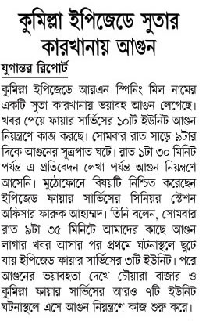
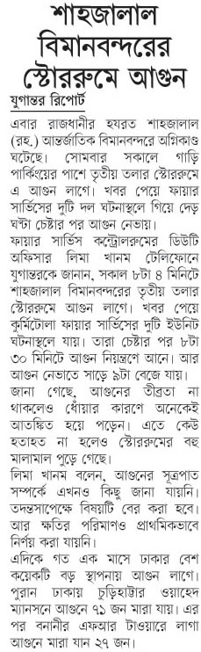
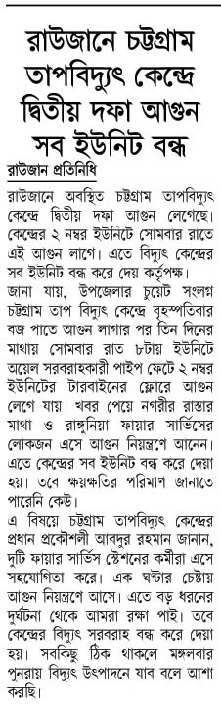
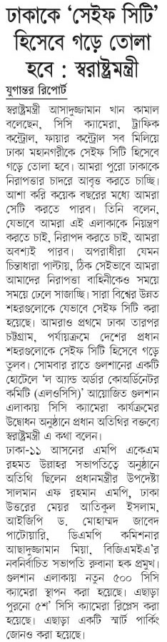
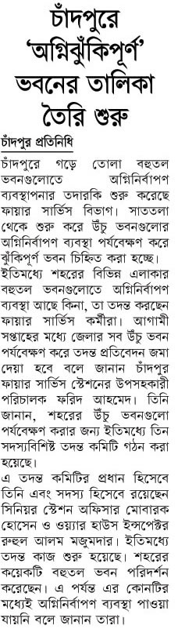
Introduction
One day Fire Incident

Slide 3
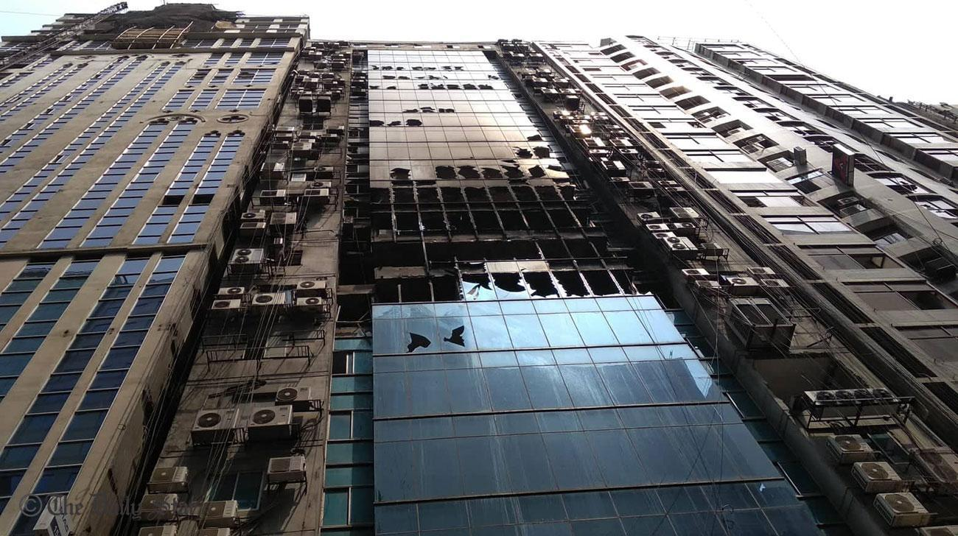
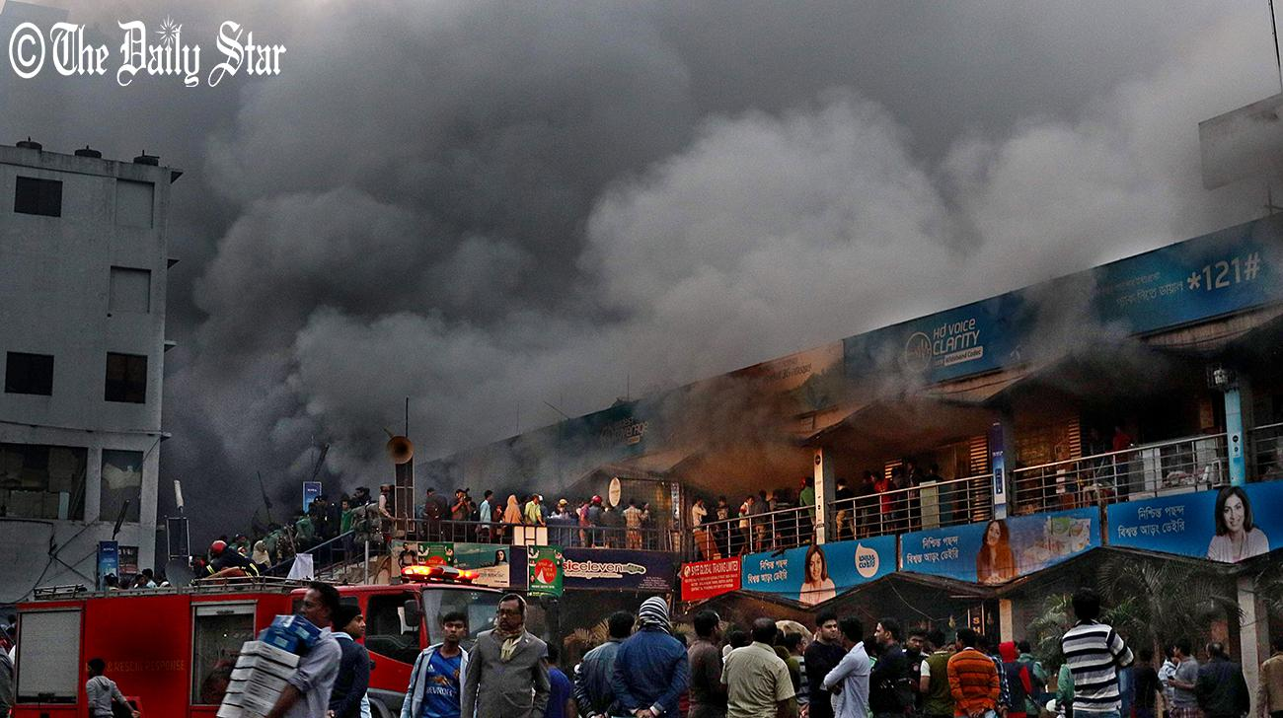
Major Problems

Slide 4


Solution Required
Interested Agencies
Fire Service and Civil Defense
Ministry of Home Affairs
Peoples Republic of Bangladesh
Implementation Partner
Sustainable Research and Consultancy Ltd. (SRCL)
28, Kawran Bazar, Dhaka-1215.
Mobile: +88 01711 459 532
Email: srcl.group.bd@gmail.com

Slide 5
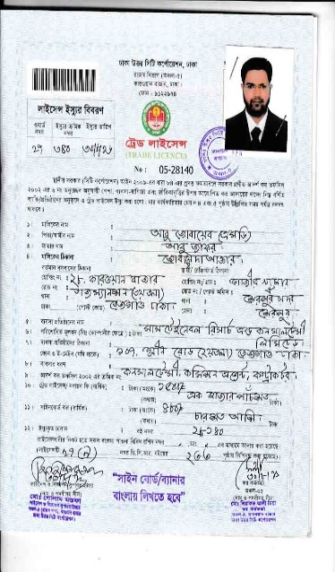
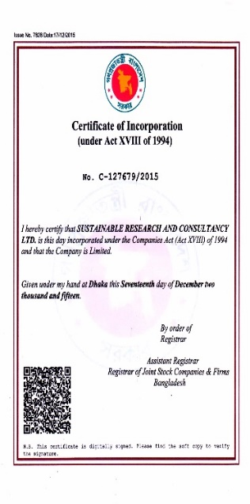
Who We Are?
Company Legal Entity
Sustainable Research and Consultancy (Ltd.) is a registered and legal consultancy firm in Bangladesh
Established year: 2015
Available documents (Incorporation Certificates, TIN, Trade license and others)

Slide 6


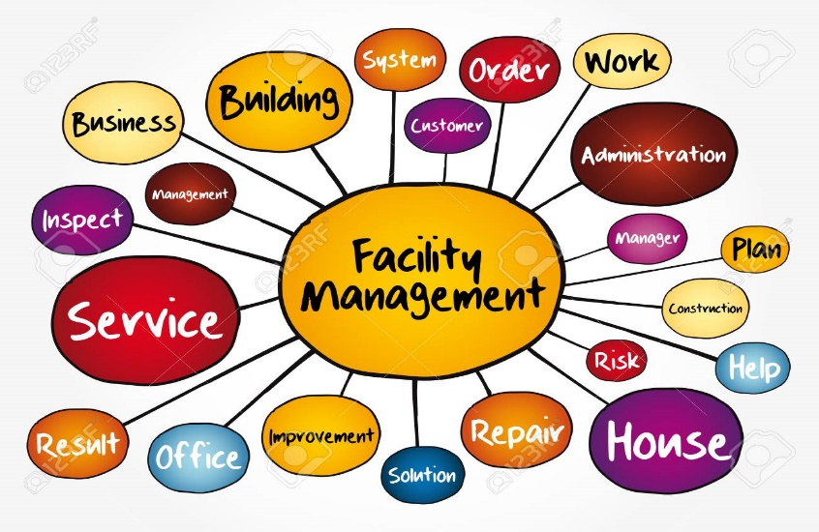

What we DO?

Slide 7
Our Previous Project Experience
Our Completed and Ongoing Projects
Sl. No. | Project Name | Organization
1. | Basic Fire Safety for Worker & Security Guard in Different Garments Factories | Alliance (Presently NIRAPON)
2. | Safety Monitoring Visit (SMV) for Factories | Alliance (Presently NIRAPON) And ACCORD
3. | Building and Fire safety assessment | Different Factories
4. | Supply Installation, Testing and Commissioning of Fire Instruments | Different Universities, Market Places and factories
5. | Mid level management training for fire safety and alarming system (Workshop and training) | Different Factory Management and University Students

Slide 8
Project Goal
One Stop Solution for Integrated Safety Management (ISM) For Housing Societies, Govt. Offices, Commercial Edifices and Corporate Premises.
Objectives
Ensuring the fire safety for Housing societies, Govt. Offices, Commercial Edifices and Corporate Premises for saving lives and cut losses
Beneficiaries
Govt. Offices
Corporate Buildings
Through inspection and implementations, safeguarding long term sustainability for corporate business and Govt. workstations
Minimization the loss by maximization the awareness among all level of stakeholders in commercial and operational sectors.
Commercial Edifices
Create trained safety fighter and public awareness for reducing fire incidents, road accident and safety casualties in Bangladesh.
Training for general house keeper, students, society members, house holders and other stakeholders
Creating awareness among al level of stakeholders.
Housing societies

Slide 9
Target Arena
Housing Societies
Gulshan Societies
Banani Societies
Baridhara Societies
Dhanmondi Societies
Govt. Officers Societies (Baily Road)
Uttora Societies
Niketon Societies and
Other Housing Societies around Dhaka City
Corporate Building
DCC markets
Corporate Buildings >10 floor
Institutions
Different Clubs

Slide 10
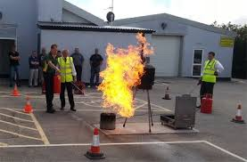
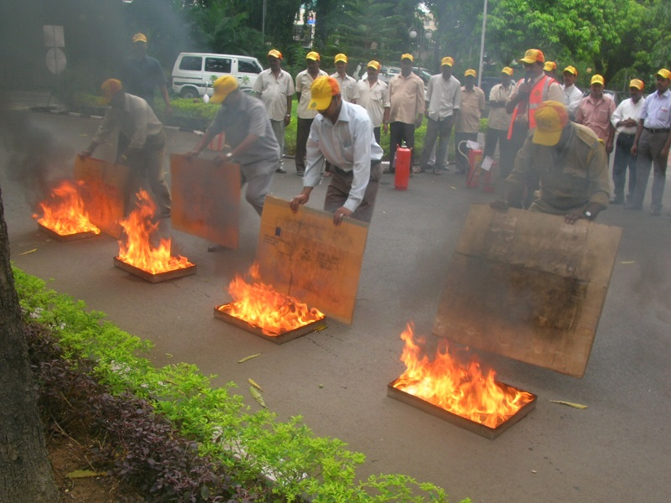
Basic Fire Safety Training
Basic Fire and Building Safety training for housing society members (Owner, tenant and renter)
Basic training for (Housemaid, guards, security persons and caretakers)
Basic training for Rescue and First Aid Team Training ( 15% of Office Staff Minimum 5 pers.)
Basic Training on road safety awareness for students, drivers, mothers and baby sitters or caregivers.

Slide 11
Minimum Participation from Every House
From high rise Building (=>10 Stored)
Every Flat – (1 Pers. Housemaid and 1 Pers. Owner party)
For security guards (Min 5 pers. periodically)
From General Building
Every Floor (3 Pers.)
All security guards (Min 4 Pers.)
For Commercial Buildings
Every Floor (4 Pers.)
Security Guard (Min 5 Pers.)
Higher Management stake holders (Min 5 Pers. from Building)
Internal Associations members (Min. 5 pers. From Building)

Slide 12
Training Target
Total Target: 50,000 nos
Category A: Officials and Above
10,000 nos
Category B: Students, Housewives etc.
15,000 nos
Category C: Guards, Housemaids, Caregivers etc.
25,000 nos

Slide 13
Role of FSCD
Conduct the Master Training for Trainers (ToT) for Local Training Providers
Monitor the training program
Participate certification handover program
Continue the Project Management Unit (PMU)
Monitor and evaluation residential and corporate safety audit
Monitor the Integrated Safety and Facility Management (ISFM) program
Participate different organized program and
International safety training programs

Slide 14
Role of SRCL
General Role of SRCL
Organize and implement the basic fire safety program for all level stakeholders
Manage all type of training facilities
Conduct the training program with a standard manner
Conduct the ISFM program for all level of patrons
Create public awareness for root level to up
Provide one stop services for ISFM for different categories
Increase the number of skilled manpower for safety matters in our society
Arrange all kinds of program arrangement for publicity
Arrange workshop, seminar and certificate providing ceremony
Program reporting monthly and half yearly
Collect different fund (national and international)
Organize the foreign training for project personnel including govt. officers and
other responsibility according to discussion

Slide 15

The Safety Team
Sl. No | Name | Basic Certification
1. | Abu Jubayer (Lead Coordinator) | M.Sc. In WRD, BUET NSDA Certified, Project Management Expert
2. | Eng. S M Abdullah Al Faruq (Fire Expert) | B.Sc. Engineer FSCD and NFPA Certified
3. | Eng. Abdullah Al Mamun (Fire Expert) FSCD and NFPA Certified | B.Sc. Engineer FSCD and NFPA Certified
4. | Eng. Manik Hossain Eng. S M Saiful Islam (Electrical Safety Expert) FSCD Certified | B.Sc. Engineer FSCD and NFPA Certified
5. | Eng. Siddiqur Rahman | B.Sc. Engineer
6. | Structural Safety Expert Assessor (Mechanical and Electrical Eng.) | FSCD and NFPA Certified 20 Nos

Slide 16

PUBLICITY OF THE PROJECT
Paper Publication
Facebook
You tube
A roundtable
5nos TV Talk Show
Banner
Poster
Rally and
5 Nos. Effective Workshops

Slide 17

FOREIGN TRAINING
NEBOSH, Singapore will be arranged under the work profile for Govt. Officers,
Consultancy Firm, Ministry level officers, FSCD officials and others as recommended.

Slide 18
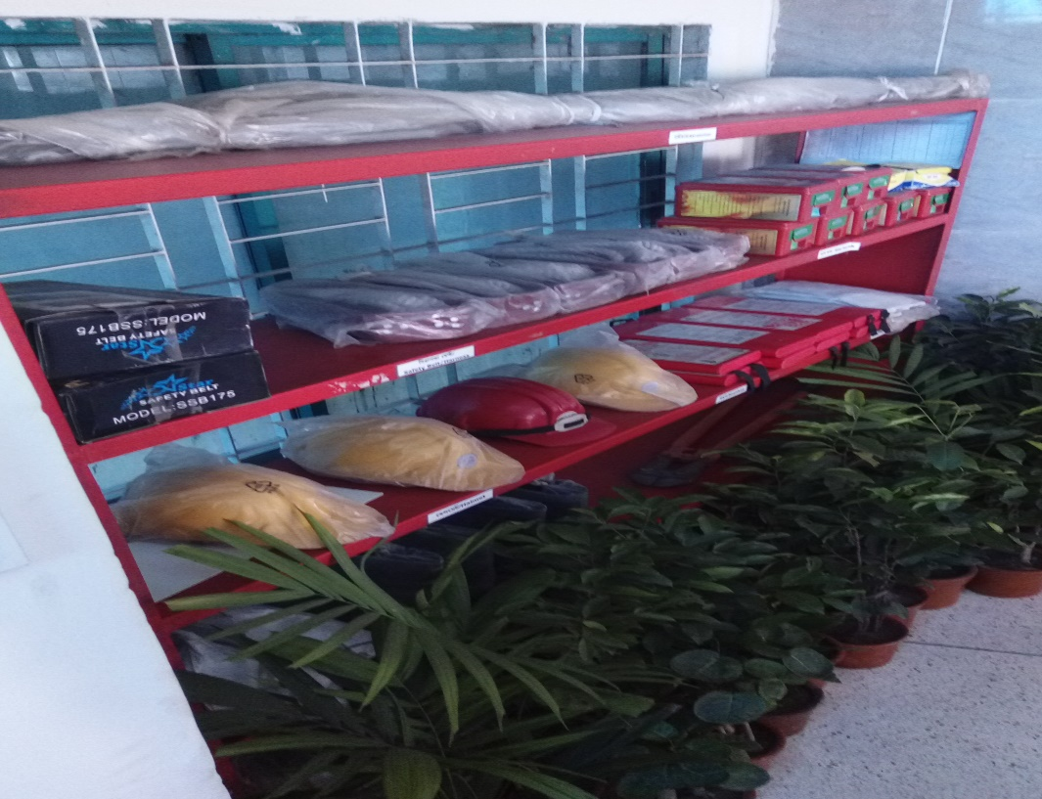
Basic Outcomes of This Project
Corporate fire safety practices will introduced

Slide 19
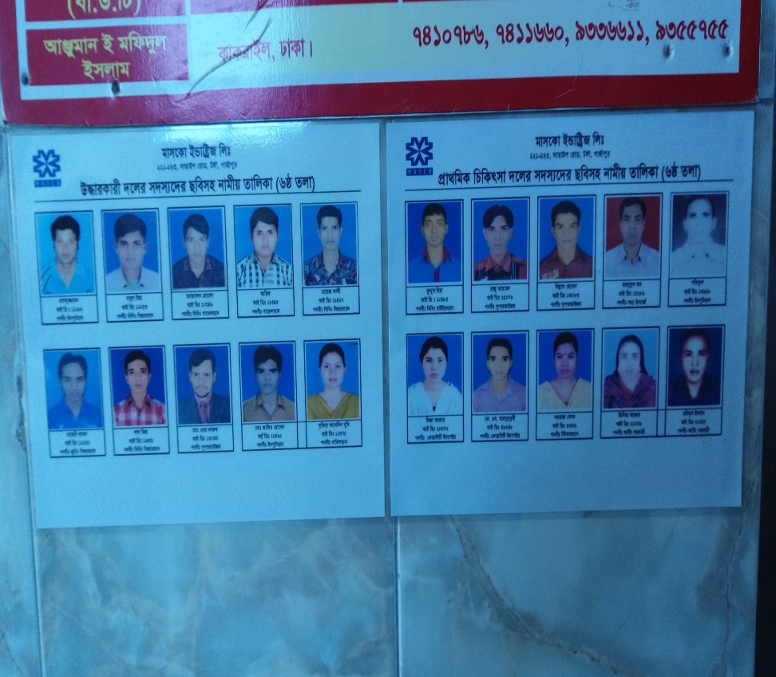
New Trained Fire Safety Workforce for Housing and Corporate Sector
Trained and certified fire rescue committee

Slide 20
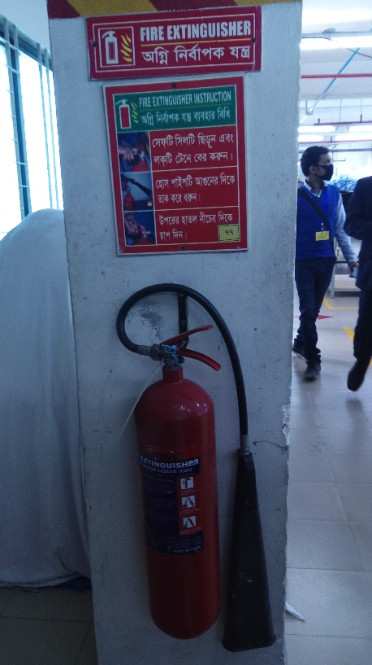
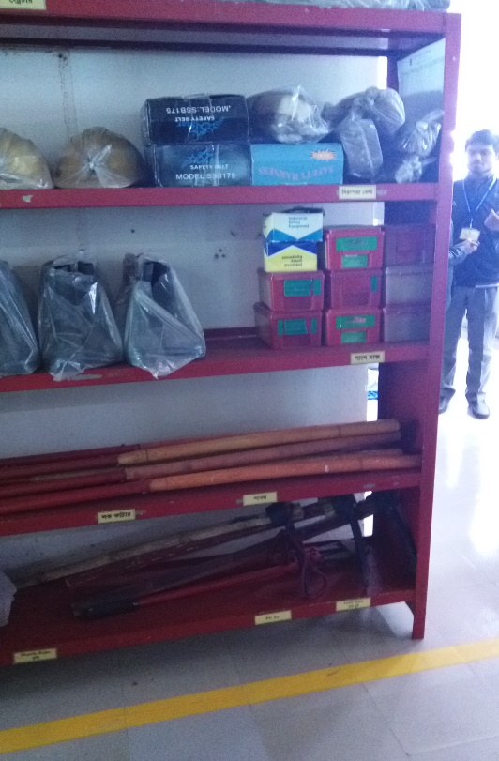
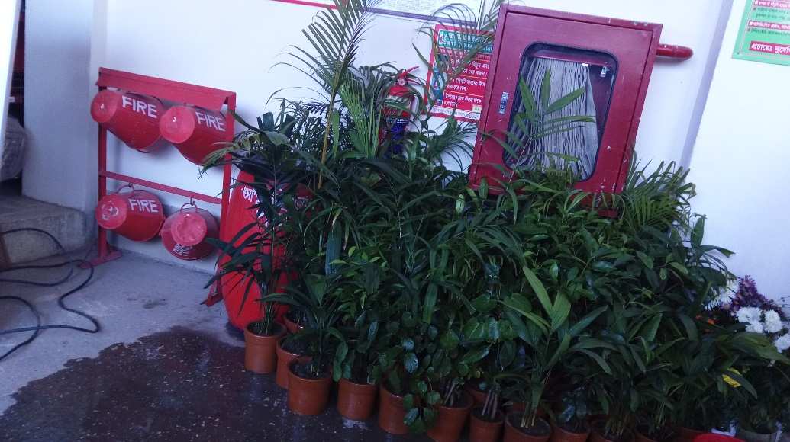
Safety Instruments Installations
Corporate sector safety instruments installation

Slide 21
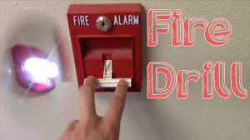
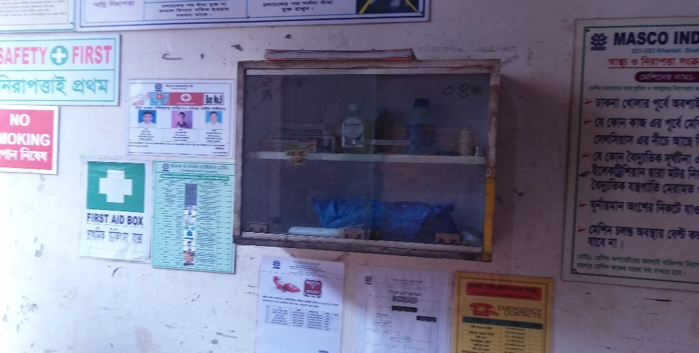
Safety Corporate Practices
Corporate practices
Fire Drill
First aid box
Rescue team work
Ultimate a safe work environment

Slide 22
Facilities for FSCD
Project Management Unit (PMU) control
Monitoring the full project
Remunerations for monitoring officers and PMU unit
Remunerations for trainers and masters trainers.
Remunerations for ISFM monitoring visit
Certification and declaration body
International training for officers (Singapore and Australia)
Branding opportunity for FSCD
Create public awareness

Slide 23
Basic Fire Safety Training
Sl. No. | Item | Cost in BDT
1. | Per Trainee Cost | 6000
 | Breakdown
 | Master ToT and ToT | 1000
 | Trainers Cost | 1000
 | Food and Travel, Venue | 1000
 | Materials (Development, Printing and Distribution) | 500
 | Online Class, Activities and CBLM Development | 500
 | Certificates and Remuneration | 1000
 | Publicity | 500
 | Overhead | 300
 | Others | 200
 | Total | 6000 per person
2. | Building Inspection, Testing and Commissioning | 50,000-100,000
3. | Foreign Training | Accommodated
4. | Feasibility Study | 5,000,000
5. | Awareness Development | Accommodated

Slide 24
Program Synopsis
Tenure of the Project | Total : 36 Months Starting Date: May 2020 Closing Dates: June 2023
Budget of the Project (Proposed)
Major expenditure of Budget (Proposed) | Pre-project cost: 5% Project procurement cost : 5% Project Implementation cost: 80% Overhead cost : 10% Total: 100% of total value.
Beneficiaries Target | Owner, tenant and renter Housemaid, guards, security persons and caretakers Office Staff Students, drivers, mothers and baby sitters or caregivers
Project Areas | 10 Important Housing Societies in Dhaka Metropolitan Areas
Further Extension of the Project Areas | All other 7 Metropolitans and City Corporations areas.
Project Procurement Method | Procurement Under Direct Procurement Method

Slide 25
Funding Sources
Fund for Project
Ministry of Home Affairs
Executing Department
Fire Service and Civil Defense Department
Implementing Partner
Sustainable Research and Consultancy Ltd. (SRCL)
Fund for Installation:
From Company Owner/Developer/Contractor
Bank
Building Owner
Market/Building Associations

Slide 26


