Slide 1
Software Requirements Specification
Web Application
on
Dawn Technology Bangladesh
Prepared By:
Md. Mehedi Hasan
ID: 1246913
Supervised By:
Md. Rajaul Islam

Slide 2
Project Requirements……
“Dawn Technology Bangladesh” wants to develop a desktop application to manage their pms along with the following facilities ………
Add & update their different categories of product;
Keep a record of their products information in details & update if needed;
Keep tracks of record of every purchase details;
Store sales record for different categories of product;
View their total sales quantity & available quantity of products.

Slide 3
Requirements Analysis…..
Create category of product
Keep product information in details
Save product purchase details
Store sales record
View available quantity of products
Summary of purchase & sales

Slide 4
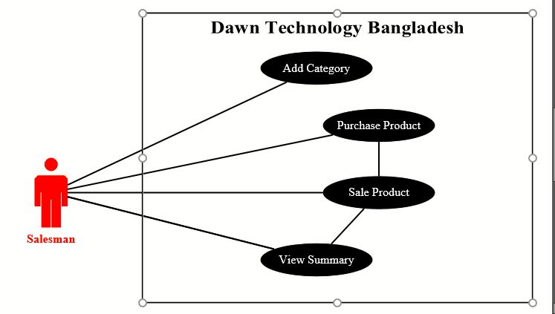
USE CASE DIAGRAM

Slide 5
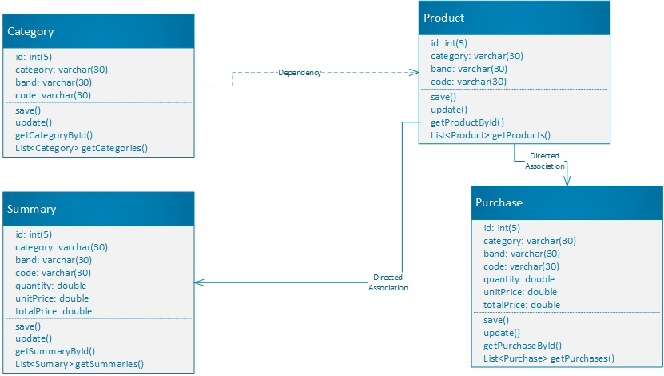
Class Diagram

Slide 6

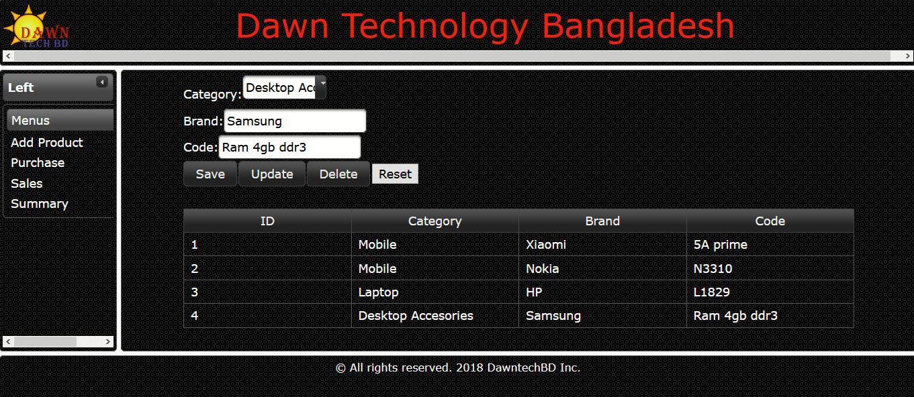
Project Description……

Slide 7

Project Description……

Slide 8
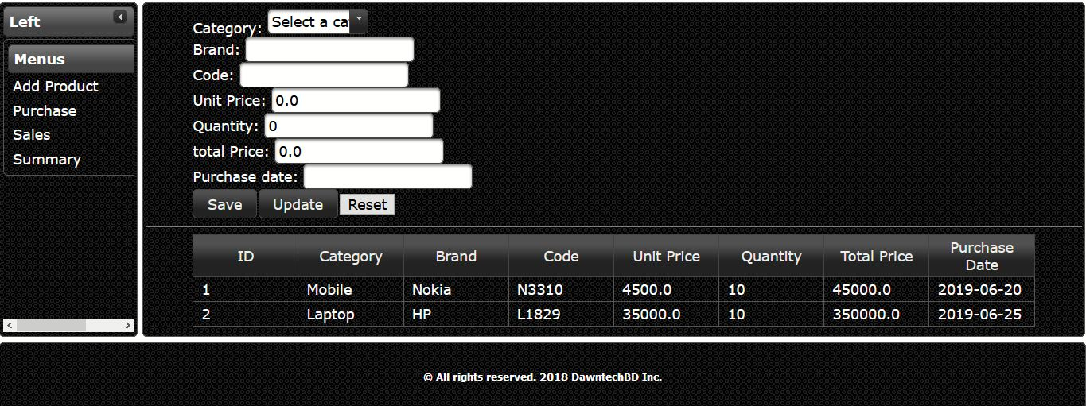
Project Description……

Slide 9
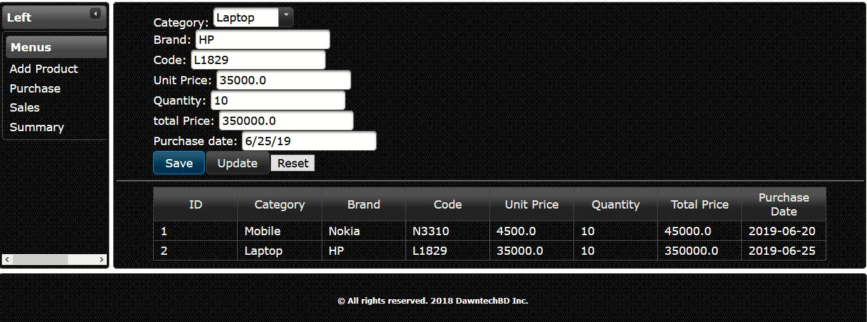
Project Description……

Slide 10
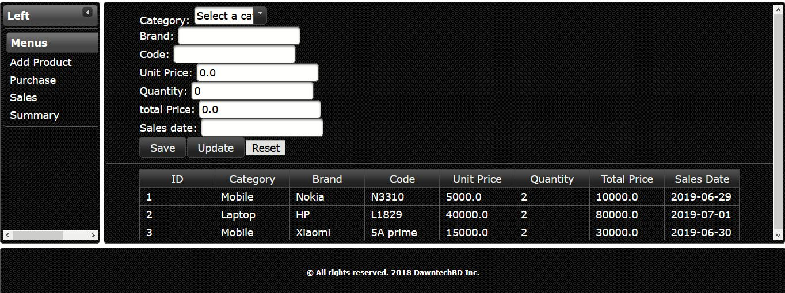
Project Description……

Slide 11
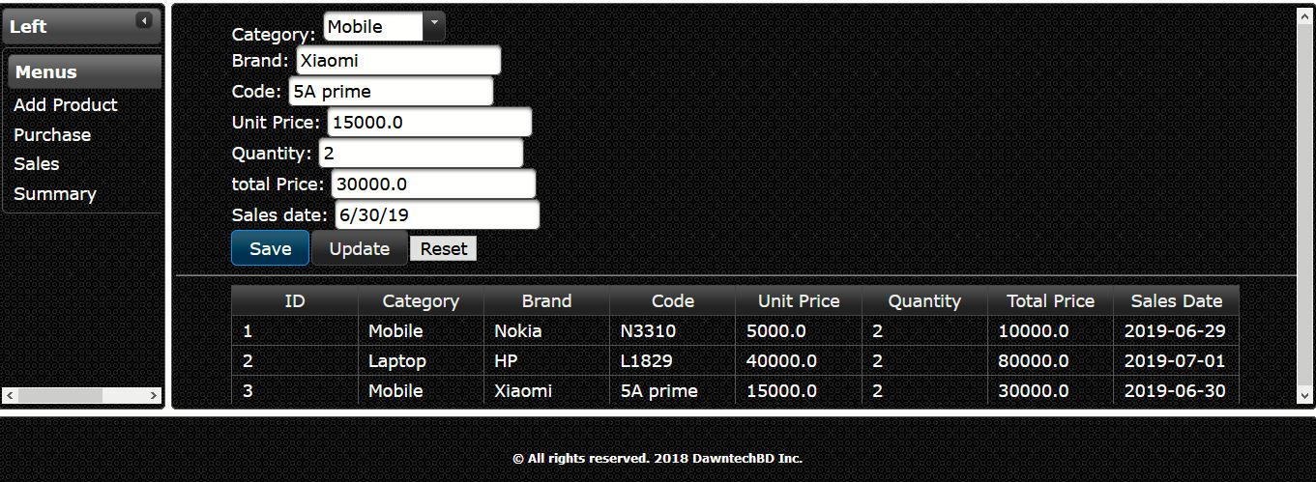
Project Description……

Slide 12
Thank You for Watching !!

