Slide 1
A Java Spring-Boot Project on Online Job Portal

Slide 2
A Brief Description of the Project:
Name of the Project: | Online Job Portal
Submitted To: | Md. Moshaidul Islam Consultant, IsDB-BISEW IT Scholarship Project 01711071219 moshaidul@showtellconsulting.com
Submitted From: | Md. Mehedi Hasan ID: 1246913 Round-39/J2EE
Instructor: | Md. Rajaul Islam
Mechanism Used: | Spring Boot, JDBC, MySQL
Contact Details: | +880-1717-677451 mhshuvo29@gmail.com

Slide 3

Project Story

Slide 4
I want to build an online based Job Portal website using Intellij_IDEA tool with Spring Boot java framework. It will have the following features:
There will be different types of roles like Admin, Applicant, User, Employer, Developer etc.
A user can create an account matching with their types of roles to fulfill their needs and demands
Users with employer role can post details advertisement for their vacant position with
- no of candidate
- job descriptions
- requirements
- location
- remuneration and benefits etc.
Employer can view the details of the applied applicants, applicants CV, company’s advertisement history with posting date and time
Employer can also post advertisement about workshops, trainings and different types of certificate courses
Users with applicant role can
- search jobs that matches their interest like: job category, location, organization type, deadline, salary range etc.
- view the details description of a job advertisement
- apply on the fly
- upload CV

Slide 5
Continue…………..
- email application with uploaded CV to the employer
- import information from the uploaded CV while applying for a position
- can subscribe for receiving the updated notification or newsletter when an advertisement is posted that matches their interest
A normal user with no specific role can view the ongoing job advertisement and professional training schedule
Users with developer role can make changes (like: edit, update, delete) to the application with the authorization and instruction of admin
Employer can also post advertisement about workshops, trainings and different types of certificate courses
Users with admin role will enjoy the ultimate power to make any kind of changes to this application like: granting roles, authorized permission to perform specific tasks, removing a role, ensuring the safety of the application and maintaining the privacy of information of the users

Slide 6
Entity Relationship

Slide 7
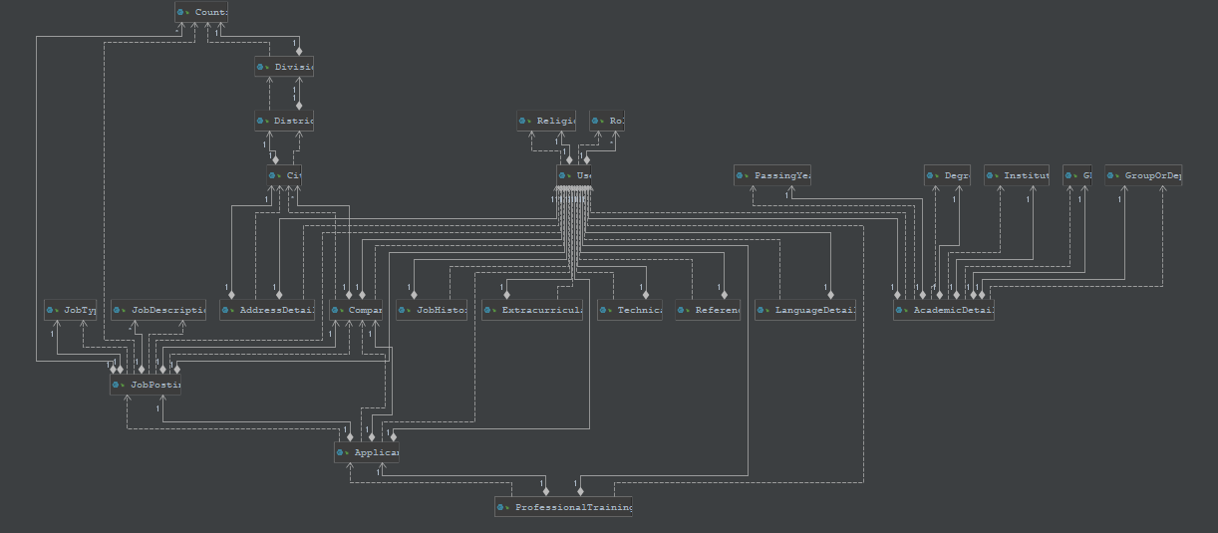

Slide 8
Class Diagram

Slide 9
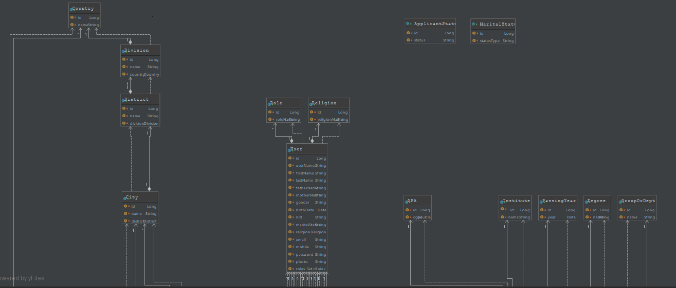

Slide 10
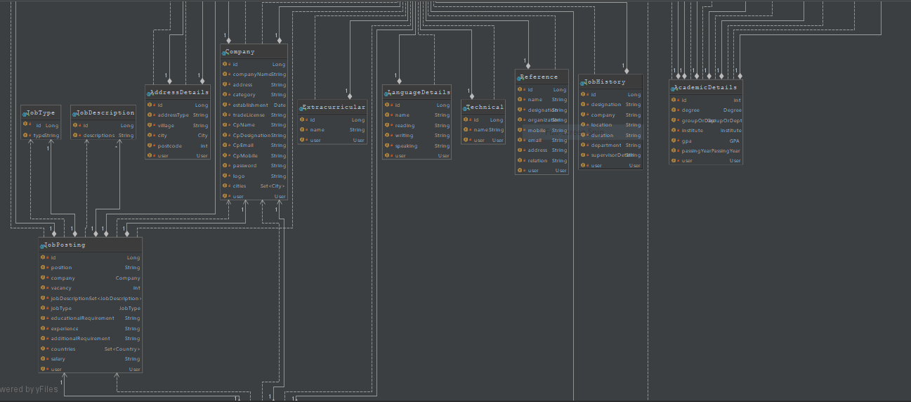

Slide 11
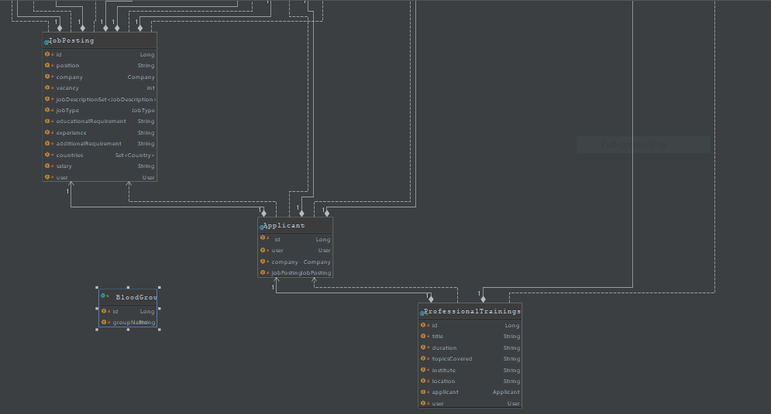

Slide 12
Use Case Diagram

Slide 13
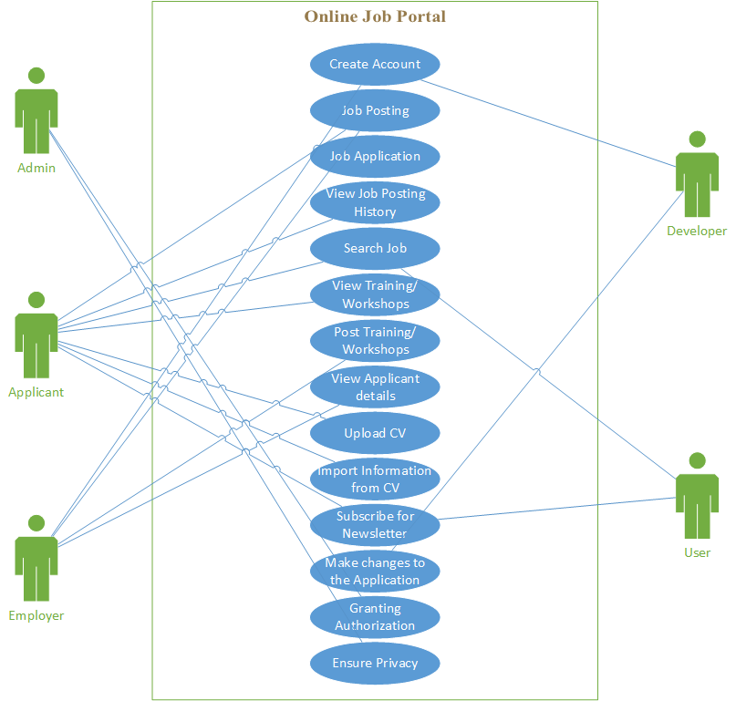

Slide 14
Project Prototype

Slide 15
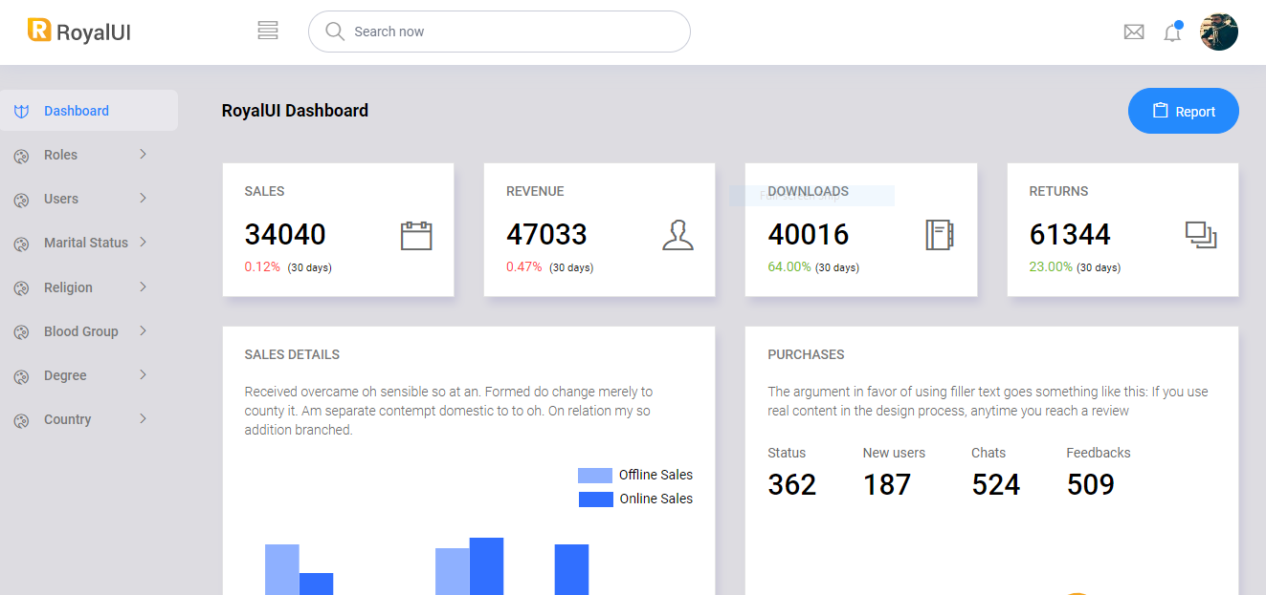
Admin Dashboard

Slide 16
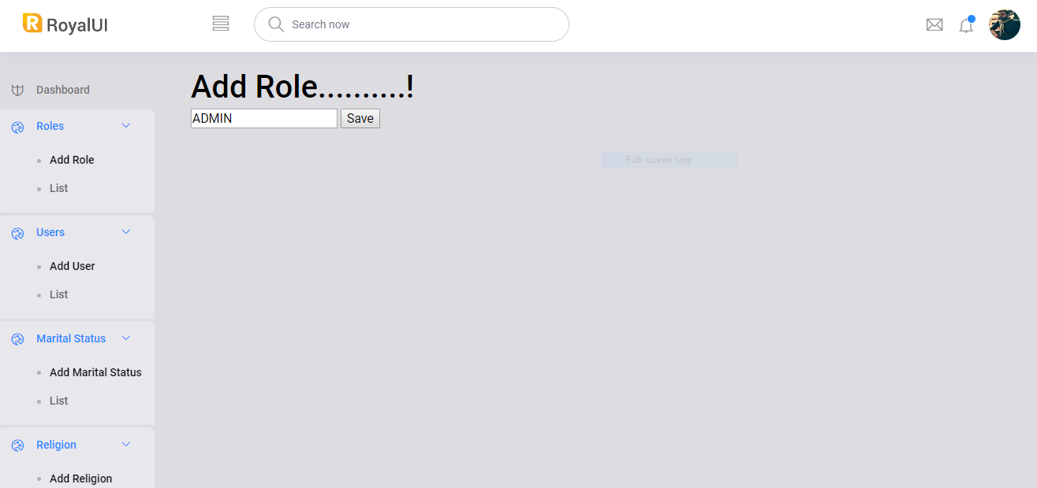
Add Role

Slide 17
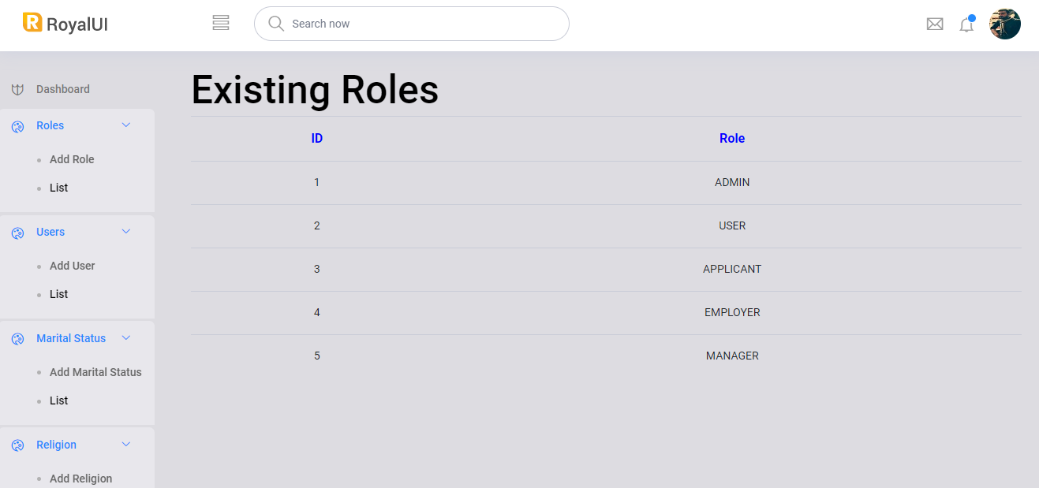
List of Roles

Slide 18
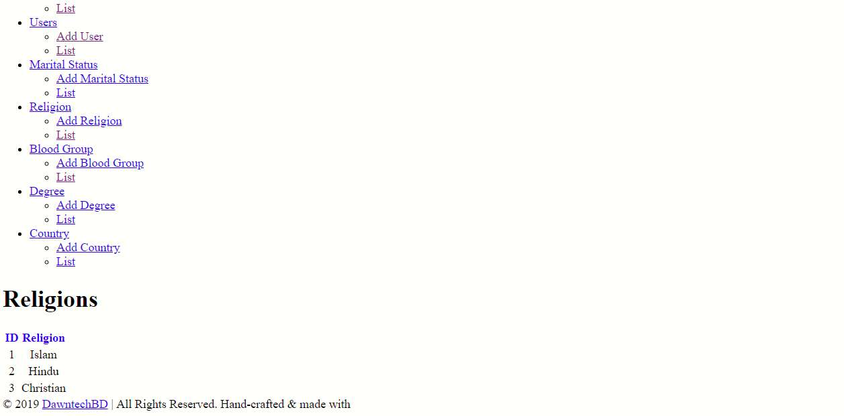
List of Religions

Slide 19
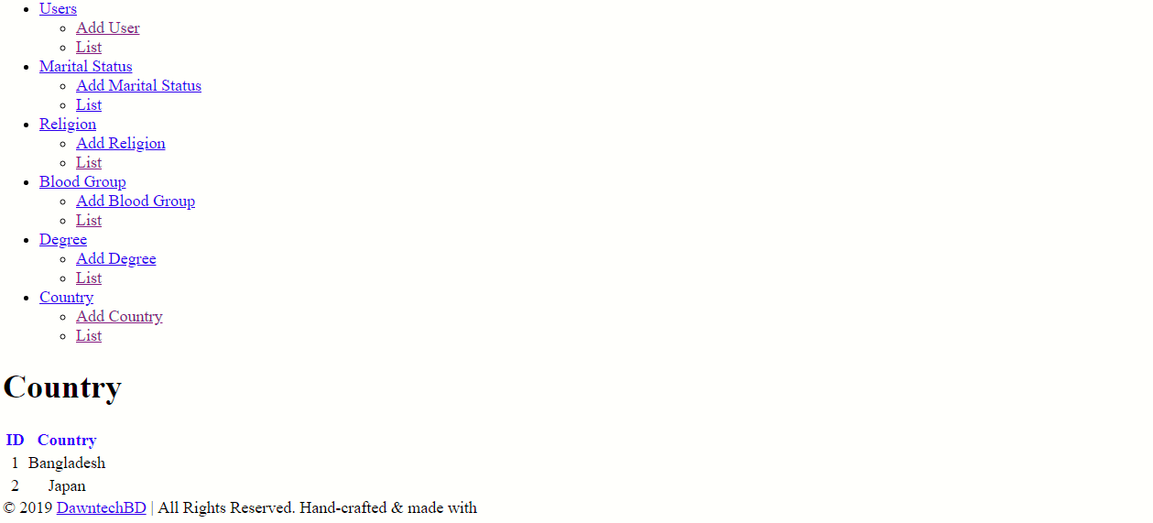
List of Countries

Slide 20
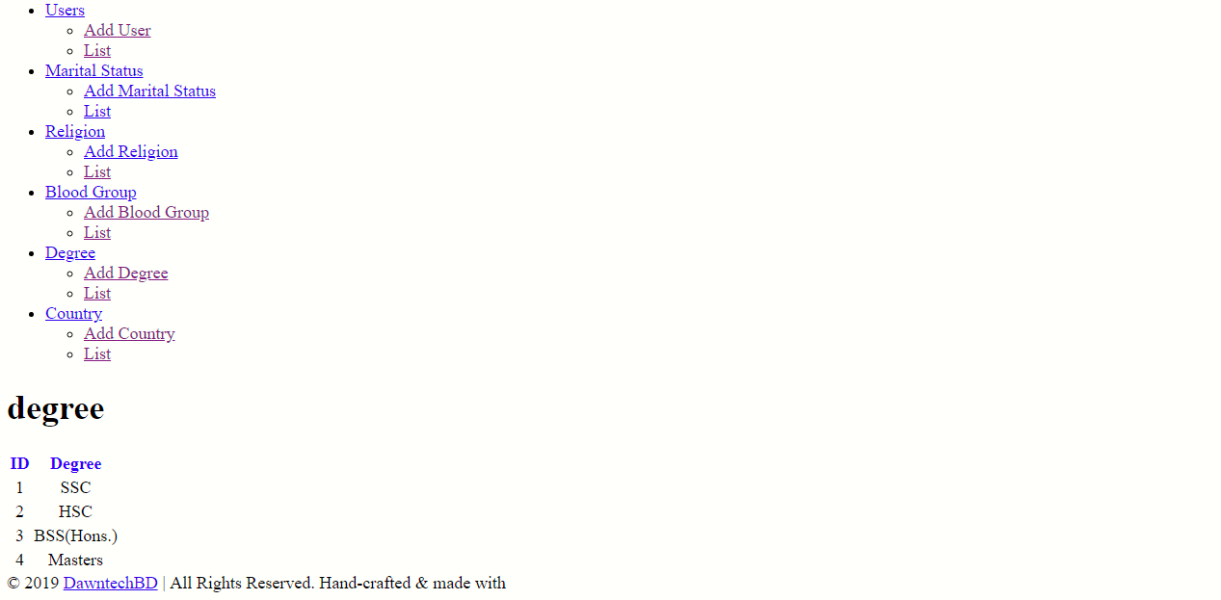
List of Degrees

Slide 21
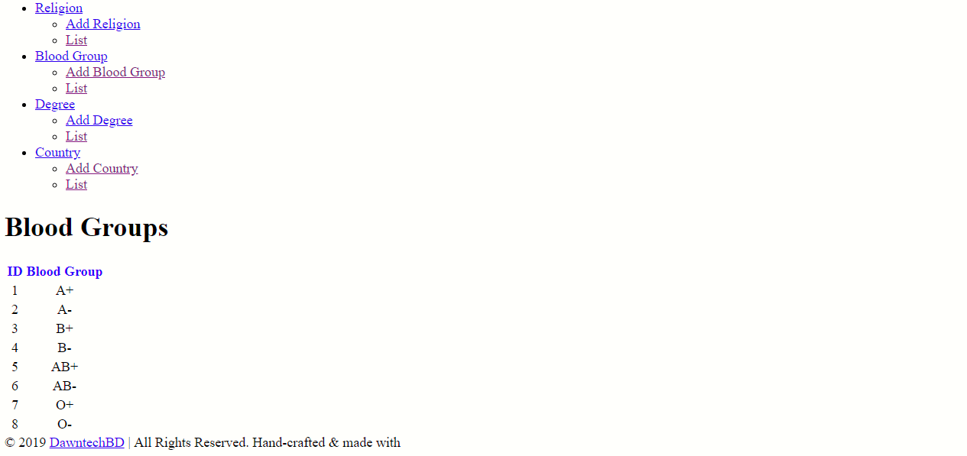
List of Blood Groups

Slide 22
The Project is not finished yet. Development is still going on……………………….!

Slide 23
Thank You Sir for Watching

