Slide 1
Software Requirements Specification
Project on Tailor Shop Management
Prepared By:
Md. Mehedi Hasan
ID: 1246913
Supervised By:
Md. Rajaul Islam

Slide 2
Project Requirements……
“Shuvo Tailor and Fabrics” wants to develop a desktop application where they can……
Add & update their different categories of product;
Keep a record of their clients information in details & update if needed;
Store & update body measurements of the clients for different categories of product;
Take order digitally with an auto generated invoice;
Search delivery date of an order by order id of that client;
Search client details by mobile number or email address;
View their total order taken in an specific date.

Slide 3
Requirements Analysis…..
Create category of product
Save client details
Store body measurements of the clients
Take order with auto generated invoice
Search delivery date
Search client details using mobile or email
Summary of total order by date

Slide 4
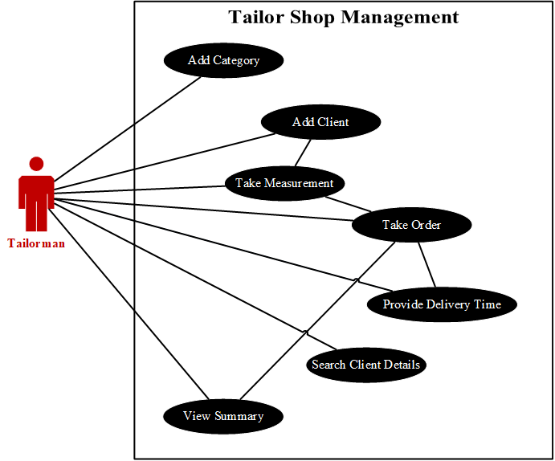
USE CASE DIAGRAM

Slide 5
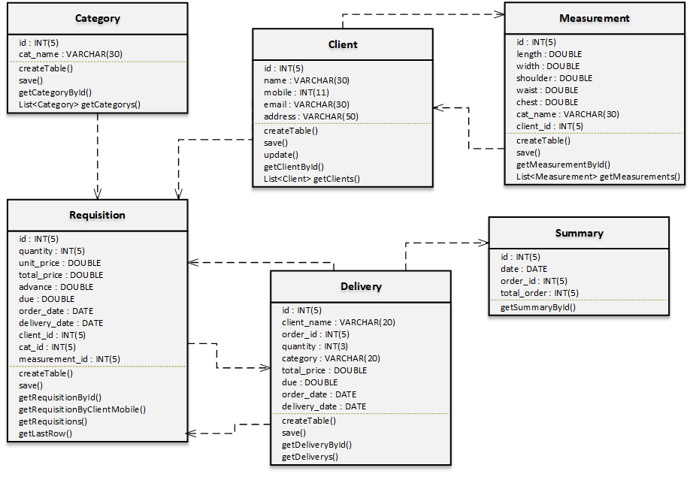
Class Diagram

Slide 6
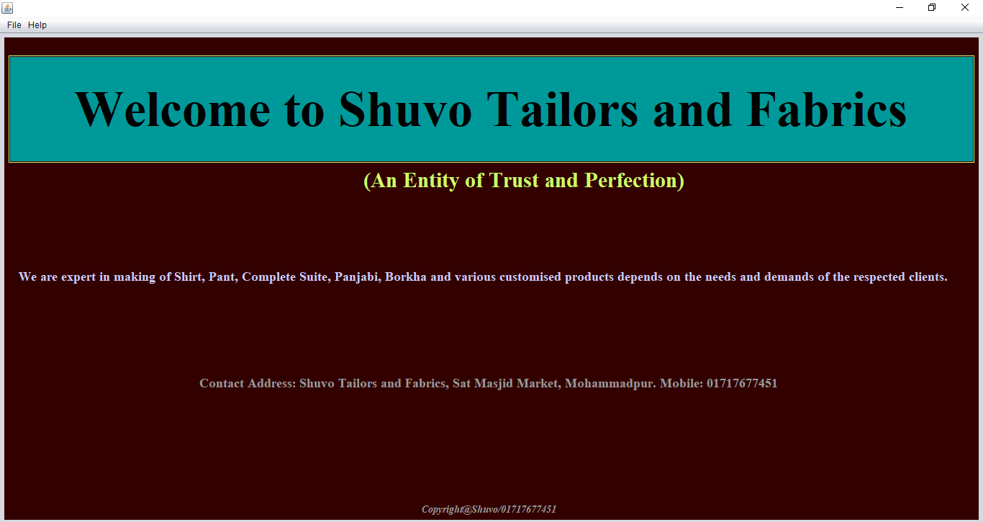
Project Description……

Slide 7
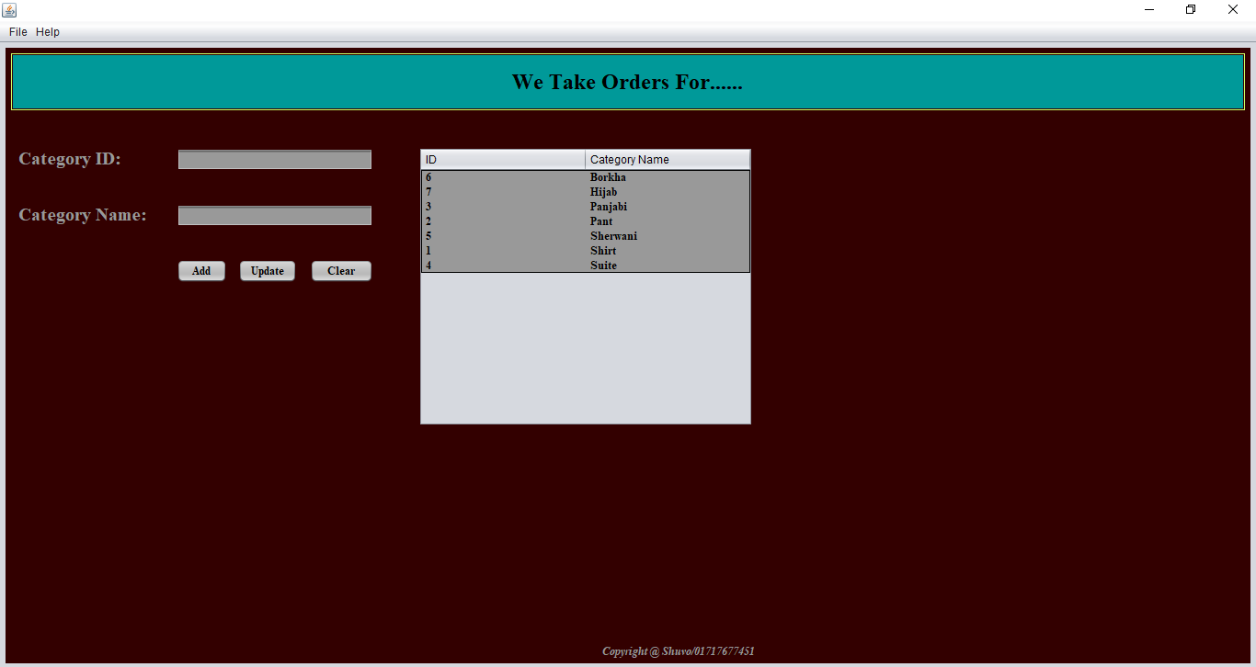
Project Description……

Slide 8

Project Description……

Slide 9
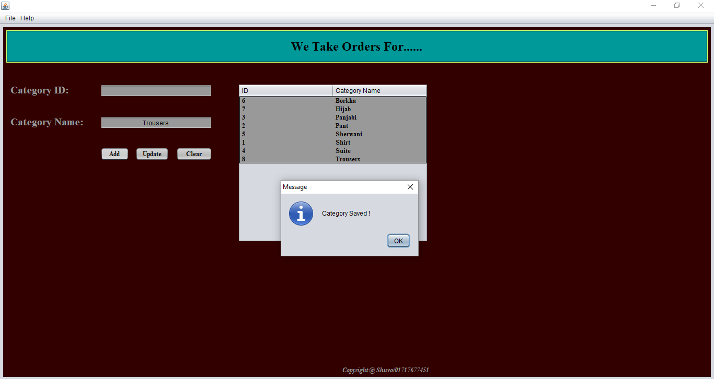
Project Description……

Slide 10
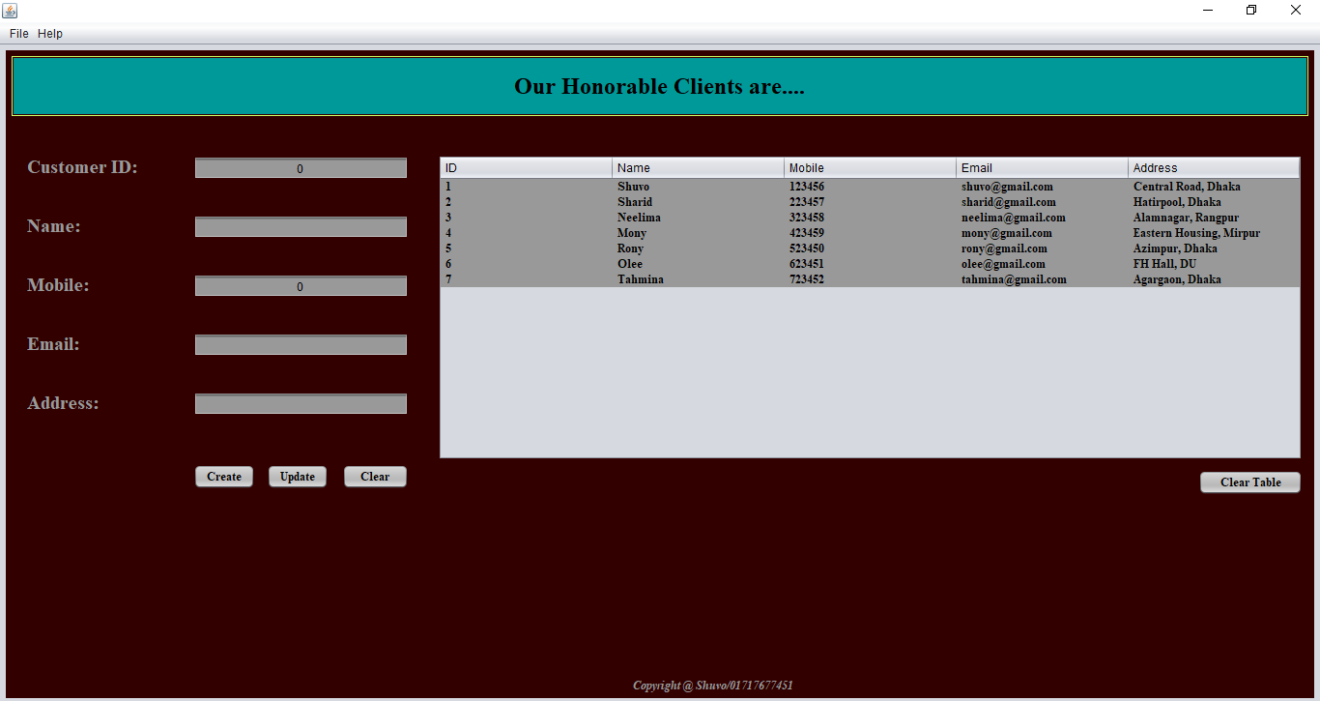
Project Description……

Slide 11

Project Description……

Slide 12
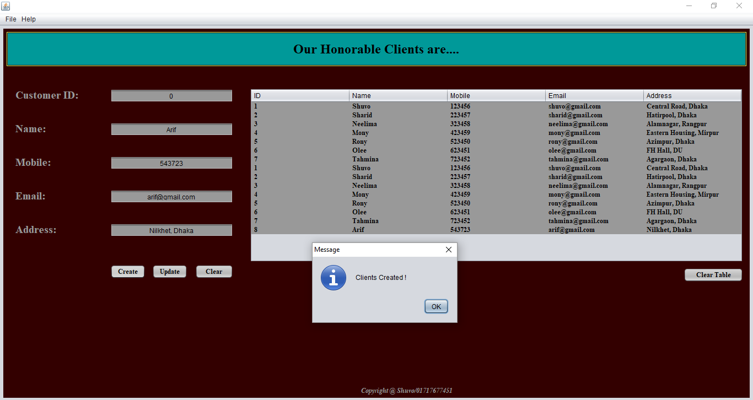
Project Description……

Slide 13
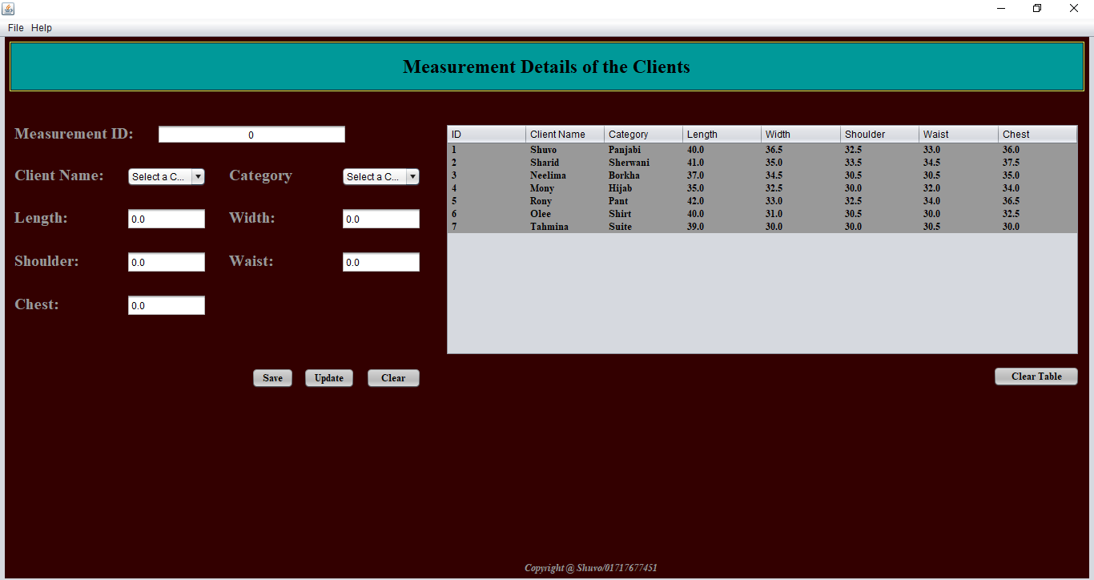
Project Description……

Slide 14
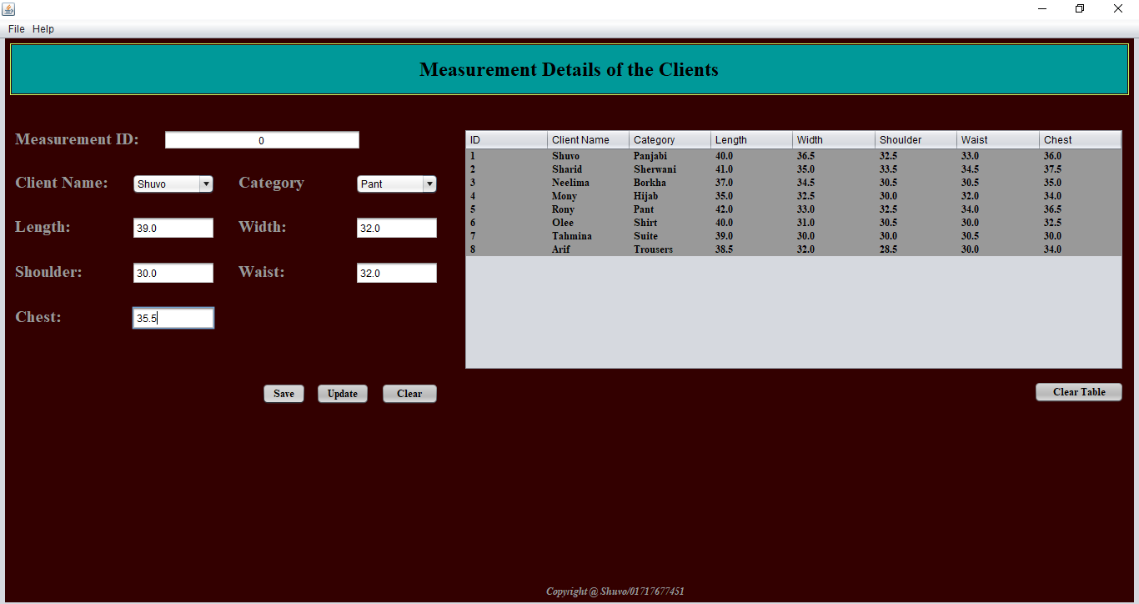
Project Description……

Slide 15
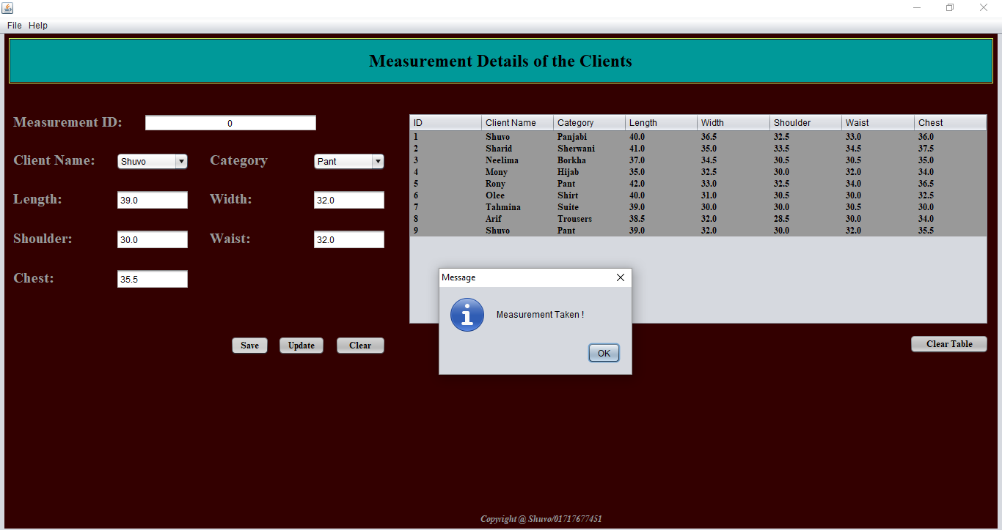
Project Description……

Slide 16
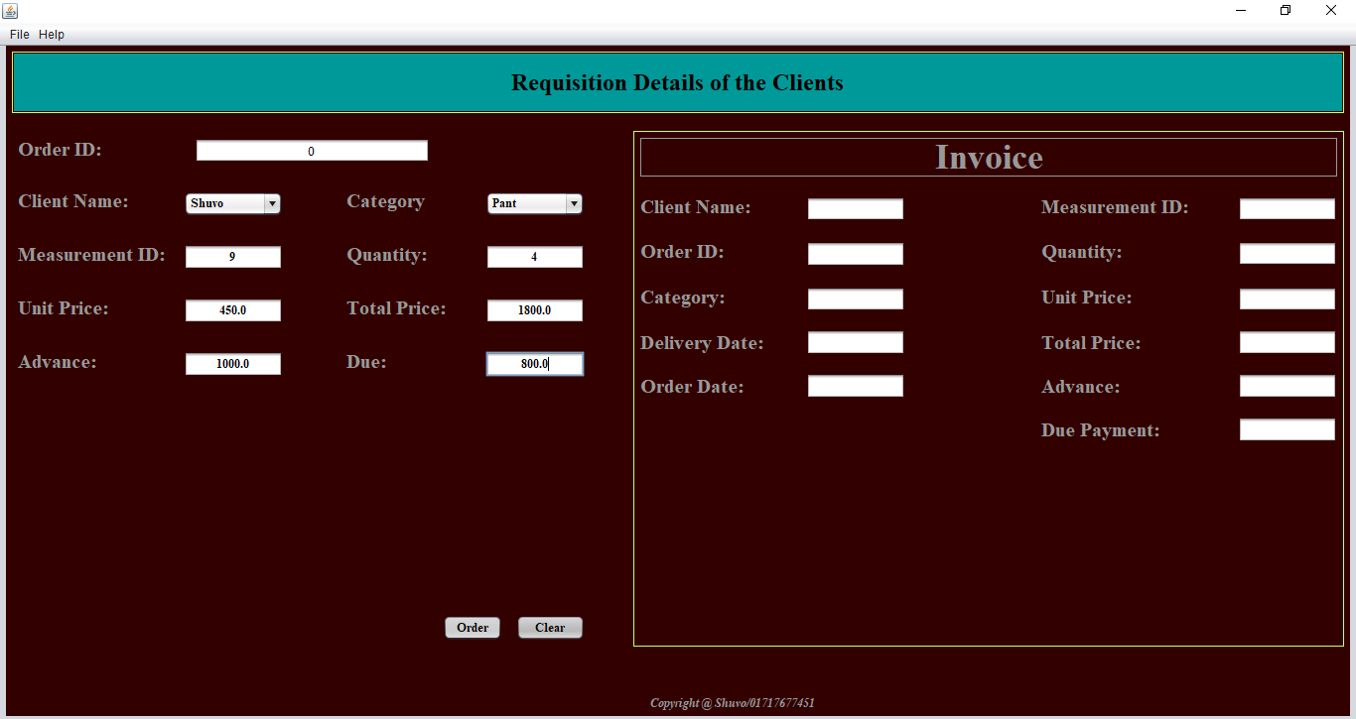
Project Description……

Slide 17
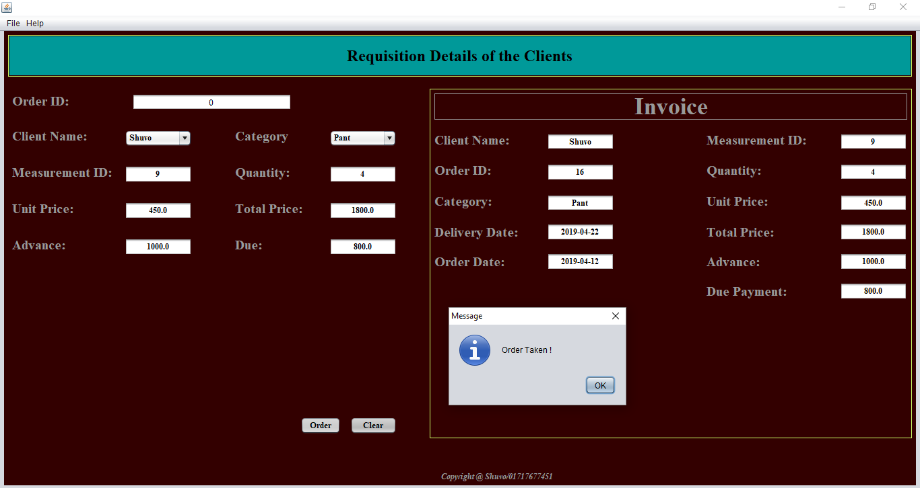
Project Description……

Slide 18
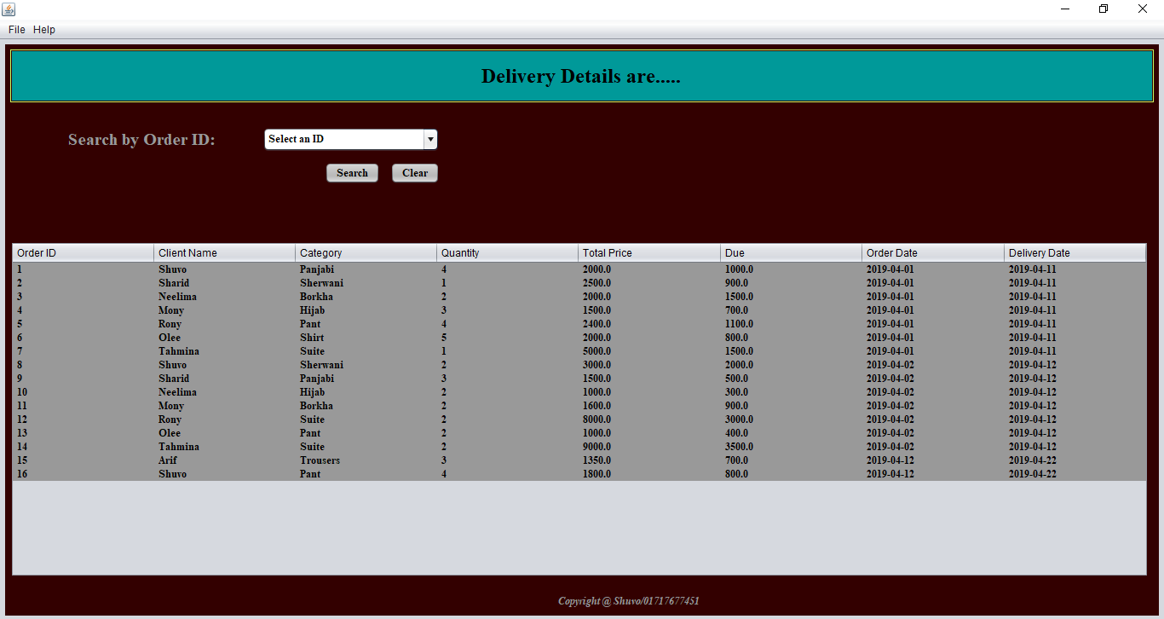
Project Description……

Slide 19
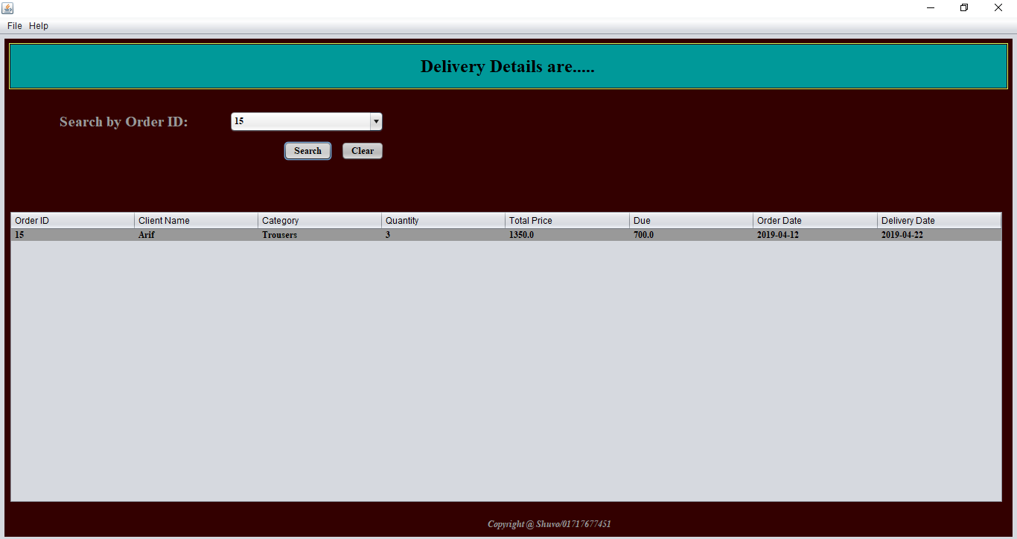
Project Description……

Slide 20
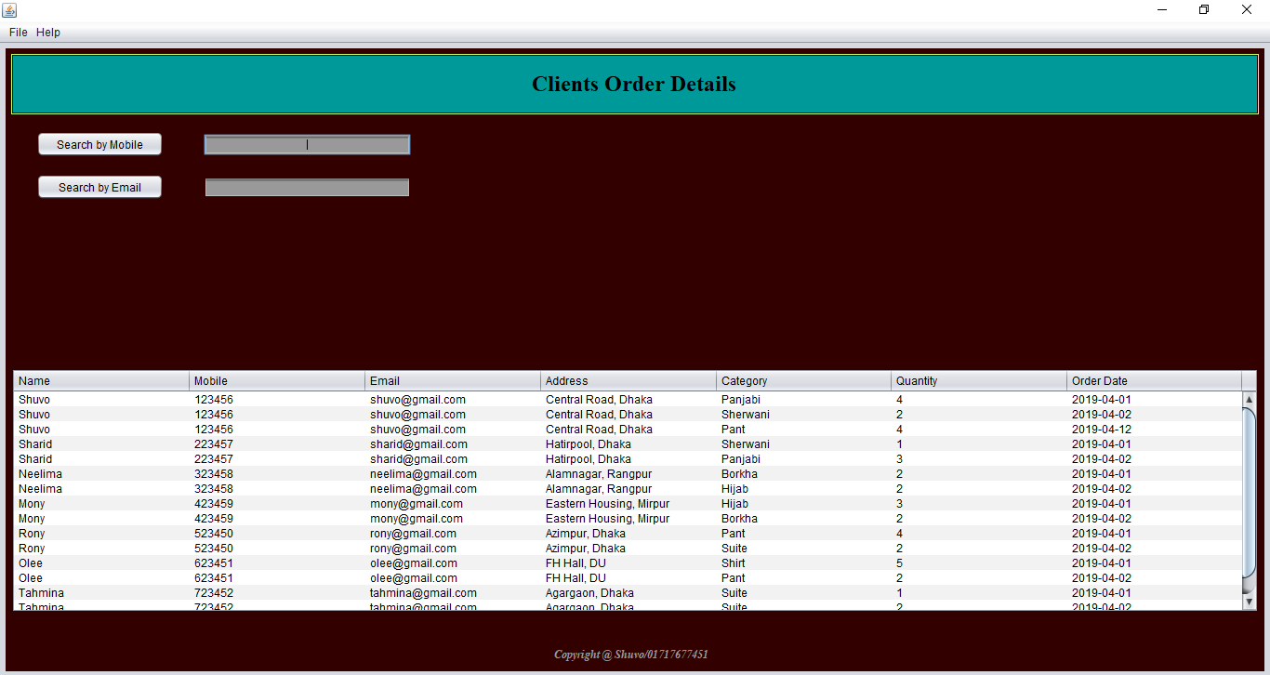
Project Description……

Slide 21
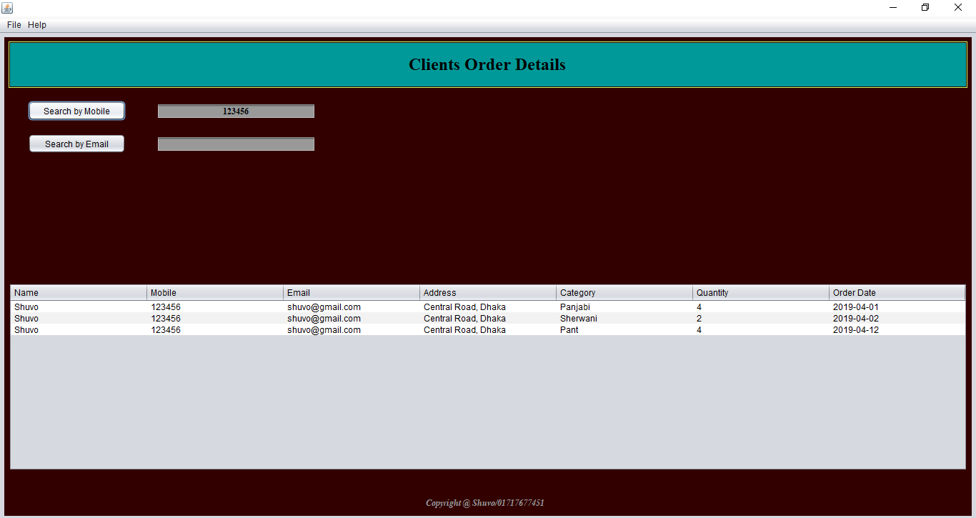
Project Description……

Slide 22
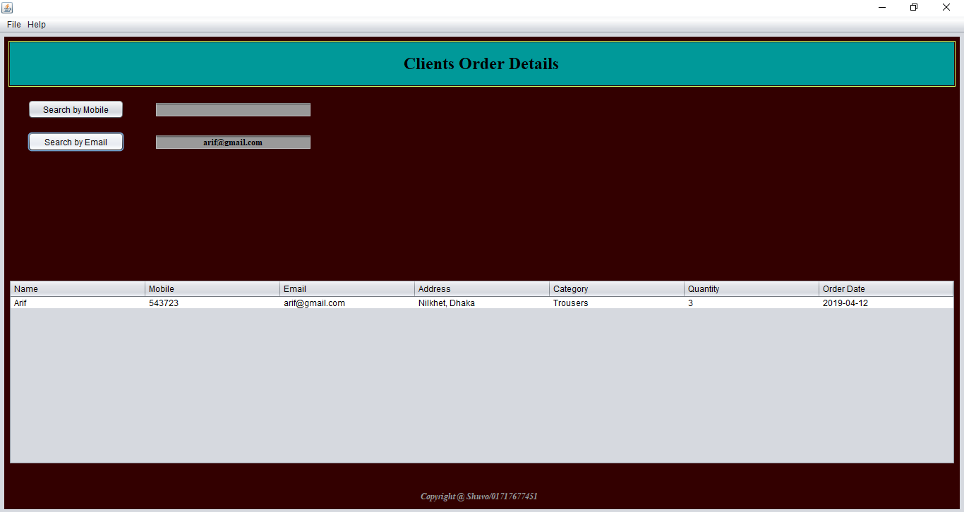
Project Description……

Slide 23
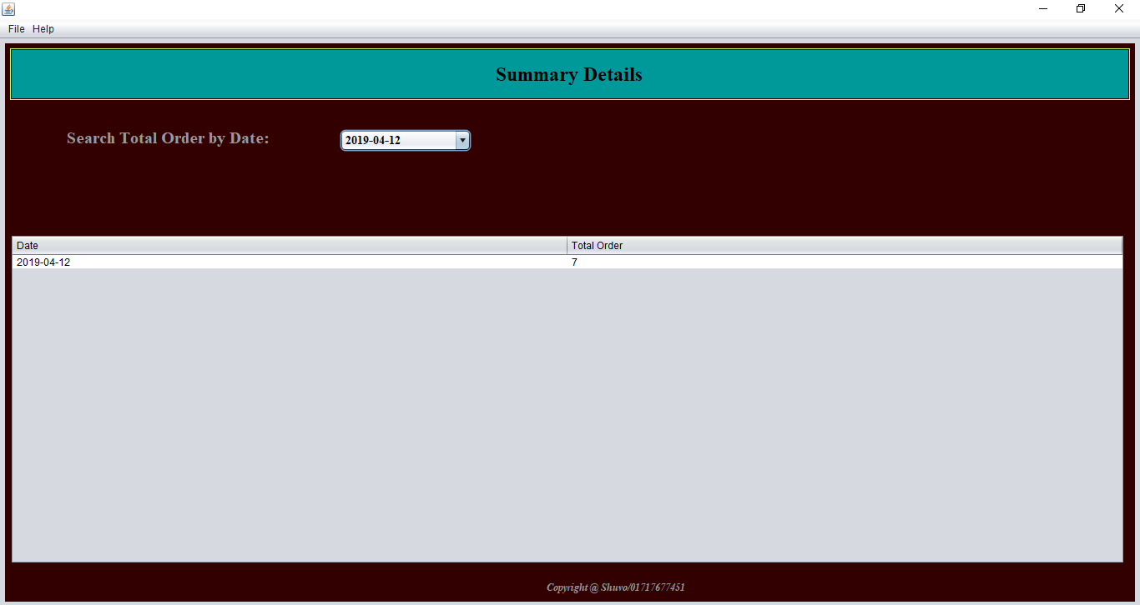
Project Description……

Slide 24
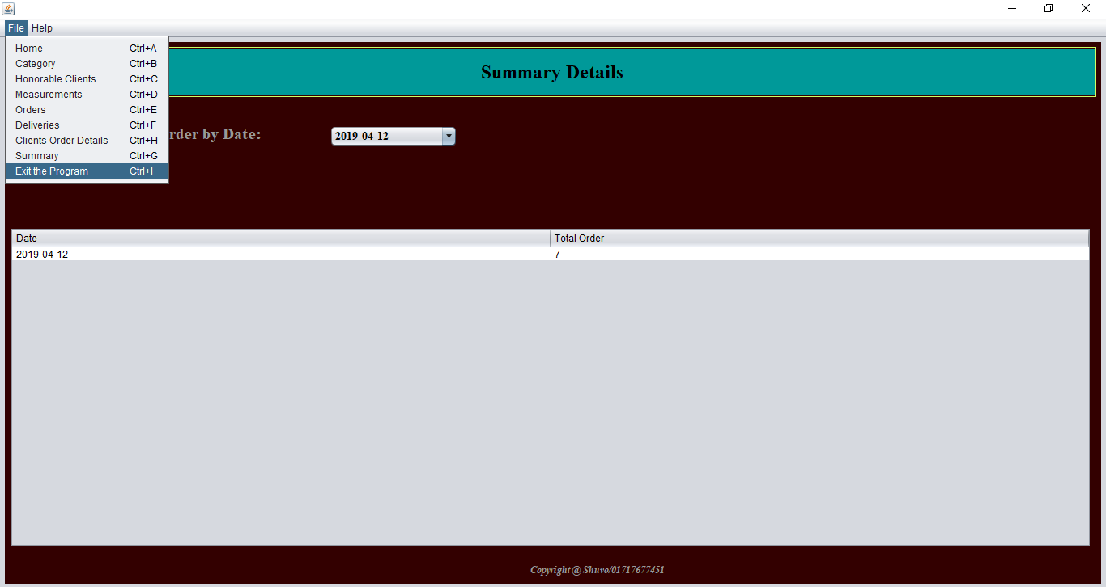
Project Description……

Slide 25
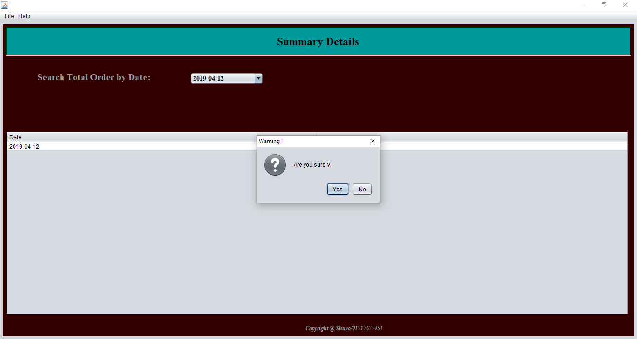
Project Description……

Slide 26
Thank You for Watching !!

