Slide 1
Software Requirements Specification
Project on Tailor Shop Management
Prepared By:
Md. Mehedi Hasan
ID: 1246913
Supervised By:
Md. Rajaul Islam

Slide 2
Project Requirements……
Client wants a

Slide 3
Requirements Analysis…..

Slide 4
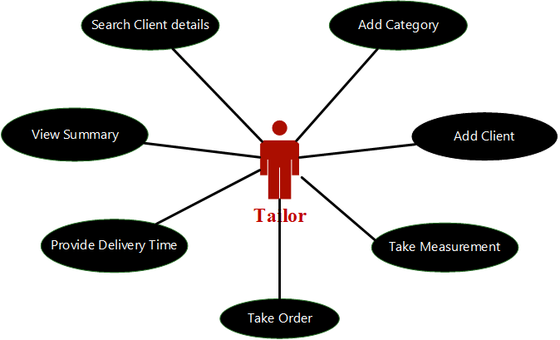
USE CASE

Slide 5
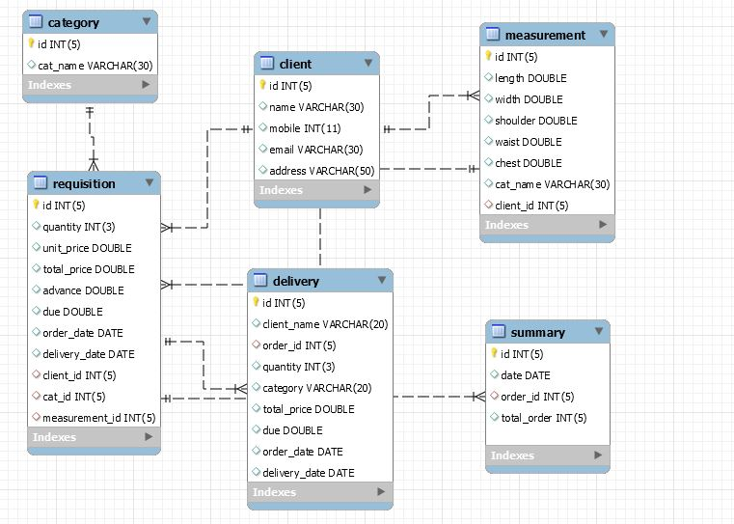
Class Diagram

