Slide 1



Bangladesh Army University of Engineering and Technology
Group-6
Submitted By:
Adib Arman Shuvro-18204004
Md Faisal Hossain Khan-18204034
Ishaat Rahman Dipu-18204048
Mohammod Shahriyar Ishmam-18204057
Sumaiya Islam Mim-18104048
Tanmim Islam-17204065
Submitted To:
Md. Muktar Hossain
Senior Lecturer of Dept. CSE,BAUET
Mithun Kumar
Senior Lecturer of Dept. CSE,BAUET
Bristi Rani Roy
Lecturer of Dept. CSE,BAUET

Slide 2

1 8.04.21
Outline
Page No. 2
Page No. 10
Project Title
Drawbacks
Page No. 3
Introduction
Page No. 11
Future Work
Page No. 4
Objective
Page No. 11
Conclusion
Page No. 5
Analysis
Use Case Diagram
Page No. 6
Page No. 7
Class Diagram
Page No. 8
Project Demonstration
Page No. 9
Benefits

Slide 3
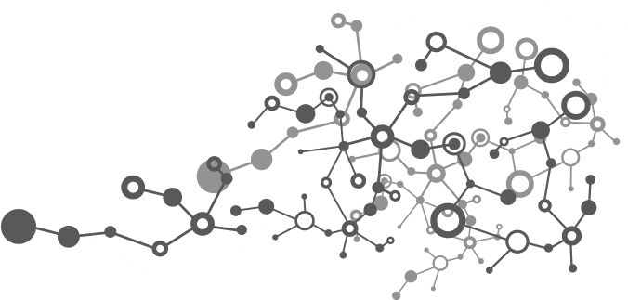
2 8.04.21
Face
Attendance

Slide 4
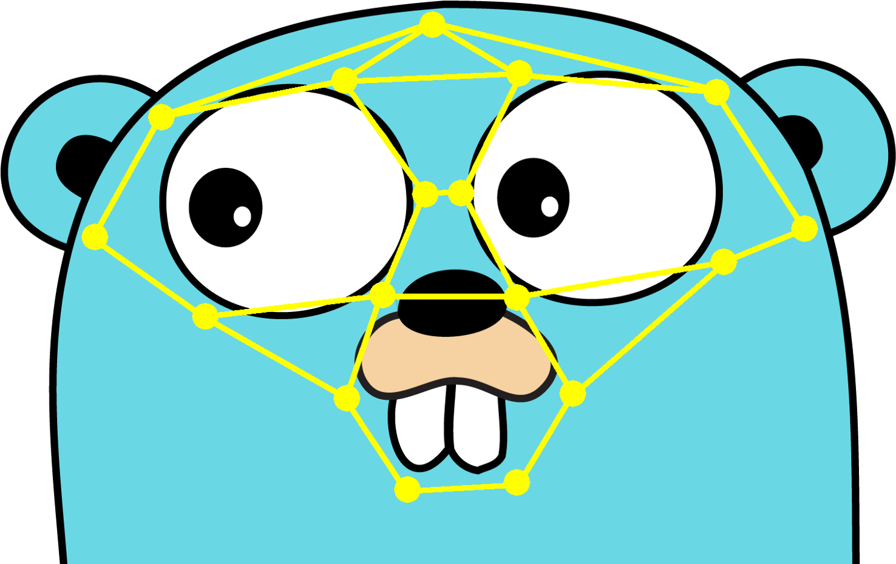

3 8.04.21
Introduction
Our Project is about attendance which is done by facial recognition. Its purpose is to make things easier in day to day virtual classes. As it’s playing a Vital role we chose our project because we saw taking attendance by roll call takes a lot of time and it is somewhat complex because it is done in virtually. So we have come into an idea so that they could show their faces and give their attendance and it is less time consuming to the teachers also to the students. By using facial recognition method we were able to achieve this process.

Slide 5

4 8.04.21
Objective
Our main goal is to save more time and make things easier. We want to make a virtually secured attendance system which is complex to implement in real world. Our project would solve a common problem in virtual classes and also it is secure. As we can see, as a student when a teacher takes attendance virtually it takes a lot of time and also some of the student joins late and says to give them attendance, by doing that the teacher, also the students loses concentration of reading a topic and it is very important to be attentive in class. Although this is not a big issue but, it remains a common problem in every virtual classes. Some of them gives proxy ID in the chat box by logging into another ones account so, it is kind of headache to take attendance all at a same time. That's why we came up with an idea which will solve this problem and also will make things easier.

Slide 6

5 8.04.21
Analysis
When we started working on this project we looked for various different methods in YouTube and also some research papers.We came into conclusion that the method we are going to use was CNN or Convolutional Neural Network.But it was taking too many face data to train in a single model. So we approached a different method by using the "Face Recognition"method in python library.This method takes just one face data and calculate it's facial distances and trains with just a single image data by data augmentation and when we show our faces in real time the software identifies and detecs the same faces as we have inputed.This makes our work a whole lot easier and very very less time consuimg and also accurate and after identifying faces this gives Attendance and can be saved as csv file.
This procedure will be shown in Use Case Diagram, Class Diagram.

Slide 7
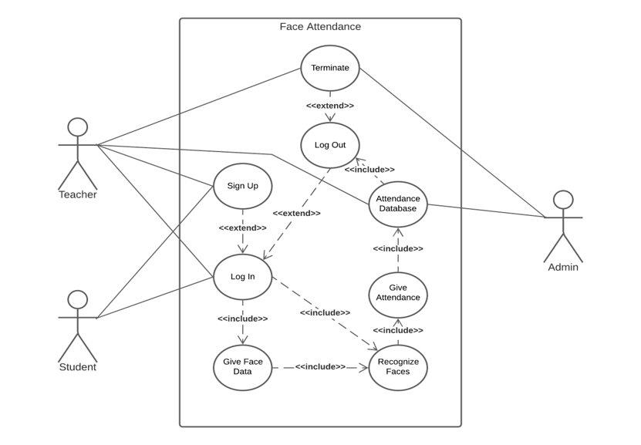
6 8.04.21
Use Case Diagram

Slide 8
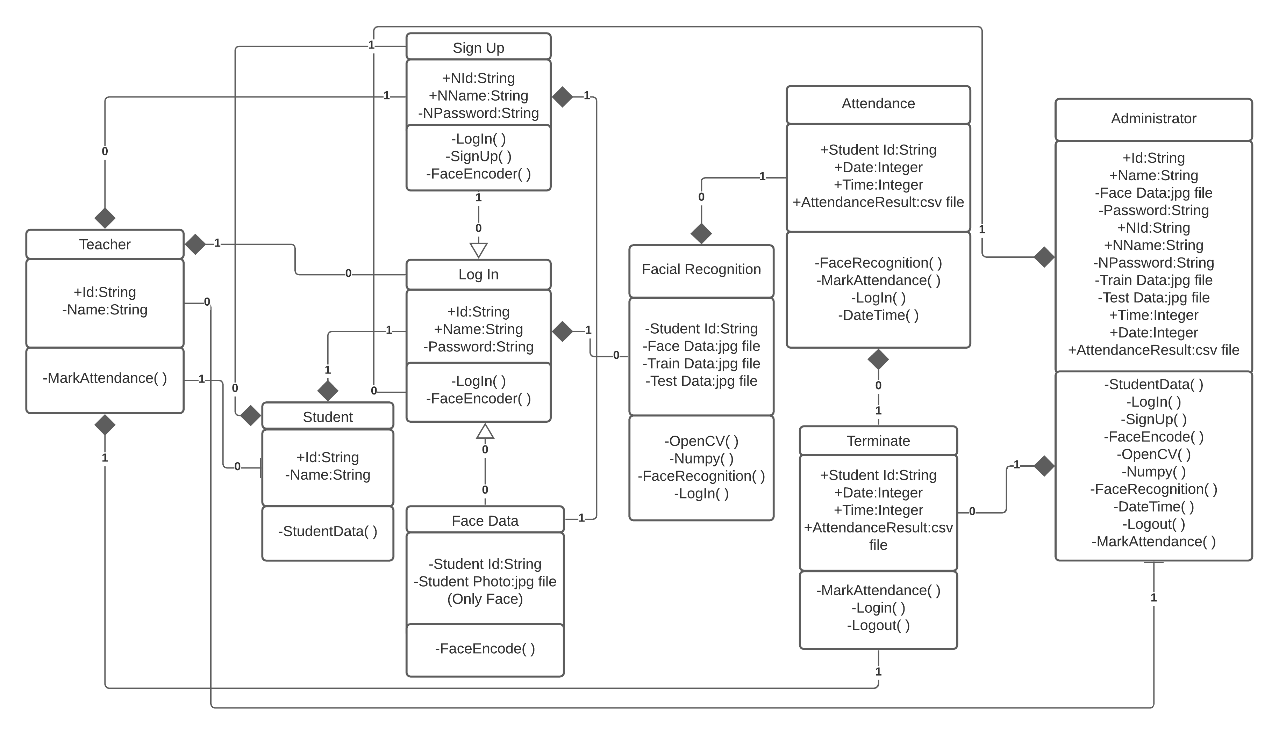
7 8.04.21
Class Diagram

Slide 9
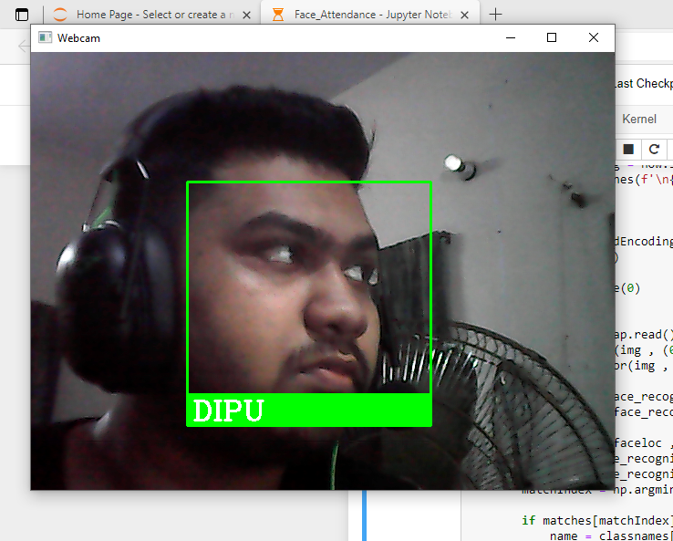
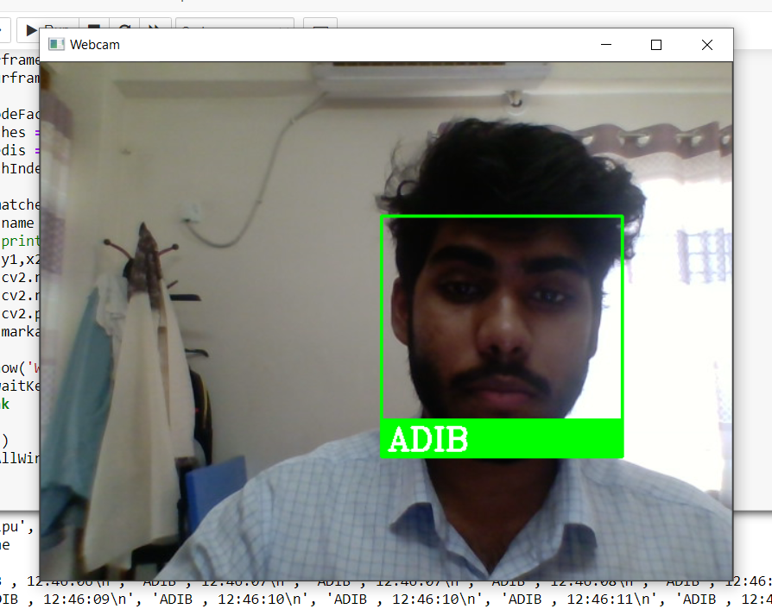
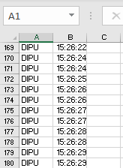
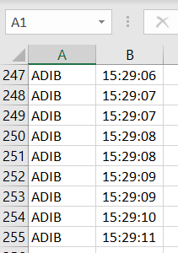
8 8.04.21
Project Demonstration
Face Recognizing(Dipu)
Face Recognizing(Adib)
Adding Attendance as csv file by facial recognition(Dipu)
Adding Attendance as csv file by facial recognition(Adib)
(Note: This was all done in real time . The faces were added as a data. This is just a demo.)

Slide 10

9 8.04.21
Benefits
1.It saves a lot of time in taking attendance.
2.Good way to hold concentration.
3.Creates less noise.
4.There is no scope of giving proxy.
5.Easier way to have attendance management system.
6.Performance will be monitored strictly.
7.Control more participants at the same time.
8.Attendance will be stored as csv file and only to the teacher.
9.It's a really good way to reduce time as well as giving more time in taking classes.

Slide 11

10 8.04.21
Drawbacks
Although our project ran, we faced many drawbacks here are the points of our drawbacks:
1.It takes a lot of library installation just to run this code.
2.The software gives attendance to the photo shown in mobile phone as well as real time face.
3.The csv file attendance prints every time and date to a single person but we want just one printed name and date time.
4.This is still code version not an application based software.
5.The fps(Frames per second) is low.
6.Cross platform implementation is complex yet fixable.
7.Face won't recognize in the darkest or blurry area.

Slide 12

11 8.04.21
Future Work
As we progress through this project,there are some things that we want to include in our project:
1.Make Voice Attendance(Added feature to Face Attendance).
2.Include Voice Background remover.
3.Make it as a WebApp.
4.Increase the rate of fps(Frames per second).
5.Add mask recognition feature.
6.Make it marketable.
Conclusion
Lastly, we want to add,the group cooperation was very good.There might be issues running this project,some code bugs,but it was fixed due to our awareness.We got help from Google, YouTube, GitHub and mostly from group works and ideas.
There is a saying that,"Little things make big changes" we started something small and hopefully we will make it big.
By the grace of Almighty, our teacher helped us to see through this project and we are very lucky to have them.

Slide 13

Thank you

Slide 14

Any Questions?

