Slide 1
Will it burn?
PLACEHOLDER · NASA footage of a flame in microgravity
Video: NASA
Notes:
Script section 1 · 0:00–0:12 · 12 s on screen
Narration (script draft 2):
A fire starts inside a spacecraft. Without gravity, flames look and act differently. So how do you know if something will burn up there?

Slide 2
Team Polaris
Dhaka, Bangladesh
Shamimul Shimul
Soleman Hossain
Team lead
Product lead
Iman Ahamad
Sara Rahman
Computer vision developer
Scientific researcher
Sihab Mahmud
Faisal Mahmud Abir
Tech development and design
AI engineer
Notes:
Script section 2 · 0:12–0:42 · 30 s on screen
Narration (script draft 2):
For centuries, sea explorers have found their way by looking up at Polaris, the North Star. We, Team Polaris, are building an interactive tool that gives space explorers direction on fire safety. From Dhaka, Bangladesh, we have Shamimul Shimul, team lead. Soleman Hossain, product lead. Iman Ahamad, computer vision developer. Sara Rahman, scientific researcher. Sihab Mahmud, tech development and design. And Faisal Mahmud Abir, AI engineer.

Slide 3
PLACEHOLDER
Team photo: all six members
Team Polaris · Dhaka, Bangladesh
Notes:
Script section 2 · 0:42–0:44 · 2 s on screen
No narration on this slide.

Slide 4
Gravity changes how things burn
17% O₂
PLACEHOLDER
NASA image: the ISS
Credit: NASA
In orbit, acrylic rods kept burning
18% O₂
On the ground, rods of the same
sizes couldn’t stay lit
Source: Scientific Reports (2018), “The Effect of Gravity
on Flame Spread over PMMA Cylinders”
Notes:
Script section 3 · 0:44–1:02 · 18 s on screen
Narration (script draft 2):
In a spacecraft, a fire has nowhere to go, and neither does the crew. And gravity changes how things burn. In orbit, acrylic rods kept burning at 17% oxygen. On the ground, the same rods couldn’t stay lit at 18%.

Slide 5
The next homes in space are different
Moon base
PLACEHOLDER
NASA concept art: a Moon habitat
Credit: NASA
1/6 g
of Earth’s gravity (0.17 g)
34% O₂ at 8.2 psi
cabin air NASA has studied
Sources: NASA evidence report (2015), NTRS 20150021491
1/6 g (0.17 g): standard value, as used in the app
Notes:
Script section 3 · 1:02–1:18 · 16 s on screen
Narration (script draft 2):
The next homes in space are different again. A Moon base has one-sixth of Earth’s gravity, and NASA has studied cabin air with 34% oxygen. So an engineer has to ask: does any real test cover my cabin?

Slide 6
NASA Space Apps 2026
Flame in Freefall:
AI-Powered Fire Safety Insights
from Microgravity Combustion Data
Notes:
Script section 4 · 1:18–1:29 · 11 s on screen
Narration (script draft 2):
Our challenge is Flame in Freefall. It asks for a tool that summarizes, ranks and interprets NASA’s microgravity fire findings, for human space exploration.

Slide 7
Will It Burn?
Your question
Check against NASA’s tests
Answer
“Will acrylic burn on the Space Station?”
BASS-II fire tests, flown on the Station
Burned
No data
Notes:
Script section 5 · 1:29–1:42 · 13 s on screen
Narration (script draft 2):
Our answer is Will It Burn? You ask a question in plain English, like: will acrylic burn on the Space Station? We check it against NASA’s BASS-II fire tests, flown on the Station.

Slide 8
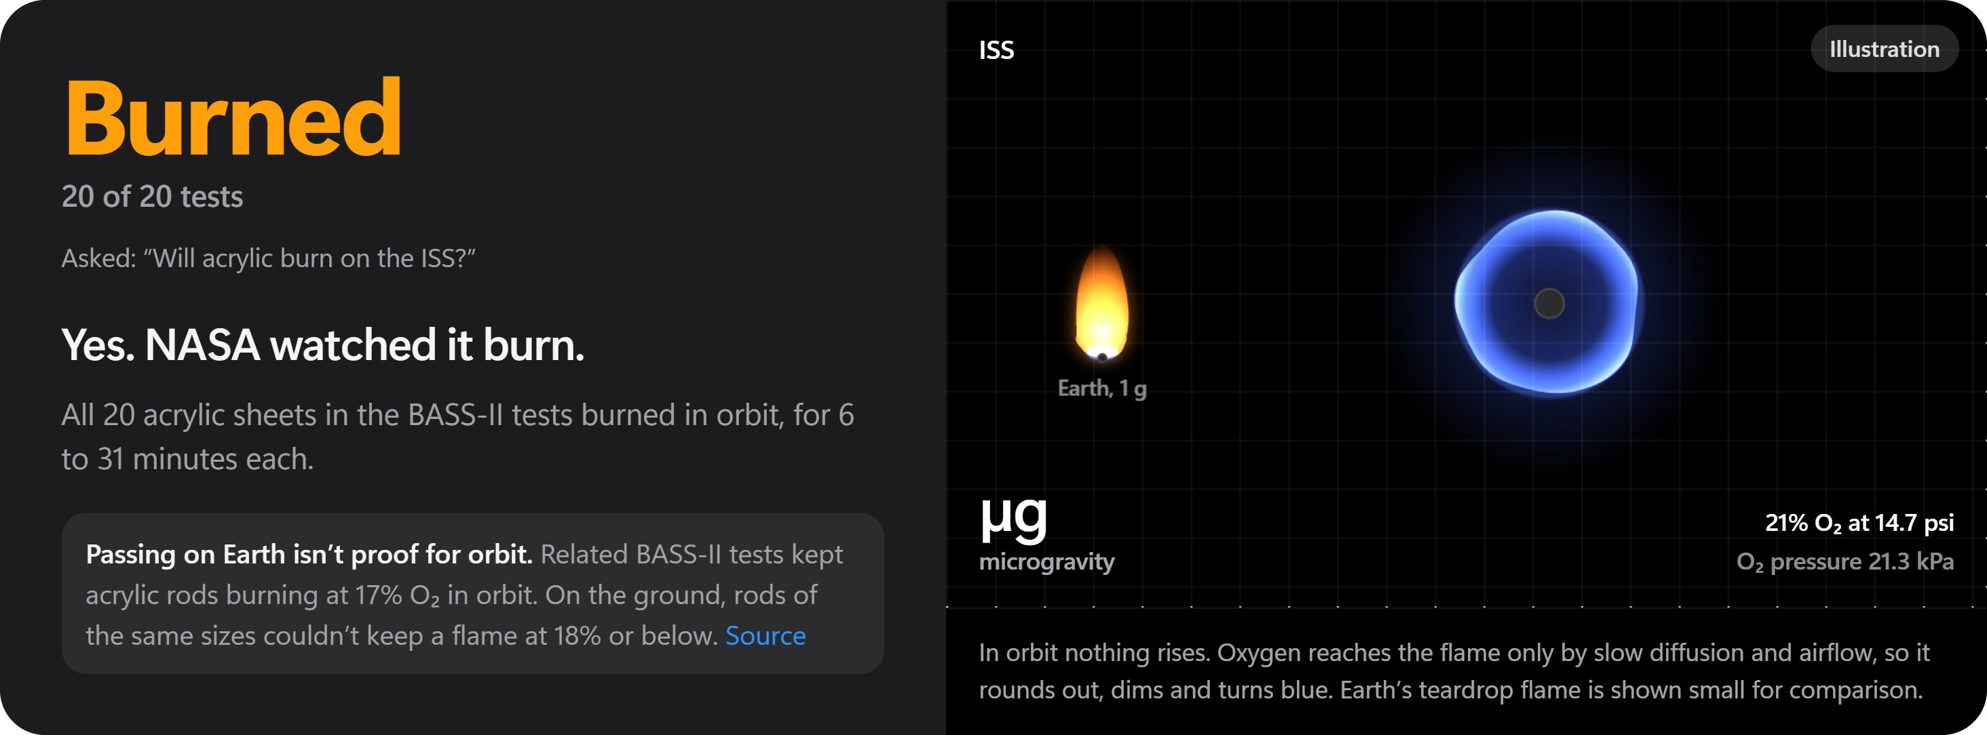
20 of 20 acrylic sheets burned,
for 6 to 31 minutes each
Source: NASA/TM-20210011385 (BASS-II), Table 5.1, printed p. 57
Notes:
Script section 5 · 1:42–1:54 · 12 s on screen
Narration (script draft 2):
The answer: Burned. All 20 acrylic sheets burned, for 6 to 31 minutes each. Tap any number, and you see the NASA table row it came from.

Slide 9
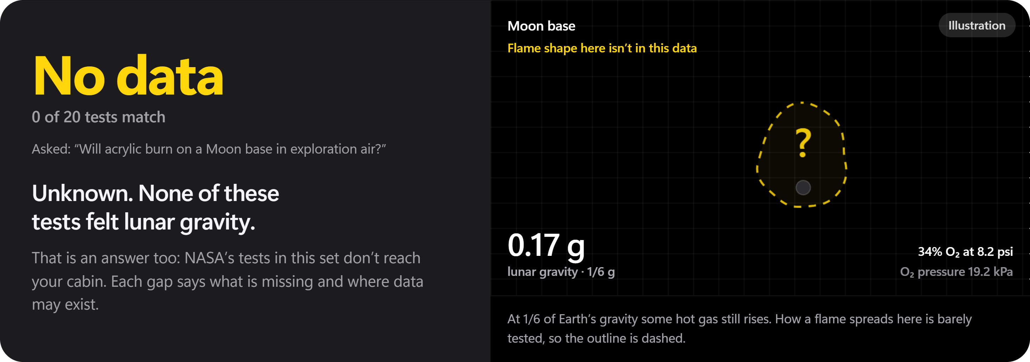
No test felt lunar gravity.
The tests recorded 16.8–22.2% oxygen.
Source: NASA/TM-20210011385 (BASS-II), Table 5.1, printed p. 57
Notes:
Script section 5 · 1:54–2:09 · 15 s on screen
Narration (script draft 2):
Now ask about a Moon base, in the air NASA studied. The answer flips to No data. No test felt lunar gravity, and the tests stopped at about 22% oxygen.

Slide 10
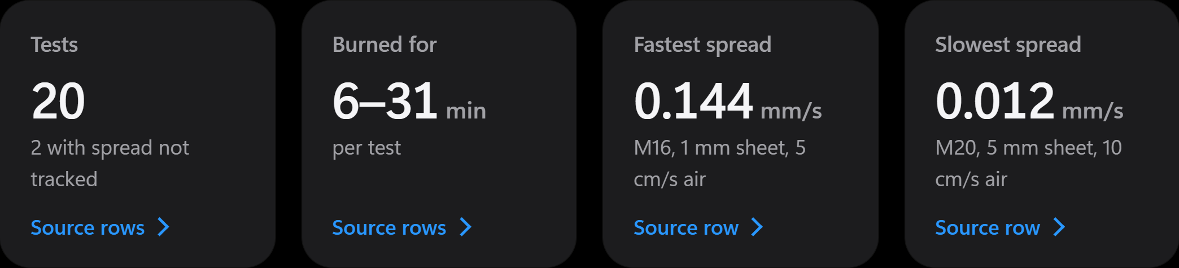
Summarize
Each answer in a few key numbers
Source: NASA/TM-20210011385 (BASS-II), Table 5.1, printed p. 57
Notes:
Script section 6 · 2:09–2:14 · 5 s on screen
Narration (script draft 2):
It summarizes each answer in a few key numbers.

Slide 11
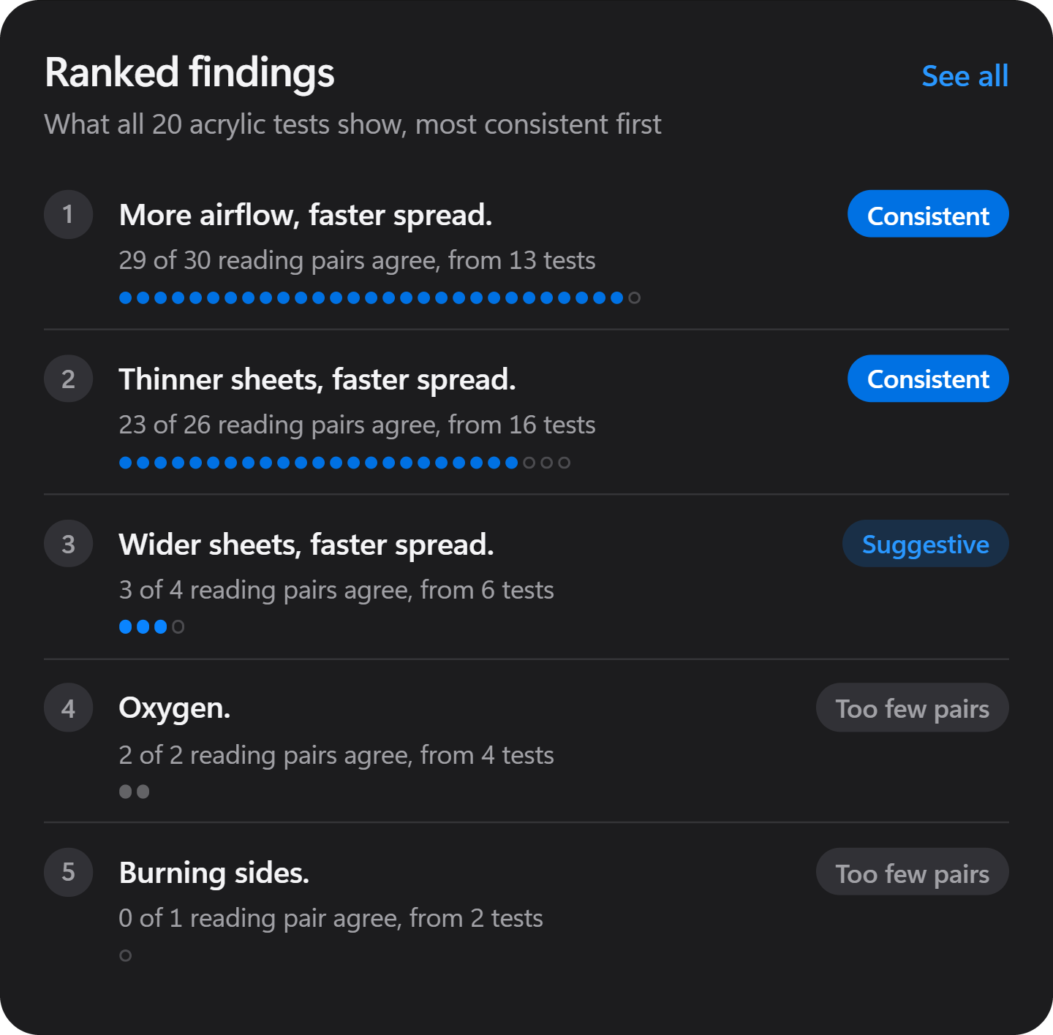
Rank
With faster airflow, flames
spread faster in 29 of 30
reading pairs
Descriptive, not causal
Source: the app’s ranked finding #1, computed from
NASA/TM-20210011385, Table 5.1. The pairs reuse readings.
Notes:
Script section 6 · 2:14–2:22 · 8 s on screen
Narration (script draft 2):
It ranks what the tests agree on: with faster airflow, flames spread faster in 29 of 30 paired readings.

Slide 12
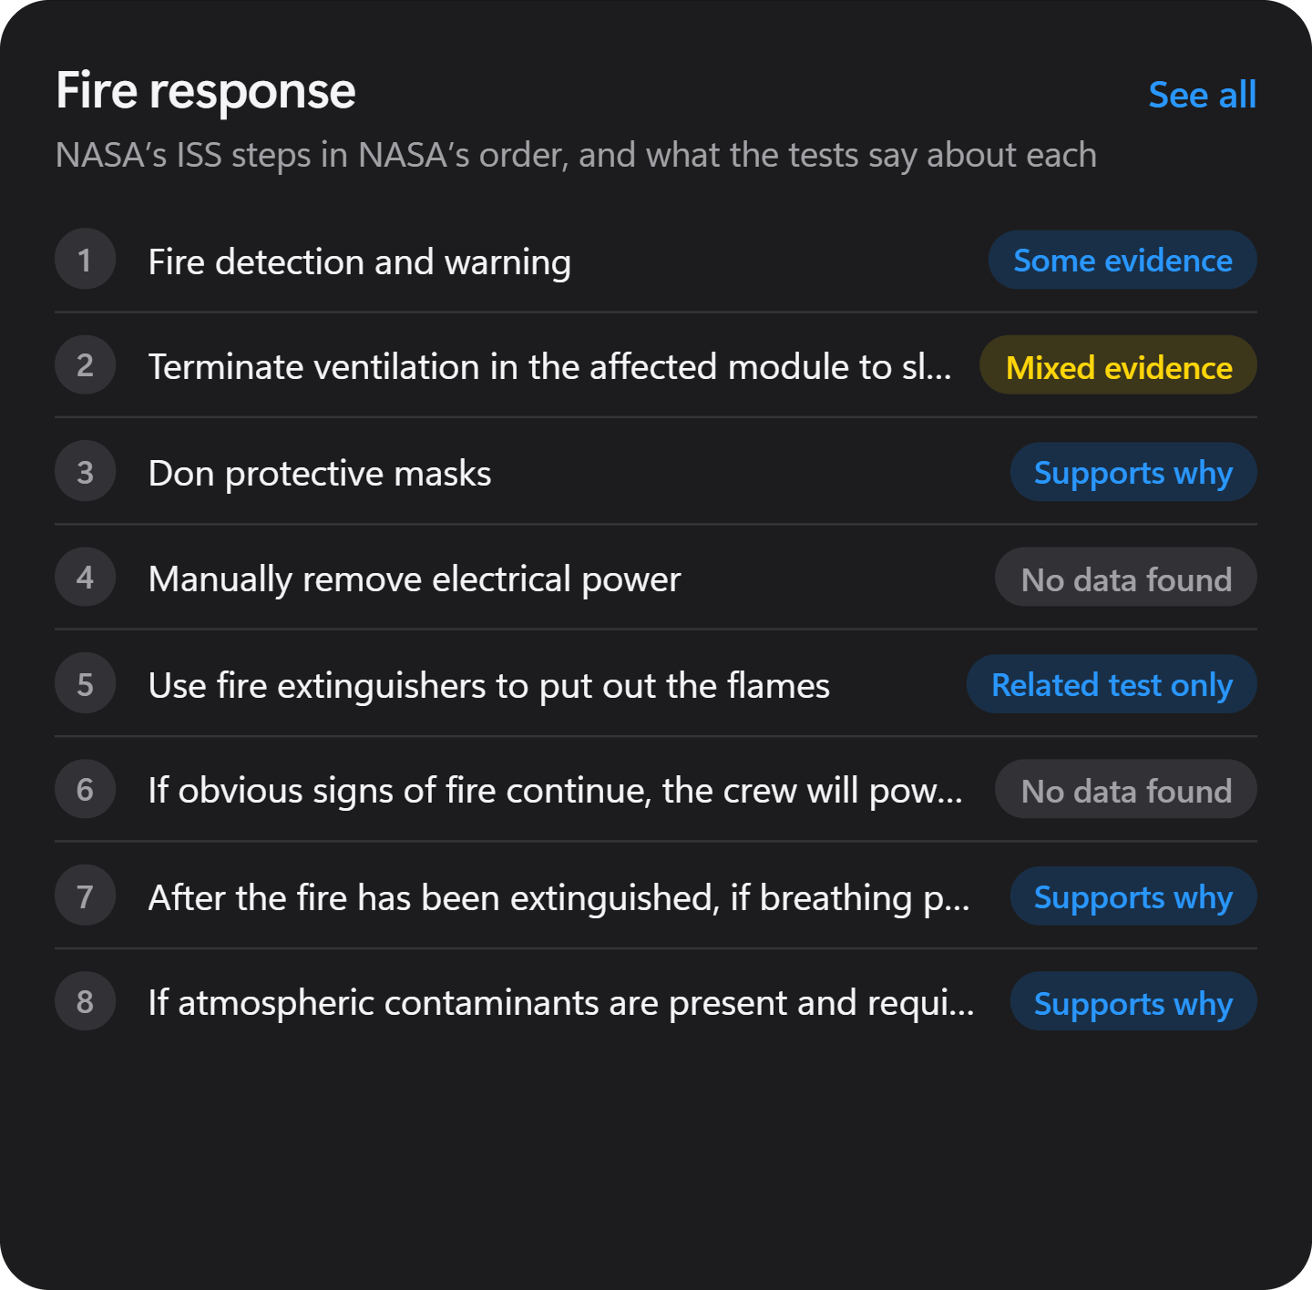
Interpret
NASA’s 8 fire-response
steps for the Station,
next to the test evidence
Source: NASA OCHMO-TB-008 Rev A (29 Nov 2023)
Notes:
Script section 6 · 2:22–2:29 · 7 s on screen
Narration (script draft 2):
And it interprets, by putting NASA’s eight fire-response steps for the Station next to the test evidence.

Slide 13
PLANNED
ChatBot
Ask in plain English. Every answer
quotes the NASA row it used.
Planned, not finished
Notes:
Script section 7 · 2:29–2:38 · 9 s on screen
Narration (script draft 2):
Next, what we’re building. These are planned, not finished. ChatBot: ask in plain English. Every answer quotes the NASA row it used.

Slide 14
PLANNED
Analysis tool
Pick one variable, like airflow, and
chart it across the tests.
Planned, not finished
Notes:
Script section 7 · 2:38–2:44 · 6 s on screen
Narration (script draft 2):
Analysis tool: pick one variable, like airflow, and chart it across the tests.

Slide 15
PLANNED
Comparison tool
Set two experiments side by side
and see what changed.
Planned, not finished
Notes:
Script section 7 · 2:44–2:50 · 6 s on screen
Narration (script draft 2):
Comparison tool: set two experiments side by side and see what changed.

Slide 16
PLANNED
FlameViz
Watch a flame spread at the speed
NASA actually measured.
Planned, not finished
Notes:
Script section 7 · 2:50–2:56 · 6 s on screen
Narration (script draft 2):
FlameViz: watch a flame spread at the speed NASA actually measured.

Slide 17
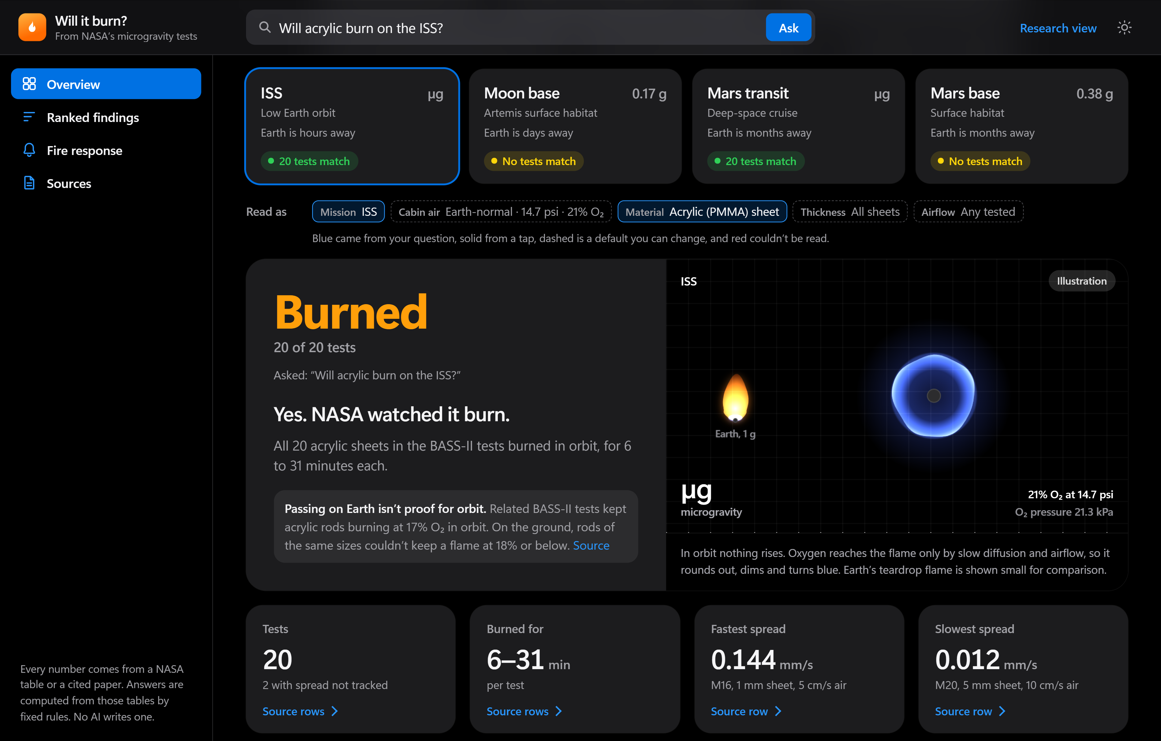
PROTOTYPE
One dashboard
PLANNED
ChatBot
Analysis tool
Comparison tool
FlameViz
More to come
Make NASA’s fire evidence easy to explore, compare and see.
Notes:
Script section 7 · 2:56–3:04 · 8 s on screen
Narration (script draft 2):
More to come, as we add more NASA experiments, like Saffire. One goal: make NASA’s fire evidence easy to explore, compare and see.

Slide 18
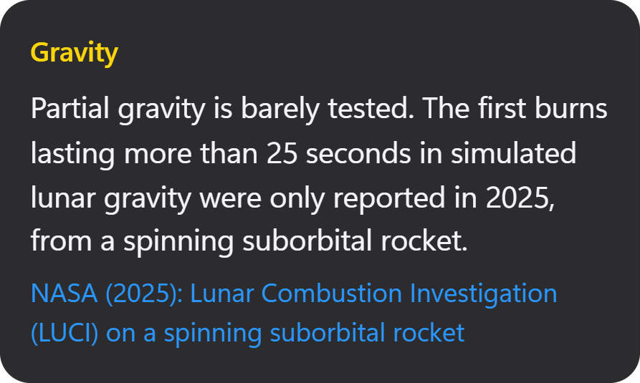
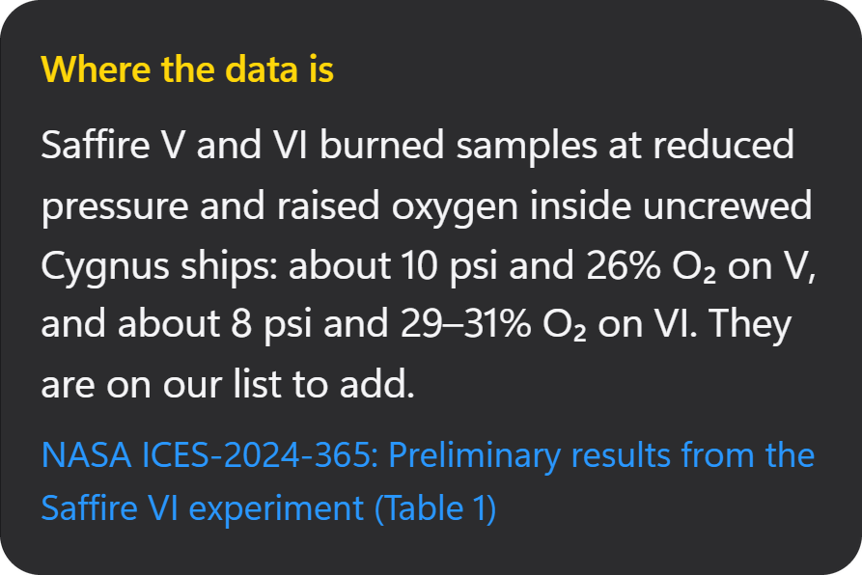
A gap is an answer too.
Each No data card says what’s missing,
and where that data may exist.
Sources: LUCI, NASA (2025), NTRS 20250010653
Saffire V and VI, NASA ICES-2024-365, Table 1
Notes:
Script section 8 · 3:04–3:17 · 13 s on screen
Narration (script draft 2):
A gap is an answer too. Each No data card says what’s missing, and where that data may exist, like NASA’s Saffire experiments. That points to which test to fly next.

Slide 19
No AI writes
a number.
Every number links back to its source.
Notes:
Script section 8 · 3:17–3:25 · 8 s on screen
Narration (script draft 2):
And no AI ever writes a number or a verdict. Every number links back to its source.

Slide 20
Will It Burn?
Team Polaris
NASA Space Apps 2026: Flame in Freefall
github.com/ShuvroShimuL/FlameScope
Notes:
Script section 9 · 3:25–3:34 · 9 s on screen
Narration (script draft 2):
Will It Burn?, by Team Polaris, for NASA Space Apps 2026: Flame in Freefall. Thank you.

Slide 21
Credits
NASA footage and images: NASA
Star field and slide graphics: Team Polaris
Music: [track name], YouTube Audio Library
[Only if used] AI voice: [tool name]
[Only if used] AI illustrations: Higgsfield
Script and slides drafted with AI assistance (Claude, Claude Code) and edited by the team.
Full credits in the video description.
Notes:
Script section 9 · 3:34–3:40 · 6 s on screen
No narration on this slide.

