Slide 1


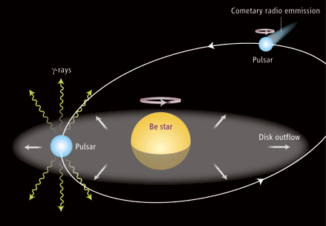
A NEW APPROACH TO THE GeV FLARE OF PSR B1259-63/LS2883
Yi Shu-Xu (易疏序)
contributor:
K-S Cheng
Department of Physics
University of Hong Kong
FPS6 @ Wuhan

Slide 2

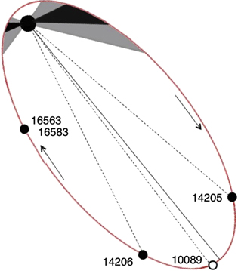
LS2883
31 M_solar
to observer
PSR B1259-63
spin P: 47.76 ms,
a = 7.2AU.
orbit P = 1237 days
George G. Pavlov et al. 2015

Slide 3
X-ray/ TeV maximum
LS2883
to observer
PSR B1259-63
spin P: 47.76 ms,
a = 7.2AU.
orbit P = 1237 days

Slide 4
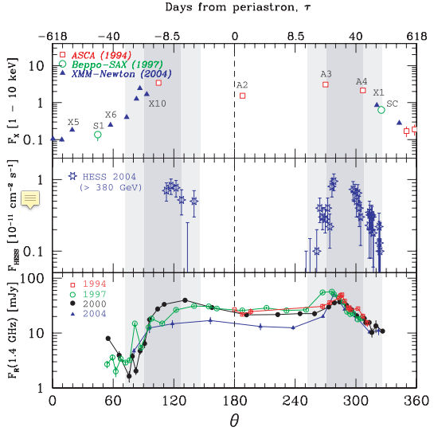
X-ray/ TeV maximum
LS2883
to observer
PSR B1259-63
spin P: 47.76 ms,
a = 7.2AU.
orbit P = 1237 days
M. Chernyakova et al. 2006

Slide 5
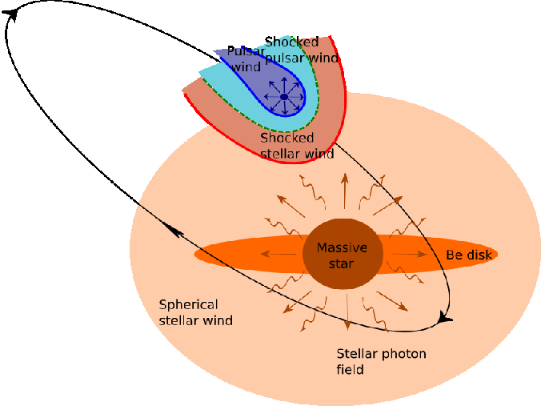
Origin of the X-ray/TeV emission

Slide 6
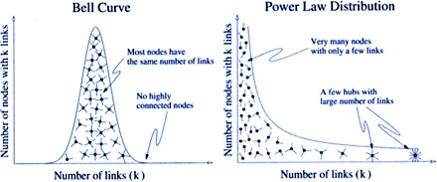
Origin of the X-ray/TeV emission
pulsar wind, cold
e^{+/-}
e^{+/-}
Synchrotron
radiation: KeV X-ray
B
B
Gaussian
pulsar wind,
hot
cold
mildly relativisitc
electrons
hot
highly relativisitc
electrons
Lorenz factor of electrons
shock front
Lorenz factor of electrons
10³
10⁵
Kong et al. 2011

Slide 7


Origin of the X-ray/TeV emission
pulsar wind, cold
e^{+/-}
e^{+/-}
B
B
Inverse-Comption
Scatter:
TeV gamma-ray
$$Γ∼{10}^{3}$$
pulsar wind,
hot
$Γ∼$10⁵
shock front
Kong et al. 2011

Slide 8
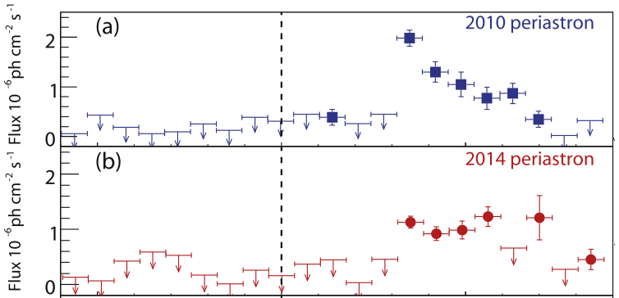
Emission in 100 MeV-100 GeV
to observer
Tam 2011, Abdo 2011, Caliandro 2015

Slide 9
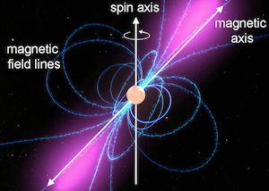

Models for GeV emission
Inverse Compton scattering
$$Γ∼{10}^{3}$$
Soft photons
GeV photons
Cold, mild relativistic pulsar wind

Slide 10
Models for GeV emission
Inverse Compton scattering
$$Γ∼{10}^{3}$$
Soft photons
?
GeV photons
Cold, mild relativistic pulsar wind

Slide 11
Models for GeV emission
X
Soft photons
The Be star and the circumstellar disk
should near periastron
Accretion disk around the neutron star
Accretion disk
pulsar
Be
star
Circumstellar disk
Gravity-captured matter

Slide 12

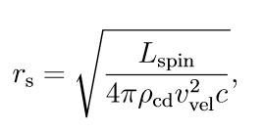



Condition of mass transfer from optical companion
Shock from should inside the Bondi-Hoyle sphere
Shock front
Shock front
$$r_{BH}$$
$$r_{BH}$$
$$r_{s}$$
pulsar
$$r_{s}$$
pulsar
Circumstellar material flow
Circumstellar material flow
Mass can transfer
Mass can NOT transfer

Slide 13
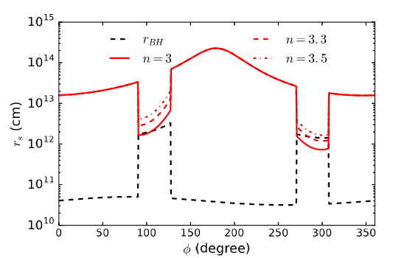
Location of the circumstellar disk, and phases of mass transfer

Slide 14

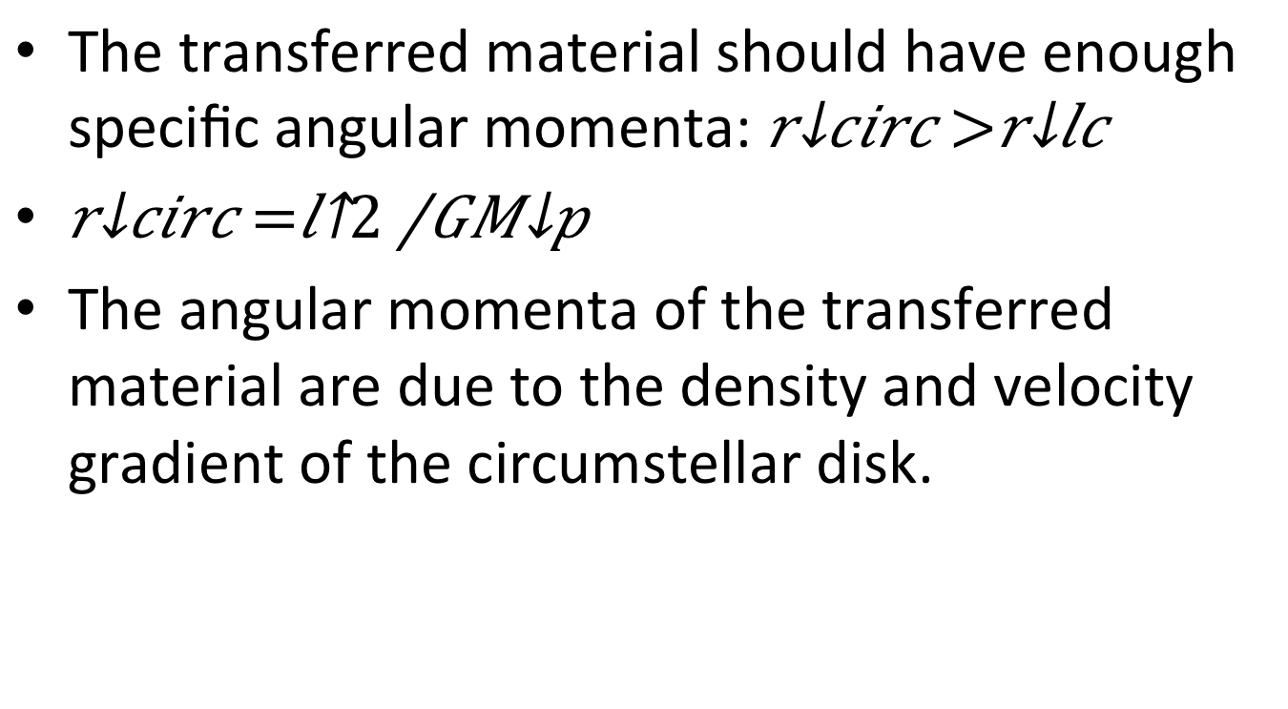
Condition of the formation of accretion disk
The transferred material should have enough specific angular momenta: $r_{circ}>r_{lc}$
$r_{circ}=\frac{l^{2}}{GM_{p}}$
The angular momenta of the transferred material are due to the density and velocity gradient of the circumstellar disk.

Slide 15
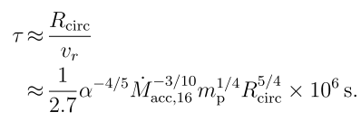
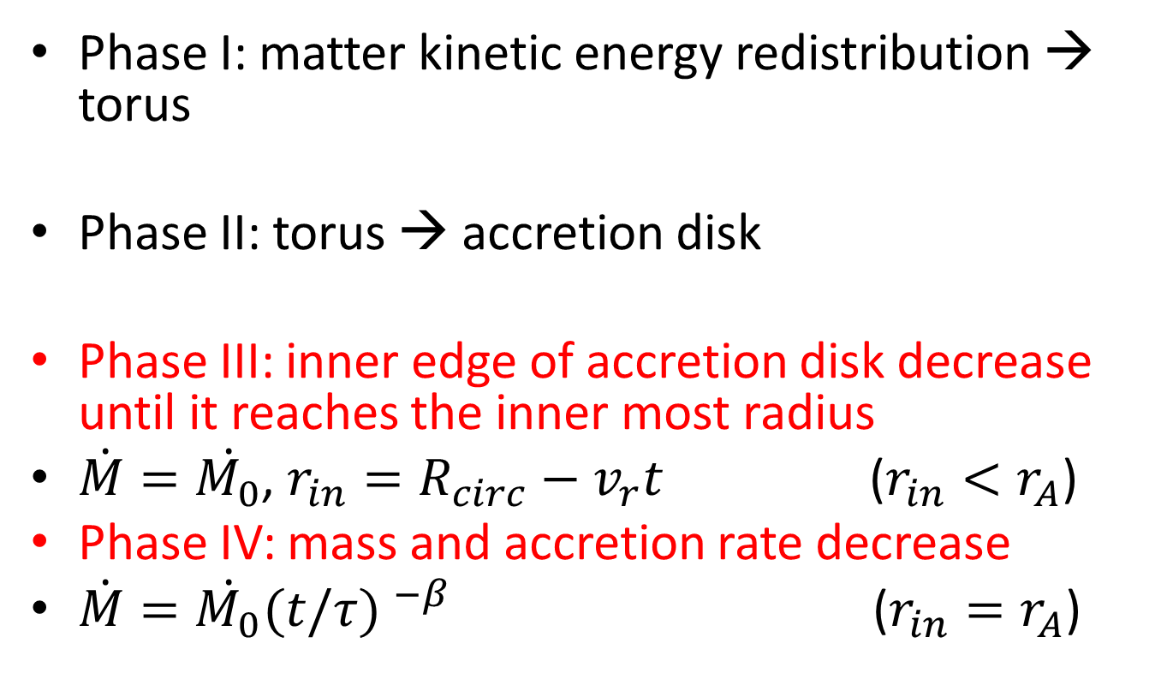
Formation of the accretion disk
Phase I: matter kinetic energy redistribution → torus
Phase II: torus → accretion disk
Phase III: inner edge of accretion disk decrease until it reaches the inner most radius
, ()
Phase IV: mass and accretion rate decrease
()
Viscosity time scale
Alfven radius

Slide 16

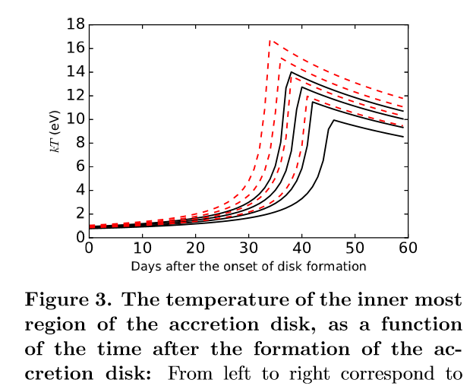
Evolution of the accretion disk

Slide 17
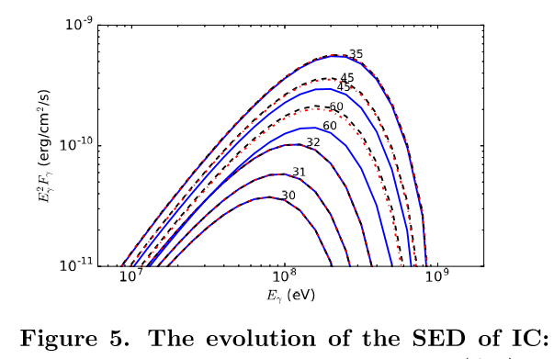
Evolution of SED

Slide 18
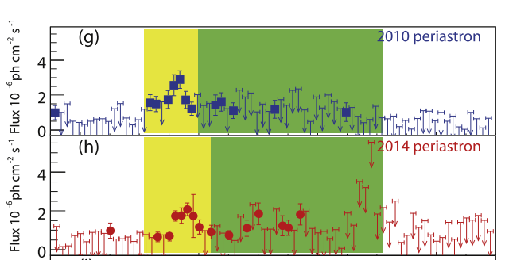
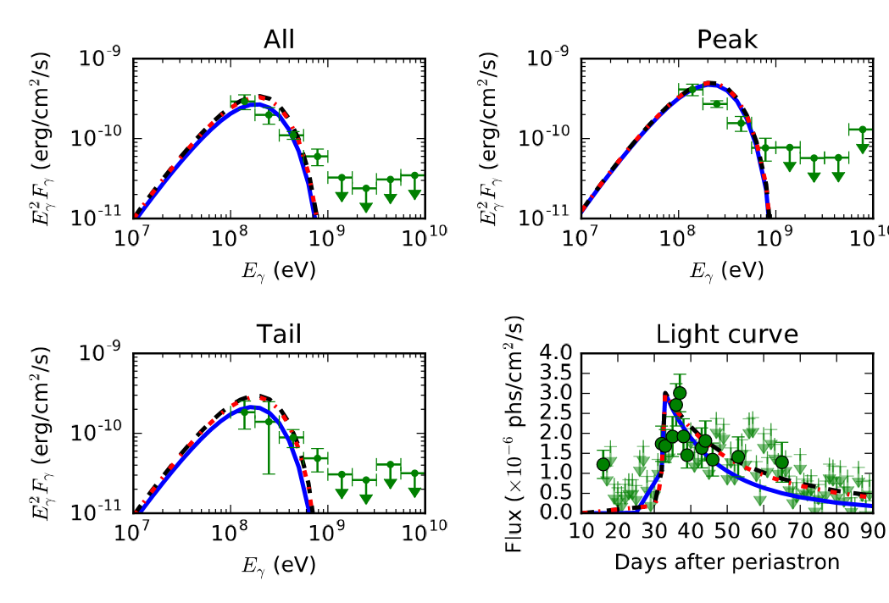
Evolution of SED and light curve

Slide 19
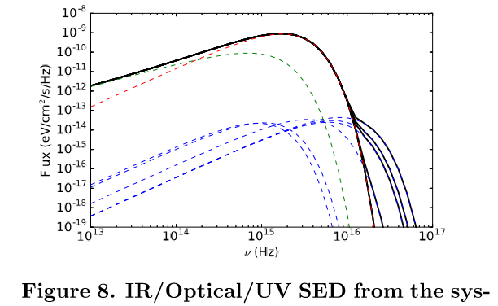
Predication
UV excess from the accretion disk

Slide 20
Summary of the model
Matter from circumstellar disk captured by gravity of pulsar
An accretion disk forms.
Pulsar wind inverse-Compton scatter the soft photon from accretion disk
Accretion disk
pulsar
Be
star
Circumstellar disk
Gravity-captured matter

