Slide 1
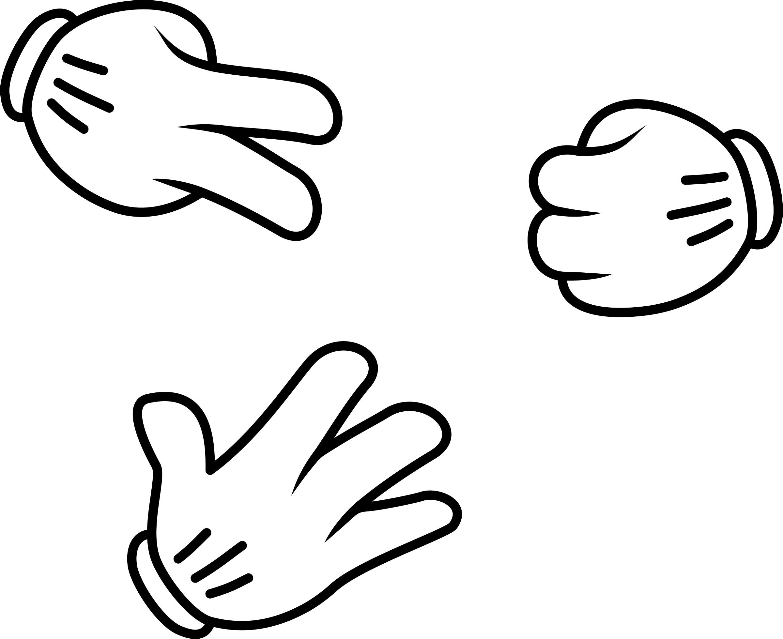
A rock-paper-scissor computer program
Yi Shu-Xu

Slide 2
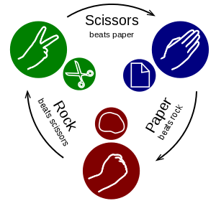
The Rule
Two people show one of their hand simultaneously, with one of the three shapes:
rock: a fist
paper: a flat palm
scissor: a V gesture
each shape can win over other shape as illustrated on the right

Slide 3
Theory
Define the hand of me in round n: M_{n} which can take value of “rock, paper or scissor”
the hand of my opposite in round n as: O_{n}
you decide your hand in the next round based on your opposite in this round, so: M_{n+1}=S*O_{n}
where “S” is the “strategy operator”.

Slide 4
Theory
There is only three independent operations from one hand to anther:
1. Identical: e.g., from rock to rock: we denote: S=I
2. Roll upward: e.g., from rock to paper. we denote: S=U
3. Roll downward: e.g., from rock to scissor: We denote: S=D
There are relations: D=U², I=U³ the index 2 or 3 means “roll upward twice or three times”
more relations:
I*U=U, I*D=D, I=D³=D*U=U*D, D^2=U, U^{i+3}=U^{i} …………………

Slide 5
Theory
Let’s see how many different strategies one can have based on the combination of the tree basics:
Strategy level | Me | Opposite
S₀ | M_{n+1}=I*M_{n} | O_{n+1}=I*O_{n}
S₁ | M_{n+1}=U*O_{n} | O_{n+1}=U*M_{n}
S₂ | M_{n+1}=U²*M_{n} | O_{n+1}=U²*O_{n}
S₃ | M_{n+1}=I*O_{n} | O_{n+1}=I*M_{n}
S₄ | M_{n+1}=U*M_{n} | O_{n+1}=U*O_{n}
S₅ | M_{n+1}=U²*O_{n} | O_{n+1}=U²*M_{n}
win
win
win
win
win

Slide 6
Theory
If your opposite using S_{i} and you use S_{i+1}, you win in the next round! And we see than S_{i+6}=S_{i} Therefore there is only six strategies in all!
You only need to know what strategy your opposite is using in this round. People usually insist on the same strategy for many round. (that’s our important assumption!)

Slide 7
theory
Say, in the first round, you hand is rock, and the opposite is scissor. And in the next round the opposite changed to paper. His strategy can be:
U*M_{n} or D*O_{n}=U²*O_{n}, in other words: S₁ or S₂
So you decide to use S₂ or S₃

Slide 8
theory
Theory
outcome flips
outcome remains
Strategy level | Me | Opposite
S₀ | M_{n+1}=I*M_{n} | O_{n+1}=I*O_{n}
S₁ | M_{n+1}=U*O_{n} | O_{n+1}=U*M_{n}
S₂ | M_{n+1}=U²*M_{n} | O_{n+1}=U²*O_{n}
S₃ | M_{n+1}=I*O_{n} | O_{n+1}=I*M_{n}
S₄ | M_{n+1}=U*M_{n} | O_{n+1}=U*O_{n}
S₅ | M_{n+1}=U²*O_{n} | O_{n+1}=U²*M_{n}

Slide 9
Theory
if you win the second round (Scissor), you want the outcome to remain. Then S₂ is the better choise (paper): Either the opposite is S₁(U*Scissor=rock) or S₂ (D*paper=rock) you will win.
if you lose the second round (rock), still S₃ is better: Either the opposite is S₁(U*rock=paper) or S₂ (D*paper=rock) , you won’t lose

Slide 10
win lose even
O₀=D*M₀ or O₀=U*M₀ or O₀=M₀
S_{1,2} S_{3,4}, S_{5,6}
S_{0,1} S_{2,3} S_{4,5}
S_{0,3} S_{1,4}, S_{2,5}
U*M₀
M₀
D*M₀
if M₁=M₀
lose
even
win
S_{1,2}
S_{0,1}
S_{1,4}
S_{5,6} S_{4,5} S_{2,5}
S_{3,4} S_{2,3} S_{0,3}
U*M₀
or
D*M₀
U*M₀
or
M₀
U*M₀
or
D*M₀
M₀
or
U*M₀
D*M₀
or
M₀
M₀
or
D*M₀
U*M₀
D*M₀
M₀
M₂=D*M₀
win
M₂=M₀
win
M₂=U*M₀
win
M₂=D*M₀
win or even
M₂=U*M₀
win or even
M₂=D*M₀
win or even
M₂=M₀
win or even
M₂=M₀
win or even
M₂=U*M₀
win or even
You’ll never lose the third round!

Slide 11
In the first and second round, you show the same hand. If the result is:
win-even: then you show U*M₀, the outcome will be even or win. “Even” means your opposite’s strategy is S₄, then you go to S₅ in the follow. “win” means your opposite is S₃, then you go to S₄. You will be winning from then.
win-lose: you show U*M₀, the outcome will be even or win. “Even” means your opposite’s strategy is S₁, then you go to S₂ in the follow. Otherwise go to S₃. You will be winning from then.

Slide 12
win-win: keep M₀, you will win again.
lose-win: keep M₀, even (go to S₅) or win (to S₀).
lose-even: keep M₀, even (to S₄) or win (to S₃)
lose-lose: D*M₀, will win
even-win: D*M₀, even (to S₀) or win (to S₃)
even-even: U*M₀, will win
even-lose: D*M₀, even (S₅) or win (S₂)

Slide 13
you insist on your strategy, until you lose. That means you opposite finally change his/her strategy. Then from this round, you repeat the analysis above, and find your new corresponding strategy again.
The above-mentioned procedure is too complicated to do by human. Therefore I wrote an app to do it.

Slide 14
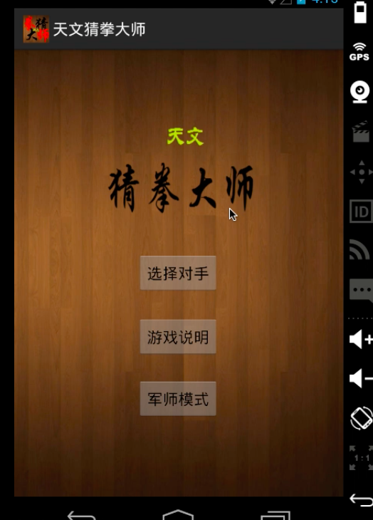
The app
It’s an android based
game called: Rock-paper-scissor master,
with astronomy features.
there’s only a Chinese interface version
Choose an astronomer to challenge
guide
advisor mode

Slide 15
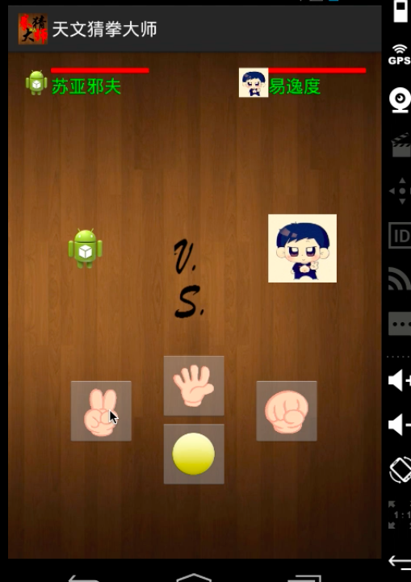
the app
I will leave the introduction
of the astronomy feature later.
As a competition between human
and a computer, you’d better let the
player be sure that the computer is
not cheating. Because, in principle, you
will not notice that the computer show
its hand 0.1 s after you show yours, and
thus win every round.

Slide 16
the app
Anti-cheating mechanism:
So I let the computer show its hand before the player in
every round.
But then how to prevent the player from cheating?
In every round, the player
is asked to press and
hold this yellow button

Slide 17
the app
Anti-cheating mechanism:
In every round, the player
is asked to press and
hold this yellow button
Once this button is released,
the computer will show its hand,
and the player should
make the choice of the hand
very quick (within 0.4 second)
the time is not sufficient for the player
to respond to the computer’s hand

Slide 18
the app
For each round, your health bar
reduces if you lose. And your opposite
‘s health bar reduces if you win.
This game is generally following
the algorithm described above.
I always add some more functions,
such that if you have a certain pattern like
rock-rock-scissor-paper-rock-rock-scissor-paper-rock-rock-scissor-paper-
It’ll know.

Slide 19
the app
Different astronomers share the same algorithms. However they have different rules of the health reduce, thus the difficulty against each other is not the same.

Slide 20
the app
苏亚邪夫(Sunyaev): the famous Soviet and Russian astronomer. He invented the Standard accretion disk. So he is a standard opposite.
霍金 (Hawking): Playing with him, your health bar is gradually evaporating during the competition, following a rule of Hawking evaporation.
古斯(Guth): If you’re hit successively, your blood will go nonlinearly. Like a cosmic inflation.
钱德拉（Chandrasekhar）: When you’re blood is 1.4 times more than Chandra’s (the Chandrasekhar limit), his blood will burst to the same as yours. Like the supernova explosion, this only happen once.
爱丁顿（Eddington）: His blood can not be less than half of yours. (Eddington limit) When reach this limit, your blood will reduce accordingly.

