Slide 1
A direct localization of a fast radio burst and its host
Presenter: Yi SHu-xu
@Journal club
2017.03.15

Slide 2
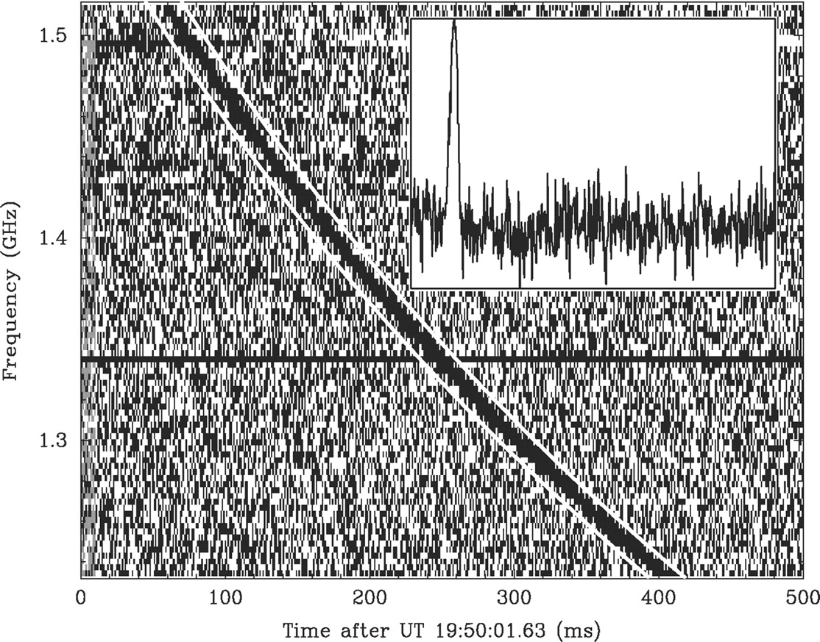
What is a Fast Radio Burst (FRB)
Radio: MHz-GHz,
Fast Burst: milliseconds
Like single pulse of radio pulsars,
but
non-repeating (expect one)
Very high Dispersion Measure (DM): 300~1600 (pulsar <100)
Very bright: ~ Jy (pulsar~ mJy)
1 Jy=10^-26 watts/m^2/hertz
“Lorimer Burst” 2007
Notes:
From it’s name we know that it’s a burst in radio frequency, and it’s fast. By radio, we mean from mega Hertz to Gega Hertz. This is also the frequency coverage of radio pulsar observation. Fast Burst, the rising and descending last only about several millisecond.
This two features remind us of single pulse of radio pulsars.
But there’re difference. First, FRB is not repeating, you see that only once.
It has very high dispearsion measure. When a packet of EM pulse travel through the free electrons in the space, the higher frequency part travel faster, and the lower frequency travel slower. So at beginning, all frequency compoments emit at the same time, but then lower frequency parts lag behind. At last, higher frequency compoment arrive early, and lower frequency part arrive later.
Like this figure.
DM is a measurement of the degree of dispersion. Larger DM means the integrated density of the free electrons along the line of sight is large. It can means that the distance is large, or there are some thing every dense in between the burst and the earth.

Slide 3
Modelling FRBs
FRB
Extra-Galactic
Milky way
Cataclysmic
Repeating

Slide 4
Difficulties in localization and finding for counter parts in other bands
Angular resolution of single dish radio telescope: ~ arcminutes
Short duration and non-repeating nature: difficult for arrangement for joint observation in multi-wavelength.
Notes:
It’s like a group of hunters in forest. One of them glance a shadow passing from the side. He turns his head and call other hunters. But that shadow never show again.

Slide 5
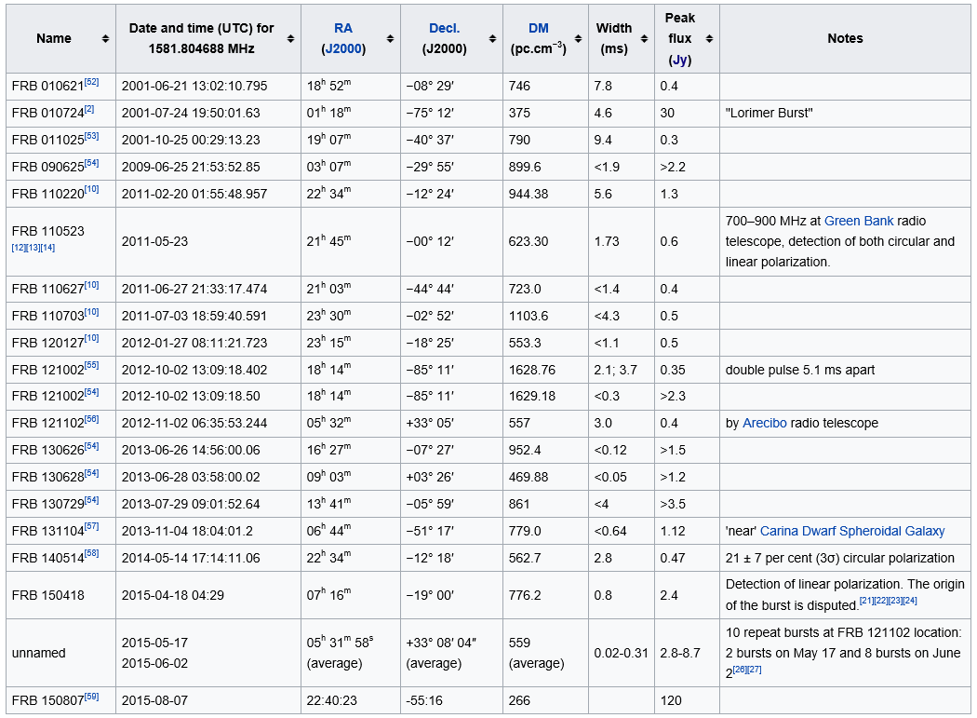
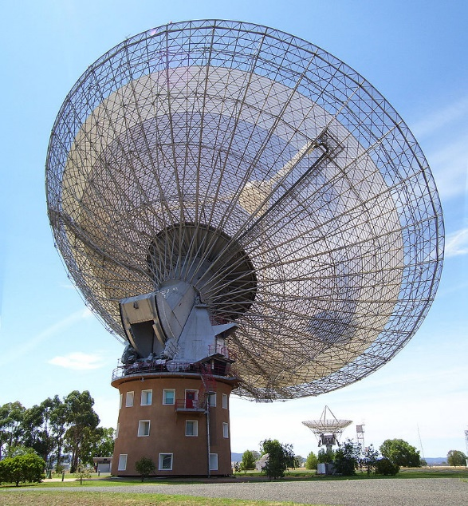
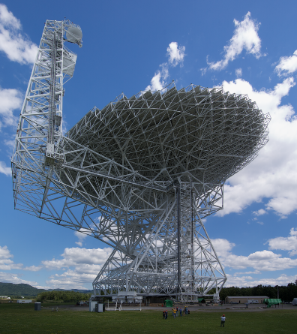
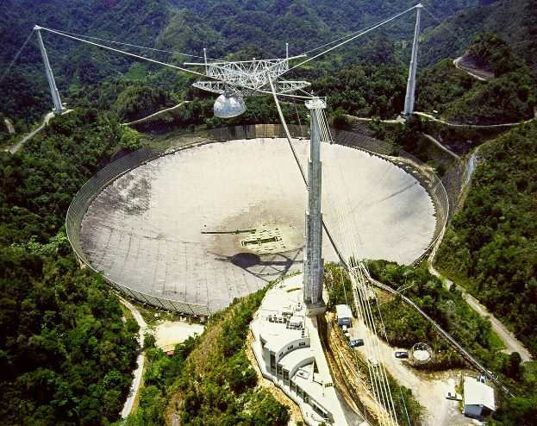
List of FRBs
Parkes telescope

Slide 6
Hints from Statistic
FRB
Extra-Galactic
Milky way
Cataclysmic
Repeating
Sky distribution ~ isotropic
Event rate: several thousands per day

Slide 7
The Repeating FRBs: FRB 121102
Discovered in 2012 Nov. 02, by Arecibo
2015 May-June: 10 more bursts, Arecibo
2015 June-2016 Dec: 6 more, 5 from GBT, 1 from Acrecibo.
FRB
Extra-Galactic
Milky way
Cataclysmic
Repeating

Slide 8
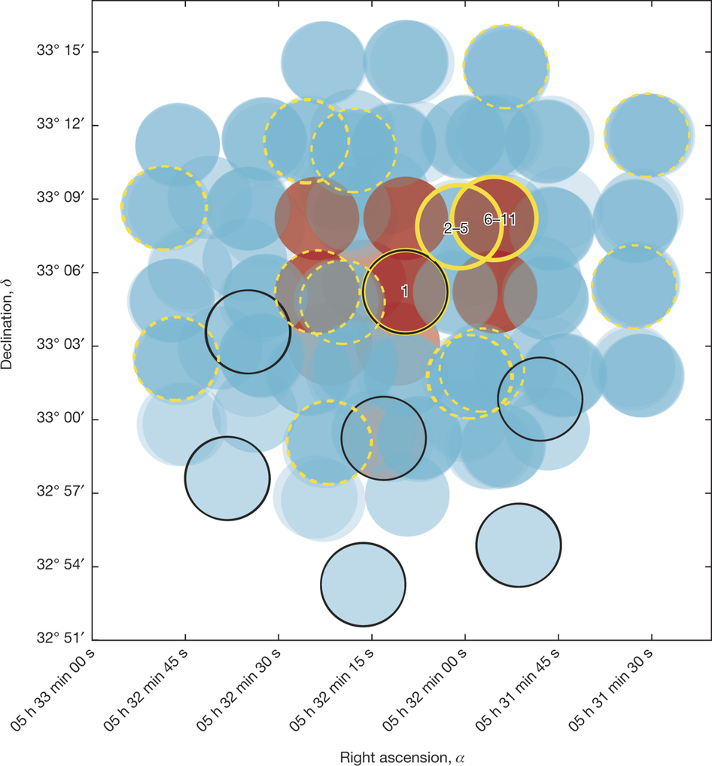
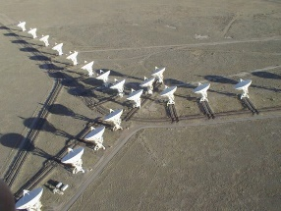
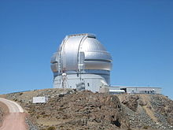
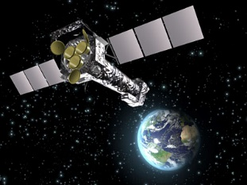

The Repeating FRBs: FRB 121102
VLA
Gemini/Keck
VLBI&VLBA
XMM Newton/Chandra
ALMA

Slide 9
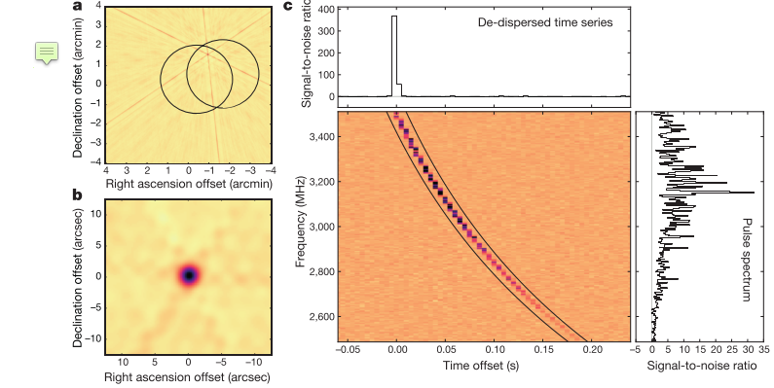


Localization of the burst

Slide 10
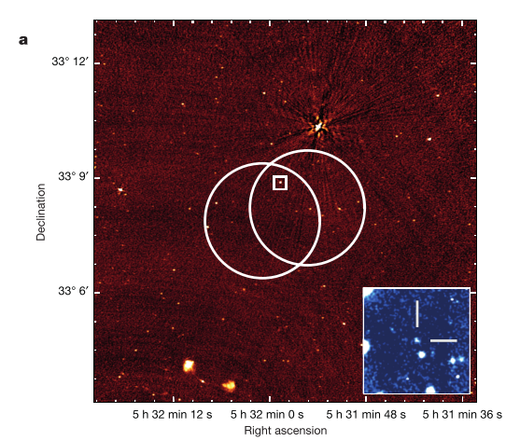


Persisting source: A Compact region in the host galaxy

Slide 11
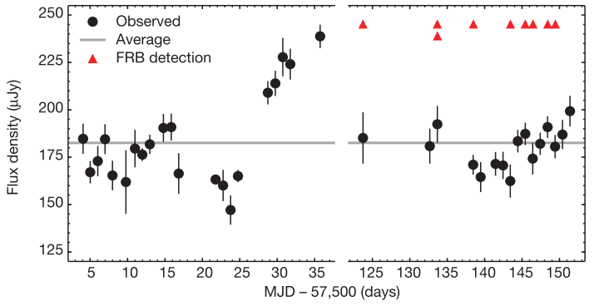
Light curve of persisting source
variability of
persisting source
is uncorrelated
with the FRB

Slide 12
Summary of the radio persisting source
Compact (<8pc, if z~0.32)
Uncorrelated with FRB
1, unrelated object with the FRB in the same host galaxy: AGN
2, interacting object with the FRB: AGN and a close neutron star
3, same object.

Slide 13
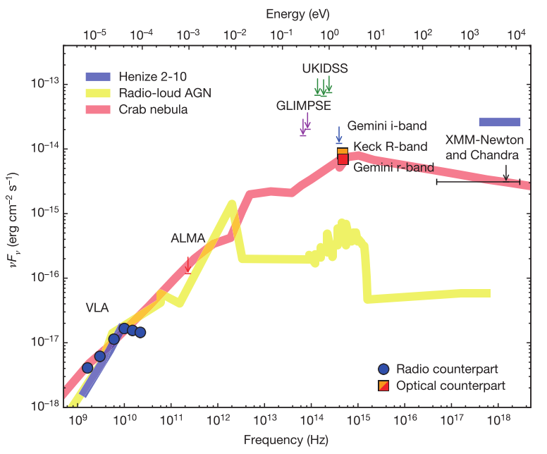

Summary of the host galaxy
Distance: 43 Mpc-1.7 Gpc
1, faint optical+non-detection at 230 GHz→
Low star formation rate < (0.016-19) $M_{⊙}$/year
2, absolute magnitude → mass about the small Magellanic cloud (${<10}^{9} M_{⊙}$)
A dwarf galaxy with a small star formation rate.
Henize 2-10: a low-luminosity AGN, a star-forming
dwarf galaxy at 25 Mpc
QSO 2128-123: A radio loud AGN scaled by 10^-4.3
at 3 Gpc
Crab nebular at 4 Mpc

