Slide 1

User Behavior in Q&A community: an analysis of Zhihu
Andi Liao
2018/04/04

Slide 2
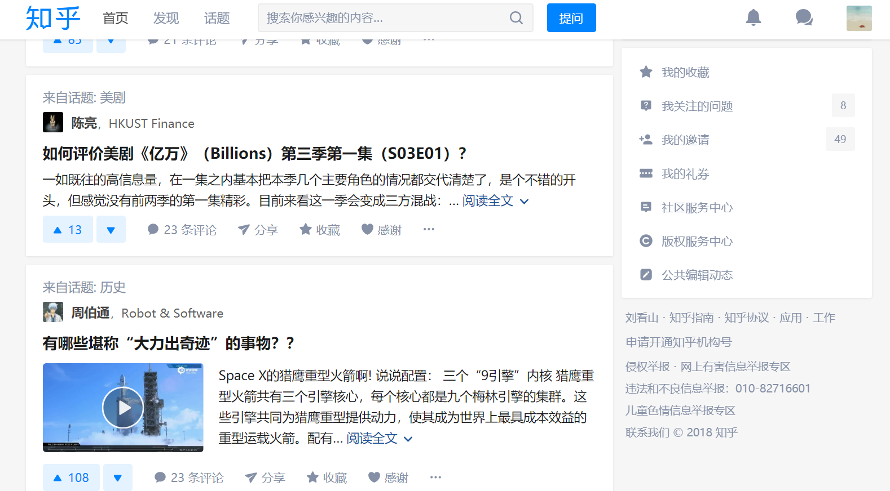
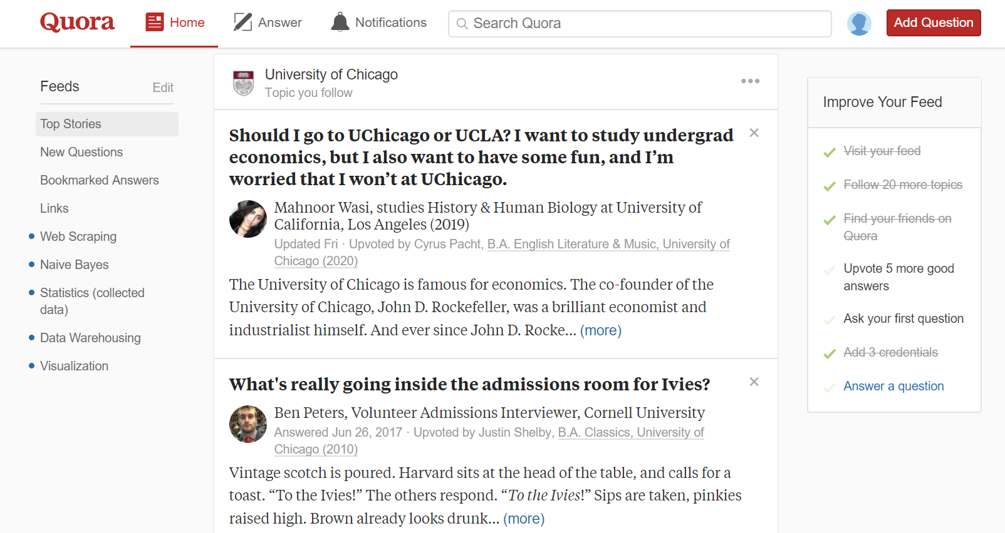
Brief Intro to Zhihu
Similar with Quora
Q&A Community - Follower & Following, Upvotes & Downvotes
User Interface - Navigate Bar, Topics
Recommend System - Feed, Invitation

Slide 3
Brief Intro to Zhihu
Difference with Quora:
User Identity - Any Name
Upvote - Agree
Top Writer - Centered

Slide 4




Research Question
User Behavior in Zhihu Community
Classification:
- Is it possible to cluster users based on data of their activities?
Prediction:
- Is it possible to predict a new user to be a top writer based on data of his activities?

Slide 5
Why It Matters?
Really Interesting!
Mixture: Q&A + social
Venmo: Finance + Social
Weibo: Nickname + Comment
Top Writers preferred?
Top writers == Users who answered a lot of questions?
Top writers == Users who has many followers?

Slide 6
Why It Matters?
Possible Contribution
Many scrapers, but few analysis
Mostly focused on “questions”, rather than users
Descriptive statistics
Help improve the community quality
Top writers & Top answers
Recommended contents

Slide 7
Data Source
Scraper: https://github.com/MatrixSeven/ZhihuSpider - Java
Backup: https://github.com/7sDream/zhihu-oauth - Python
unofficial API
Data form: Mysql database
Follower | User | User Information
user_name | user_id | company, job
follower_name | index_url | education
update_time | token | answer, question
… | … | …

Slide 8
Possible Theory
Social and Interaction graph for social – computing system:
Degree-distribution
Clustering coefficient
Reciprocity and balance
Assortativity
Tie Strength
Reference:
Zhang, X., Tang, S., Zhao, Y., Wang, G., Zheng, H., & Zhao, B. Y. (2017). Cold Hard E-Cash: Friends and Vendors in the Venmo Digital Payments System. In ICWSM (pp. 387-396).
Wang, T., Chen, Y., Wang, Y., Wang, B., Wang, G., Li, X., ... & Zhao, B. Y. (2016). The power of comments: fostering social interactions in microblog networks. Frontiers of Computer Science, 10(5), 889-907.
Wang, G., Gill, K., Mohanlal, M., Zheng, H., & Zhao, B. Y. (2013, May). Wisdom in the social crowd: an analysis of quora. In Proceedings of the 22nd international conference on World Wide Web (pp. 1341-1352). ACM.

Slide 9
Method & Tool
Classification & Prediction
Random forest classifiers
Challenge:
Supervised learning methods
Categorical variables exist
Reference
Patil, S., & Lee, K. (2016). Detecting experts on Quora: by their activity, quality of answers, linguistic characteristics and temporal behaviors. Social network analysis and mining, 6(1), 5.
Grosseck, G. (2012, January). An empirical analysis of the educational effects of social media in universities and colleges. In The International Scientific Conference eLearning and Software for Education (Vol. 1, p. 167). " Carol I" National Defence University.

Slide 10






Expectation
Non-Social
Social

