Slide 1

User Behavior in Q&A community: an analysis of Zhihu
Andi Liao
2018/04/04

Slide 2
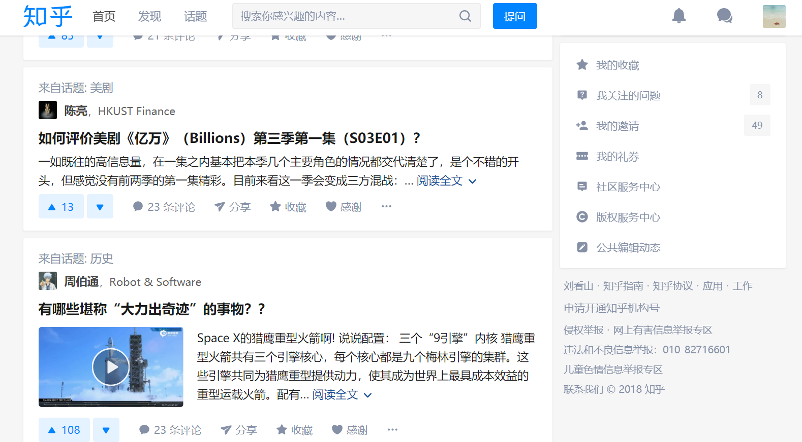
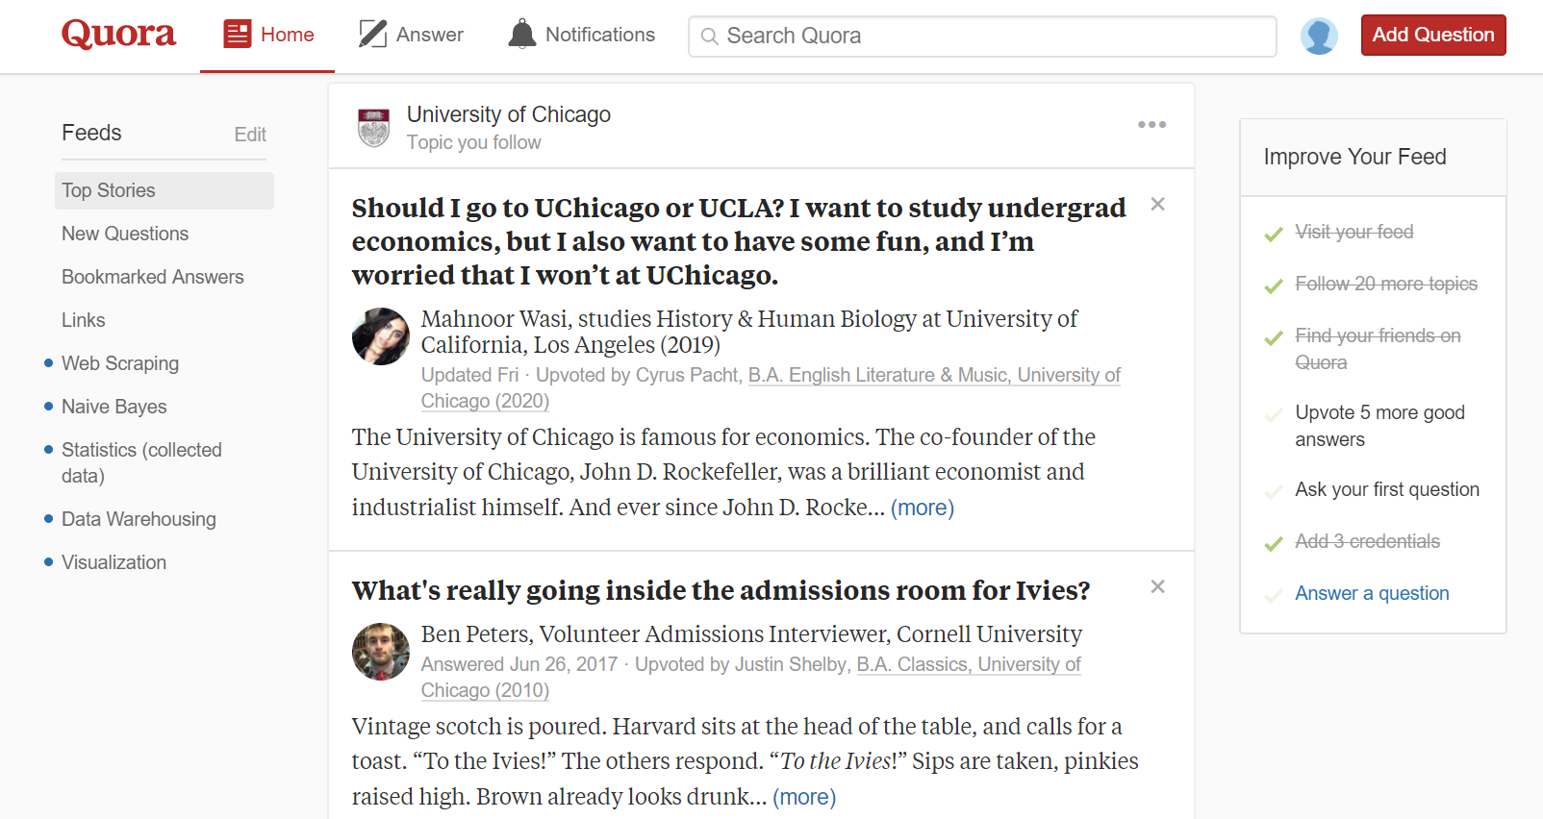
Brief Intro to Zhihu
Similar with Quora
Q&A Community - Follower & Following, Upvotes & Downvotes
User Interface - Navigate Bar, Topics
Recommend System - Feed, Invitation

Slide 3
Brief Intro to Zhihu
Difference with Quora:
User Identity - Any Name
Upvote - Agree
Top Writer - Centered

Slide 4




Research Question
User Behavior & Interaction in Zhihu Community
Clustering:
- Is it possible to cluster users based on data of their activities?
Prediction:
- Is it possible to predict a new user to be a top writer based on data of his activities?

Slide 5
Why It Matters?
Mixture: knowledge sharing + social
Venmo: Finance + Social
Weibo: Nickname + Comment
Many scrapers, but few analysis focused on users in depth
scrapers
analysis
users

Slide 6
Why It Matters?
Mixture: knowledge sharing + social
Venmo: Finance + Social
Weibo: Nickname + Comment
Many scrapers, but few analysis focused on users in depth
scrapers
analysis
users

Slide 7
Data Source
Scraper: https://github.com/MatrixSeven/ZhihuSpider - Java
Backup: https://github.com/7sDream/zhihu-oauth - Python
unofficial API
Data form: Mysql database
Follower | User | User Information
user_name | user_id | company, job
follower_name | index_url | education
update_time | token | answer, question
… | … | …

Slide 8
Possible Theory
Social and Interaction Graph
Degree-distribution: following, follower
Clustering coefficient: similarity
Reciprocity and balance: symmetric relationship
Assortativity: tend to connect similar nodes in the network
Tie Strength: interaction frequency
Reference:
Zhang, X., Tang, S., Zhao, Y., Wang, G., Zheng, H., & Zhao, B. Y. (2017). Cold Hard E-Cash: Friends and Vendors in the Venmo Digital Payments System. In ICWSM (pp. 387-396).
Wang, T., Chen, Y., Wang, Y., Wang, B., Wang, G., Li, X., ... & Zhao, B. Y. (2016). The power of comments: fostering social interactions in microblog networks. Frontiers of Computer Science, 10(5), 889-907.
Wang, G., Gill, K., Mohanlal, M., Zheng, H., & Zhao, B. Y. (2013, May). Wisdom in the social crowd: an analysis of quora. In Proceedings of the 22nd international conference on World Wide Web (pp. 1341-1352). ACM.

Slide 9
Method & Tool
Clustering & Prediction
K-mean++ clustering
Random forest classifiers
Challenge
Supervised learning methods without labels
Categorical variables exist
Reference
Patil, S., & Lee, K. (2016). Detecting experts on Quora: by their activity, quality of answers, linguistic characteristics and temporal behaviors. Social network analysis and mining, 6(1), 5.

Slide 10






Expectation
Non-Social
Social

