Slide 1
Automatic Reviewer Predicting Whether a Paper will be Accepted or Rejected
CS 521 Statistical Natural Language Processing, Fall 2012
Hong Wang (hwang207@uic.edu)
Shuyang Lin (slin38@uic.edu)

Slide 2
Problem we studied
What statistical features of papers are correlated to the decision of the conference?
To what extend can an automatic program predict whether a paper will be accepted or not?

Slide 3
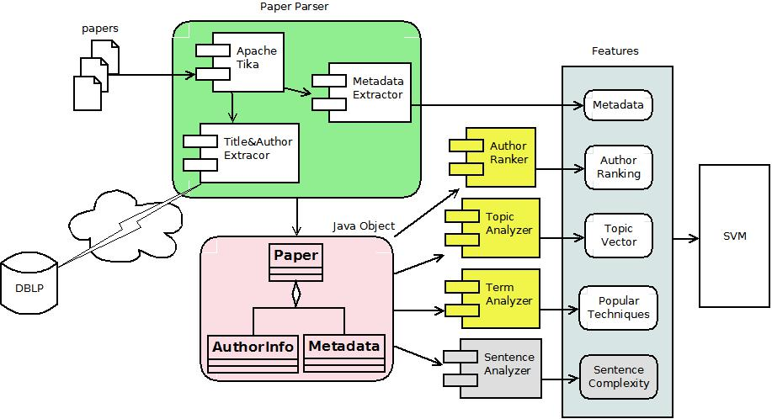
Architecture

Slide 4
Features
Metadata
Number of pages
Total number of tables/formulas/figures
Number of tables/formulas/figures per page
Max number of tables/formulas/figures per page
Author Ranking
2000 top authors in Natural Language & Speech from Microsoft Academic Search [1]

Slide 5
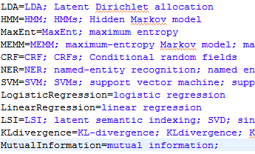
Features – Cont.
Popular techniques mentioned in the paper
Words in the Title (TF-IDF Score)
Topic – LDA (Latent Dirichlet Allocation )

Slide 6
Data Set
Currently we only focus on ACL conference
Year 2007, 2010, 2012
Positive samples:
Full papers that are accepted by the ACL
Negative samples:
ACL workshop papers
Year | Positive | Negative | Total
2007 | 99 | 267 | 366
2010 | 160 | 297 | 457
2012 | 111 | 145 | 256
Total | 370 | 709 | 1079

Slide 7
Classifier
We classify the samples by the SVM classifier.
For the implementation, we are using a java version of LIBSVM.

Slide 8
Evaluation (ACL 2012)
 | Precision | Recall | F-score
#Pictures | 53.0 | 39.6 | 45.4
#Formulas | 70.5 | 66.7 | 68.5
#Tables | 72.6 | 69.4 | 71.0
Metadata | 73.5 | 74.8 | 74.1
Title | 64.3 | 56.8 | 60.2
LDA Topic | 78.5 | 75.6 | 77.1
Popular Tech. | 53.0 | 40.5 | 46.0
Author Ranking | 40.3 | 71.2 | 52.5
Metadata+LDA | 81.4 | 82.9 | 82.1
All features | 85.0 | 76.6 | 80.6
All Positive | 43.4 | 100.0 | 60.0

Slide 9
Evaluation – Cont.
ACL 2010
ACL 2007
 | Precision | Recall | F-score
Metadata+LDA | 70.4 | 66.9 | 68.6
All features | 68.1 | 57.5 | 62.4
All Positive | 0.35 | 100.0 | 51.9
 | Precision | Recall | F-score
Metadata+LDA | 51.0 | 55.6 | 53.1
All features | 54.4 | 50.5 | 52.3
All Positive | 27.0 | 100.0 | 42.5

Slide 10
Discussion and Conclusion
The model can predicts whether the paper is published in ACL or not with good accuracy.
The metadata and the topic distribution learned by LDA model are the best features.
It seems that the model works better on a more balanced dataset than on a less balanced one.
We plan to study how the topic/style of papers changes over the time.

Slide 11
References
[1] Apache Tika, http://tika.apache.org/
[2] iText, http://itextpdf.com/
[3] D. M. Blei, A. Y. Ng, and M. I. Jordan. Latent dirichlet allocation. J. Mach. Learn. Res., 3:993–1022, Mar. 2003.
[4]http://academic.research.microsoft.com/RankList?entitytype=2&topDomainID=2&subDomainID=9
[5] Carven von Bearnensquash Paper Gestalt http://vision.ucsd.edu/sites/default/files/gestalt.pdf

Slide 12
Thank you!

