Slide 1
Automatic Reviewer Predicting Whether a Paper will be Accepted or Rejected
CS 521 Statistical Natural Language Processing, Fall 2012
Hong Wang (hwang207@uic.edu)
Shuyang Lin (slin38@uic.edu)

Slide 2
Problem we studied
What statistical features of papers are correlated to the decision of the conference?
To what extend can an automatic program predict whether a paper will be accepted or not?

Slide 3
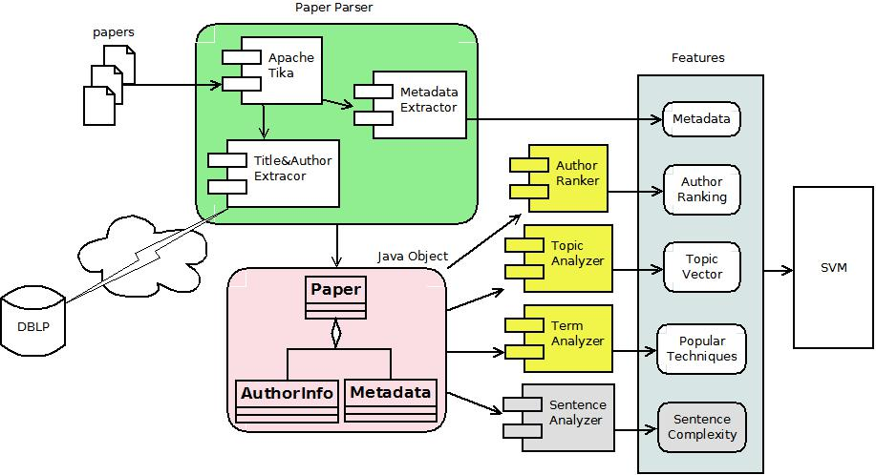
Architecture

Slide 4
Features
Metadata
Number of pages
Total number of tables/formulas/figures
Number of tables/formulas/figures per page
Max number of tables/formulas/figures per page
Author Ranking
2000 top authors in Natural Language & Speech from Microsoft Academic Search [1]

Slide 5
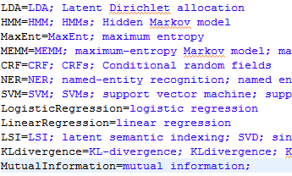
Features – Cont.
Popular techniques mentioned in the paper
Topic – LDA (Latent Dirichlet Allocation )

Slide 6
Data Set
Currently we only focus on ACL conference
Year 2007, 2010, 2012
Positive samples:
Full papers that are accepted by the ACL
Negative samples:
ACL workshop papers
Year | Positive | Negative | Total
2007 | 99 | 267 | 366
2010 | 160 | 297 | 457
2012 | 111 | 145 | 256
Total | 370 | 709 | 1079

Slide 7
Classifier
We classify the samples by the SVM classifier.
For the implementation, we are using a java version of LIBSVM.

Slide 8
Evaluation

Slide 9
Evaluation – Cont.

Slide 10
Discussion
Pros
Cons

Slide 11
Conclusion

Slide 12
References
[1]http://academic.research.microsoft.com/RankList?entitytype=2&topDomainID=2&subDomainID=9

