Slide 1
Going On
Tells what is currently happening on campus

Slide 2
Our idea
There is always a moment that you see many people gathering at a place but have no idea what they are doing.
GoingOn app is trying to solve this problem!
More specifically, GoingOn organizes events on campus and tells the user what is currently happening on campus according to the user's current location.

Slide 3
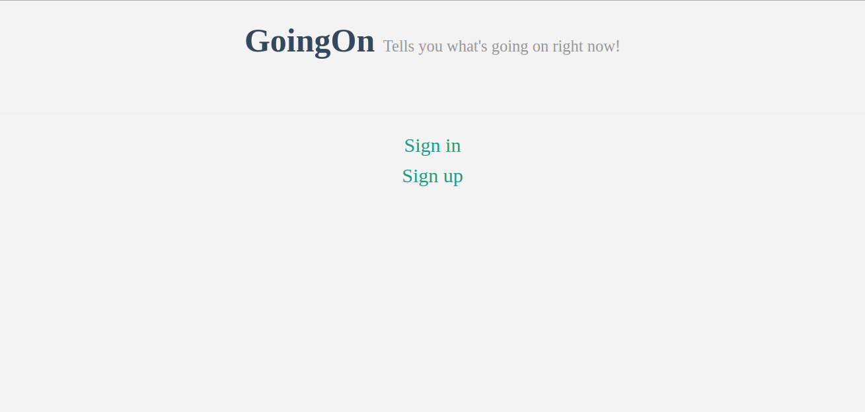
Homepage

Slide 4
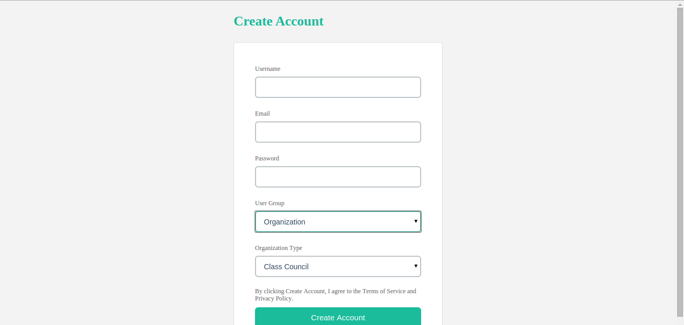
Sign up －organization

Slide 5
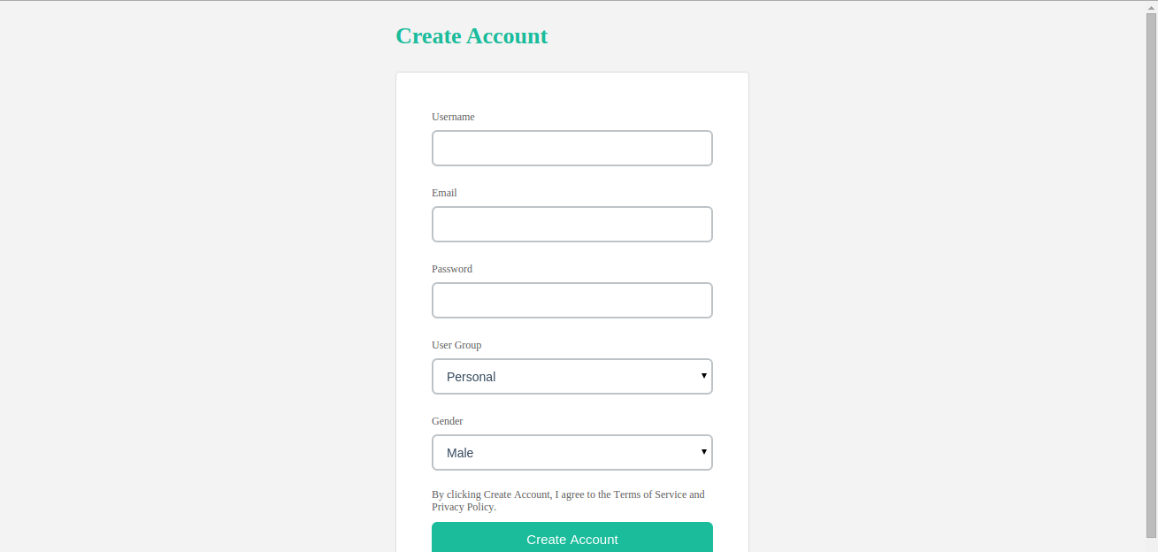
Sign up - personal

Slide 6
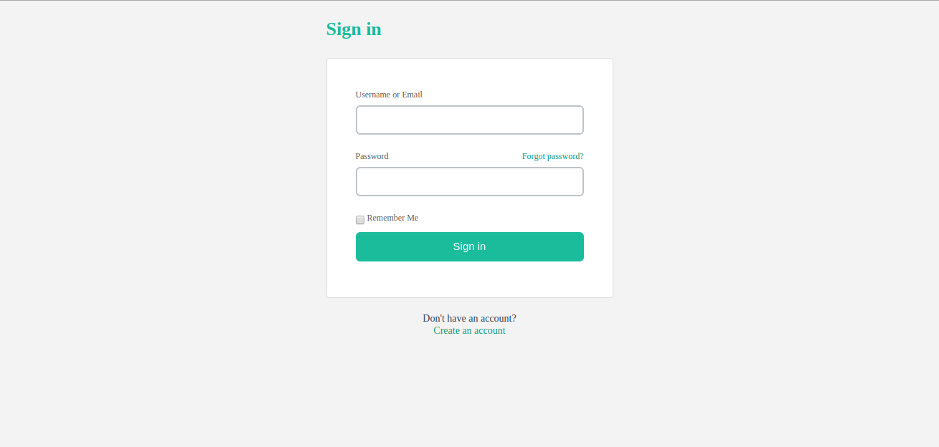
Sign in

Slide 7
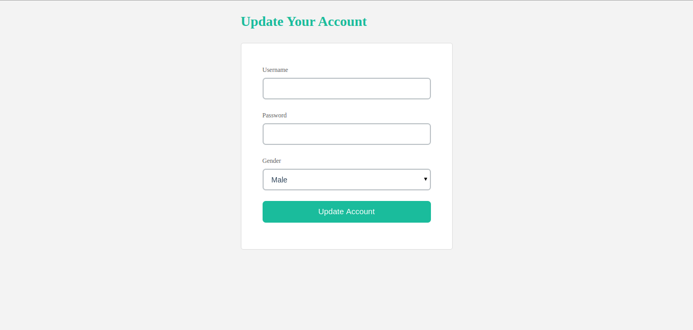
Update account

Slide 8
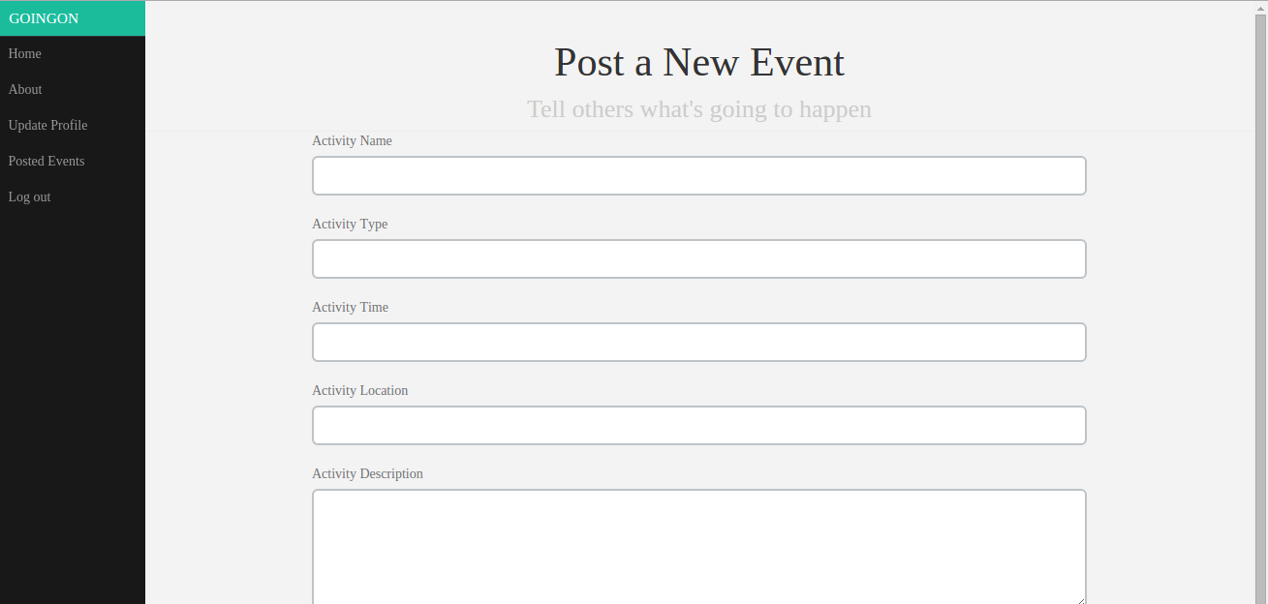
Homepage for organization

Slide 9
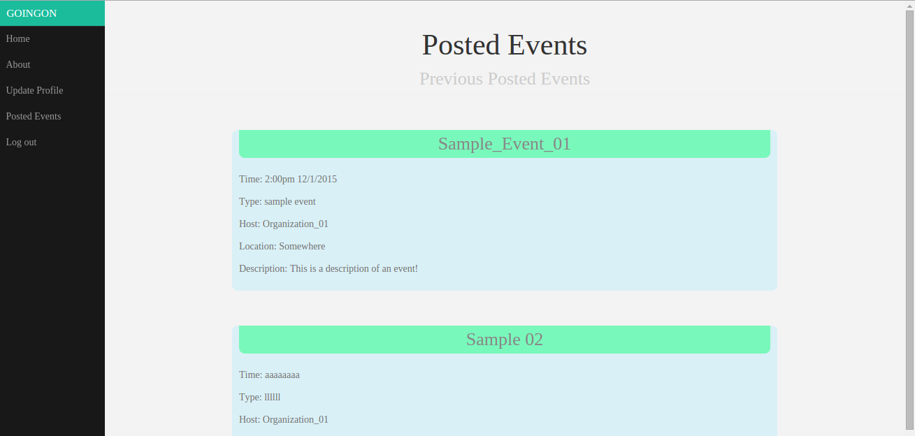
Posted events

Slide 10
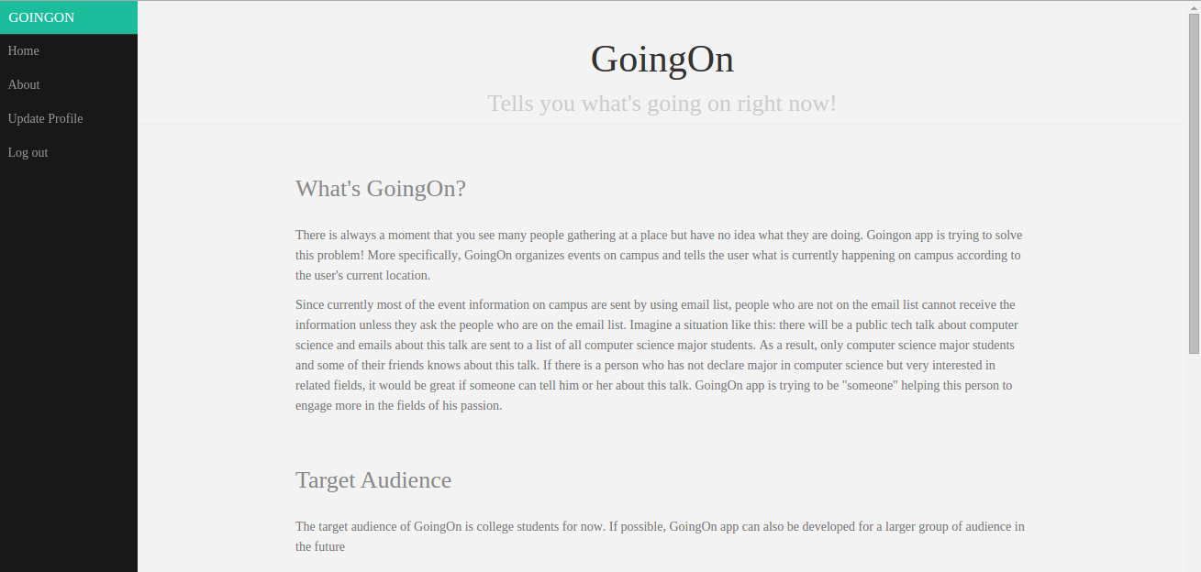
about

Slide 11

Homepage for personal user

Slide 12
Thank you!!!

