Slide 1
Week 2
Review of d3 API

Slide 2
Acquire
Parse
Filter
Mine
Represent
Refine
Interact

Slide 3
Acquire
Parse
Filter
)
(
(
Mine
Represent
Refine
Interact
)
Data import
Data transformation
DOM Manipulation

Slide 4
Acquire
Parse
Filter
)
(
(
Mine
Represent
Refine
Interact
)
Data import
d3.csv
…
Data transformation
d3-collection
d3-array
Data structure manipulation (e.g. arrays)
Various d3 layouts
DOM Manipulation
d3-selection
Enter-exit-update pattern

Slide 5
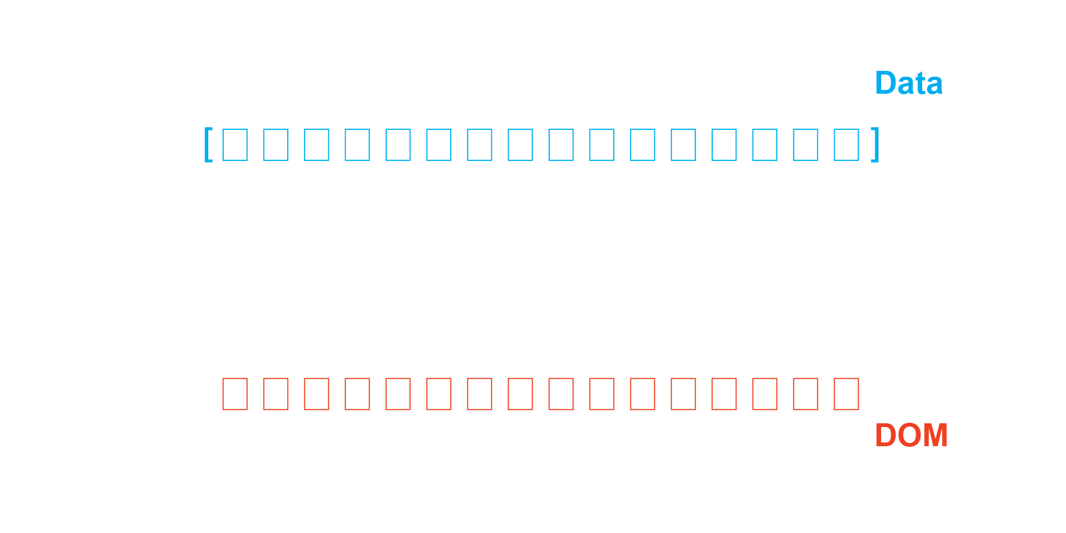
Week 2
Enter/Exit/Update

Slide 6
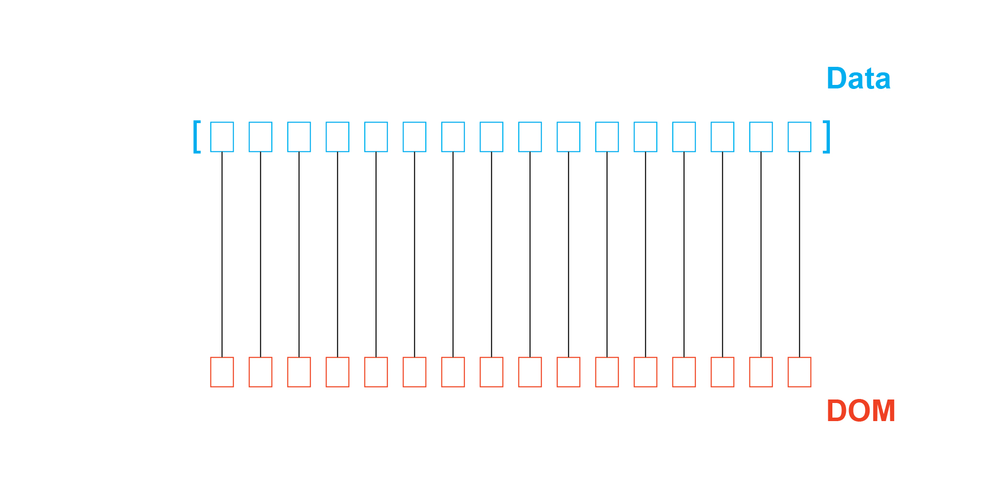
const updateSet = selection.data(array)

Slide 7
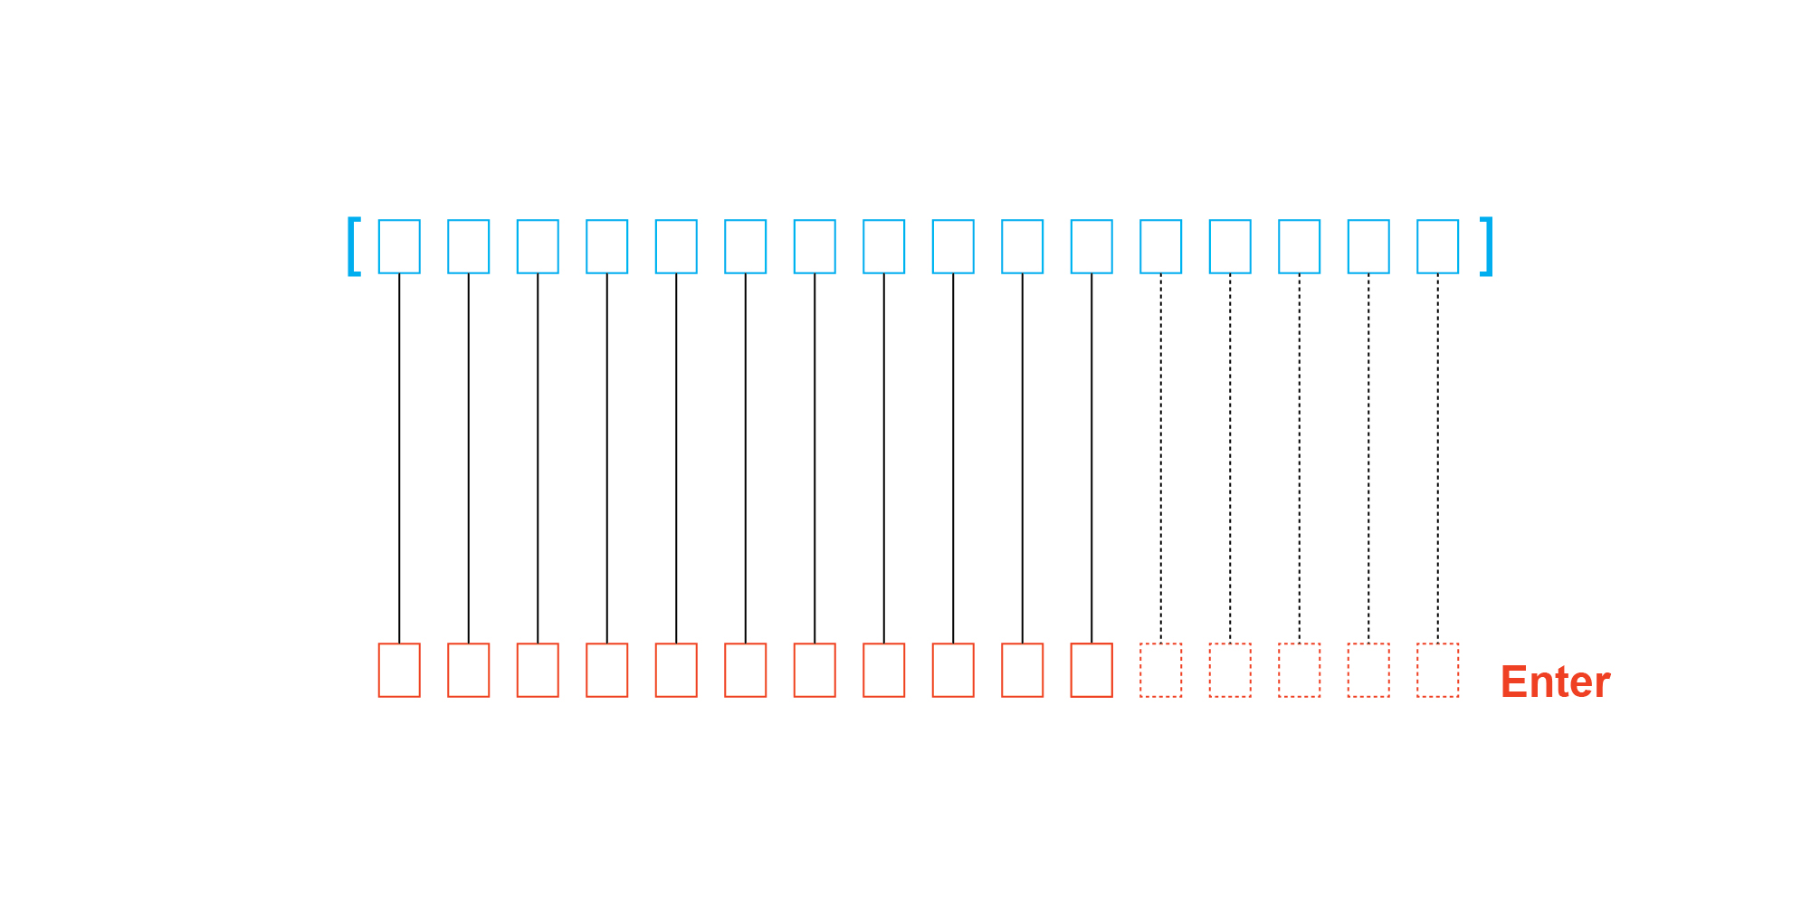
updateSet.enter()

Slide 8
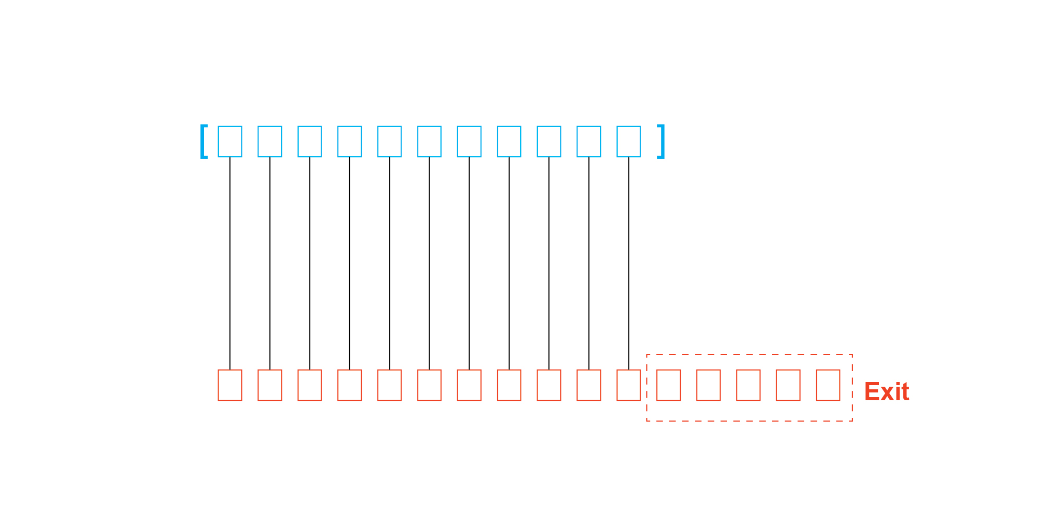
updateSet.exit()

Slide 9
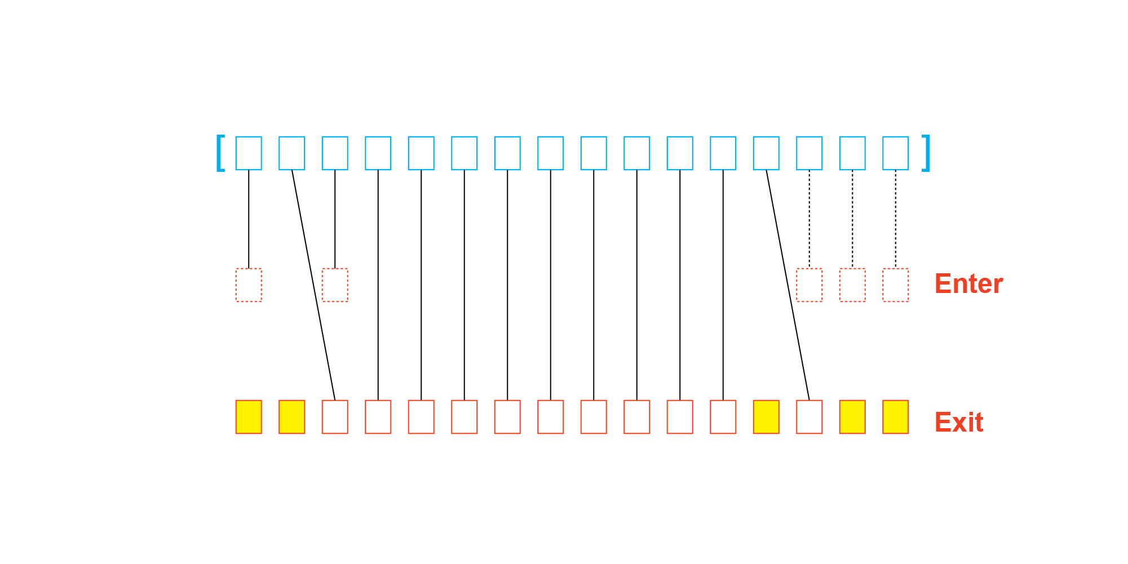
const updateSet = selection.data(array, key)

Slide 10
Week 2
Recap
d3
Understand how various d3 modules relate to the visualization pipeline
Understand d3.selection
Difference between selection and DOMNode, and how to go from one to the other
Manipulating selection, changing style and attributes
Binding data to selection (enter-exit-update pattern)
Fundamentals of Functions
Variable scope
“this” context
Function closure

