Slide 1

PRESENTATION TOPIC: UNIX OPERATING SYSTEM
Course Title: Operating System
Course Code:ICT- 2201
Presented By:
Shuyaib Hasan Shuyeb
ID: IT23047
Department of In formation and Communication Technology,
MBSTU
Supervised By:
Dr. Nazrul Islam
Associate Professor
Department of Information and CommunicationTechnology,
MBSTU

Slide 2
What is UNIX
• UNIX is a multiuser operating system.
• Developed in 1969.
• Used in servers and networks.
• Handles multiple users at once.

Slide 3
Why UNIX is Used
• Stable and reliable.
• Strong security.
• Supports multitasking.
• Used in servers and IT systems.

Slide 4
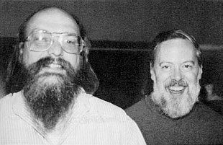
History of UNIX
• Developed at Bell Labs.
• Created by Ken Thompson
and Dennis Ritchie.
• Written in C language.
• Base of Linux and macOS.

Slide 5
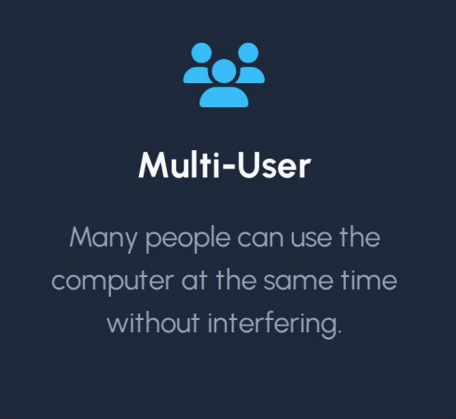
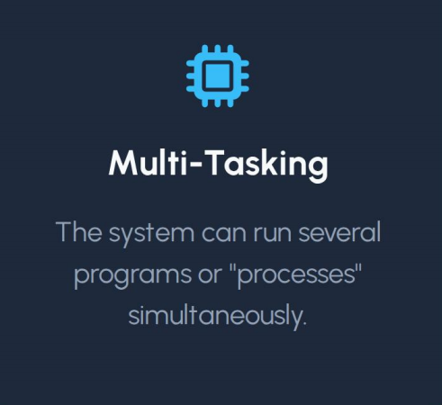
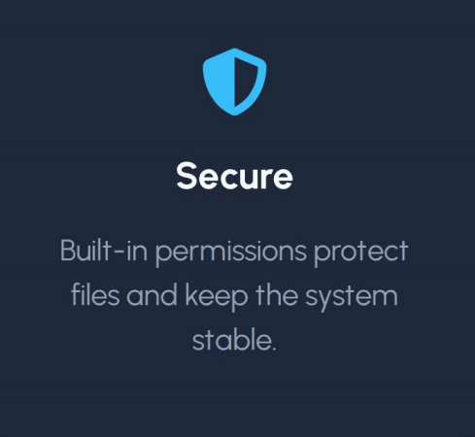
Core Features of Unix

Slide 6
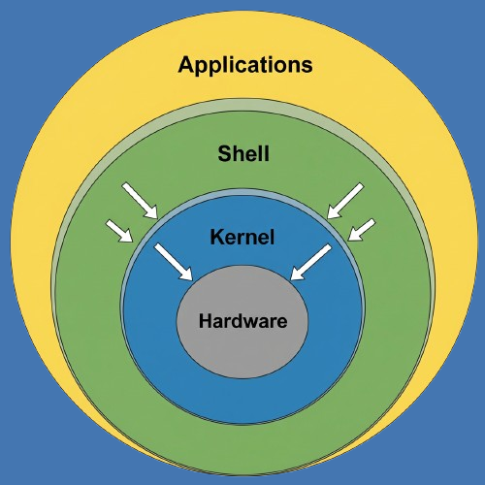
UNIX Architecture
• Kernel – core part.
• Shell – user interface.
• File System.
• Hardware interaction.

Slide 7
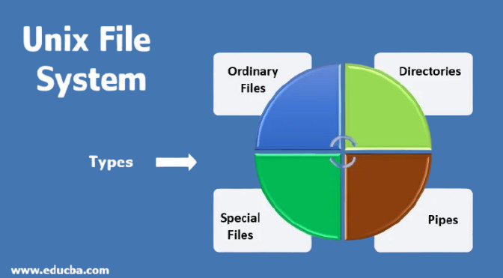
UNIX File System
• Hierarchical (Tree structure).
• Root directory:”/”
•Example Folder:
• /home, /bin, /etc
• Organized storage system

Slide 8
Basic UNIX Commands
• ls – list files
• cd – change directory
• pwd – show path
• mkdir – create folder
Commands | What it does
ls | list files
cd | change directory
pwd | show current path
mkdir | creat folder
rm | remove files

Slide 9
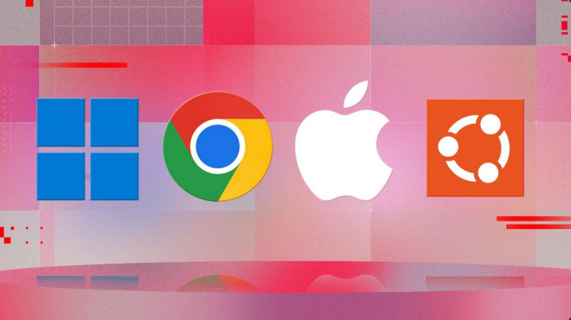
Popular Unix System
• Linux: The open-source version thst runs the internet
• macOs: Apple’s computer run on a Unix core
• Android
• FreeBSD: High-end system used by big companis

Slide 10
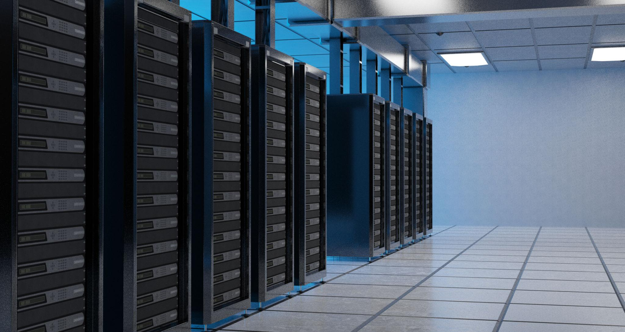

Real-Life Uses of Unix
• Web Servers
• Cloud Computing
• Banking Systems
• Telecommunication
• Scientific Research

Slide 11
Unix vs Windows
Feature | UNIX | WINDOWS
Interface | Command Line | Graphical
Security | High | Moderate
Stability | Very High | Medium
Users | Advance | General

Slide 12
Advantages of UNIX
• High stability.
• Multiuser support.
• Secure system.
• Powerful networking.

Slide 13
Disadvantages of UNIX
• Hard for beginners.
• Command-line based.
• Less user-friendly.

Slide 14
Summary
• UNIX is powerful and reliable.
• Used in modern systems.
• Base for many OS.
• Important in IT field.

Slide 15

Thank You

