Slide 1
PyCON KENYA 2017
YouTube data visualization tool
Presenter: Mainye Ben
@Shuyin_ben

Slide 2
YouTube video sharing website. Loads of content being added everyday.
Thanks to it, we've seen the African YouTubers (a couple of African YouTubers made this, i happen to be one), =3, skateline their introduction video if your https://youtu.be/GABRAB9QEkQ). Are you one?

Slide 3
Main Points
Other visualization tools existing and some problems associated with them.
About Bokeh API.
Is it useful? For other other things apart from YouTube exported data.
Data visualization in Action
Review.
Questions? Comments? Recommendations?

Slide 4
Alternatives:
Social Blade: https://www.socialblade.com
YouTube analytics section: https://www.youtube.com/analytics

Slide 5
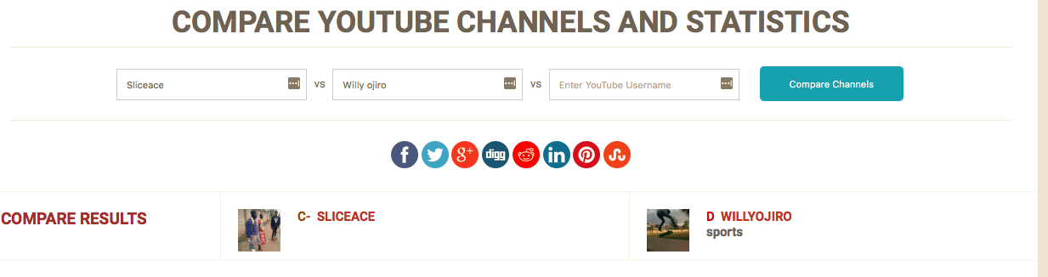
How are these grades being determined?
C- and D

Slide 6
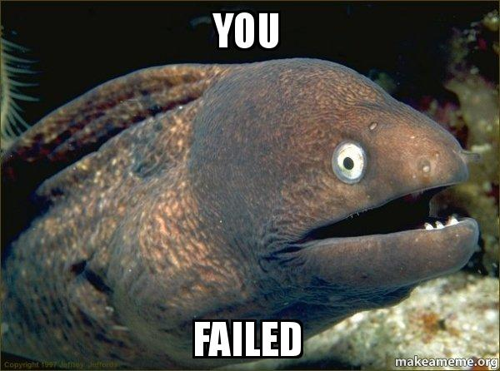

Slide 7
YouTube is cool, but they don't provide a codebook for the different columns of data.
Some column names:
watch_time_minutes
views
youtube_red_watch_time_minutes
youtube_red_views
average_view_duration

Slide 8
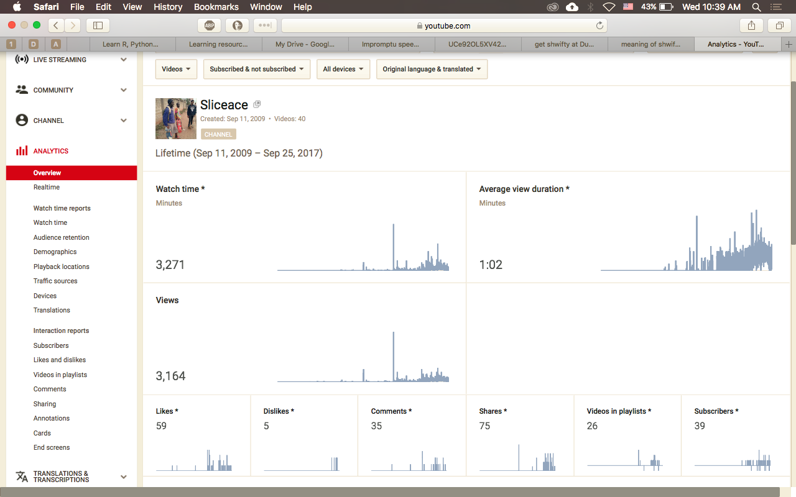

Slide 9
Why i made it?
A Request
Wanted to build something with Bokeh API.
Some limitations i wanted to try and address.

Slide 10
Is it useful? For other other things apart from YouTube exported data

Slide 11
As long as the dataframe is Tidy it will. Tidy datasets have this structure:
1. Each variable forms a column.
2. Each observation forms a row.
3. Each type of observational unit forms a table.
From Hadley Wickham's paper http://vita.had.co.nz/papers/tidy-data.pdf

Slide 12
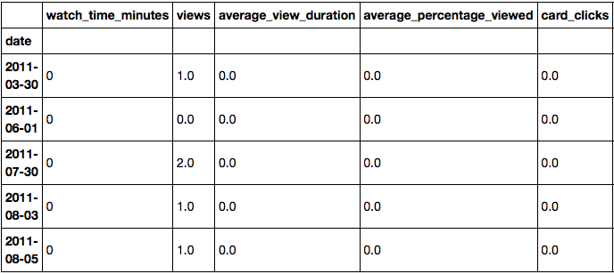

Slide 13
About Bokeh
Bokeh is an interactive data visualization library for Python and other languages like R that targets modern web browsers for presentation.
For more check out: https://bokeh.pydata.org/en/latest/

Slide 14
Let's see this data visualization tool in action

Slide 15
Review

Slide 16
Other visualization tools existing and some problems associated with them.
Quick overview of the API used to build the tool.
How it is useful? For other other things apart from YouTube exported data.
Data visualization in Action
Review & Conclusion

Slide 17
Questions? Comments? Recommendations?

