Slide 1
Subword Tokenization & Robustness on CoNLL‑2003
Presenter: Shuyang Ren
Notes:
Hi everyone, I explored how subword tokenizers—Unigram, BPE, and WordPiece—affect performance and robustness. I used Hugging Face tokenizers only, then TF‑IDF + Logistic Regression. To probe robustness, I compared normal test data with a noisy version where about 5% of alphabetic characters are randomly substituted.
<number>

Slide 2
Dataset & Task Adaptation
Dataset: CoNLL‑2003 (English)
Original task: NER (token-level tags)
Our task: sentence-level classification
Loaded from Parquet branch (no remote script)
Notes:
CoNLL‑2003 is an NER dataset. I converted each sentence into text and created a sentence‑level label: 1 if any token has a non‑O tag. I loaded from the Parquet branch to avoid executing remote loader scripts and to stay compatible with modern datasets.
<number>

Slide 3
Pipeline Overview
Prepare sentences + labels
Train tokenizer (Unigram / BPE / WordPiece, ~10k vocab)
Vectorize: TF‑IDF over tokenizer outputs (fixed vocab)
Classify: Logistic Regression
Evaluate: Clean vs Noisy (+ Zipf plots)
Notes:
The pipeline is: prepare data, train the tokenizer (Unigram/BPE/WordPiece at ~10k vocab), convert token sequences to TF‑IDF features using the tokenizer’s vocabulary, train a Logistic Regression classifier, and evaluate on clean vs noisy text. I also generate Zipf plots of token frequencies.
<number>

Slide 4
Code: Data Prep
ds = load_dataset("parquet", data_files={...})
# sentence label = 1 if any NE tag != 'O'
for tokens, ner_ids in zip(ds[split]["tokens"], ds[split]["ner_tags"]):
text = " ".join(tokens)
label = 1 if any(tid != O_IDX for tid in ner_ids) else 0
Notes:
Key prep lines: joining tokens to sentences and setting the label to 1 if any NE tag is not O. Outputs are a CSV for classification and a raw text corpus for tokenizer training.
<number>

Slide 5
Code: Train Tokenizer
from tokenizers.models import Unigram, BPE, WordPiece
from tokenizers import Tokenizer
from tokenizers.trainers import UnigramTrainer, BpeTrainer, WordPieceTrainer
from tokenizers.normalizers import NFD, Lowercase, StripAccents, Sequence
model = Unigram() # or BPE(), WordPiece()
tok = Tokenizer(model)
tok.normalizer = Sequence([NFD(), Lowercase(), StripAccents()])
tok.train([CORPUS_PATH], UnigramTrainer(vocab_size=10000, special_tokens=[...]))
tok.save(TOK_PATH) # JSON file (no SentencePiece needed)
Notes:
Training the tokenizer with Hugging Face tokenizers: choose Unigram, BPE, or WordPiece. Use NFD → lowercase → strip accents and whitespace pre‑tokenization. Save the trained tokenizer as JSON—no SentencePiece dependency.
<number>

Slide 6
Code: Vectorize & Evaluate
# Encode → space-joined tokens → TF-IDF with fixed vocab
X_train_tok = [" ".join(encode_fn(t)) for t in X_train]
vectorizer = TfidfVectorizer(
vocabulary=vocab_map, tokenizer=str.split,
preprocessor=None, token_pattern=None, lowercase=False
)
Xtr = vectorizer.fit_transform(X_train_tok)
clf = LogisticRegression(max_iter=1000).fit(Xtr, y_train)
# Noise: ~5% character substitutions, then re-tokenize and re-vectorize
Notes:
For features, I encode sentences to tokens, join with spaces, and build TF‑IDF using a fixed vocabulary equal to the tokenizer’s tokens. Train Logistic Regression. For noise, I apply 5% character substitutions and then re‑tokenize and re‑vectorize before predicting.
<number>

Slide 7
Results: Scoreboard
Tokenizer | Vocab | Clean Acc | Noisy Acc | Drop (%)
unigram-conll2003-10k | 9374 | 0.8865 | 0.8532 | 3.33
bpe-conll2003-10k | 10000 | 0.8768 | 0.8479 | 2.89
wordpiece-conll2003-10k | 10000 | 0.8768 | 0.8455 | 3.13
Notes:
Results: Unigram had the best clean and noisy accuracy; BPE had the smallest relative drop. Differences are modest—around half to one percentage point—so all three are competitive. The plots make this easy to see.
<number>

Slide 8
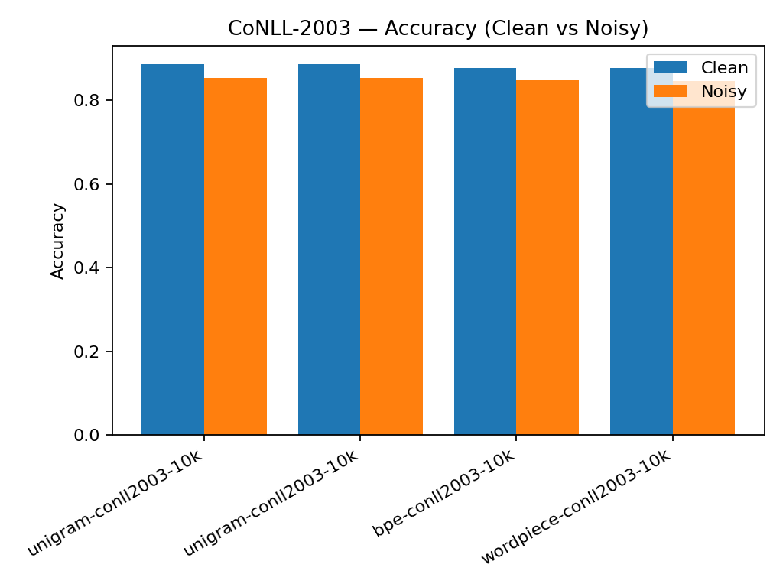
Clean vs Noisy Accuracy (Chart)
Notes:
This chart shows clean vs noisy accuracy across tokenizers. The gaps illustrate how performance changes under noise.
<number>

Slide 9
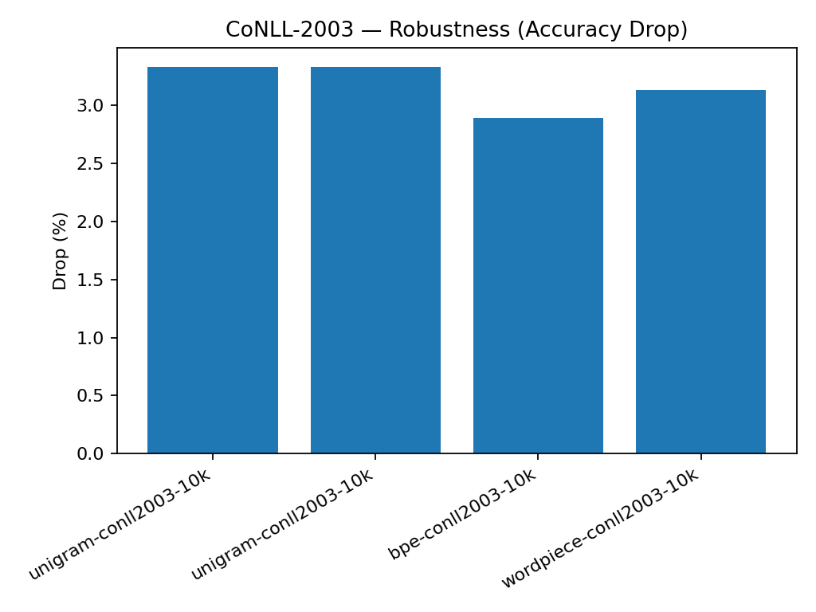
Robustness: Accuracy Drop (%)
Notes:
This chart shows the relative accuracy drop. Lower is better—here BPE degrades slightly less from its own clean baseline.
<number>

Slide 10
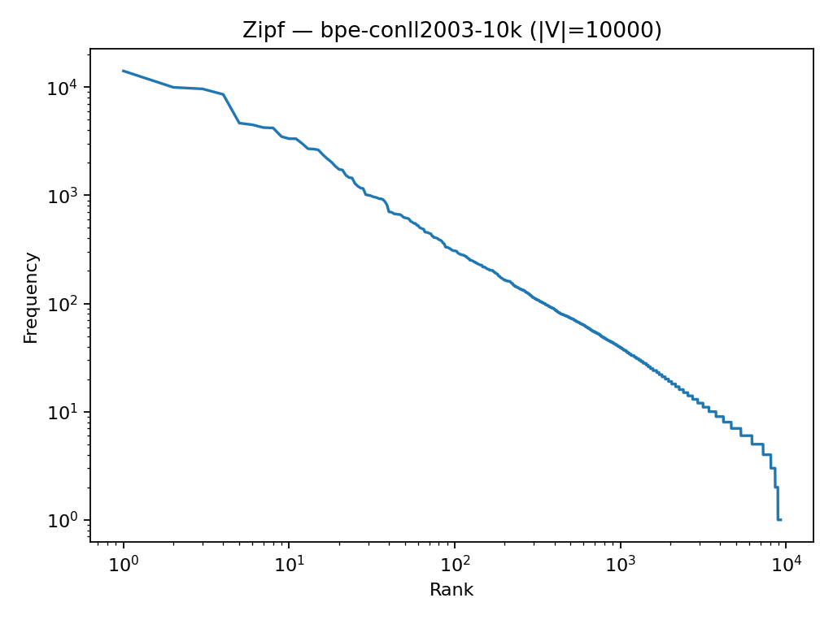
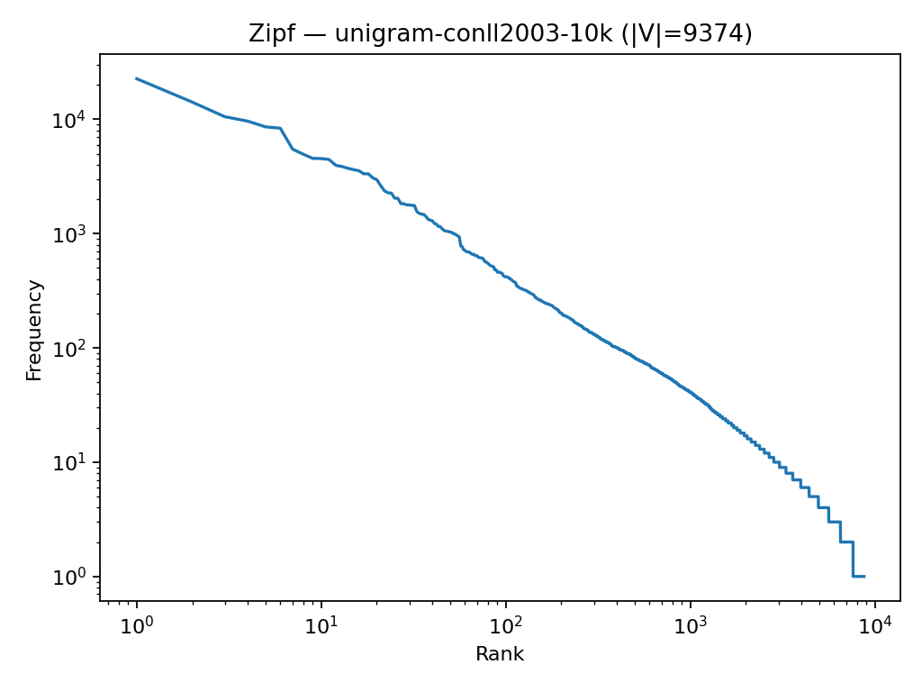
Zipf Plot (Token Frequency)
Notes:
The Zipf plot visualizes token frequency vs rank on log‑log axes; typical Zipf‑like behavior indicates a heavy‑tailed vocabulary distribution.
<number>

Slide 11
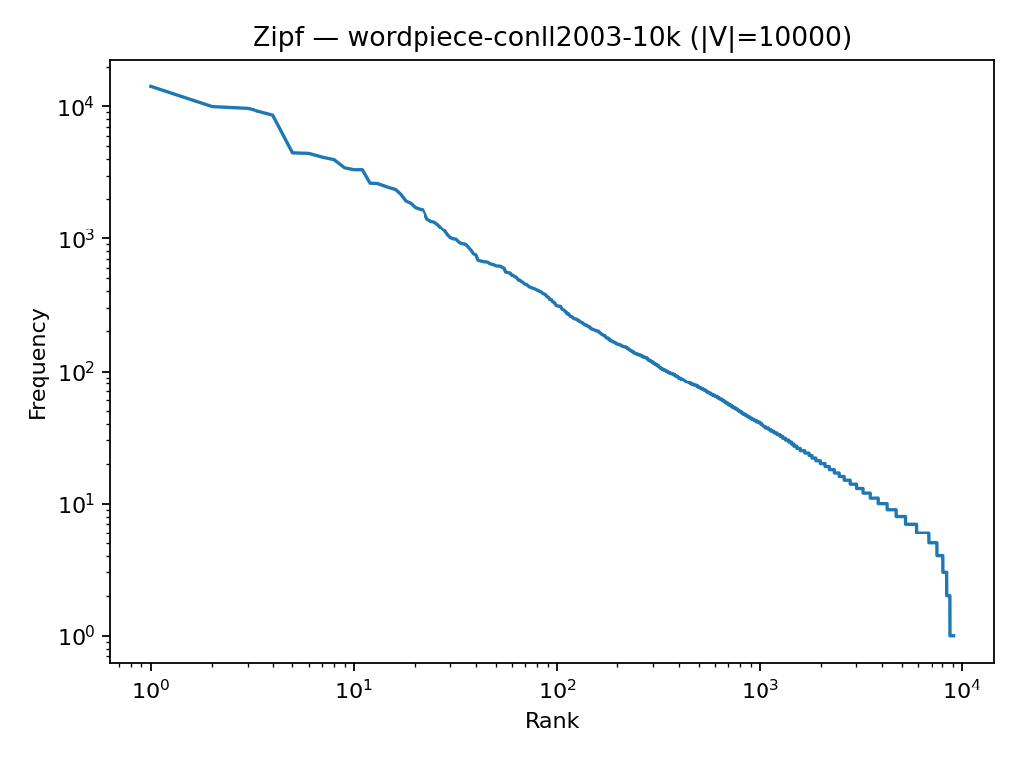
Zipf Plot (Token Frequency)
Notes:
The Zipf plot visualizes token frequency vs rank on log‑log axes; typical Zipf‑like behavior indicates a heavy‑tailed vocabulary distribution.
<number>

Slide 12
Takeaways & Design Choices
OOV handling: subwords avoid [UNK] most of the time
Normalization: lowercasing helps but can hide case cues
Granularity vs robustness: Unigram slightly best absolute; BPE smallest relative drop
Simple model → clearer tokenizer comparison
Notes:
Takeaways: subwords avoid OOV; lowercasing unifies forms but may hide case cues; Unigram wins slightly on absolute accuracy while BPE is slightly more robust. A simple linear model keeps the comparison focused on tokenization.
<number>

Slide 13
What’s Next
Vocab sweeps: 5k / 10k / 30k
Case-sensitive training (drop Lowercase() in normalizer)
Richer noise: deletions/insertions, keyboard-adjacent
Byte-level BPE baseline
Subword regularization (Unigram)
Small neural encoder (tokenizer fixed)
Notes:
Next steps: vary vocabulary size, test case sensitivity, use richer noise, try byte‑level BPE, and add subword regularization for Unigram. With more time, I’d also test a small neural encoder with the tokenizer fixed.
<number>

Slide 14
References
Sennrich et al., 2016 — BPE
Schuster & Nakajima, 2012 — WordPiece
Kudo, 2018 — Unigram LM / SentencePiece
Tjong Kim Sang & De Meulder, 2003 — CoNLL‑2003
Pedregosa et al., 2011 — scikit‑learn
Notes:
References for BPE, WordPiece, Unigram, the CoNLL‑2003 dataset, and scikit‑learn.
<number>

