Slide 1
Simulating Homogeneous Rectangular Waveguide Modes Using FEM
Project#2 ECE618
Team Members
Shuzhan Sun⁽¹⁾, Pintu Adhikari⁽²⁾, Ahmed Abdelraheem⁽³⁾
sun630@purdue.edu⁽¹⁾, adhikarp@purdue.edu⁽²⁾, aabdelr@purdue.edu⁽³⁾

Slide 2
Outline
Problem Formulation
Code Implementation
Results Validation & GUI

Slide 3
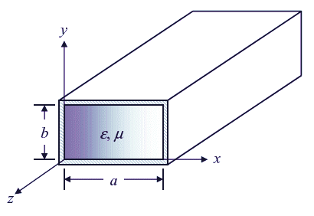
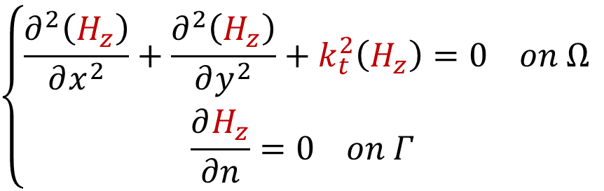
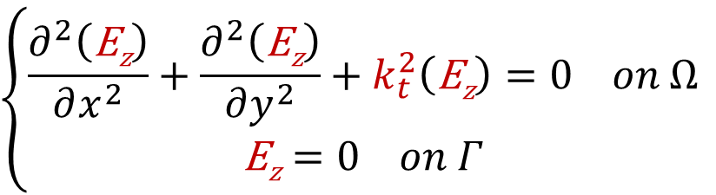
Problem Formulation
TM modes
TE modes
Solve for E_{z}
Solve for H_{z}
$$\left\{\begin{aligned}\frac{∂^{2}\left(H_{z}\right)}{∂x^{2}}+\frac{∂^{2}\left(H_{z}\right)}{∂y^{2}}+k_{t}^{2}\left(H_{z}\right)=0 on Ω \\ \frac{∂H_{z}}{∂n}=0 on Γ \end{aligned}\right.$$
$$\left\{\begin{aligned}\frac{∂^{2}\left(\text{E}\text{z}\right)}{∂x^{2}}+\frac{∂^{2}\left(\text{E}\text{z}\right)}{∂y^{2}}+k_{t}^{2}\left(\text{E}\text{z}\right)=0 on Ω \\ \text{E}\text{z}=0 on Γ\end{aligned}\right.$$

Slide 4
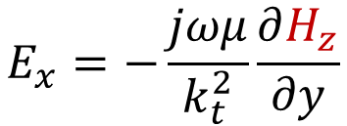
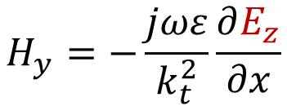
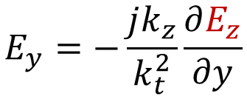
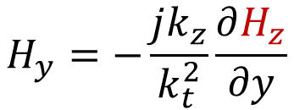
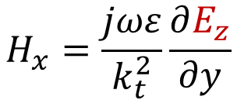
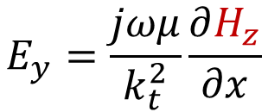
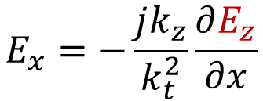
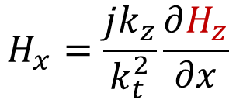
Problem Formulation
TM modes
TE modes
Solve for E_{z}
Solve for H_{z}
$$E_{x}=−\frac{jk_{z}}{k_{t}^{2}}\frac{∂E_{z}}{∂x}$$
$$H_{x}=\frac{jωε}{k_{t}^{2}}\frac{∂E_{z}}{∂y}$$
$$E_{x}=−\frac{jωμ}{k_{t}^{2}}\frac{∂H_{z}}{∂y}$$
$$H_{x}=\frac{jk_{z}}{k_{t}^{2}}\frac{∂H_{z}}{∂x}$$
$$E_{y}=−\frac{jk_{z}}{k_{t}^{2}}\frac{∂E_{z}}{∂y}$$
$$H_{y}=−\frac{jωε}{k_{t}^{2}}\frac{∂E_{z}}{∂x}$$
$$E_{y}=\frac{jωμ}{k_{t}^{2}}\frac{∂H_{z}}{∂x}$$
$$H_{y}=−\frac{jk_{z}}{k_{t}^{2}}\frac{∂H_{z}}{∂y}$$

Slide 5
Problem Formulation: Functional
Quote the lecture notes:
Equivalent Variational Problem:

Slide 6



Problem Formulation: TM Mode
Quote the lecture notes:
Equivalent Variational Problem:
1
- $k_{t}^{2}$
0
0
1
- $k_{t}^{2}$
$$\left\{\begin{aligned}\frac{∂^{2}\left(\text{E}\text{z}\right)}{∂x^{2}}+\frac{∂^{2}\left(\text{E}\text{z}\right)}{∂y^{2}}+k_{t}^{2}\left(\text{E}\text{z}\right)=0 on Ω \\ \text{E}\text{z}=0 on Γ\end{aligned}\right.$$

Slide 7

Problem Formulation: TE Mode
Quote the lecture notes:
Equivalent Variational Problem:
1
- $k_{t}^{2}$
0
0
1
- $k_{t}^{2}$
1
0
0
$$\left\{\begin{aligned}\frac{∂^{2}\left(H_{z}\right)}{∂x^{2}}+\frac{∂^{2}\left(H_{z}\right)}{∂y^{2}}+k_{t}^{2}\left(H_{z}\right)=0 on Ω \\ \frac{∂H_{z}}{∂n}=0 on Γ \end{aligned}\right.$$

Slide 8

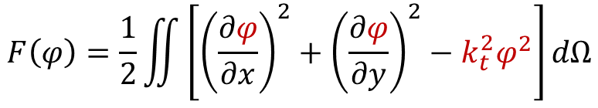

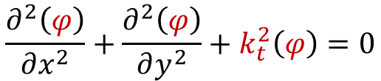

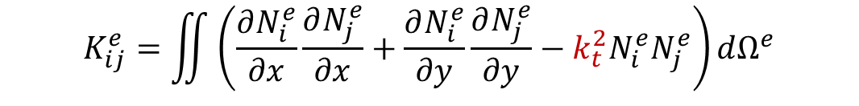

Problem Formulation
Scalar Helmholtz Equation
$$\frac{∂^{2}\left(φ\right)}{∂x^{2}}+\frac{∂^{2}\left(φ\right)}{∂y^{2}}+k_{t}^{2}\left(φ\right)=0$$
$$F\left(φ\right)=\frac{1}{2}\iint{\left[{\left(\frac{∂φ}{∂x}\right)}^{2}+{\left(\frac{∂φ}{∂y}\right)}^{2}−k_{t}^{2}φ^{2}\right]dΩ}$$
Equivalent Variational Problem
Unknown
$$K_{ij}^{e}=\iint{\left(\frac{∂N_{i}^{e}}{∂x}\frac{∂N_{j}^{e}}{∂x}+\frac{∂N_{i}^{e}}{∂y}\frac{∂N_{j}^{e}}{∂y}−k_{t}^{2}N_{i}^{e}N_{j}^{e}\right)dΩ^{e}}$$
Applying FEM
$$\left[K\right]\left\{φ\right\}=\left\{0\right\}$$
Split into 2 matrices
General Eigen-Value Problem
$$\left[A\right]\left\{φ\right\}=k_{t}^{2}\left[B\right]\left\{φ\right\}$$
$$A_{ij}^{e}=\frac{1}{4Δ^{e}}\left(b_{i}^{e}b_{j}^{e}+c_{i}^{e}c_{j}^{e}\right)$$
$$B_{ij}^{e}=\frac{Δ^{e}1}{12}\left(b_{i}^{e}b_{j}^{e}+c_{i}^{e}c_{j}^{e}\right)$$

Slide 9
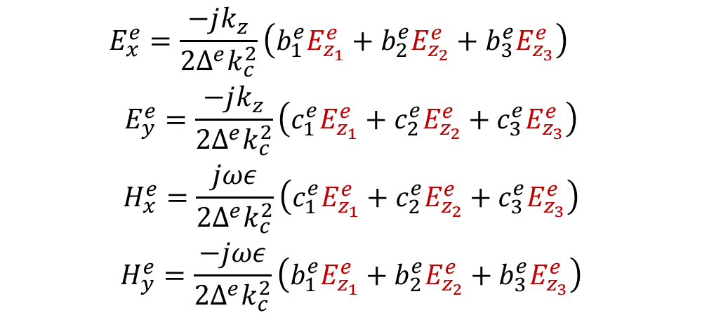
Problem Formulation
Post Processing
$$E_{x}^{e}=\frac{−jk_{z}}{2Δ^{e}k_{c}^{2}}\left(b_{1}^{e}E_{z_{1}}^{e}+b_{2}^{e}E_{z_{2}}^{e}+b_{3}^{e}E_{z_{3}}^{e}\right)$$
$$E_{y}^{e}=\frac{−jk_{z}}{2Δ^{e}k_{c}^{2}}\left(c_{1}^{e}E_{z_{1}}^{e}+c_{2}^{e}E_{z_{2}}^{e}+c_{3}^{e}E_{z_{3}}^{e}\right)$$
$$H_{x}^{e}=\frac{jωε}{2Δ^{e}k_{c}^{2}}\left(c_{1}^{e}E_{z_{1}}^{e}+c_{2}^{e}E_{z_{2}}^{e}+c_{3}^{e}E_{z_{3}}^{e}\right)$$
$$H_{y}^{e}=\frac{−jωε}{2Δ^{e}k_{c}^{2}}\left(b_{1}^{e}E_{z_{1}}^{e}+b_{2}^{e}E_{z_{2}}^{e}+b_{3}^{e}E_{z_{3}}^{e}\right)$$

Slide 10
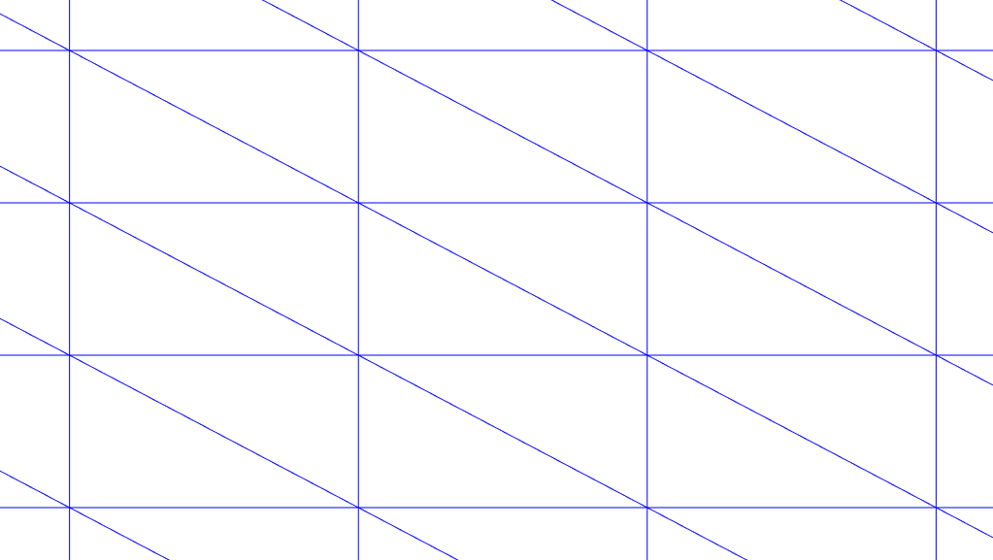
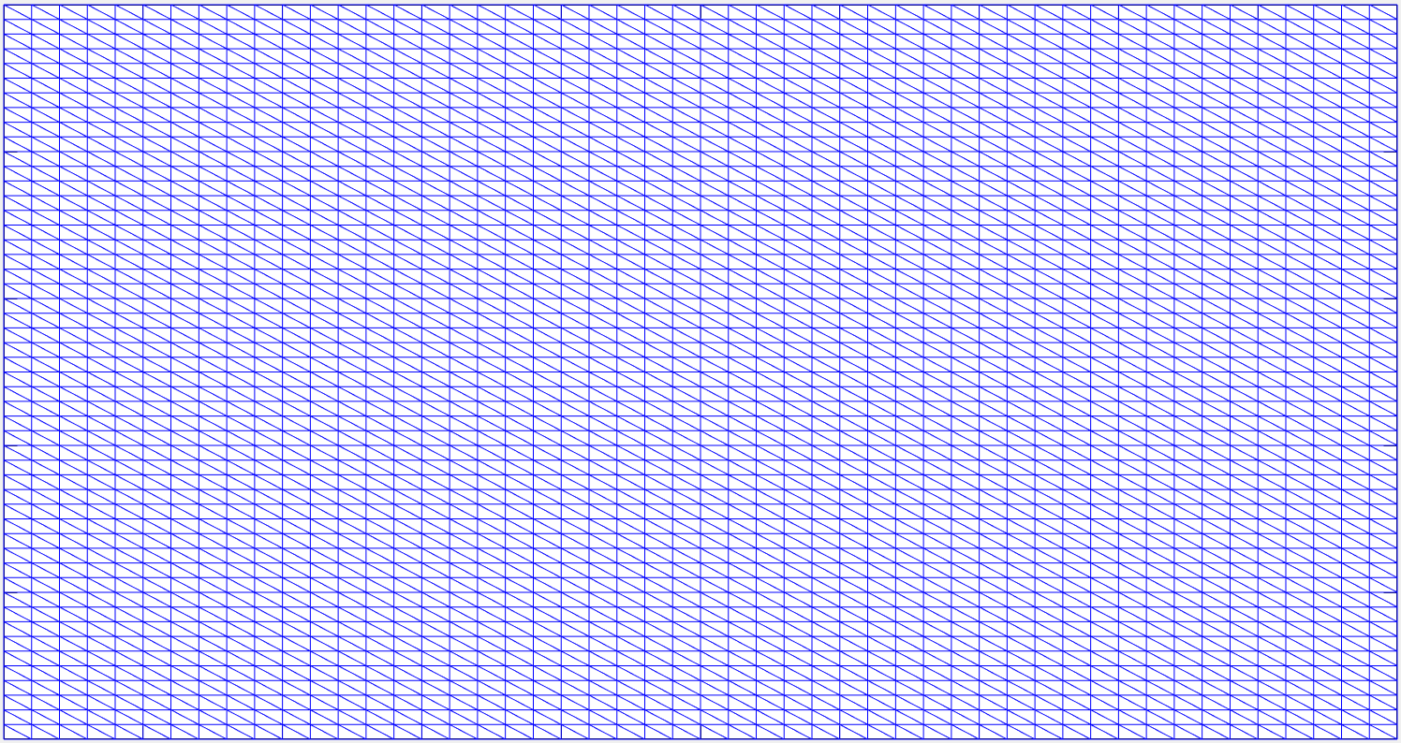
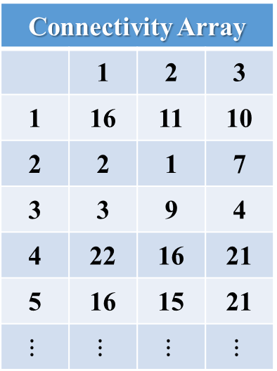




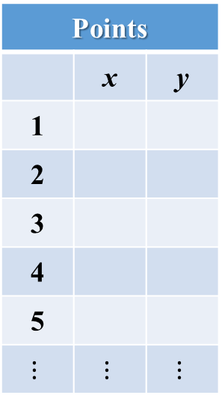
Code Implementation
1- Meshing
The outputs of “Meshing” step is two important matrices:
Connectivity Array
 | 1 | 2 | 3
1 | 16 | 11 | 10
2 | 2 | 1 | 7
3 | 3 | 9 | 4
4 | 22 | 16 | 21
5 | 16 | 15 | 21
$$⋮$$ | $$⋮$$ | $$⋮$$ | $$⋮$$
Points
 | x | y
1
2
3
4
5
$$⋮$$ | $$⋮$$ | $$⋮$$
$$\left(x_{3}^{e},y_{3}^{e}\right)$$
$$\left(x_{2}^{e},y_{2}^{e}\right)$$
$$e$$
$$\left(x_{1}^{e},y_{1}^{e}\right)$$
Assembly of the triangular elements and building matrices A & B

Slide 11
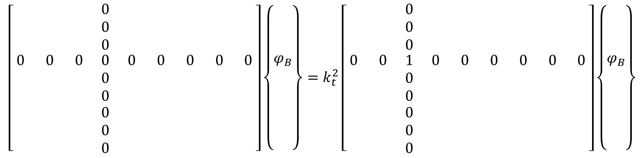
Code Implementation
2- Imposing Dirichilet BCs
A
φ
B
φ
$$\left[\begin{matrix}\begin{matrix} & & \\ & & \\ & & \end{matrix} & \begin{matrix}0 & & \\ 0 & & \\ 0 & & \end{matrix} & \begin{matrix} & & \\ & & \\ & & \end{matrix} \\ \begin{matrix}0 & 0 & 0 \\ & & \\ & & \end{matrix} & \begin{matrix}0 & 0 & 0 \\ 0 & & \\ 0 & & \end{matrix} & \begin{matrix}0 & 0 & 0 \\ & & \\ & & \end{matrix} \\ \begin{matrix} & & \\ & & \\ & & \end{matrix} & \begin{matrix}0 & & \\ 0 & & \\ 0 & & \end{matrix} & \begin{matrix} & & \\ & & \\ & & \end{matrix}\end{matrix}\right]\left\{\begin{matrix}\begin{matrix} \\ \\ \end{matrix} \\ \begin{matrix}φ_{B} \\ \\ \end{matrix} \\ \begin{matrix} \\ \\ \end{matrix}\end{matrix}\right\}=k_{t}^{2}\left[\begin{matrix}\begin{matrix} & & 0 \\ & & 0 \\ & & 0\end{matrix} & \begin{matrix} & & \\ & & \\ & & \end{matrix} & \begin{matrix} & & \\ & & \\ & & \end{matrix} \\ \begin{matrix}0 & 0 & 1 \\ & & 0 \\ & & 0\end{matrix} & \begin{matrix}0 & 0 & 0 \\ & & \\ & & \end{matrix} & \begin{matrix}0 & 0 & 0 \\ & & \\ & & \end{matrix} \\ \begin{matrix} & & 0 \\ & & 0 \\ & & 0\end{matrix} & \begin{matrix} & & \\ & & \\ & & \end{matrix} & \begin{matrix} & & \\ & & \\ & & \end{matrix}\end{matrix}\right]\left\{\begin{matrix}\begin{matrix} \\ \\ \end{matrix} \\ \begin{matrix}φ_{B} \\ \\ \end{matrix} \\ \begin{matrix} \\ \\ \end{matrix}\end{matrix}\right\}$$

Slide 12
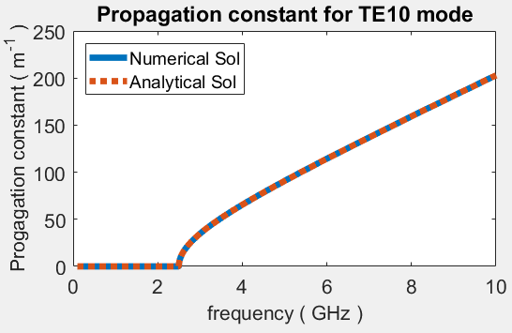
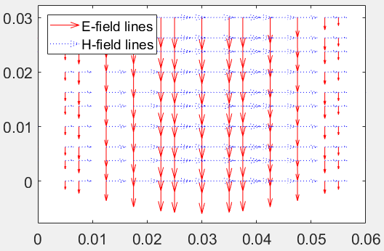
Code Implementation
3- Results

Slide 13
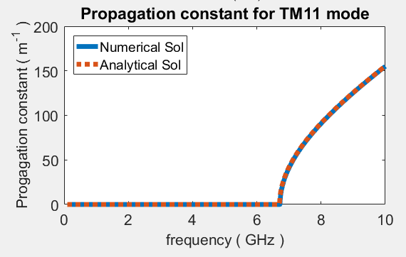
Results Validation
Numerical solution has compared with both Analytical solution and HFSS simulation
Propagation constant for all six modes are compared and an example is shown here
Cutoff frequency of TM11 mode from all the results are same i.e. 6.8 GHz, when a is 5 mm and b is 2.5 mm
Modal filed distributions have been compared with reference book for a rectangular waveguide with a/b=2:1
HFSS simulation

Slide 14
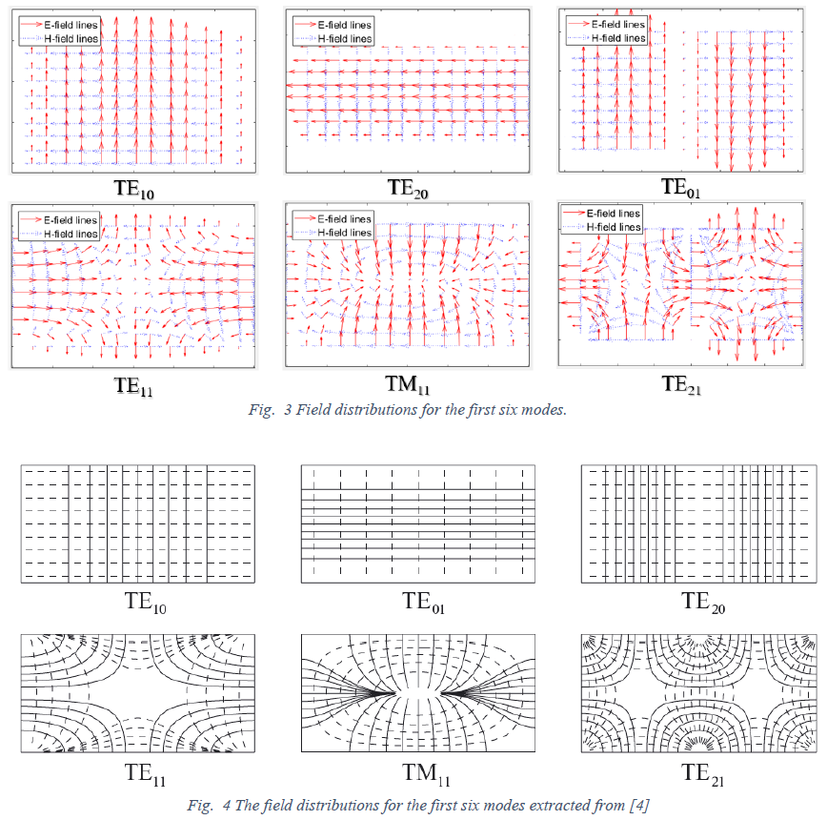
Results Validation & GUI
Field Distribution:
Modal Field Distribution of first six mode
Red arrow shows E-field and purple dost are H-filed from FEM code
Black solid and dot line represents E- & H-field from Reference book
GUI
GUI has designed in a user friendly manner
User can choose Waveguide dimension, dielectric constant, finite element size (mesh density), and modes

