Slide 1
Thin Wire Antenna Analysis using Method of Moments (MOM)
Shuzhan Sun

Slide 2
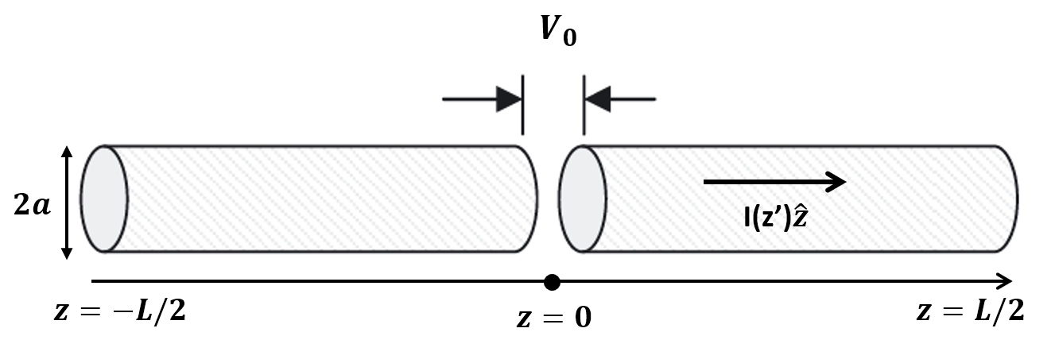
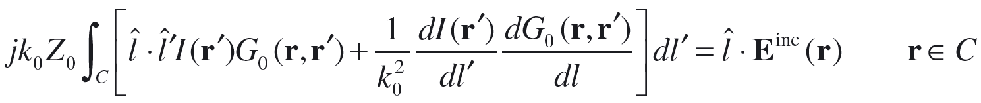
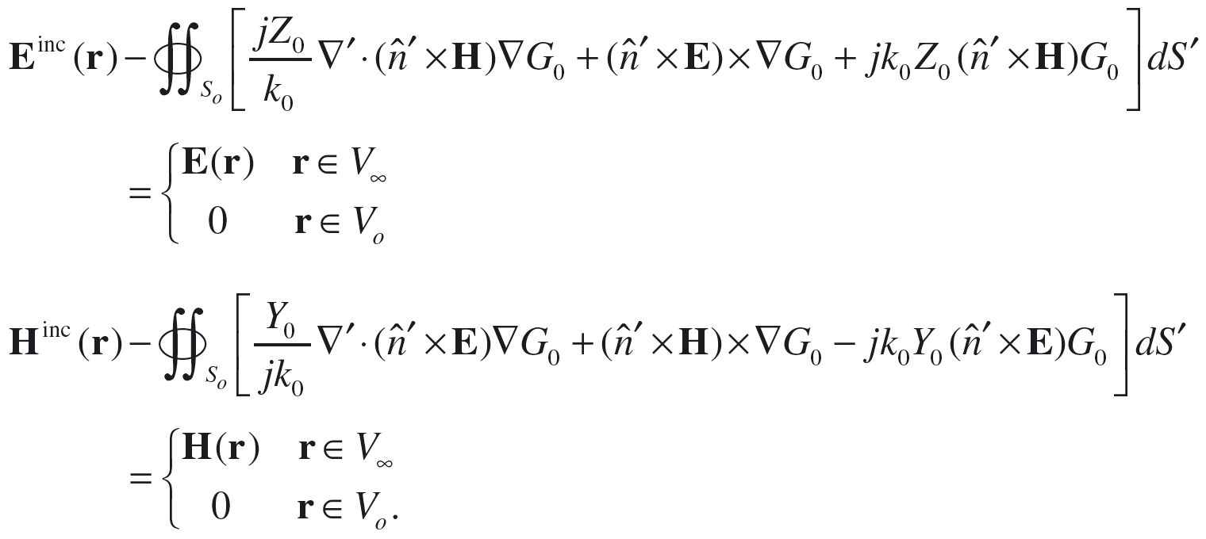
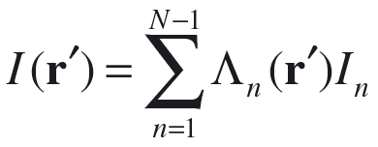
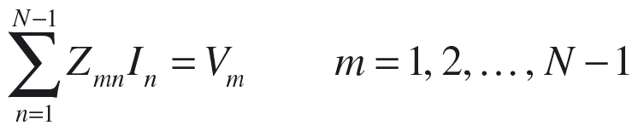
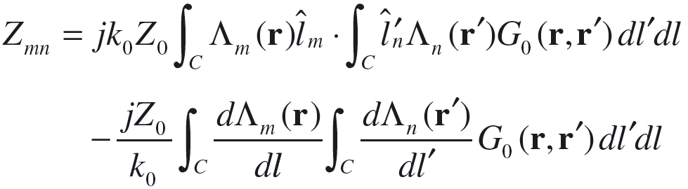
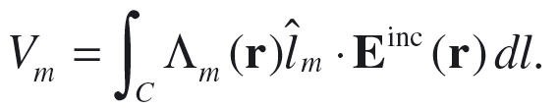
MOM Formulation
General 3D integral equation (IE)
Simplified IE for thin conducting wire antenna
Expansion and matrix formula
Notes:
Simplification: conductor, E//=0, H//~j, then integral over circle to get I from j, then 3D problem->2D IE -> 1D line integral

Slide 3
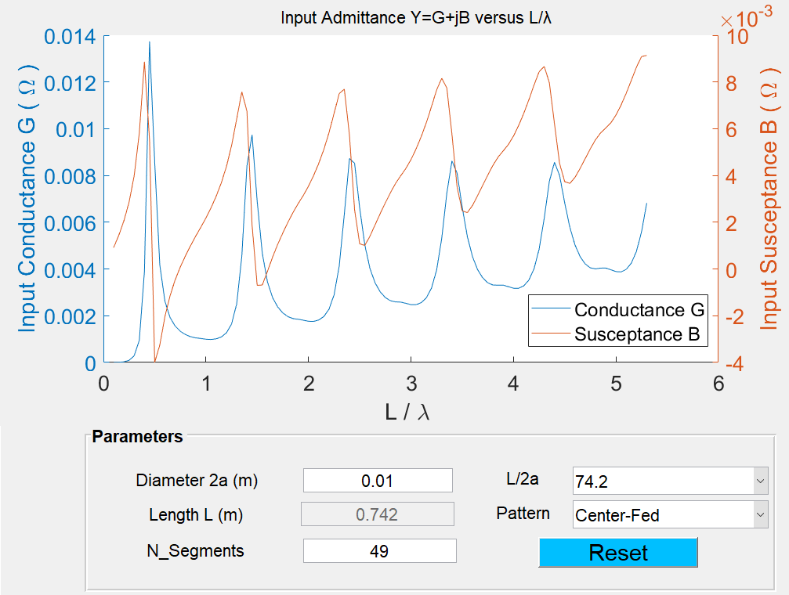
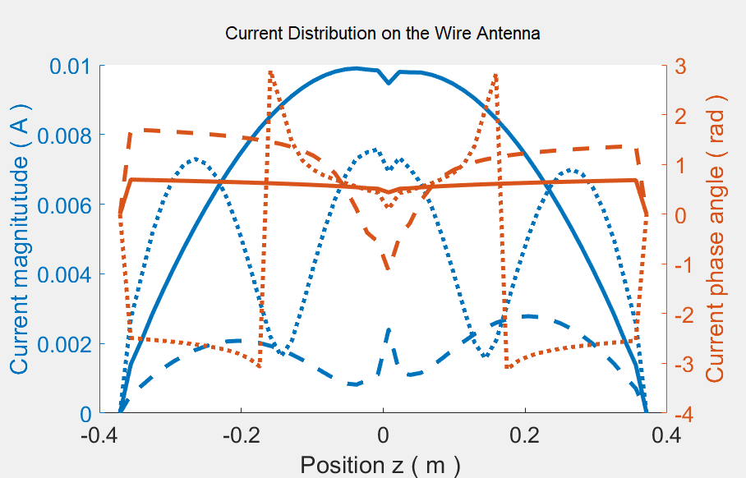
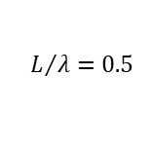
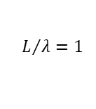
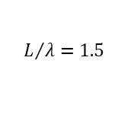
Center-Fed Antenna
$$L/λ=0.5$$
$$L/λ=1$$
$$L/λ=1.5$$

Slide 4
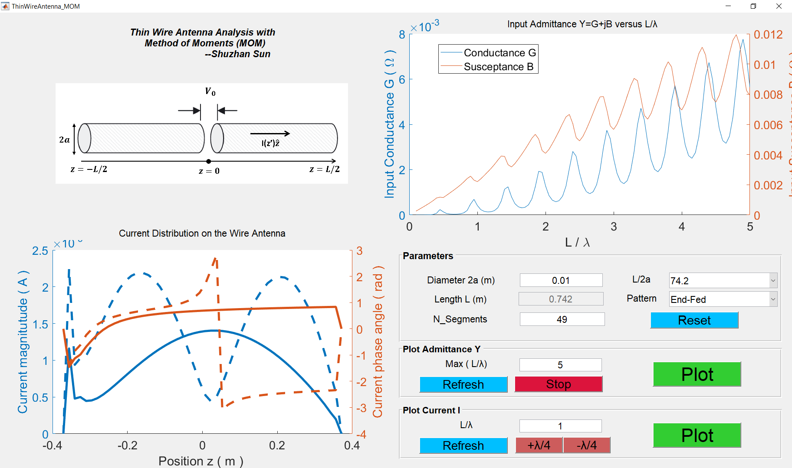

End-Fed Antenna ${(V}_{0} @ z=−L/2)$

