Slide 1

Wave propagation in parallel plate waveguide using Yee’s 3D finite-difference time-domain algorithm
Chang Yang
Shuzhan Sun
Skanda Kotethota
School of Electrical and Computer Engineering
Purdue University, USA

Slide 2
Objective
Solve for E and H inside parallel plate waveguide using FDTD method
Graphical illustration of the wave propagation along waveguide
Compare results with analytical solution

Slide 3
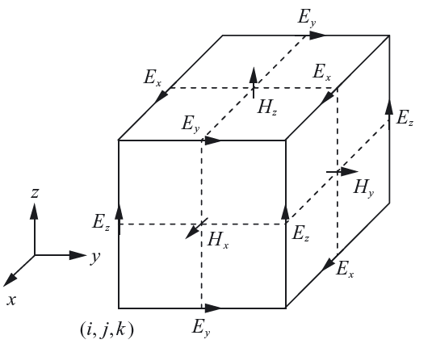
Yee’s 3D FDTD method ^{[1, 2]}
Replace Maxwell’s equation with finite difference equations
Space and time discretization
Solve equations along with boundary conditions to get E and H components
Representation of E and H fields in space

Slide 4
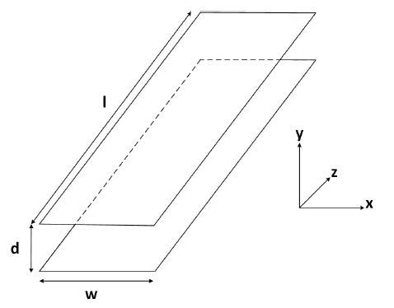
Parallel plate waveguide^{[3]}
Metal plates of finite length and width
Perfectly conducting plates separated by distance ‘d’
Allows propagation of all modes, (TEM, TM and TE)
A parallel plate waveguide

Slide 5
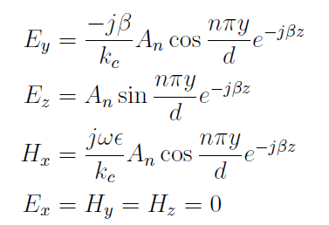
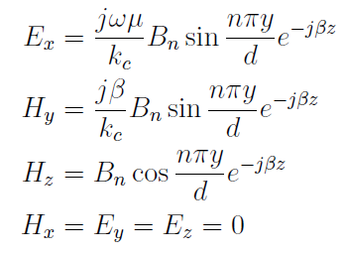



Theoretical analysis
Analysis done for TM and TE mode of propagation
Analytical results for infinitely long waveguide
Wave in +z direction
TM mode
TE mode

Slide 6
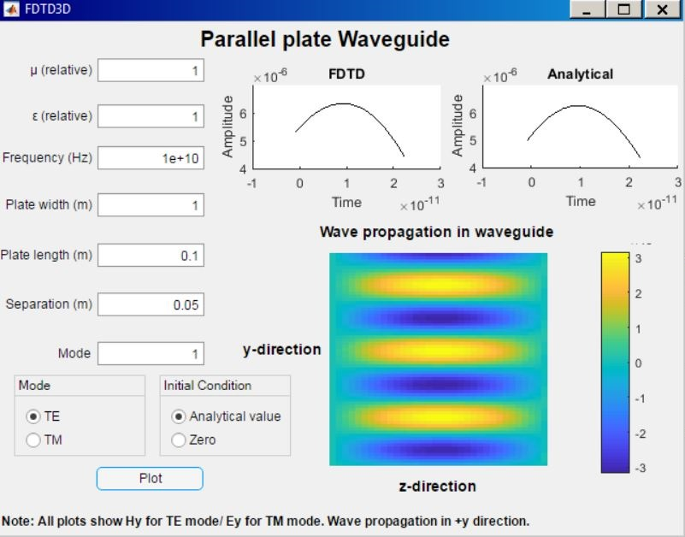
FDTD Implementation: GUI

Slide 7
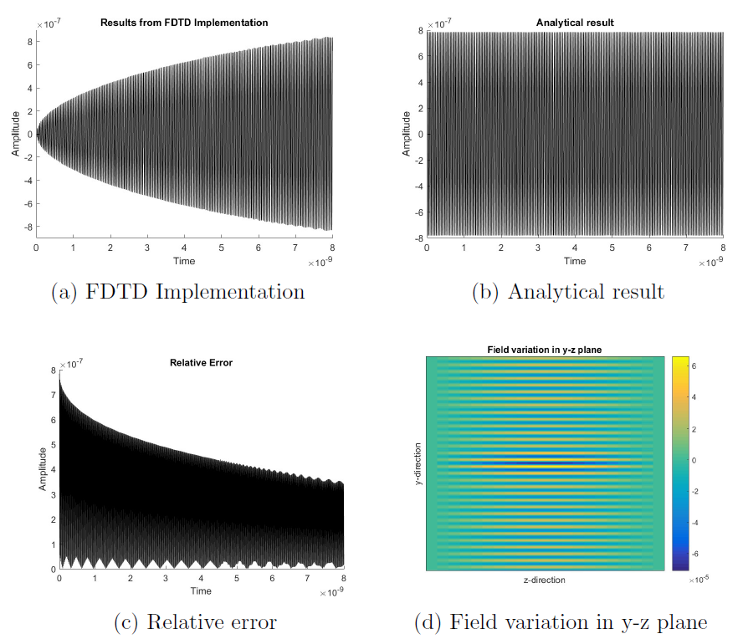
FDTD Implementation: All fields initialized to 0
TE mode: Variation of Hy with time (wave along +y direction)

Slide 8
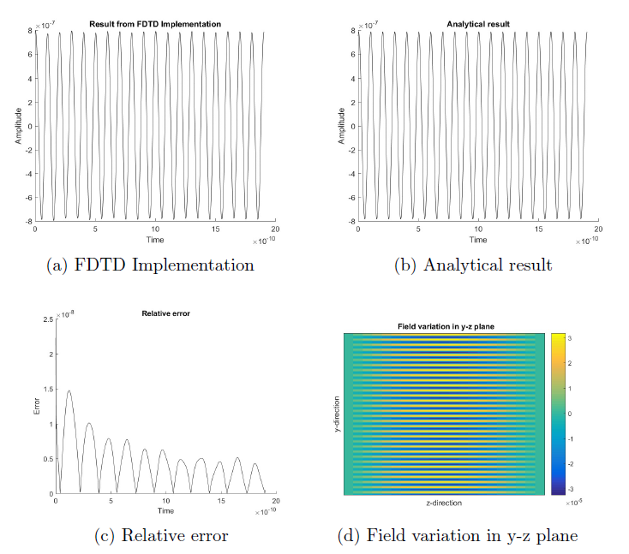
FDTD Implementation: Fields initialized using analytical result
TE mode: Variation of Hy with time (wave along +y direction)

Slide 9
Interpretation of results
When plate width to separation is small, PMC boundary does not behave like perfect absorbing boundary. Reflections cause results to deviate from analytical values.
Fix: Make the ratio large to resemble infinitely- large case
Relative error is attributed to phase difference.
Fix: Lower the value of grid size along direction of wave

Slide 10
References
[1] J.-M. Jin, Theory and Computation of Electromagnetic Fields, 2nd Edition. John Wiley & Sons, 2015.
[2] K. Yee, “Numerical solution of initial boundary value problems involving maxwell's equations in isotropic media," IEEE Transactions on Antennas and Propagation, vol. 14, no. 3, pp. 302{307, May 1966.
[3] D. M. Pozar, Microwave engineering. Wiley, 2012.

