Slide 1
Botnet Detection in Network Traffic Based on GBM
Kiran Muloor
Shashidhara GM
Somesh Sahu
Sandeep Shyam Bajaj

Slide 2
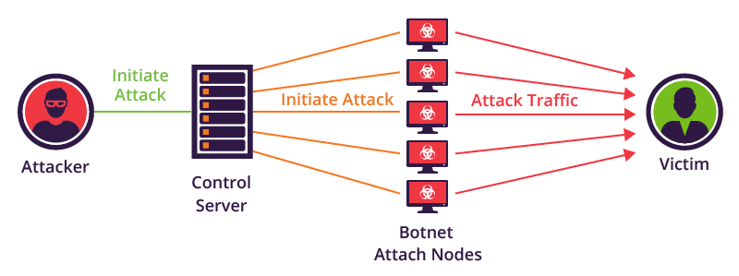
Agenda
Business Problem
Business Understanding
Data Pipeline
Modeling
Conclusion
Literature Review
Data Understanding
Business Problem/ Understanding
Literature Review
Data Pipeline
Data Understanding
Modeling
Conclusion
Image Source: https://www.imperva.com/blog/how-to-identify-a-mirai-style-ddos-attack/

Slide 3
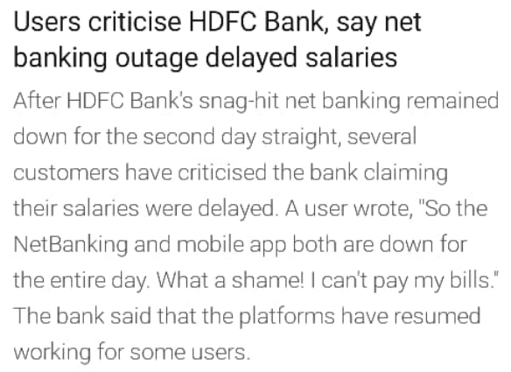
Agenda
Business Problem
Business Understanding
Data Pipeline
Modeling
Conclusion
Literature Review
Data Understanding
Service provider deliverables are impacted due to Intermittent Network down or slowness causing,
Service failure
Financial loses
Reputation
Different attacks been identified
3ve—2018
3ve botnet gave rise to three different yet interconnected sub-operations, each of which was able to evade investigation after perpetrating ad fraud skillfully. Google, White Ops, and other tech companies together coordinated to shut down 3ve’s operations. It infected around 1.7 million computers and a large number of servers that could generate fake traffic with bots.
Mirai—2016
Mirai infects digital smart devices that run on ARC processors and turns them into a botnet, which is often used to launch DDoS attacks. If the default name and password of the device is not changed then, Mirai can log into the device and infect it. In 2016, the authors of Mirai software launched a DDoS attack on a website that belonged to the security service providing company.
Article Source:
https://blog.eccouncil.org/9-of-the-biggest-botnet-attacks-of-the-21st-century/
https://timesofindia.indiatimes.com/business/india-business/hdfc-bank-online-snag-persists-for-second-day/articleshow/72356772.cms
Notes:
Use of intellectual resources to disruptive network and environment, intended for financial gain or even fun.

Slide 4
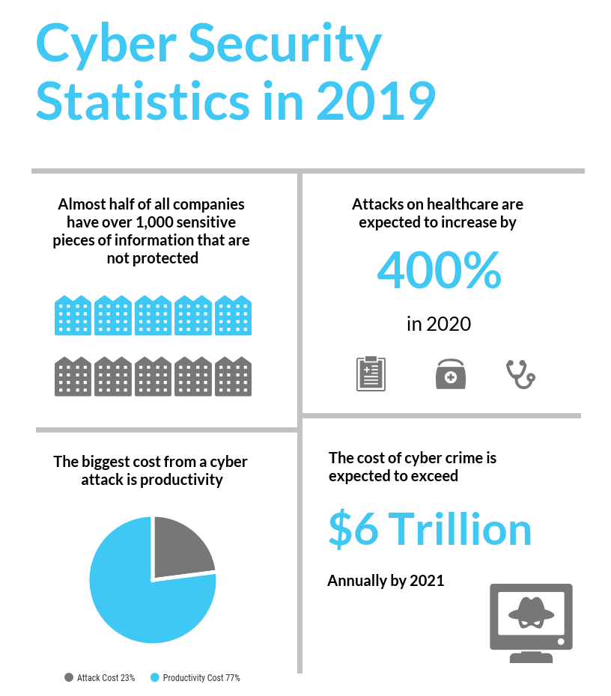
Agenda
Business Problem
Business Understanding
Data Pipeline
Modeling
Conclusion
Literature Review
Data Understanding
Malware rose 79% from 2017
In 2018, 90% of financial institutions reported being targeted by malware
92% of malware is delivered by email.
New malware variants for mobile increased by 54% in 2018
Botnets were shifted from Windows platforms towards Linux and IoT platforms, leading to the fast decline of older Windows-based families and the thriving of new IoT-based ones.
Image Source:
https://purplesec.us/resources/cyber-security-statistics/
https://www.gigabitmagazine.com/telecoms/ensuring-network-security-5g-era

Slide 5
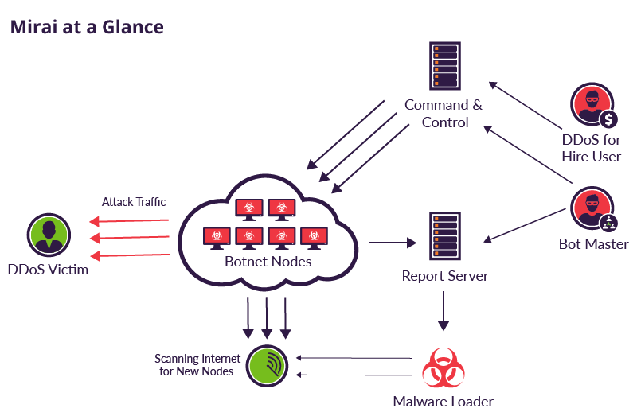
Agenda
Business Problem
Business Understanding
Data Pipeline
Modeling
Conclusion
Literature Review
Data Understanding
Botnet attack amasses a large number of compromised hosts sending useless packets to jam its services
Breach of availability
Unauthorized destruction of data
Theft of service
Unauthorized use of resources
Denial of service (DOS)
Prevention of legitimate use
Bots are typically controlled remotely

Slide 6
Agenda
Business Problem
Business Understanding
Data Pipeline
Modeling
Conclusion
Literature Review
Data Understanding
Research Paper | Author | Machine Learning Models | Results
Botnet Detection Based On Machine Learning Techniques Using DNS Query Data | Hoang et.al (2018) | Random Forest | 90.80%
Automated Botnet Traffic Detection via Machine Learning | Wai, F. K. et.al (2018) | Support Vector Machine , Random Forest etc. | 90.8% (Average Score)
An Adaptive Multi-Layer Botnet Detection Technique Using Machine Learning Classifiers | Khan, R. U et.al (2019) | Decision Trees | 98.7%
Research Paper Gap
Above Research papers have analyzed botnet through various classification ML models and has given good results
Lesser work done on H2O Gradient Boosting Machine (GBM)
Scope to work on H2O GBM detecting botnet
Notes:
H2O.ai shines here for a few reasons:It streamlines the process for development into an intuitive workflow, Trains models faster than popular packages like sci-kit learn,
H2O certainly delivers a fast and accessible machine learning platform for large datasets that is equipped with user-friendly and high-performing tools.

Slide 7


Agenda
Business Problem
Business Understanding
Data Pipeline
Modeling
Conclusion
Literature Review
Data Understanding
Classes / Features
Data
Data Preparation
Binning
Label the data as Attacked or Normal traffic
Resampling
Up sampling
Train/Test Split
Train
Test
Validate
Random Forest
Gradient Boosting Algorithm (GBM)
Evaluation
Results
Generalized Linear Modelling
MSE
RMSE
AUC
Confusion Matrix

Slide 8
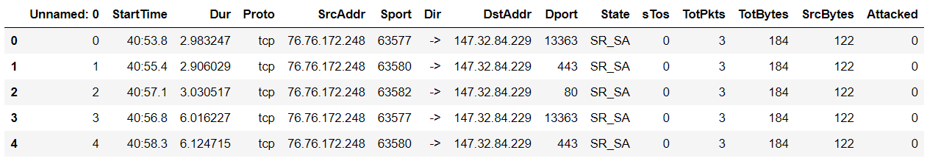
Agenda
Business Problem
Business Understanding
Data Pipeline
Modeling
Conclusion
Literature Review
Data Understanding
Data
Total number of Records – 1.8M
Features - 16
Data has been labelled
Sample Data
Data Source: Collected from End Points [ Firewall, switch etc.]

Slide 9
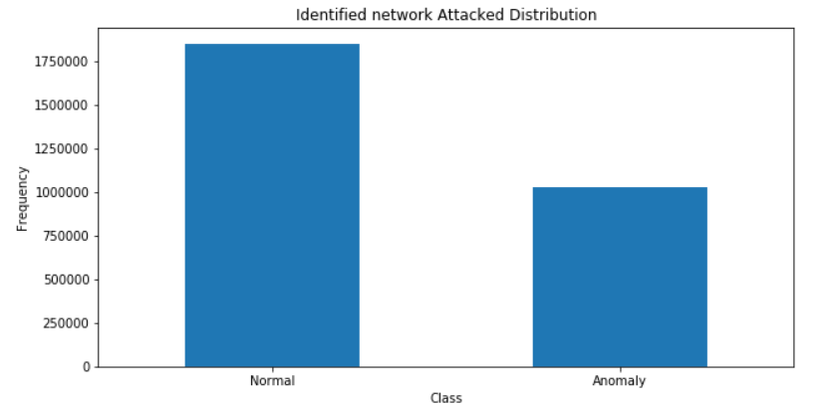
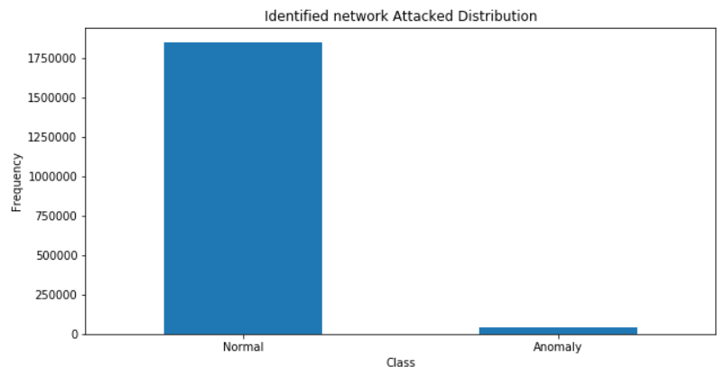
Agenda
Business Problem
Business Understanding
Data Pipeline
Modeling
Conclusion
Literature Review
Data Understanding
Initial Data
Labelled data
Anomaly – 40003 (2% of total data)
After Up sampling
Before Up sampling
Data Up-sampling
Overcome the problem of overfitting
Minority -class increased to 55%

Slide 10
Agenda
Business Problem
Business Understanding
Data Pipeline
Modeling
Conclusion
Literature Review
Data Understanding
WHY Gradient Boosting Algorithm:
Gradient boosting is a machine learning technique for regression and classification problems
GBM produces a prediction model in the form of an ensemble of weak prediction models, typically decision trees.
It build model in stage-wise fashion and it generalizes them by allowing optimization of arbitrary differentiable loss function
WHY H2O.ai
It streamlines the process for development into an intuitive workflow
Trains models faster than popular packages like sci-kit learn
Delivers a fast and accessible ML platform for large datasets that is equipped with user-friendly and high-performing tools.
Notes:
the intuition behind gradient boosting algorithm is to leverage the pattern in residuals and strengthena weak prediction model, until our residuals become radnomly (maybe random normal too) distributed.
Model Hyper-Parameters :
gbm_v3 = H2OGradientBoostingEstimator(
ntrees=30,
learn_rate=0.3,
max_depth=10,
sample_rate=0.7,
col_sample_rate=0.7,
stopping_rounds=2,
stopping_tolerance=0.01,
score_each_iteration=True,
model_id="gbm_covType_v3",
seed=2000000
)

Slide 11
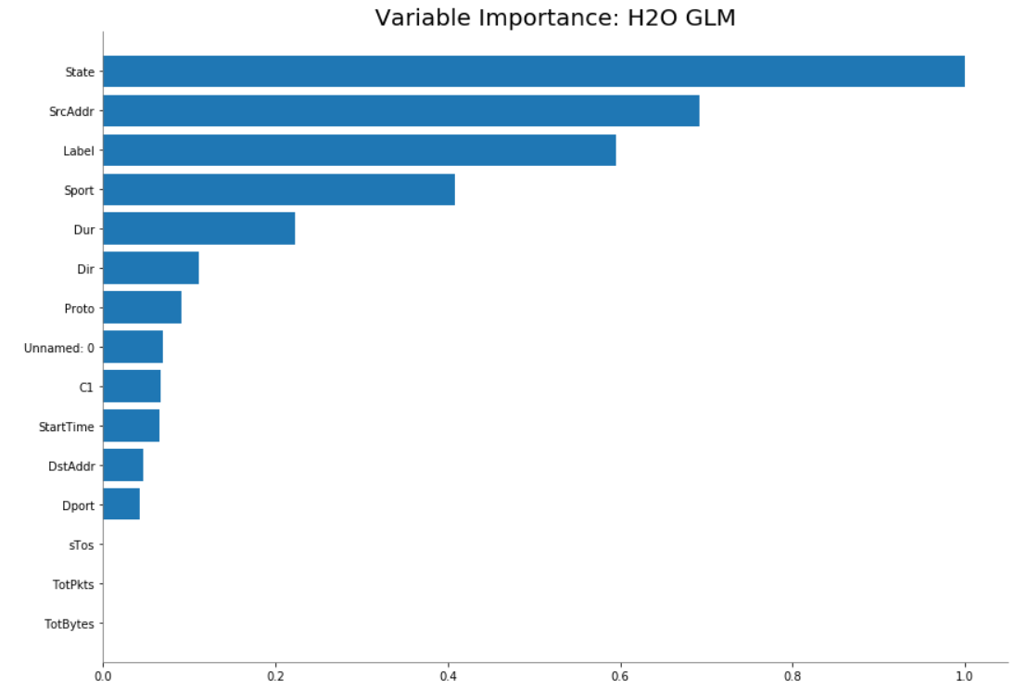
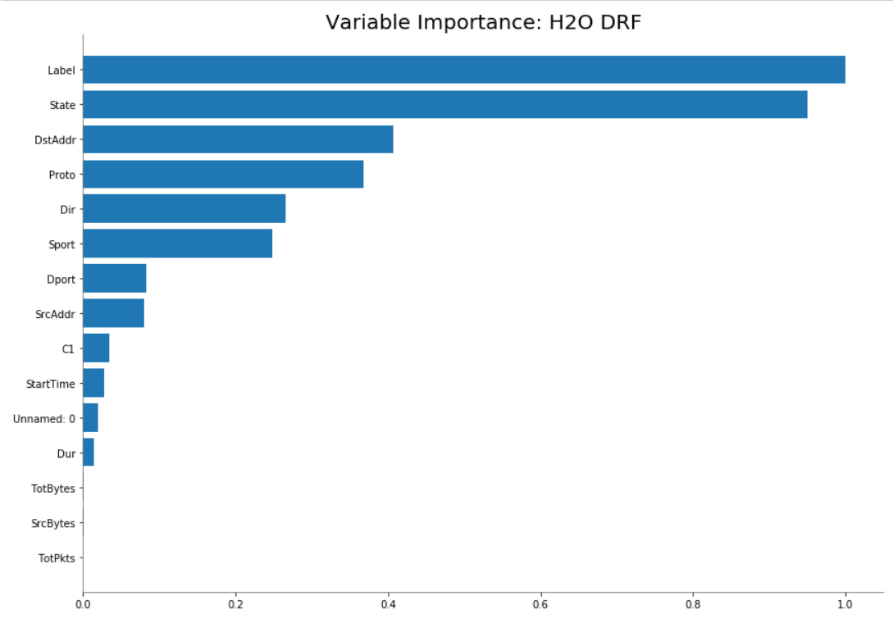
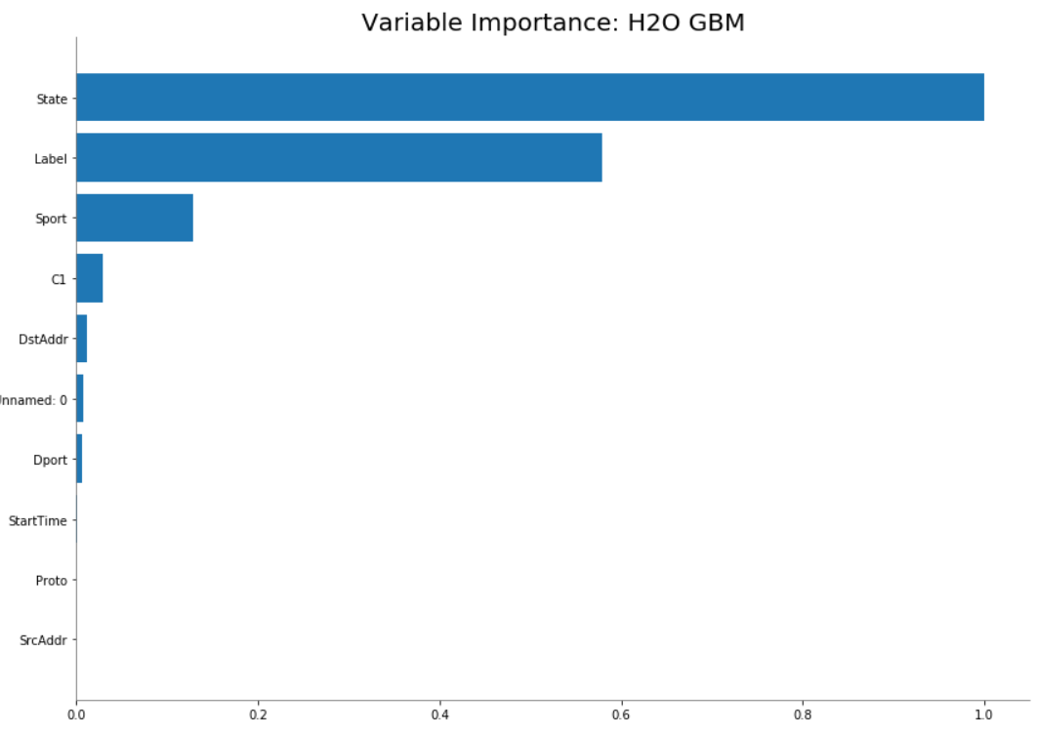
Agenda
Business Problem
Business Understanding
Data Pipeline
Modeling
Conclusion
Literature Review
Data Understanding
Variable importance for the different models

Slide 12
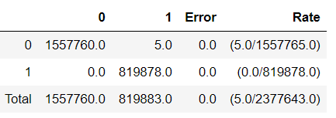
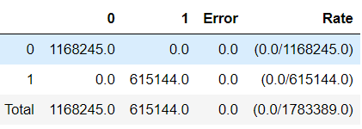
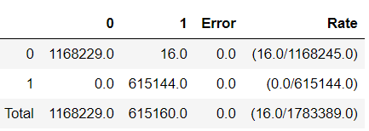
Agenda
Business Problem
Business Understanding
Data Pipeline
Modeling
Conclusion
Literature Review
Data Understanding
Our experiment is focused on GBM
Experiment 1
[Train/Test Split]
Train: 80%
Validate: 20%
Mean Square Error: 1.3916525385408573e-05
Experiment 2
[Train/Test Split]
Train: 70%
Test: 15%
Validate: 15%
Mean Square Error: 2.9326425712147635e-09
Experiment 3
[Train/Test Split]
Train: 60%
Test: 20%
Validate: 20%
Mean Square Error: 2.958186564514117e-05
Accuracy: 0.9999999996781965
Root Mean Square Error (RMSE) : 0.003730485944941835
Root Mean Square Error (RMSE) : 5.415387863500419e-05
Accuracy: 1.0
Root Mean Square Error (RMSE) : 0.005438921367802735
Accuracy: 0.9999999983733137

Slide 13
Agenda
Business Problem
Business Understanding
Data Pipeline
Modeling
Conclusion
Literature Review
Data Understanding
True Positives and True Negatives have been precisely classified with small error in Experiment 1 and 3.
The precise classification of True positives and True negatives also mirrors with high AUC.
The approach used in this study helps Cybersecurity teams to detect Botnet attacks proactively, increase network uptime and minimize the business impact.
Based on the results using H2O GBM demonstrates high AUC ranging from 0.9999 to 1.0
Recommendation:
We recommend using Experiment 2
Future Studies:
Further we would like to expand our study in predict different types of Botnet attacks and work on productizing solution.

Slide 14
Thank you

Slide 15
Q & A

