Slide 1
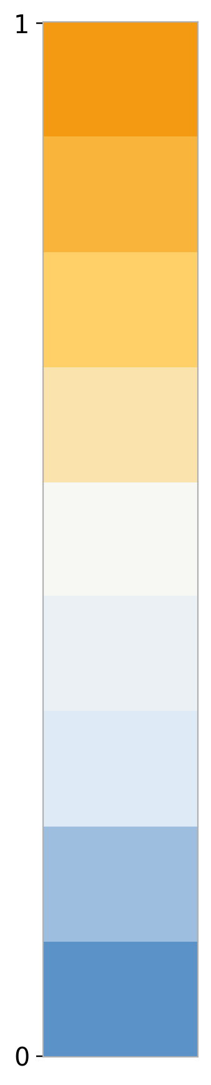
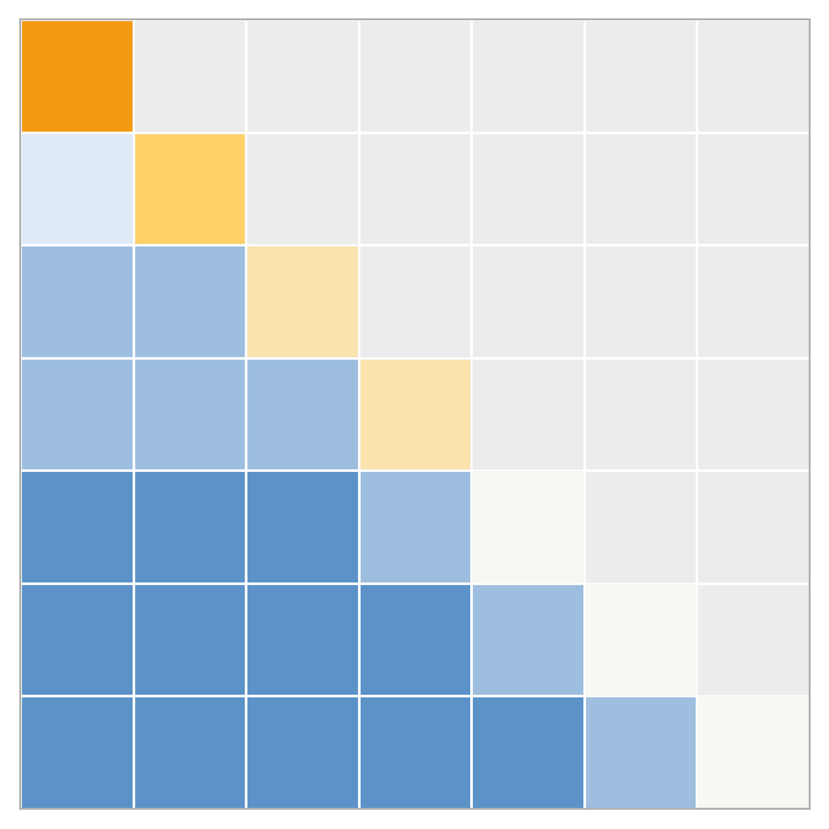
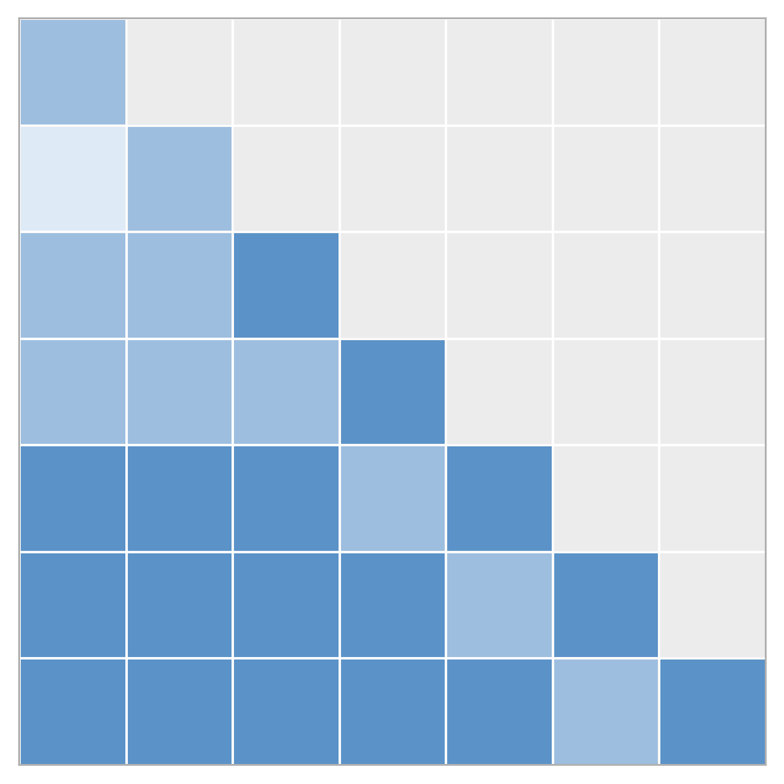
Parallel and Perpendicular Components Play Distinct Roles
define interpret in attention intervene conclude
A
A. Geometric
Decomposition
C
C. Manipulating the Perpendicular Component
Δ = Δ∥ + Δ⊥
Δ∥ = αx
Δ⊥ ⟂ x
Intervention: stretch or shrink Δ⊥ while keeping the rest of the update fixed
baseline  stretch Δ⊥  shrink Δ⊥
change direction
more aggressively
or weaken the
directional change
Parallel: scaling-like
Perpendicular: direction-changing
Poor / fragile behavior
Performance degrades quickly when Δ⊥ is perturbed.
B
B. Attention / Value-Based
Interpretation
D
D. Manipulating the Parallel Component
Diagonal suppression weakens self-copy and redistributes mass off diagonal.
Intervention: scale Δ∥ up or down while keeping the rest of the update fixed
baseline  scale up Δ∥  scale down Δ∥
preserve direction,
change magnitude
still mostly a
scaling-like edit

Good / stable behavior
Key observation: suppressing the diagonal reduces self-routing and pushes attention mass away from self-dominant positions.
Changing Δ∥ has limited impact on performance.
Parallel edits are largely tolerated
Takeaway: parallel components mainly act like scaling-like updates and are relatively robust, whereas perpendicular components are more functionally critical.

