Slide 1
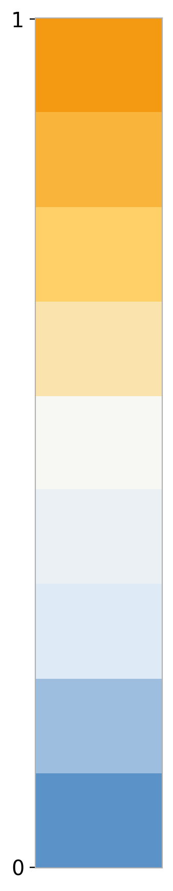
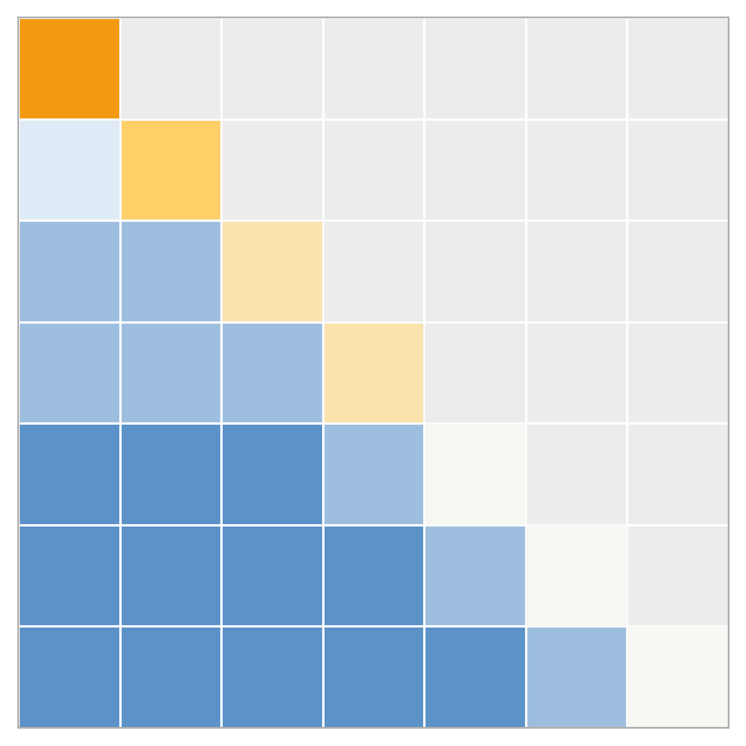
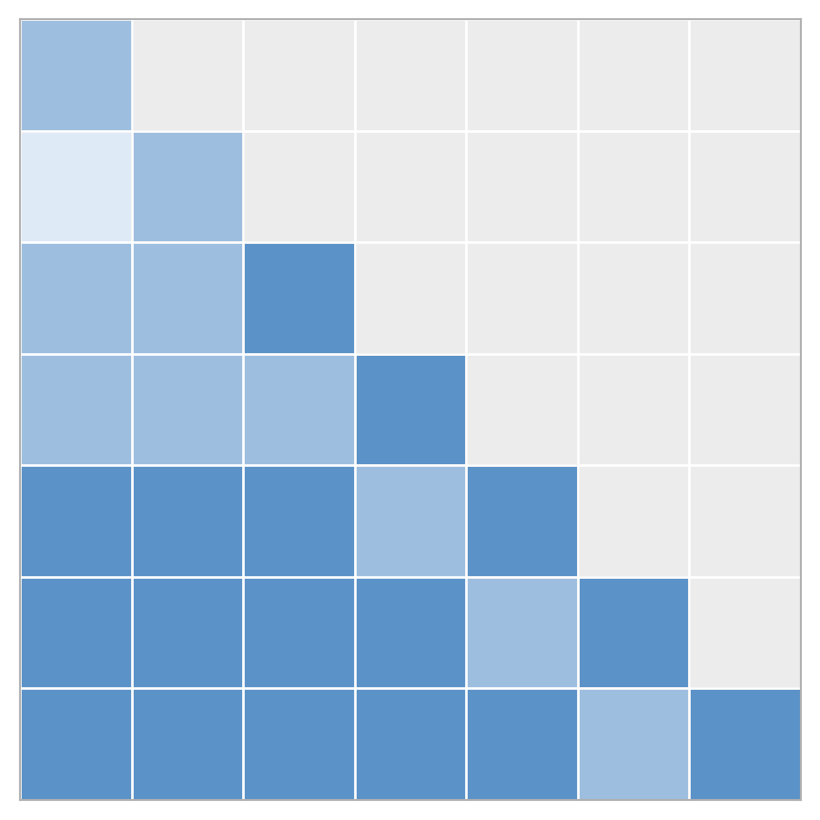
Parallel and Perpendicular Components Play Distinct Roles
define -> interpret in attention -> intervene -> conclude
A
A. Geometric
Decomposition
C
C. Manipulating the Perpendicular Component
Delta = Delta_parallel + Delta_perp
Delta_parallel = alpha x
Delta_perp ⟂ x
Intervention: stretch or shrink Delta_perp while keeping the rest of the update fixed
baseline → stretch Delta_perp → shrink Delta_perp
Parallel: scaling-like
Perpendicular: direction-changing
Poor / fragile behavior
Performance degrades quickly when Delta_perp is perturbed.
B
B. Attention / Value-Based
Interpretation
D
D. Manipulating the Parallel Component
Diagonal suppression weakens self-copy and redistributes mass off diagonal.
Intervention: scale Delta_parallel up or down while keeping the rest of the update fixed
baseline → scale up Delta_parallel → scale down Delta_parallel
→
Good / stable behavior
Key observation: suppressing the diagonal reduces self-routing and pushes attention mass away from self-dominant positions.
Changing Delta_parallel has limited impact on performance.
Parallel edits are largely tolerated
Takeaway: parallel components mainly act like scaling-like updates and are relatively robust, whereas perpendicular components are more functionally critical.

