Slide 1
Predictive Maintenance System
Group Q4: Carson McClelland, Kalid Ajibade, Konrad Herbus, Shwan Majeed

Slide 2
Outline
Introduction
Dataset Used
System Architecture
Real World Application
Contribution Matrix
Conclusion

Slide 3
Introduction
Cloud computing project working with HighD for Traffic Analysis
Leverages the Google Cloud Service for efficient data processing
Provides quick analysis and results for high volume and high velocity (realtime) datasets for traffic analysis

Slide 4

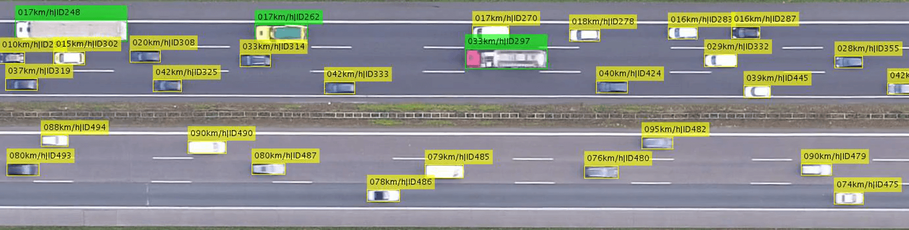
Dataset Used- HighD dataset
Highway Drone Dataset
Dataset of naturalistic vehicle trajectories
Used for it’s:
Large-scale dataset
Enriched data
High quality and variety
Easy implementation

Slide 5
System architecture
Jobs in terms of Dataflow
Step 1 - Reading from Google Cloud Service
Step 2 - Clean the Data that has been read
Step 3 - Write to BigQuery

Slide 6
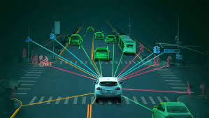
Real World Application
Traffic Analysis
Develop algorithms for real-time traffic monitoring
Gain information about traffic flow, congestion, accidents
Autonomous driving
Train and test object detection and tracking algorithms for autonomous vehicles
Road Safety and Security
Develop algorithms for detecting and tracking safety and threats on the road
Gain information about reckless driving, suspicion vehicles

Slide 7
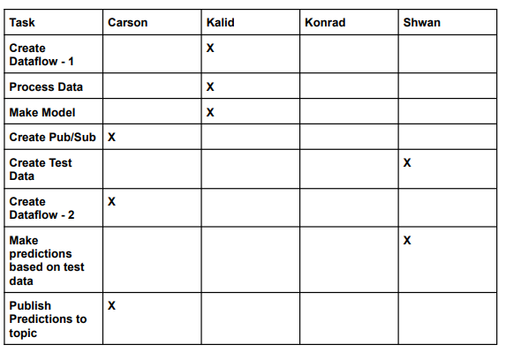
Contribution Matrix

Slide 8
Conclusion
Required the creation a full data processing cloud computing system
Traffic Analysis utilizing the HighD (Highway Drone Dataset)
Efficient data processing techniques to accommodate for real time data
Project provided a perfect summary of the cloud computing techniques and principles learnt throughout the course of this semseter

