Slide 1
Prediction of Mumbai’s temperature
Bsc Statistics

Slide 2
Index
Objectives
Data cleaning, missing values & outlier treatment
MA Process
Stationarity
ACF and PACF
AR Process
ARIMA
Prediction
Conclusion

Slide 3
objectives
Objectives:-
We want to predict the temperature of the Mumbai city for the next 30 days on the basis of the past 10 years data
We want to fit the different Time series models such as.
MA model
AR model
ARIMA model

Slide 4
Data Processing
Data Import
Data Cleaning
Handling the Null Values
Handling Date column(Date Parsing)
Handling Outliers
Handling The Data Types
Use the Data to Perform The Analysis

Slide 5
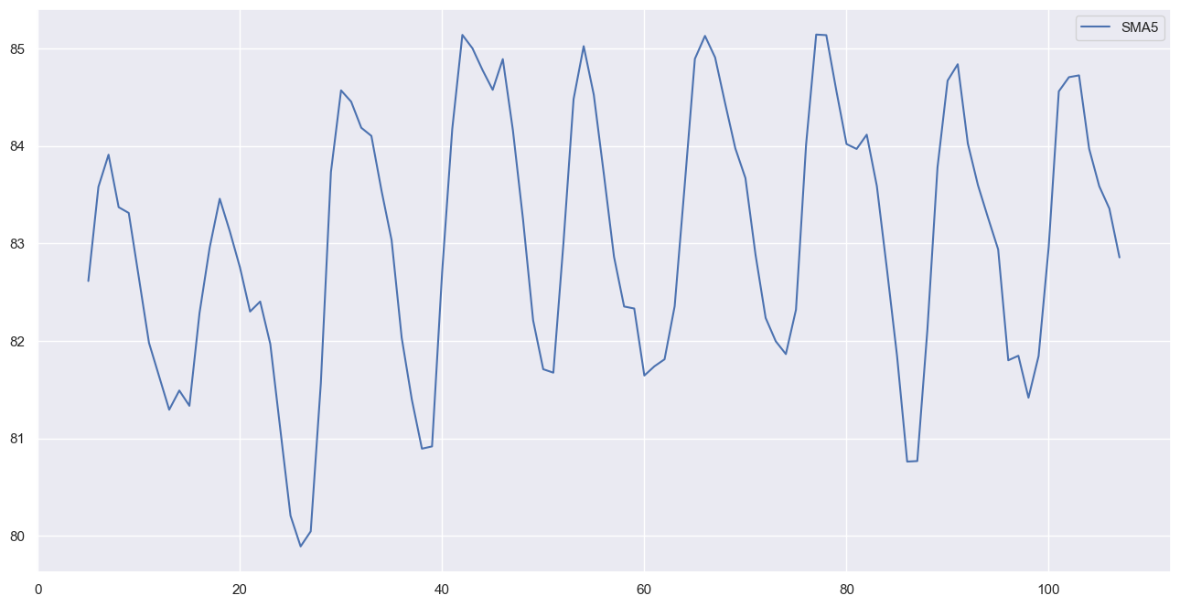
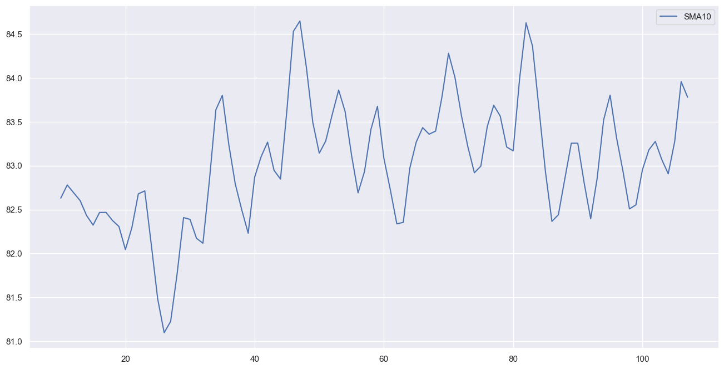
MA Process
Defination
MA Process by Rolling Method
Plot after Rolling Method
5 PERIOD SMA
10 PERIOD SMA

Slide 6
stationarity
What is Stationarity?
Why We Check The Stationarity of The Data?
Augmented Dickey Fuller (ADF) test to check the Statioinarity.
Conclusion

Slide 7
ACF and pacf
What is ACF and PACF In Time Series Analysis?
Need of The ACF and PACF plot During Prediction of Mumbai’s Temperature
Interpretation Of ACF and PACF Plots.

Slide 8
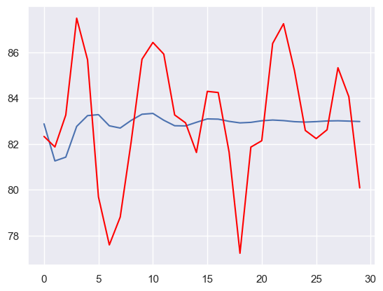
AR process
Defination
Splitting Of the Dataset Into Train and Test Set.
Predictiion Of temperature by AR Process.
Plotting the prediction.

Slide 9
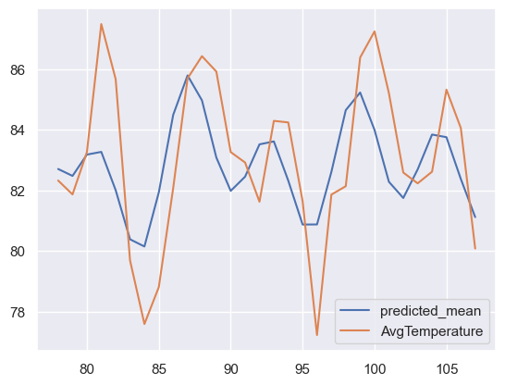
Arima model
Defination
Libraries used to fit the ARIMA model
Prediction using ARIMA model
Plotting the prediction

Slide 10
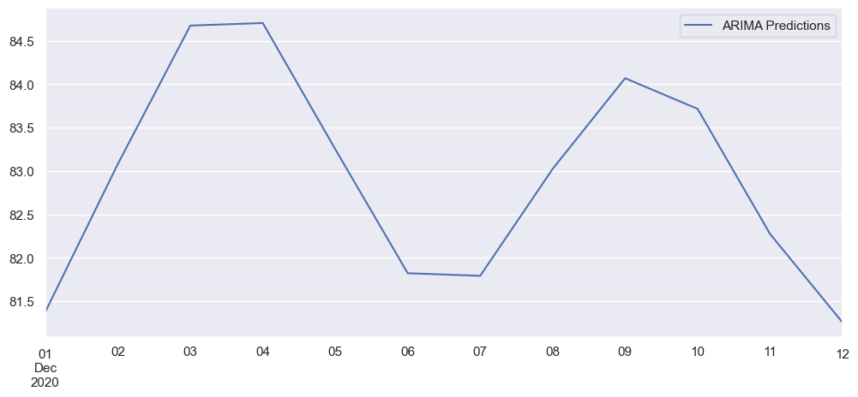
Prediction for the next 12 days

Slide 11
Thank You

