Slide 1
UI DESIGN-FLUTTER Skill Development course
K S PADMAPRIYA
Assistant Professor
IT DEPT

Slide 2
FLUTTER Histroy-INTRODUCTION
For developing mobile apps, Android provides a native framework based on Java and Kotlin language, while iOS provides a framework based on Objective-C/Swift language. Thus, we need two different languages and frameworks to develop applications for both OS.
Today, to overcome form this complexity, there are several frameworks have introduced that support both OS along with desktop apps. These types of the framework are known as cross-platform development tool
The cross-platform development framework has the ability to write one code and can deploy on the various platform (Android, iOS, and Desktop). It saves a lot of time and development efforts of developers.
Flutter is a cross-platform UI toolkit that is designed to allow code reuse across operating systems such as iOS and Android, while also allowing applications to interface directly with underlying platform services.

Slide 3
Flutter
Flutter is a UI toolkit for creating fast, beautiful, natively compiled applications for mobile, web, and desktop with one programming language.
It is free and open-source. It was initially developed from Google and now manages by an ECMA standard.
Flutter apps use Dart programming language for creating an app.
The dart programming shares several same features as other programming languages, such as Kotlin and Swift, and can be trans-compiled into JavaScript code.
Flutter is mainly optimized for 2D mobile apps that can run on both Android and iOS platforms. We can also use it to build full-featured apps, including camera, storage, geolocation, network, third-party SDKs, and more.
Flutter is used in Google apps such as Google pay and Google earth

Slide 4
Prerequisite
Dart programming
Web scripting languages such as HTML, JavaScript, and CSS.
Android Studio

Slide 5
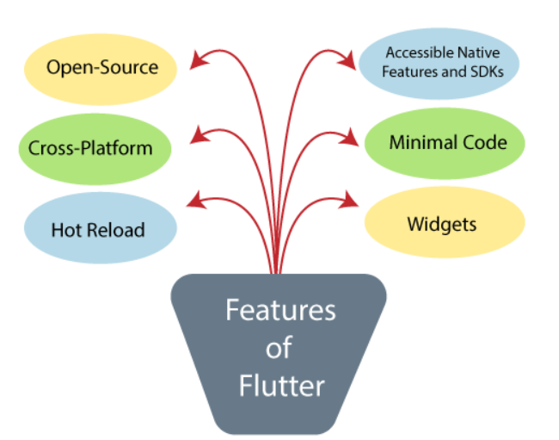
Features of Flutter

Slide 6
Hot Reload: Whenever the developer makes changes in the code, then these changes can be seen instantaneously with Hot Reload. It means the changes immediately visible in the app itself. It is a very handy feature, which allows the developer to fix the bugs instantly.
Accessible Native Features and SDKs: This feature allows the app development process easy and delightful through Flutter's native code, third-party integration, and platform APIs. Thus, we can easily access the SDKs on both platforms.
Minimal code: Flutter app is developed by Dart programming language, which uses JIT and AOT compilation to improve the overall start-up time, functioning and accelerates the performance. JIT enhances the development system and refreshes the UI without putting extra effort into building a new one.
Widgets: The Flutter framework offers widgets, which are capable of developing customizable specific designs. Most importantly, Flutter has two sets of widgets: Material Design and Cupertino widgets that help to provide a glitch-free experience on all platforms.

Slide 7
Advantages of flutter
It makes the app development process extremely fast because of the hot-reload feature. This feature allows us to change or update the code are reflected as soon as the alterations are made.
It provides the smoother and seamless scrolling experiences of using the app without much hangs or cuts, which makes running applications faster in comparison to other mobile app development frameworks.
Flutter reduces the time and efforts of testing. As we know, flutter apps are cross-platform so that testers do not always need to run the same set of tests on different platforms for the same app.
It has an excellent user interface because it uses a design-centric widget, high-development tools, advanced APIs, and many more features.
It is similar to a reactive framework where the developers do not need to update the UI content manually.
It is suitable for MVP (Minimum Viable Product) apps because of its speedy development process and cross-platform nature.

Slide 8
Disadvantages of flutter
The Flutter is a comparatively new language that needs continuous integration support through the maintenance of scripts.
It provides very limited access to SDK libraries. It means a developer does not have a lot of functionalities to create a mobile application. Such types of functionalities need to be developed by the Flutter developer themselves.
The Flutter apps do not support the browser. It only supports Android and iOS platforms.
It uses Dart programming for coding, so a developer needs to learn new technologies. However, it is easy to learn for developers.

Slide 9
Application of Flutter
Google Ads
Alibaba
Dream11
ebay Motors
BMW
Google Pay
Toyota

Slide 10
Software Required
Flutter SDK
Android Studio
Visual Studio code

