Slide 1
Week-3 DECISION MAKING & LOOPS IN DART
III YEAR I SEMESTER
R22
Padma Priya
Assistant Professor
IT DEPT

Slide 2
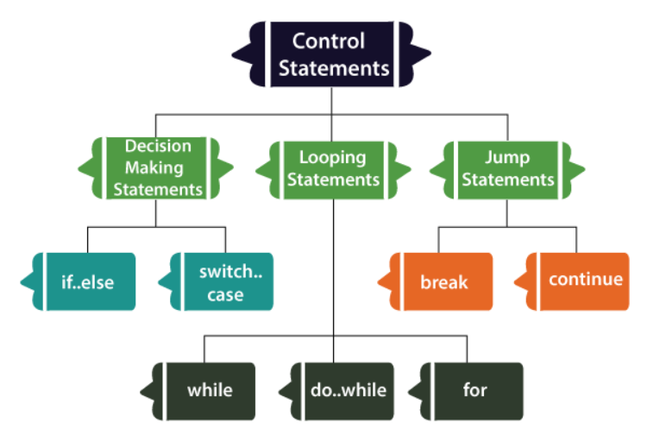
Control statements

Slide 3
Decision Making Statements
If Statement
If-else Statements
If else if Statement
Switch Case Statement

Slide 4
If-else statement
syntax
Example
if(condition) {
// statement(s);
} else {
// statement(s);
}
void main() {
var x = 20;
var y = 30;
if(x > y){
print("x is greater than y");
}
else {
print("y is greater than x");
}
}

Slide 5
If-else-if statements
Example
Syntax
void main() {
var marks = 74;
if(marks > 85) {
print("Excellent");
}
else if(marks>75) {
print("Very Good");
}
else if(marks>65) {
print("Good");
}
else {
print("Average");
}
}
if (condition1) {
// statement(s)
}
else if(condition2) {
// statement(s)
}
else if (conditionN) {
// statement(s)
}
.
else {
// statement(s)
}

Slide 6
Switch - case
switch( expression )
{
case value-1:{
//statement(s)
Block-1;
}
break;
case value-2:{
//statement(s)
Block-2;
}
break;
case value-N:{
//statement(s)
Block-N;
}
break;
default: {
//statement(s);
}
}
void main() {
int n = 3;
switch (n) {
case 1:
print(“ONE");
break;
case 2:
print(“TWO");
break;
case 3:
print(“THREE");
break;
case 4:
print(“FOUR");
break;
default:
print("Out of range");
break;
}
}

Slide 7
Loops statements
Dart for loop
Dart for…in loop
Dart while loop
Dart do-while loop

Slide 8
For loop
Syntax
Example
for(Initialization; condition; incr/decr) {
// loop body
}
void main()
{
int num = 1;
for(num; num<=10; num++)
{
print(num);
}
}

Slide 9
for… in Loop
Syntax
Example
for (var in expression) {
//statement(s)
}
void main()
{
var list1 = [10,20,30,40,50];
for(int i in list1)
{
sum=i+sum;
}
print(“$sum”);
}

Slide 10
While loop
Syntax
Example
while(condition) {
// loop body
}
void main()
{
var a = 1;
var maxnum = 10;
while(a<maxnum){
print(a);
a = a+1;
}
}

Slide 11
Do-while
Example
Syntax
void main() {
int i = 10;
print(“numbers btw 10 &20 are");
do{
print(i);
i++;
}while(i<=20);
print("The loop is terminated");
}
do {
// loop body
}while(condition);

Slide 12
Dart Input
Example 1
Example 2
import 'dart:io';
void main()
{
// Asking for favourite number
//print("Enter your favourite number:");
// Scanning number
int? n = int.parse(stdin.readLineSync()!);
// Here ? and ! are for null safety
// Printing that number
print("Your favourite number is $n");
}
import 'dart:io';
void main()
{
print("Enter your name?");
String? name = stdin.readLineSync();
print("Hello, $name!");
}

