Slide 1
Layout widget
Week 7

Slide 2
Layout Widgets
Layout widgets are a fundamental part of Flutter’s widget library, designed to structure and organize visual elements within your app’s user interface.
They control how child widgets are displayed on the screen, including their size, position, and alignment.
Using layout widgets effectively is crucial for creating responsive and visually appealing designs.

Slide 3
Layout a Widget
Flutter allows us to create a layout by composing multiple widgets to build more complex widgets.
The following steps show how to layout a widget:
Step 1: First, you need to select a Layout widget.
Step 2: Next, create a visible widget.
Step 3: Then, add the visible widget to the layout widget.
Step 4: Finally, add the layout widget to the page where you want to display.

Slide 4
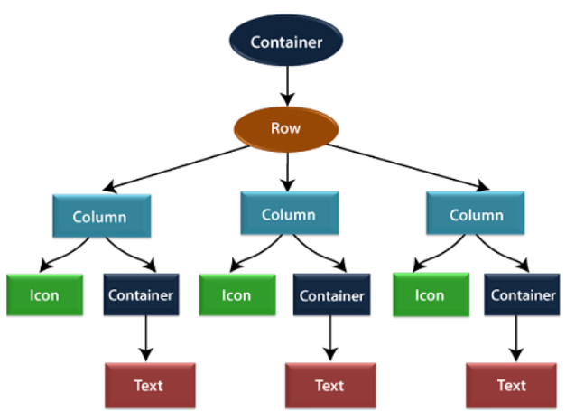
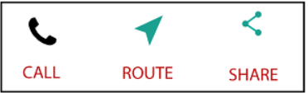
Example for Layout Widget

Slide 5
Types of Layout Widgets
The layout widget into two types:
1.Single Child Widget
2.Multiple Child Widget

Slide 6
Single child layout widget
The single child layout widget is a type of widget, which can have only one child widget inside the parent layout widget. These widgets can also contain special layout functionality.
Flutter provides us many single child widgets to make the app UI attractive. If we use these widgets appropriately, it can save our time and makes the app code more readable.

Slide 7
The list of different types of single child widgets are:
Container: It is the most popular layout widget that provides customizable options for painting, positioning, and sizing of widgets.
Padding: It is a widget that is used to arrange its child widget by the given padding. It contains EdgeInsets and EdgeInsets.fromLTRB for the desired side where you want to provide padding
Center: This widget allows you to center the child widget within itself.
Align: It is a widget, which aligns its child widget within itself and sizes it based on the child's size. It provides more control to place the child widget in the exact position where you need it.
SizedBox: This widget allows you to give the specified size to the child widget through all screens.
FittedBox: It scales and positions the child widget according to the specified fit.

Slide 8
Multiple child widgets
The multiple child widgets are a type of widget, which contains more than one child widget, and the layout of these widgets are unique.
For example, Row widget laying out of its child widget in a horizontal direction, and Column widget laying out of its child widget in a vertical direction.
If we combine the Row and Column widget, then it can build any level of the complex widget.

Slide 9
Different types of multiple child widgets:
Column: It allows to arrange its child widgets in a vertical direction.
ListView: It is the most popular scrolling widget that allows us to arrange its child widgets one after another in scroll direction.
GridView: It allows us to arrange its child widgets as a scrollable, 2D array of widgets. It consists of a repeated pattern of cells arrayed in a horizontal and vertical layout.
Expanded: It allows to make the children of a Row and Column widget to occupy the maximum possible area.
Table: It is a widget that allows us to arrange its children in a tablebased widget.
Flow: It allows us to implements the flow-based widget.
Stack: It is an essential widget, which is mainly used for overlapping several children widgets. It allows you to put up the multiple layers onto the screen.

