Slide 1
HEART FAILURE PREDICTION USING ML
GUIDE: B.LALITHA
SUBMITTED BY-
SHASHANK GUPTA
SHWEJAN SHASHANK
MAHESHWAR REDDY
CHARAN
Notes:
Date missing

Slide 2
ABSTRACT:
Machine learning can be used to predict the Heart Disease.
Cleveland Heart Disease dataset has some non-linear tendency.
Improvement on Heart Disease Prediction technique by correctly adjusting the Machine Learning Models (fetching 85.81% accuracy).
Health care data contains hidden information which is useful for making effective decisions.
This can help patients in getting a quick diagnosis with a lot less cost.

Slide 3
ATTRIBUTES USED:
The dataset have 76 raw attributes, only 14 of them are actually used. The attributes used are :
Age : age in years
Sex : sex (1 = male; 0 = female)
Cp : Chest Pain Type
Value 1: typical angina
Value 2: atypical angina
Value 3: non‐anginal pain
Value 4: asymptomatic
Trestbps : Resting blood pressure (in mm Hg on admission to the hospital)
Chol : serum cholestoral in mg/dl
Fbs : (fasting blood sugar > 120 mg/dl) (1 = true; 0 = false)
Thalach : maximum heart rate achieved

Slide 4
Restecg : resting electrocardiographic results
Value 0: normal
Value 1: having ST‐T wave abnormality (T wave inversions and/or ST elevation or depression of > 0.05 mV)
Value 2: showing probable or definite left ventricular hypertrophy by Estes' criteria
Exang : exercise induced angina (1 = yes; 0 = no)
Oldpeak : ST depression induced by exercise relative to rest
Slope : the slope of the peak exercise ST segment
Value 1: upsloping
Value 2: flat
Value 3: downsloping
Ca : number of major vessels (0‐3) colored by flourosopy
Thal : 3 = normal; 6 = fixed defect; 7 = reversable defect
Num : diagnosis of heart disease (angiographic disease status)
Value 0: < 50% diameter narrowing
Value 1: > 50% diameter narrowing

Slide 5
Existing system and its limitations
Clinical decisions are often made based on doctors' intuition and experience rather than on the knowledge rich data hidden in the database
This practice leads to unwanted biases, errors and excessive medical costs which affects the quality of service provided to patients
There are many ways that a medical misdiagnosis can present itself. Whether a doctor is at fault, or hospital staff, a misdiagnosis of a serious illness can have very extreme and harmful effects
Medical Misdiagnoses are a serious risk to our healthcare profession. If they continue, then people will fear going to the hospital f treatment.

Slide 6
Proposed system and advantages
The main objective of this project is to develop a prototype Intelligent Heart Disease Prediction System using three data mining modeling techniques, namely, PCA, SVM
This practice leads to unwanted biases, errors and excessive medical costs which affects the quality of service provided to patients.
Thus we proposed the computer based patient records could reduce medical errors, enhance patient safety decrease unwanted practice variation, and improve patient outcome.

Slide 7
Implementation
Start
Get dataset
Create training set and testing set
Preprocess dataset
(replace missing value, etc.)
Apply Supervised Learning Algorithm
Analyze dataset for different type of Machine Learning Algorithm
Do cross-validation
Show the accuracy
No
If supervised
?
yes
Stop

Slide 8
METHODOLOGY:
Machine learning algorithms used (using sklearn library of python):
Support Vector Machine
Principal component analysis.
Cross Validation Techniques used:
3-fold
5-fold
10-fold

Slide 9
HARDWARE REQUIRED:
1 GB RAM or more
32 or 64 bit processor
1Ghz speed
6 GB memory or more.
SOFTWARE REQUIRED:
Windows operating system.
Python 2.7 or above.
SVM machine learning algorithm.

Slide 10
references:
1.Udemy –Machine learning with python
2.Youtube
3.www.python.org(packages documentation)
4.Sklearn official documentation
5.Nptel
etc.

Slide 11
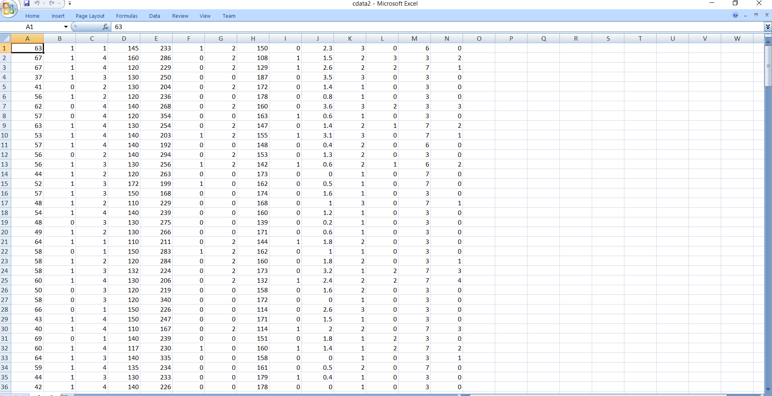
CLEVELAND DATASET

Slide 12
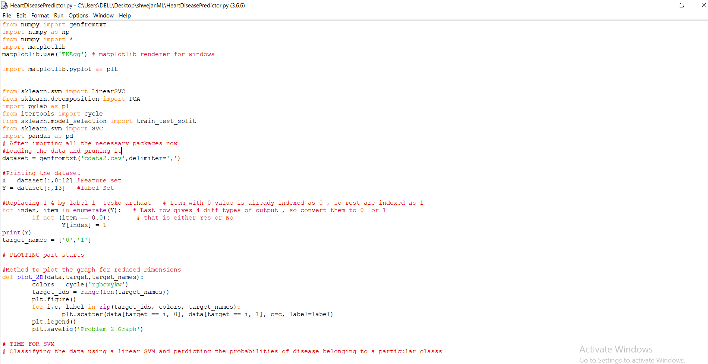

Slide 13
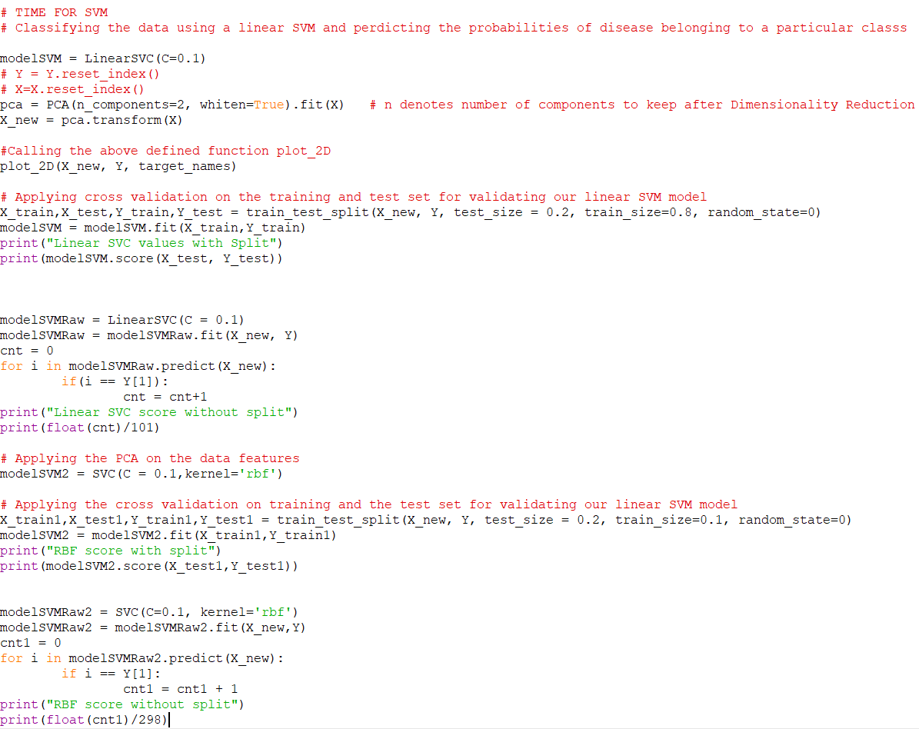

Slide 14
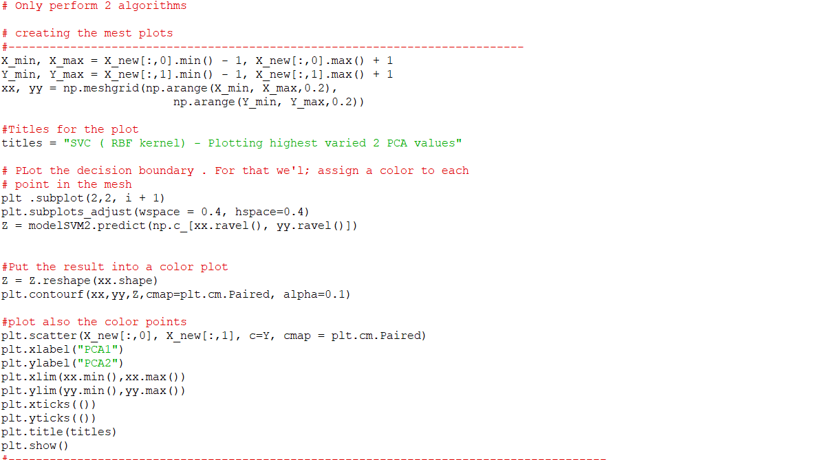

Slide 15
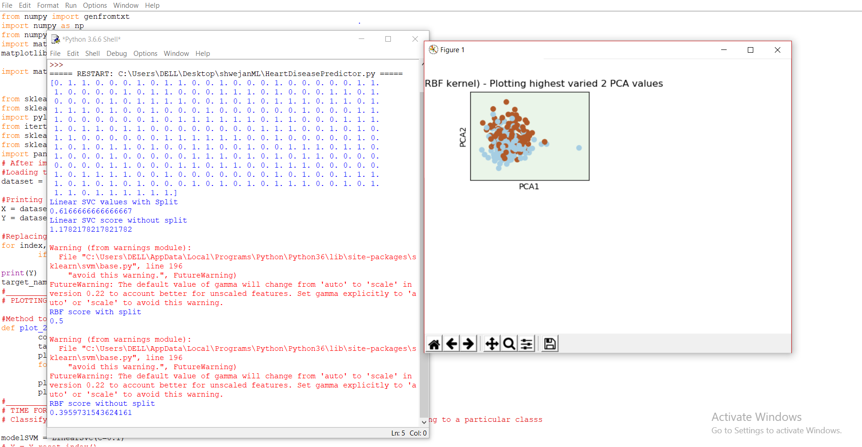
RESULTS:

Slide 16
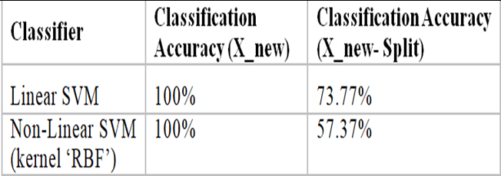
RESults:

Slide 17
Thank you

