Slide 1
Web development

Slide 2

Shweta Maurya

Slide 3

Introduction to the organization
Udemy, Inc. is an American massive open online course (MOOC) provider aimed at professional adults and students. It was founded in May 2010 by Eren Bali, Gagan Biyani, and Oktay Caglar.
As of Jan 2020, the platform has more than 35 million students and 57,000 instructors teaching courses in over 65 languages. There have been over 400 million course enrollments. Students and instructors come from 180+ countries and 2/3 of the students are located outside of the U.S.
Students take courses largely as a means of improving job-related skills. Some courses generate credit toward technical certification. Udemy has made a special effort to attract corporate trainers seeking to create coursework for employees of their company.] As of 2020, there are more than 130,000 courses on the website.

Slide 4
Topics
01
Why do I choose this project
02
Software /Hardware Requirement
03
Fundamental languages
04
Overview of the project

Slide 5
Why do I choose this project

Slide 6
Smart Phones
Internet access anywhere
Social networking
Millions of mobile users
Due to covid everthing is turned online eg. schools and collages
Few reasons

Slide 7
Software / Hardware Requirement

Slide 8
Software Req.
•Intel 3.0 ghz or higher processor
•2 GB RAM
•10 GB HDD Space
Hardware Req.
•PHP
•MySQL Server
•XAMMP

Slide 9
Fundamental Units

Slide 10
HTML
HTML stands for Hyper Text Markup Language
HTML is the standard markup language for creating Web pages
HTML describes the structure of a Web page
HTML consists of a series of elements
HTML elements tell the browser how to display the content
HTML elements label pieces of content such as "this is a heading", "this is a paragraph", "this is a link", etc.

Slide 11
CSS
CSS stands for Cascading Style Sheets
CSS describes how HTML elements are to be displayed on screen, paper, or in other media
CSS saves a lot of work. It can control the layout of multiple web pages all at once
External stylesheets are stored in CSS files

Slide 12
PHP
PHP is an acronym for "PHP: Hypertext Preprocessor"
PHP is a widely-used, open source scripting language
PHP scripts are executed on the server
PHP is free to download and use

Slide 13
MY SQL
MySQL is a database system used on the web
MySQL is a database system that runs on a server
MySQL is ideal for both small and large applications
MySQL is very fast, reliable, and easy to use
MySQL uses standard SQL
MySQL compiles on a number of platforms

Slide 14
Project Overview

Slide 15

Home Page

Slide 16
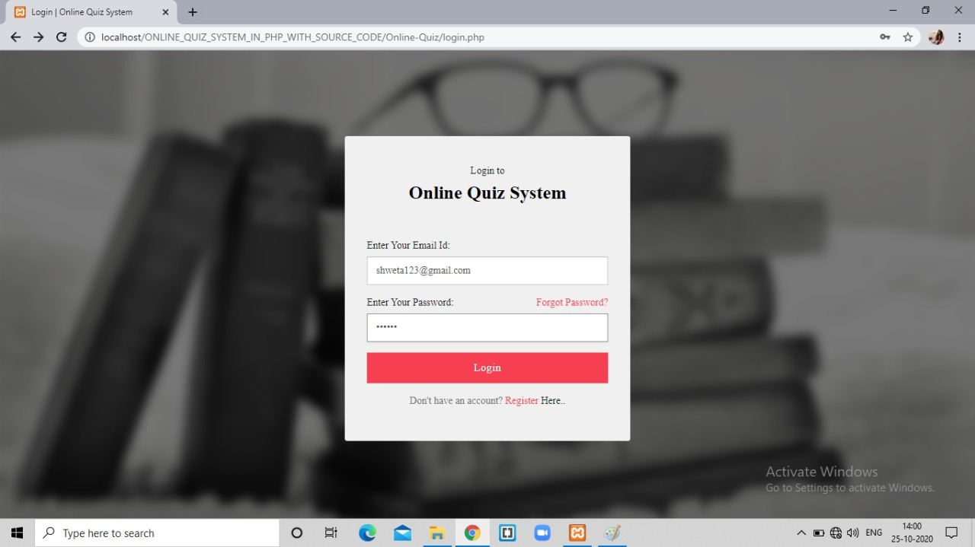
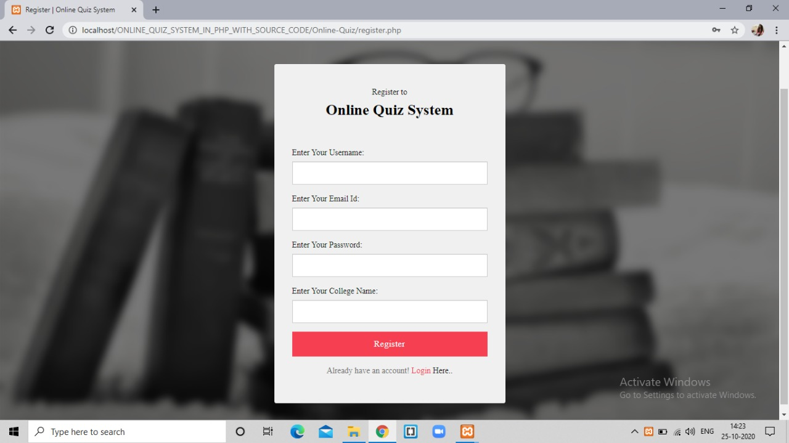
Login Sinup

Slide 17
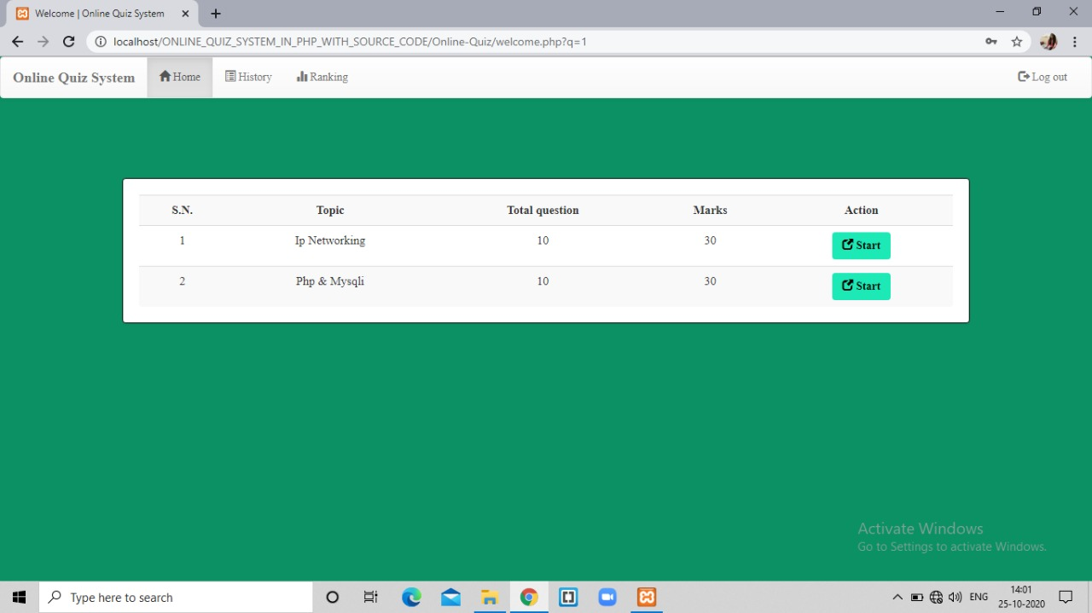
Quiz

Slide 18
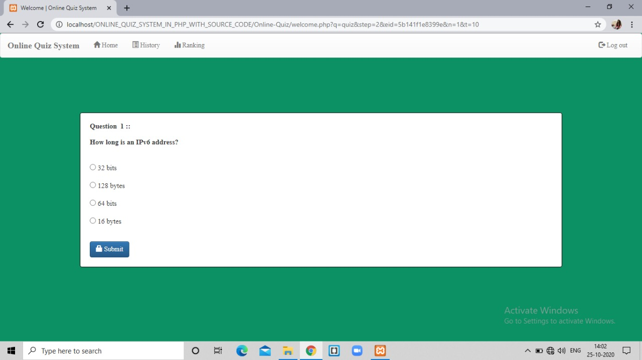

Slide 19
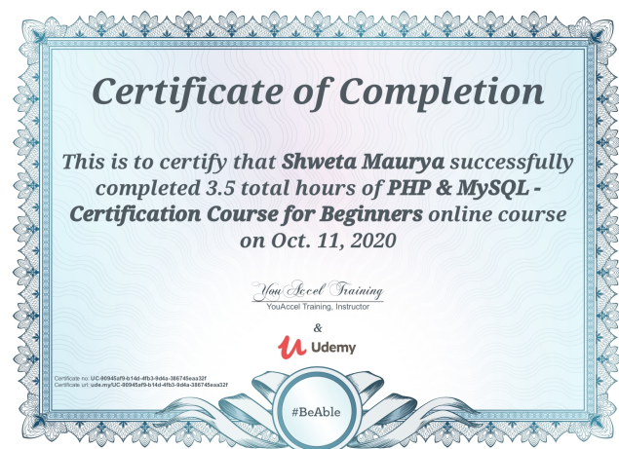
Certificate 1

Slide 20
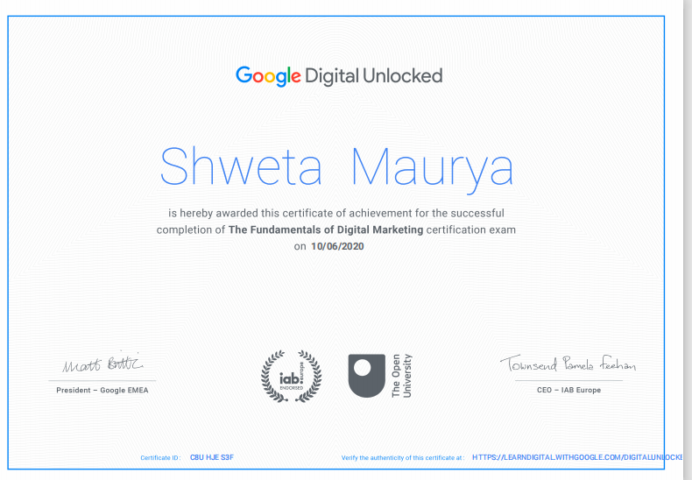
Certificate 2

Slide 21
THANKU !!
For your Support

