Slide 1
COEN 380 PROJECT 3 GROUP NO - 5
Shweta Kharat

Slide 2
OVERVIEW
Dataset (Car Sales Database System)
Database Schema
Data loading and Pre-processing
Queries Execution (Oracle Vs Hive)
Oracle Vs Hive (Comparison)
Challenges Faced
Conclusion

Slide 3
DATASET
CAR SALES DATABASE SYSTEM

Slide 4
CLASSICMODELS CAR SALES DATABASE
The classicmodels database is a retailer of scale models of classic cars database. It contains typical business data such as customers, products, sales orders, sales order line items, etc.
CUSTOMERS
customerNumber
customerName
addressLine1
addressLine2
city
state
postalCode
country
salesRepEmployeeNumber
creditLimit
PAYMENTS
customerNumber
checkNumber
paymentDate
amount
EMPLOYEES
employeeNumber
lastName
firstName
email
reportsTo
jobTitle
PRODUCTS
productCode
productName
productVendor
quantityInStock
buyPrice
MSRP
ORDERS
orderNumber
orderDate
requiredDate
status
customerNumber
Row Count: 273
ORDERITEMS
orderNumber
productCode
quantityOrdered
priceEach
Row Count: 326
Row Count: 23
Row Count: 110
Row Count: 2996
Row Count: 122

Slide 5
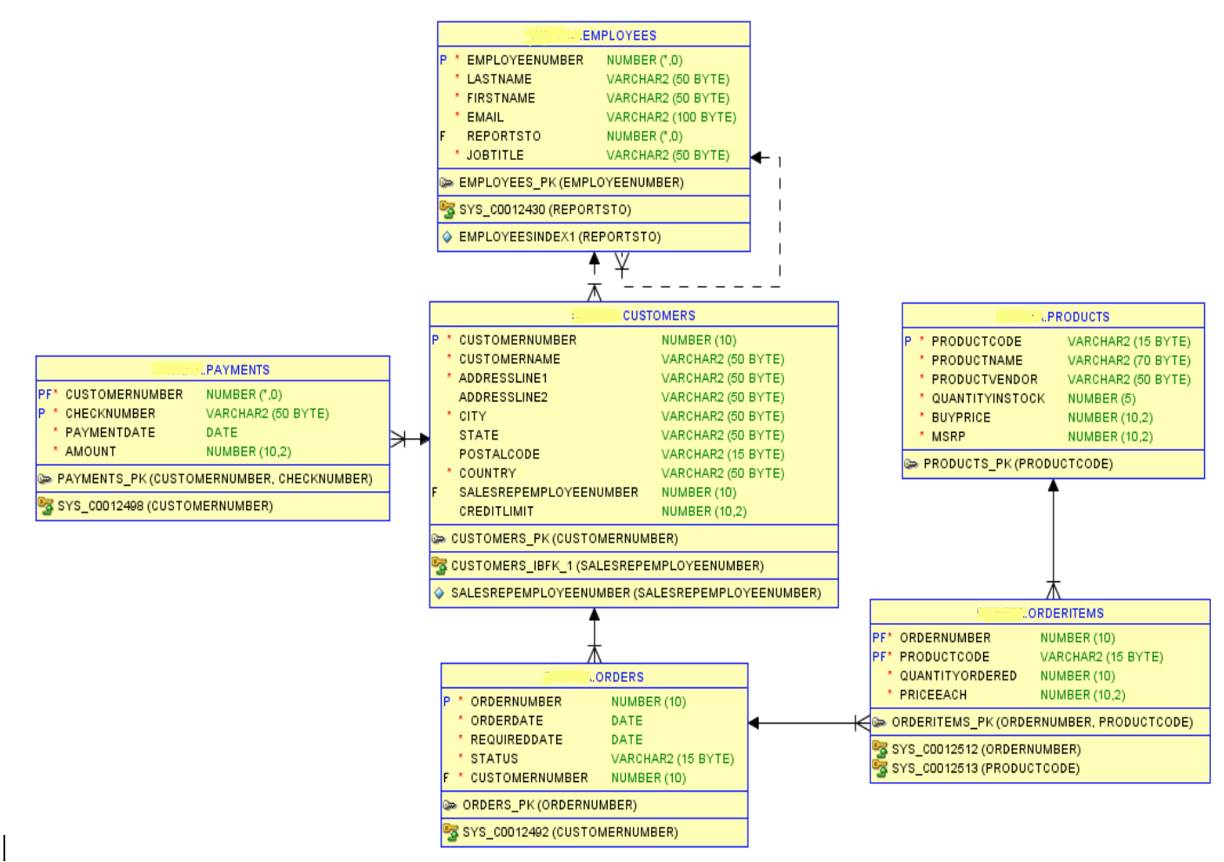
DATABASE SCHEMA

Slide 6
DATA LOADING AND PRE-PROCESSING
We are using the sample classicmodels database that is available publicly. (http://www.mysqltutorial.org/mysql-sample-database.aspx ).
Database Size : 352KB
Some of the columns and tables from the original dataset are not used.
Also, some of the table names are modified for convenience.
All the tables were originally in CSV files and later loaded into the Oracle database as well as Hive.

Slide 7
QUERIES EXECUTION
ORACLE VS HIVE

Slide 8
QUERY 1- Display the records from Orderitems table
SELECT * FROM ORDERITEMS;

Slide 9
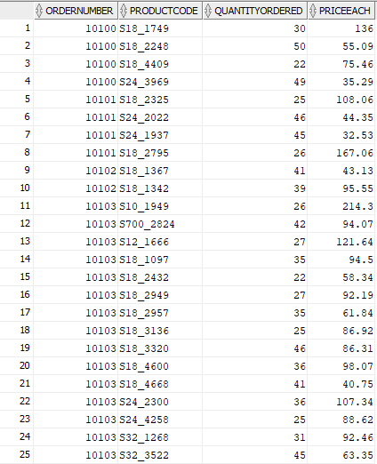
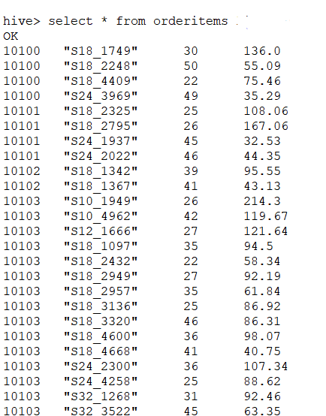
QUERY 1- SELECTION
Results on Oracle
Results on Hive

Slide 10
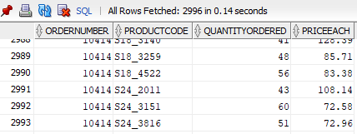
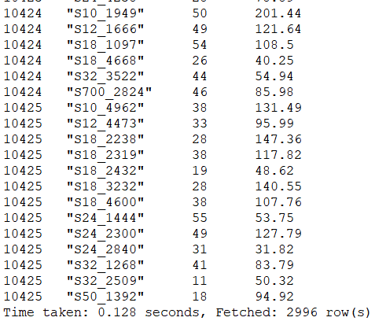
QUERY 1- SELECTION
Execution time on Oracle
Execution time on Hive
Hive 1.09 times faster. Nearly the same execution time.

Slide 11
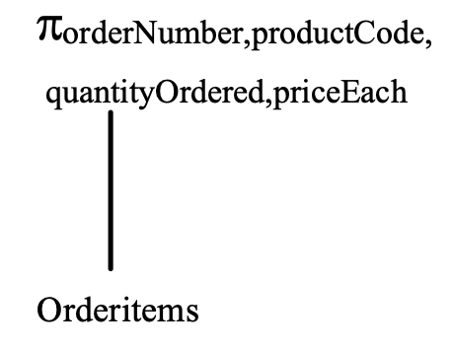
QUERY 1 – PROPOSED QUERY PLAN

Slide 12
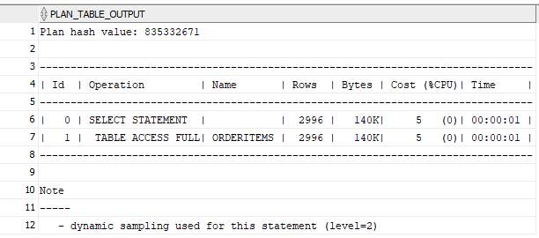
QUERY 1 – ORACLE EXPLAIN PLAN

Slide 13
QUERY 2- List of products supplied by the vendor 'Gearbox Collectibles'
SELECT productName
FROM products
WHERE productVendor LIKE '%Gearbox Collectibles%';

Slide 14
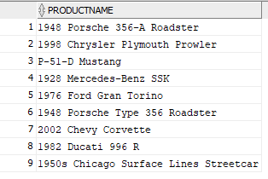

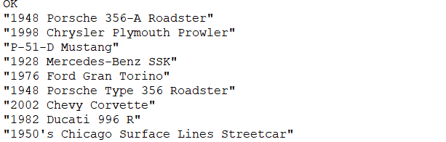
QUERY 2- PREDICATE
Results on Oracle
Results on Hive

Slide 15
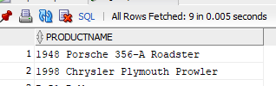

QUERY 2- PREDICATE
Execution time on Oracle
Execution time on Hive
Oracle is over 4200 times faster than Hive

Slide 16
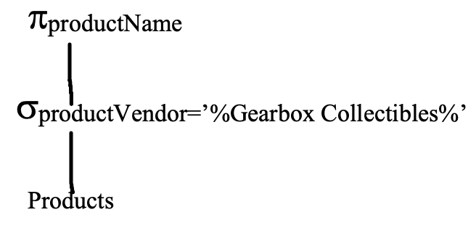
QUERY 2 – PROPOSED QUERY PLAN

Slide 17
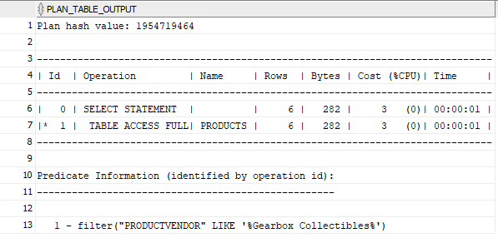
QUERY 2 – ORACLE EXPLAIN PLAN

Slide 18
QUERY 3- Find the number of customers at every postal code and the employee number of the sales representatives who assisted their by, if applicable.
SELECT salesRepEmployeeNumber,
postalCode,
COUNT(*) FROM
customers
WHERE salesRepEmployeeNumber != 0
GROUP BY salesRepEmployeeNumber , postalCode;

Slide 19
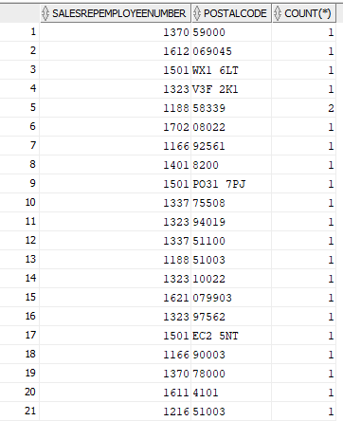
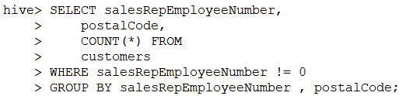
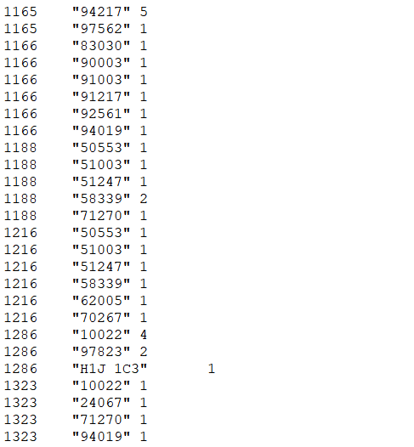
QUERY 3- AGGREGATE
Results on Oracle
Results on Hive

Slide 20
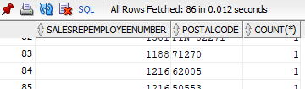

QUERY 3- AGGREGATE
Execution time on Oracle
Execution time on Hive
Oracle is over 2000 times faster than Hive

Slide 21
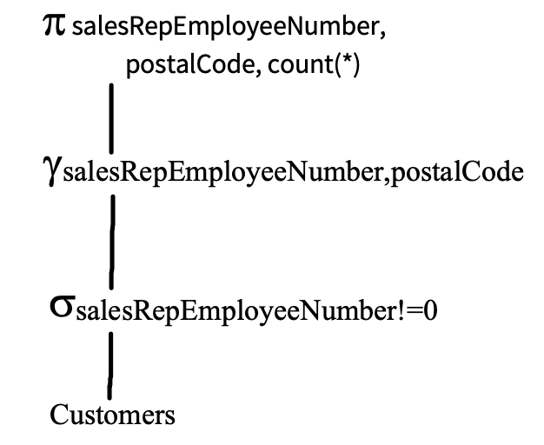
QUERY 3 – PROPOSED QUERY PLAN

Slide 22
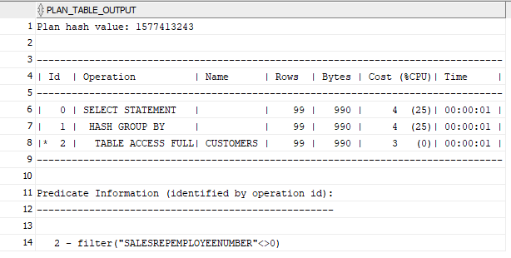
QUERY 3 – ORACLE EXPLAIN PLAN

Slide 23
QUERY 4 - Find the customer details whose order status is ‘On Hold’.
SELECT customerName,addressLine1, city, state, country FROM customers NATURAL JOIN orders WHERE status LIKE '%On Hold%';

Slide 24

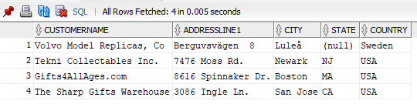
QUERY 4- NATURAL JOIN
Execution on Hive
Execution on Oracle

Slide 25
QUERY 4- NATURAL JOIN MODIFICATION
Previous query is modified so that it successfully executes and displays expected results on HIVE.
SELECT c.customerName,c.addressLine1, c.city, c.state, c.country FROM customers c INNER JOIN orders o ON (o.customerNumber = c.customerNumber) WHERE o.status LIKE '%On Hold%';

Slide 26
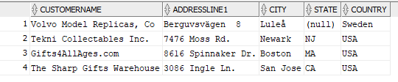

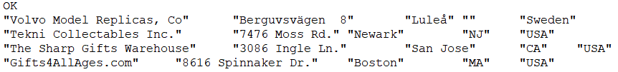
QUERY 4- NATURAL JOIN MODIFICATION
Execution on Oracle
Execution on Hive

Slide 27


QUERY 4- NATURAL JOIN MODIFICATION
Execution on Oracle
Execution on Hive
Oracle is around 2900 times faster than Hive.

Slide 28
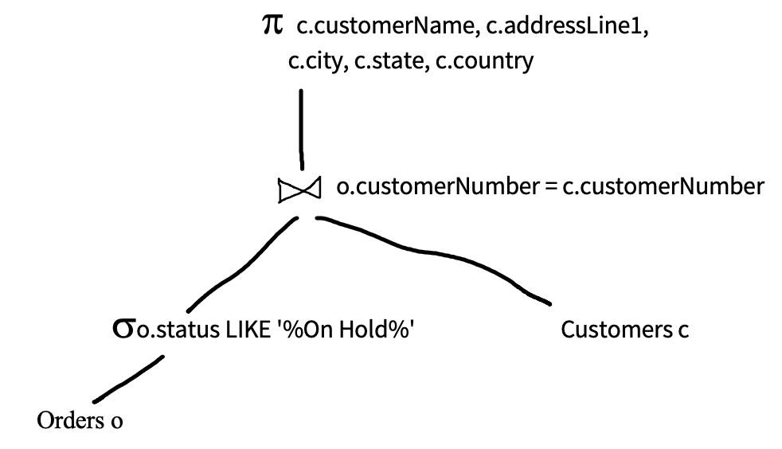
QUERY 4 – PROPOSED QUERY PLAN

Slide 29
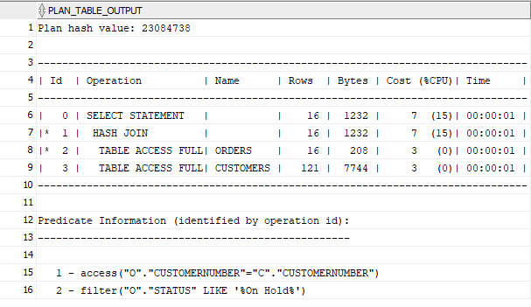
QUERY 4 – ORACLE EXPLAIN PLAN

Slide 30
QUERY 5- Find the number of times each product was sold at a loss.
SELECT orderitems.productCode, COUNT(priceEach) , AVG(priceEach)-AVG(buyPrice) FROM orderitems JOIN products ON priceEach > buyPrice GROUP BY orderitems .productCode;
This query includes a theta join. Theta join does not directly execute on hive, we need to modify it.

Slide 31
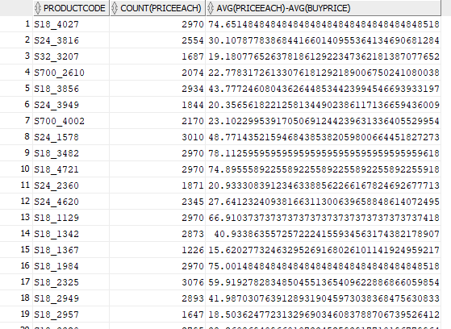
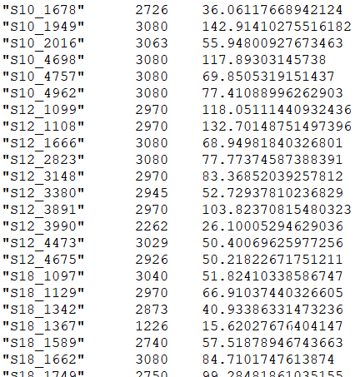
QUERY 5- THETA JOIN
Results on Oracle
Results on Hive

Slide 32

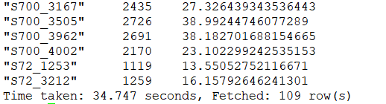
QUERY 5- THETA JOIN
Execution time on Oracle
Execution time on Hive
Oracle is around 200 times faster than Hive.

Slide 33
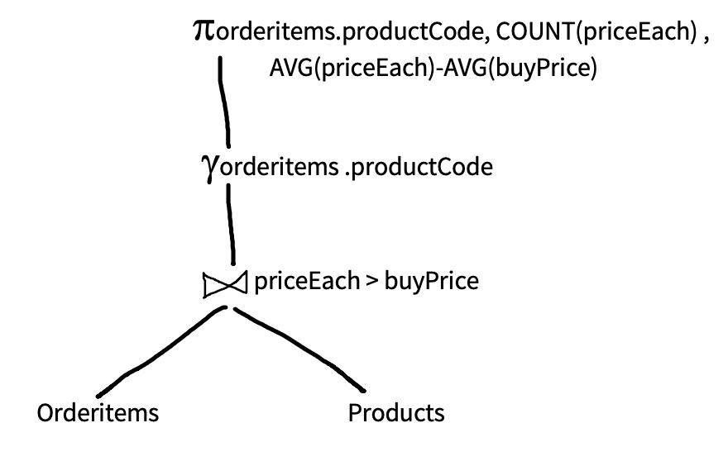
QUERY 5 – PROPOSED QUERY PLAN

Slide 34
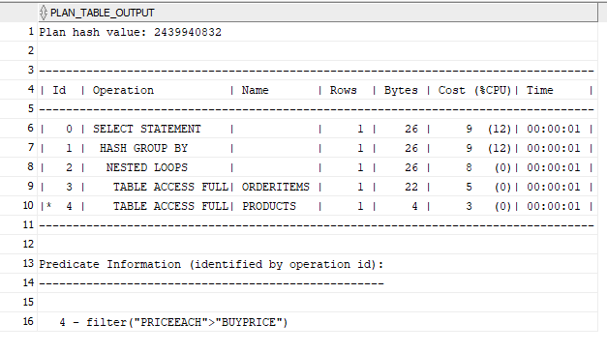
QUERY 5 – ORACLE EXPLAIN PLAN

Slide 35
QUERY 6 - Find the total number of employees reporting to each Manager
SELECT m.firstname,COUNT(e.firstname)
FROM employees e INNER JOIN employees m ON (e.reportsto = m.employeeNumber) GROUP BY m.firstname;

Slide 36
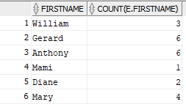
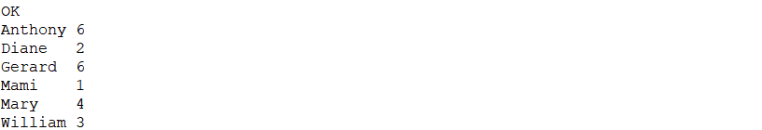
QUERY 6- SELF JOIN
Results on Oracle
Results on Hive

Slide 37


QUERY 6- SELF JOIN
Execution time on Oracle
Execution time on Hive
Oracle is around 2400 times faster than Hive.

Slide 38
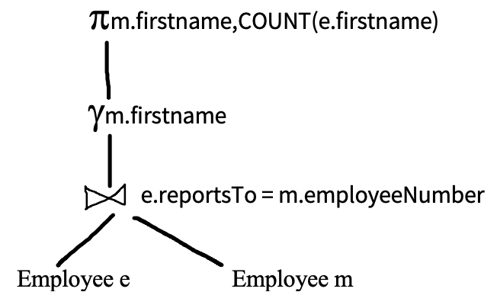
QUERY 6 – PROPOSED QUERY PLAN

Slide 39
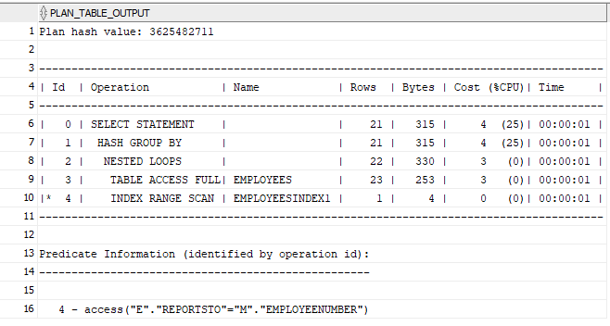
QUERY 6 – ORACLE EXPLAIN PLAN

Slide 40
QUERY 7 - List products with order quantities greater than 50.
SELECT productName FROM products
WHERE productCode IN
(SELECT productCode FROM orderitems
WHERE quantityOrdered > 50 );

Slide 41
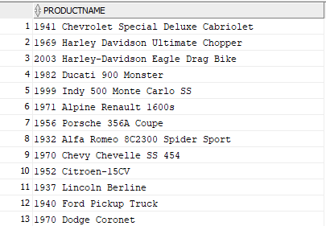
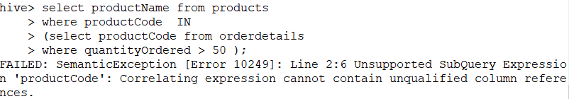
QUERY 7- SUBQUERY TYPE 1
Results on Oracle
Results on Hive

Slide 42
QUERY 7 - SUBQUERY TYPE 1- MODIFIED
SELECT p.productName FROM products p
WHERE p.productCode IN
(SELECT o.productCode FROM orderitems o
WHERE quantityOrdered > 50 );

Slide 43

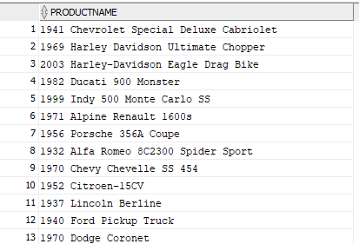
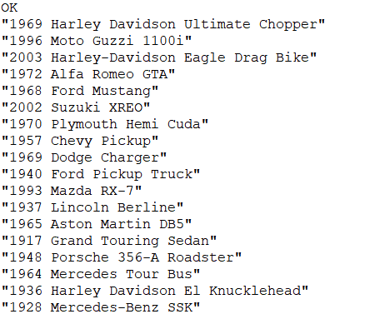
QUERY 7- SUBQUERY TYPE 1
Results on Oracle
Results on Hive

Slide 44


QUERY 7- SUBQUERY TYPE 1
Execution time on Oracle
Execution time on Hive
Oracle is over 1700 times faster than Hive.

Slide 45
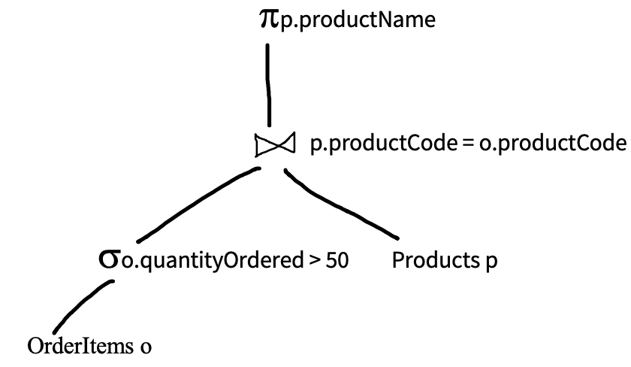
QUERY 7 – PROPOSED QUERY PLAN

Slide 46
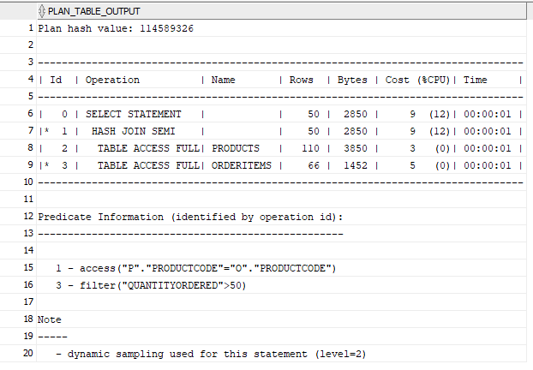
QUERY 7 – ORACLE EXPLAIN PLAN

Slide 47
QUERY 8 - Find employee details who represent the customers in the United States.
SELECT e.firstName, e.email FROM employees e
WHERE EXISTS ( SELECT c.customerName FROM customers c
WHERE e.employeeNumber = c.salesRepEmployeeNumber
AND c.country LIKE '%USA%');
This is a correlated subquery because the subquery references the enclosing query (with c.salesRepEmployeeNumber).
WHERE EXISTS tests for the existence of any records in a subquery.
EXISTS returns true if the subquery returns one or more records.
EXISTS is commonly used with correlated subqueries.

Slide 48
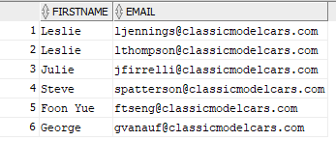
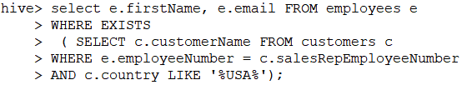
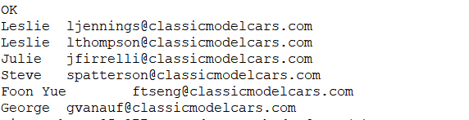
QUERY 8- SUBQUERY TYPE 2
Results on Oracle
Results on Hive

Slide 49

QUERY 8- SUBQUERY TYPE 2
Execution time on Oracle
Execution time on Hive
Oracle is over 5000 times faster than Hive.

Slide 50
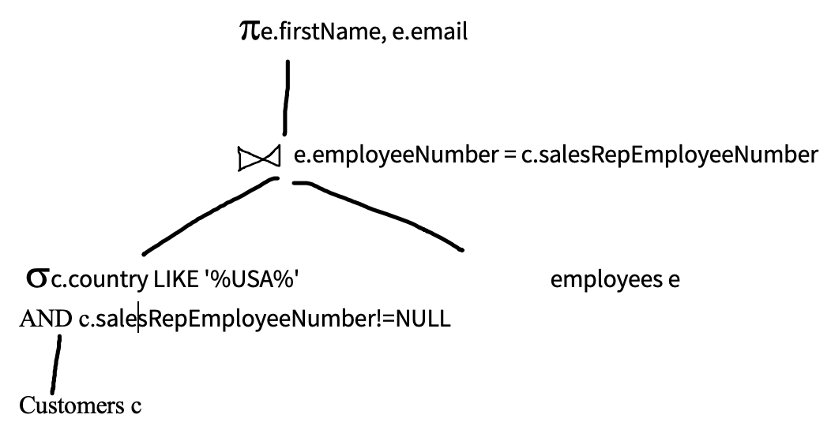
QUERY 8 – PROPOSED QUERY PLAN

Slide 51
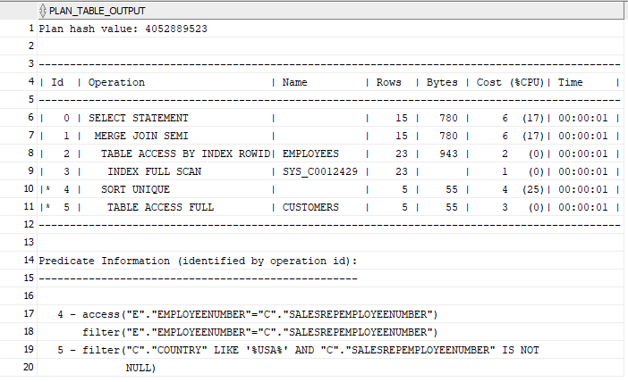
QUERY 8 – ORACLE EXPLAIN PLAN

Slide 52
Oracle VS Hive
Sr No. | Oracle | Hive
1 | Oracle is used as RDBMS Model for dealing with small datasets not Big -data. | Hive is built on Hadoop and it’s widely used as a Data Warehouse model for distributed large set of data managing and querying.
2 | Based on the notion of Read and Write many times. | Based on the notion of Write once, Read many times
3 | Oracle mainly supports OLTP workload. | Hive doesn’t support OLTP (Online Transaction Processing) but it is closer to OLAP (Online Analytical Processing).
4 | Appropriate for large-scale enterprise applications where data availability, integrity, disaster recovery and efficiency is important. | This is best suited for data analysts and scientists.

Slide 53
CHALLENGES FACED
ORACLE
Data loading and table creation
Data types needed to be modified
Special characters needed to be removed/skipped while query execution
Query execution
The output was incorrect if we missed even one entry while inserting data in tables
HIVE
Data loading and table creation
Data types needed to be modified
Special characters needed to be removed/skipped while query execution
Query execution
Queries needed modifications to run correctly on hive.

Slide 54
CONCLUSION
Almost all the queries perform better on Oracle compared to Hive.
Natural Join is not supported in Hive so an equivalent join with the join condition is used to get the expected results in Hive.
The theta join query needs to be modified into an equivalent cross join for Hive in order to get same results as Oracle.
Some of the flavours of subqueries needs to be modified for error free execution on Hive.
Hive is well suited for analytics purpose and Oracle is well suited for transaction processing.

Slide 55
THANK YOU

