Slide 1

Sentient
News summarizer based on sequence to sequence RNN

Slide 2
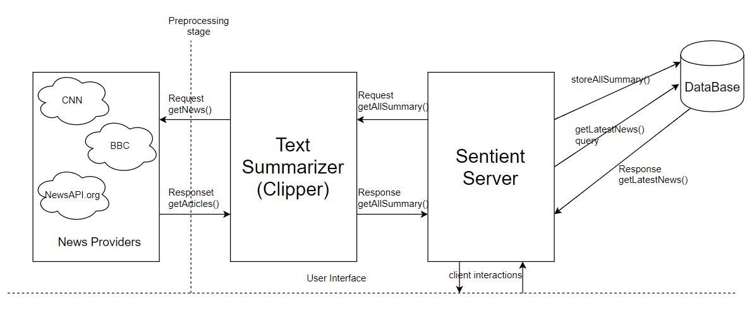
Overview architecture

Slide 3
Text summarizer: the algorithm
Sequence to sequence attentional model:
The encoder : consist of bidirectional LSTM
It takes the input word embeddings and produces a context vector.(hidden state)
Decoder has single layer unidirectional LSTM
It has same number of hidden states as encoder.
Decoder at each stage receives word embedding of previous word and a decoder state St and attention distribution is calculated
Attention distribution is used with context vector from encoder to produce a weighted sum

Slide 4
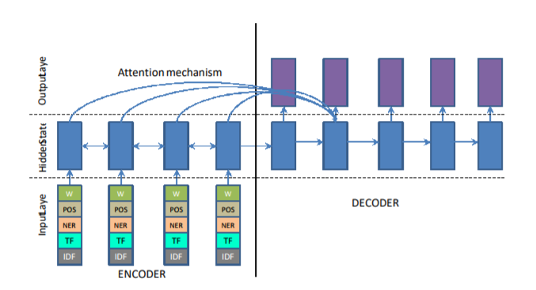
Basic attention based model
Ramesh Nallapati, Bowen Zhou, Cicero dos Santos, C¸ aglar Gulc¸ehre, and Bing Xiang. 2016. Abstractive text summarization using sequence-to-sequence RNNs and beyond

Slide 5
Pointer generator network:
Allows both copying words via pointing and generating words from a fixed vocabulary.
In addition to the previous model we use generation probability.
this is a soft switch which tells that whether we should use the words from vocab or simply by copying from the input sequence.
Advantage of this model.
Limitations

Slide 6
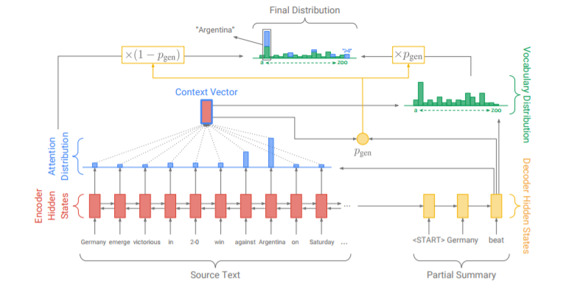
Pointer generator networks
Get To The Point: Summarization with Pointer-Generator Networks Abigail See Stanford University abisee@stanford.edu Peter J. Liu Google Brain peterjliu@google.com Christopher D. Manning Stanford University manning@stanford.edu

Slide 7
Coverage mechanism:
Sequence to sequence model common problem repetition
Coverage vector c: sums the attention distribution over all previous time steps used as an input to attention mechanism
unnormalized distribution over the source document that represent the degree of coverage those words received from attention mechanism.
Coverage loss penalize the repetitive attended location

Slide 8
MOdules
Sentient Data Collector and Preprocessor
For training and testing : CNN dataset
Model will use latest news articles on deployment
CNN , Daily mail API
Summarizer will request the news and data collecter will receive the request
Preprocessing layer removes images and save only the articles and summary

Slide 9
Sentient smart summarizer
Uses the sequence to sequence model
Attention mechanism
Pointer generator
Coverage mechanism
Interacts with the preprocessing layer to collect the new data
Interacts with database to store the summary
Using AWS ML AMI for the same and p2 instances

Slide 10
Sentient news server
Responsible for providing news to the client
Will be implemented using node js/java
Query the text summarizer
Stores data in database
Only point of interaction to user

Slide 11
Sentient smart storage
Using mongo db to store the summary
Summarizer will run only once a day
The sentient server will store data here after collecting it from the summarizer
The client requested summary will be queried
Will make system resilient even when the system is down

Slide 12

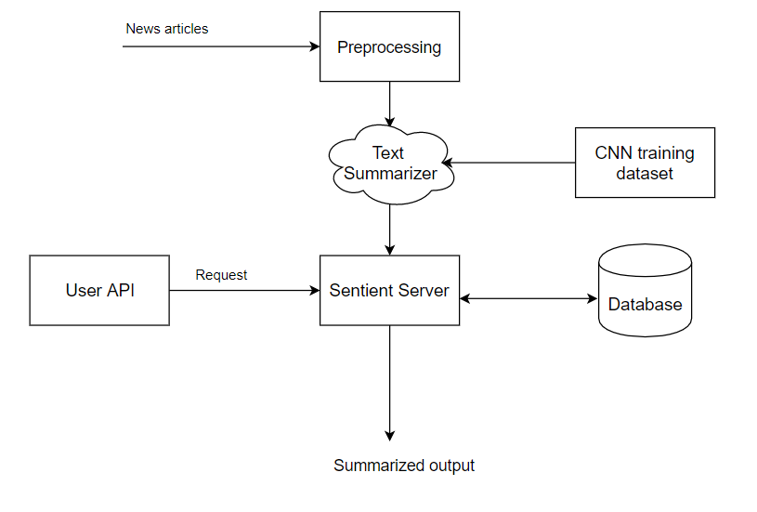
Flow diagram

Slide 13
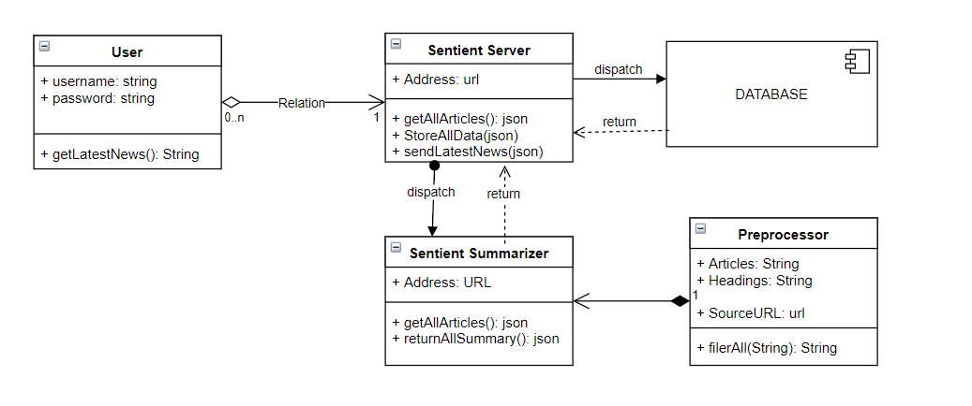
Class diagram

Slide 14
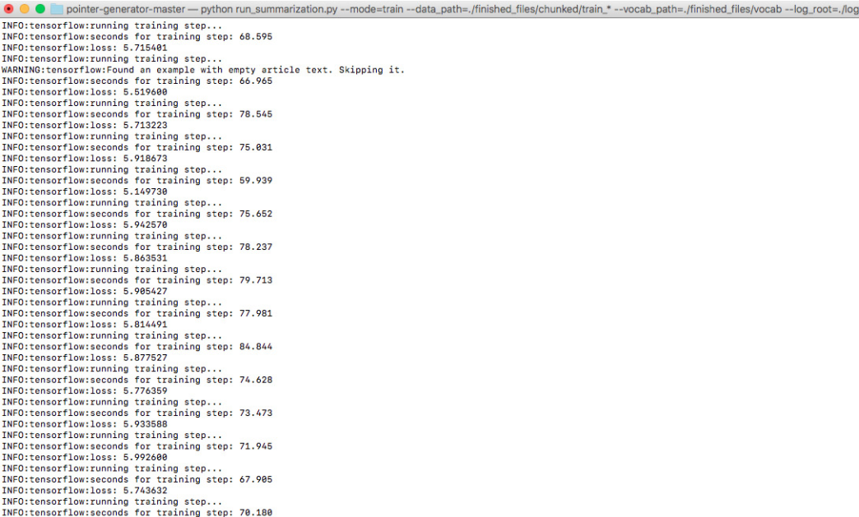
Training:

Slide 15
dataset
CNN dataset with 781 words per article on average
Approximately 4 sentences of summary
287,226 training pairs, 11,490 testing pairs

Slide 16
Experiment:
256 dimensional hidden layer
128 dimension word embeddings
Training on 50k words
No pretraining for word embeddings
Learned from scratch
Length of summary – 100 tokens
Length of articles 400 words

Slide 17
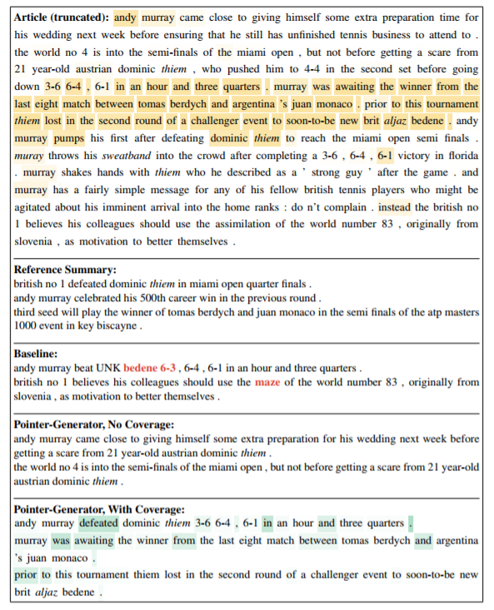
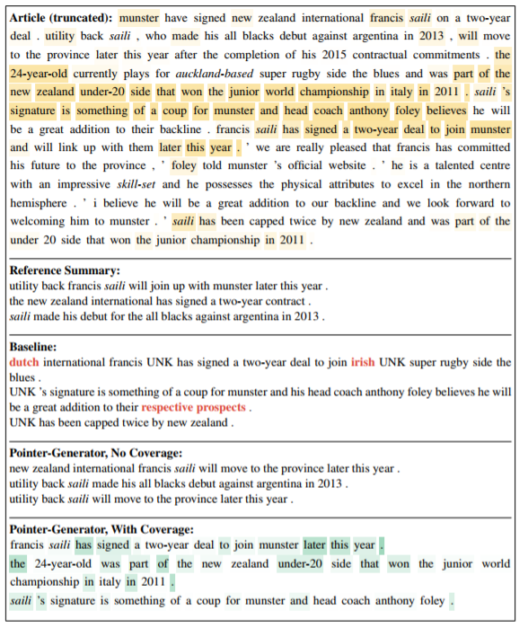
Outputs: sample

Slide 18
Observation:
Basic model performs poorly for rouge.
Facts are generated incorrectly
Summaries are mostly repetitive
Pointer network performed better even with the fewer epoch
OOV words are handled easily
Still repetition
With coverage the repetitions are solved

Slide 19
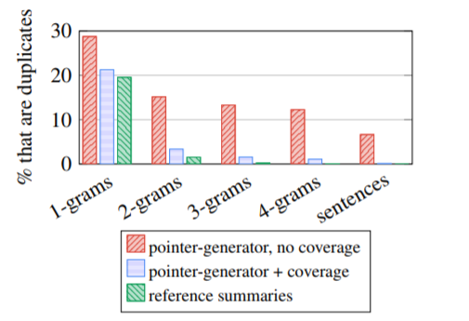
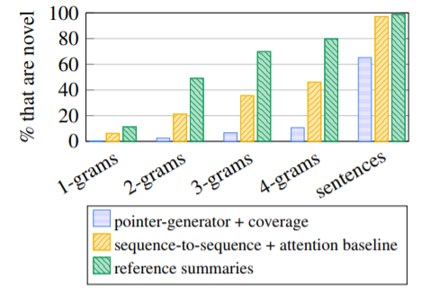
comparison
Get To The Point: Summarization with Pointer-Generator Networks Abigail See Stanford University abisee@stanford.edu Peter J. Liu Google Brain peterjliu@google.com Christopher D. Manning Stanford University manning@stanford.edu

Slide 20
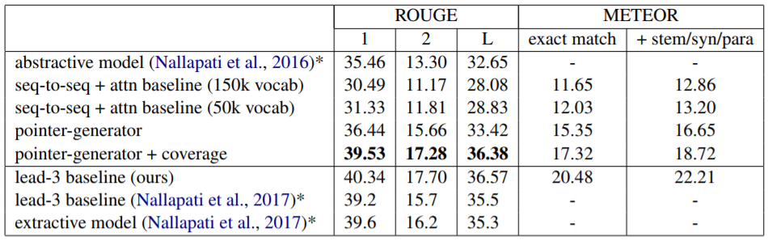
Get To The Point: Summarization with Pointer-Generator Networks Abigail See Stanford University abisee@stanford.edu Peter J. Liu Google Brain peterjliu@google.com Christopher D. Manning Stanford University manning@stanford.edu

Slide 21
Current STatus
We have been able to complete a basic model and started to train our summarizer.
We have been training the summarizer for three days and monitoring the logs. The dataset that we are using is the CNN/Daily Mail dataset which is approximately 2GB in size.
Also, we are building the backend server and database system in parallel. We have been able to hit the intended milestones and have approximately covered 50% of the task.

