Slide 1



Marketing
Campaign
Presented By: Shweta Gupta

Slide 2

BNDIATHE
THE BETTER INDIA
Title: The Better India - Content Driven Impact Platform
Introduction: Largest positive and solution-based content platform
Content sharing: Website, articles, and various media formats

Slide 3
THE BETTER INDIA
THE BETTER INDIA
Problem: Segregation and automation of article classification
Goal: Reach the right audience effectively
Solution: AI-driven classification using deep learning

Slide 4
Business Objectives
BUSINESS OBJECTIVES
Gain insights into marketing campaign effectiveness
Identify opportunities for improving marketing strategies
Increase sales and revenue

Slide 5
PROBLEM STATEMENTS
campaign effectiveness through conversion rate analysis
Identify factors contributing to higher customer acceptance and conversion rates
Analyze impact of demographics, spending behavior, and purchase history
Provide actionable insights for targeting customer segments and refining marketing strategies
Optimize marketing efforts, improve conversion rates, and enhance ROI

Slide 6
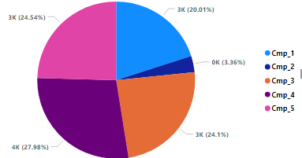
CUSTOMER SEGMENTATION
HIGHEST CUSTOMER ACCEPTANCE…………….Cmp_4
Income Group
Age Group
Marital Status
Education Level
Frequency Group

Slide 7
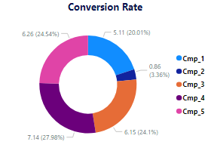
Highest Conversion Rate....Cmp_4
HIGHEST CONVERSION RATE…………….Cmp_4

Slide 8
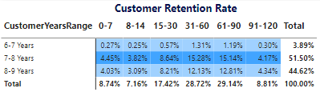
COHORT ANALYSIS
Cohort analysis:
Technique to analyze customer behavior
Groups customers based on shared characteristics
Examines behaviors, preferences, and outcomes
Benefits of cohort analysis:
Gain insights into customer segments
Inform targeted marketing strategies
Track changes and patterns over time

Slide 9
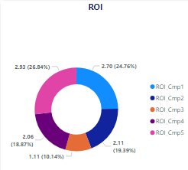
ROI

Slide 10
Recommendations For Optimal Marketing Campaigns and Enhanced ROI
Targeted Segmentation
Refine Campaign Strategies
Personalization and Customization
Improve Customer Experience
Continuous Monitoring and Analysis
Experiment and Innovate

Slide 11
THANK YOU

