Slide 1
P&L Variance Analysis
Dashboard
FY 2021 – 2023
6 Departments
5 Regions
SQL · Power BI
Kaggle Dataset
A 3-year budget vs actuals analysis across departments, categories and regions — identifying variance drivers, overrun patterns, and spend trends.
TOTAL ACTUAL
TOTAL BUDGET
TOTAL VARIANCE
VARIANCE %
₹97.73M
₹87.96M
+₹9.77M
+11.10%
Created by Shweta Gurram
Notes:
Introduce yourself and the project. State the business question: 'Where and why did actual spend deviate from budget over 3 years?'

Slide 2
Problem Statement & Objective
What business question am I answering?
PROBLEM
OBJECTIVE
A company accumulated 3 years of budget and actual spend data across 6 departments, 6 categories and multiple regions.
Finance leadership could not easily identify:
Which departments are consistently overspending
Which regions drive the most variance
Whether spend control is improving year over year
Identify high-variance departments & categories
Detect regional overrun patterns
Analyse YoY spend trend
Provide actionable CFO-level recommendations
" The goal was to answer: where is the company losing budget control — and what should leadership do about it? "
Notes:
Explain the business context. This slide answers 'why does this project matter?' before showing any numbers.

Slide 3
Dataset & Tools Overview
8 columns · FY 2021–2023 · Source: Kaggle
ORIGINAL 8 COLUMNS
7 CUSTOM COLUMNS ADDED
Transaction_ID
Unique identifier per row — Primary key
Variance (Actual − Budget)
Variance %
Date
Transaction date (YYYY-MM-DD)
Status (Favourable/Unfavourable)
Month
Department
6 departments: Sales, HR, IT, Finance, Ops, Mktg
Month_Num (1–12)
Category
6 types: Salaries, Marketing, Infrastructure…
Year
Quarter (Q1–Q4)
Region
Geographical region (North/South/East/West/Central)
Budget_Amount
Planned / budgeted spend (₹)
SQL
Power Query
Power BI
Kaggle
Actual_Amount
Actual spend (₹)
Exploration · Cleaning
Analysis · Insights
Transform · Shape
Data Types · Columns
Data Model · DAX
Dashboard · Visuals
Dataset source
Synthetic · 3 years
Payment_Method
Bank Transfer, Credit Card, Cash, Cheque
Notes:
Explain each column briefly. Emphasise the 7 custom columns you added — this shows you transformed the data, not just loaded it. Mention that Month_Num is critical for correct chart sorting in Power BI.

Slide 4
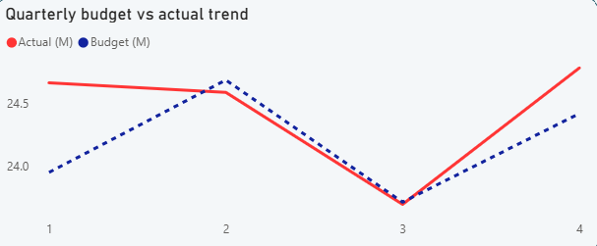
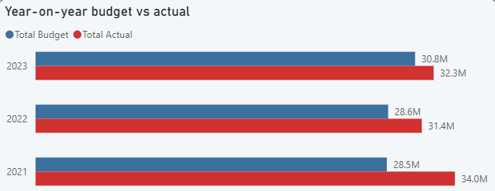
Dashboard Page 1 — Executive Overview
Total spend · Budget vs Actual trend · Year-on-year comparison
Total Budget
Total Actual
Variance Amount
Variance %
₹87.96M
₹97.73M
+ ₹9.77M
+ 11.10%
▶ Overspend
▶ Q3 Dip
▶ Improving
All 3 years exceeded budget. 2021 had the largest absolute overrun (₹5.5M).
Consistent spend dip in Q3 every year — seasonal mid-year slowdown.
YoY gap is narrowing: budget +7.63% but actual only +3.07% in 2022→2023.
Notes:
Say: The headline number is ₹9.77M over budget (11.10%). Every year exceeded budget. But notice the 2022-2023 comparison — the gap is narrowing, which is a positive sign. Q3 dips consistently across all years — this is a seasonal pattern, not a one-off issue.

Slide 5
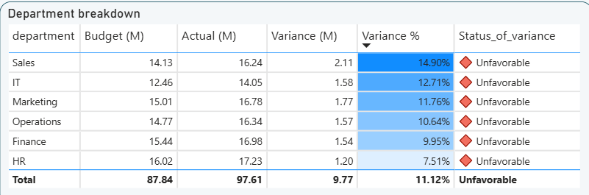
Dashboard Page 2 — Department Analysis
All 6 departments reported unfavourable variance — a systemic budgeting issue
Notes:
Key message: Every single department overspent. Sales had the highest overrun at 14.90%. The fact that all 6 are unfavourable tells us this is not a departmental failure — it is a systematic under-budgeting problem that leadership needs to address.

Slide 6
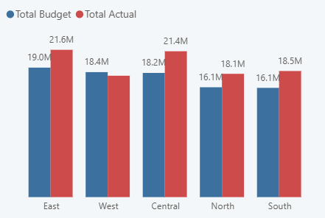
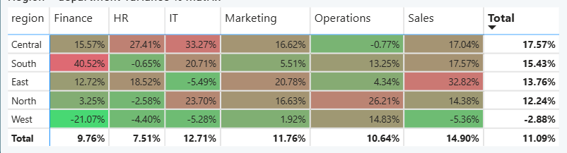
Dashboard Page 3 — Regional Analysis
East and Central regions drive the largest overruns · West region best budget control
Budget vs Actual by Region (₹M)
Region × Department Variance % Matrix
East: Highest Spend
Central IT: +33.3%
West: Best Control
₹21.6M actual vs
₹19.0M budget (+13.7%)
Biggest single variance
in entire dataset
Actual ₹17.8M slightly
under ₹18.4M budget
Notes:
Point to the matrix first — it tells the whole regional story at a glance. Central's IT department at +33.3% is the single biggest variance cell in the dataset. West is the only region that came close to budget — use it as an internal benchmark for best practice.

Slide 7
Key Findings & Recommendations
P&L Variance Analysis — FY 2021–2023 | Synthesised from SQL analysis and Power BI dashboard
KEY FINDINGS
RECOMMENDATIONS
🔴 All 6 departments overspent — systemic under-budgeting, not isolated overruns
✓
Revise annual budgets upward by 10–12% to reflect actual spending reality
🔴 Sales led overruns at 14.90% (+₹2.11M) — highest of all departments
✓
Audit Sales department travel and operational costs — biggest overrun driver
🔴 Central IT variance +33.27% — largest single cell in the entire dataset
✓
Review IT infrastructure contracts in Central region — +33% is unsustainable
🔴 56.87% of all transactions exceeded their individual budgets
✓
Implement quarterly budget reviews to catch overruns mid-year, not year-end
📊 Q3 dip is consistent across all 3 years — clear seasonal spending pattern
✓
Use West region as internal best-practice model for budget discipline
🟢 2023 variance gap is narrowing vs 2021 — cost discipline is improving
✓
Plan Q4 spend controls to prevent year-end budget-burn pattern
Thank you
Notes:
This is your most important slide. Say: The data shows this is not a random variance — it is systemic. Every department overspent, which tells us the budgets were set too low. My recommendation is a 10-12% upward revision combined with quarterly review cycles to catch issues early rather than discovering them at year-end.

