Slide 1
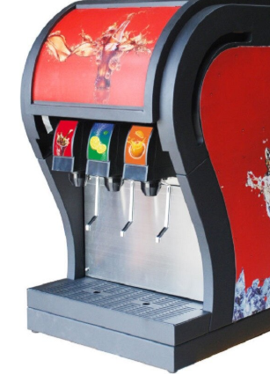
Predicting the Time Taken by a Vending Machine
to Dispense a Soft drink
- Shweta Kallurkar

Slide 2
Problem Statement
A soft drink bottler company is analyzing the vending machine service routes in their system. They need to know the time required by the route driver to service the vending machines.
There are two most important variables affecting the delivery time
1. The number of cases of product stocked
2. The distance walked by the route driver

Slide 3
The Dataset
The delivery dataset provides information about the time taken to bottle a soft drink using the vending machines.
The delivery dataset is a data frame with 25 observations on the following 3 variables
•n_prod: Number of Products stocked in a vending machine
•distance: Distance traversed by the driver mechanism of the vending machine to dispense a soft drink
•delTime: Time required to deliver(bottle) the soft drink.

Slide 4
The Data
ExpVar1 | ExpVar2 | TargetVar
n_prod | distance | delTime
7 | 560 | 16.68
3 | 220 | 11.5
3 | 340 | 12.03
4 | 80 | 14.88
6 | 150 | 13.75
7 | 330 | 18.11
2 | 110 | 8
7 | 210 | 17.83
30 | 1460 | 79.24
5 | 605 | 21.5
16 | 688 | 40.33
10 | 215 | 21
4 | 255 | 13.5
6 | 462 | 19.75
9 | 448 | 24
10 | 776 | 29
6 | 200 | 15.35
7 | 132 | 19

Slide 5
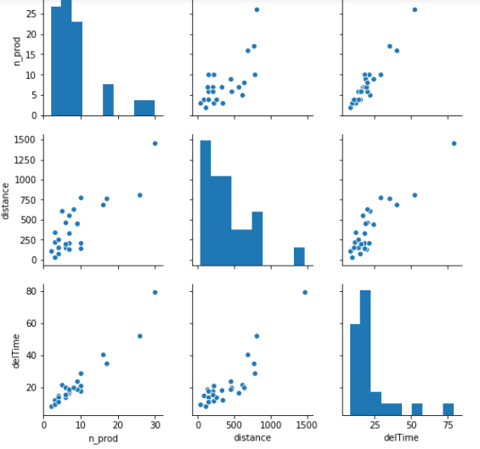
EDA for the Dataset
Using a scatter plot, we can visually determine whether there exists a linear association between the variables.

Slide 6
Building the Model
Applying machine learning algorithm on the dataset.
Here we are considering Linear Regression Algorithm
Linear Regression Model is predicting the continuous Independent Variable(Target) based on one or more Dependent Variables(Explanatory)
Initializing X and Y variables as
X (Explanatory Variable ) = n_prod , distance
Y (Target Variable ) = delTime
Predicting the Y variable
Calculating the Rsquare = 0.95959

Slide 7
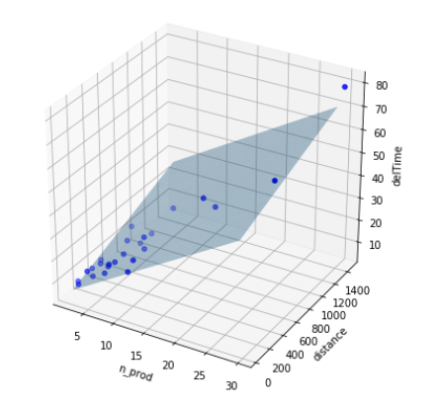
Building the Model
The best fit model to predict the delivery time based on n_prod and distance can be expressed by below equation.
y = 2.34123 + 1.61590 * n_prod + 0.01438 * distance
The multiple regression model represents a plane .
The best fit model obtained for predicting the delTime for the given sample dataset can be visualized as shown

Slide 8
Model Evaluation
Here I tried to build 2 models considering the predictors i.e explanatory Variables
Model1 with a single predictor - n_prod
Rsq Value is 0.930481
Model2 with a both the predictors – n_prod and distance
Rsq Value is 0.959593
The Adjusted Rsquare Value is 0.955920
The R2 value here indicates that approximately 95.95 % of the variability observed in the delTime of the vending machine can be explained by variability in the predictor variables n_prod and distance

Slide 9
Conclusion
We can analyze a continuous Target variable called delTime based on the independent variables called n_products and distance by using Linear Regression.
Hence we can provide insights to the soft drink bottler company about the usage of the vending machine with respect to delivery time which in turn can be predicted by the above discussed variables.

Slide 10
- Thank you

