Slide 1
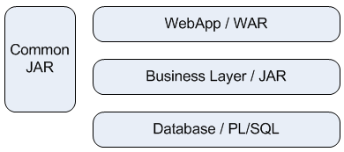
1 application (EAR) build & maintain by 4 teams
Team 1: Database
Technology: PL/SQL
Delivery: SQL files that contain upgrade for production database.
Members: 1DBA + 2 PL/SQL developpers
Team 2: Common
Technology: Java
Delivery: 1 jar file
Members: 20p (developer + Project manager)
Team 3: Business Layer
Technology: Java
Delivery: 1 jar file
Members: 4p (developer + Project manager)
Team 4: WebApp
Technology: JEE
Delivery: 1 War file.
Members: 6p (developpers + Project manager)

