Slide 1
RRAM Device Modelling Using
COMSOL Multiphysics and MATLAB LiveLink
Presented by: Sweta Maurya | Scholar ID: 2315080
B.Tech., 7th Semester
Under the guidance of Dr. Shivendra Kumar Pandey
Department of Electronics and Instrumentation Engineering
National Institute of Technology Silchar • June–July 2026
SN Bose
Internship Program, 2026

Slide 2
1. Motivation & Problem Context
02
Why filamentary RRAM needs coupled device modelling
RRAM switching
Why physics matters
Internship focus
Resistance changes between a high-resistance state (HRS) and low-resistance state (LRS) through formation and rupture of a conductive filament.
Switching is coupled to Joule heating, filament growth/rupture, electrostatics and material properties.
Develop and debug a numerical COMSOL model driven and post-processed through MATLAB LiveLink.
• Study the thermodynamic and electro-thermal framework reported for filamentary RRAM.
• Automate the OFF → SET → ON → RESET sequence and extract device-level quantities.
• Build a reproducible workflow that can later support quantitative validation against literature.
SN Bose Internship Program 2026 • RRAM Device Modelling

Slide 3
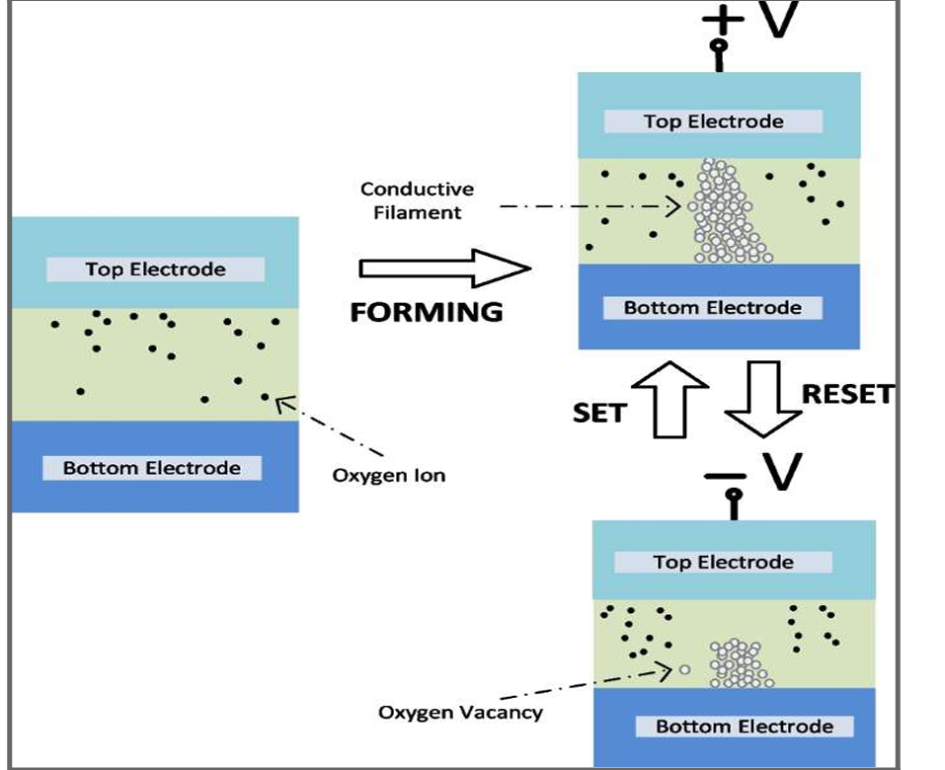
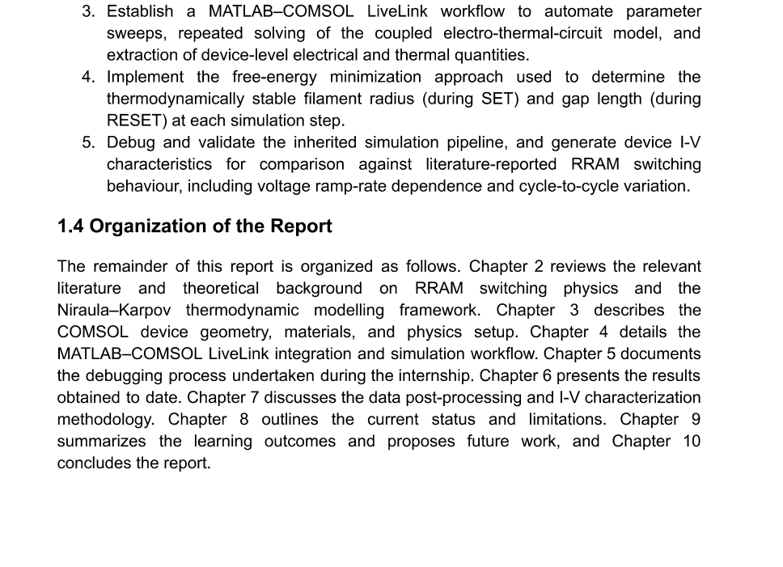
1. RRAM Structure & Switching Mechanism
03
From oxygen vacancies to conductive-filament switching
RRAM states
• HRS: filament is interrupted
• LRS: conductive filament forms
SET / RESET
SET → filament grows → LRS
RESET → filament ruptures → HRS
Physical picture
Applied electric field drives oxygen-ion / vacancy redistribution, changing the conductive path.
KEY IDEA: FILAMENT FORMATION & RUPTURE
SN Bose Internship Program 2026 • RRAM Device Modelling

Slide 4
3. Theoretical Framework
04
Niroula–Karpov thermodynamic modelling
FREE-ENERGY MODEL
Chemical / volume
Surface
• For a given applied bias, the model evaluates the total free energy as a function of filament radius.
• The equilibrium filament radius is obtained by minimizing the total free energy.
• The approach is repeated across voltage/current sweeps to construct switching behaviour.
Phase-change contribution
Interface energy + surface tension
Electrostatic
Thermal
Electric-field energy in the dielectric/gap
Joule-heating-related heat energy
Applied bias
→
Electro-thermal
fields
→
Free-energy
vs. radius
→
Minimum-energy
state
SN Bose Internship Program 2026 • RRAM Device Modelling

Slide 5
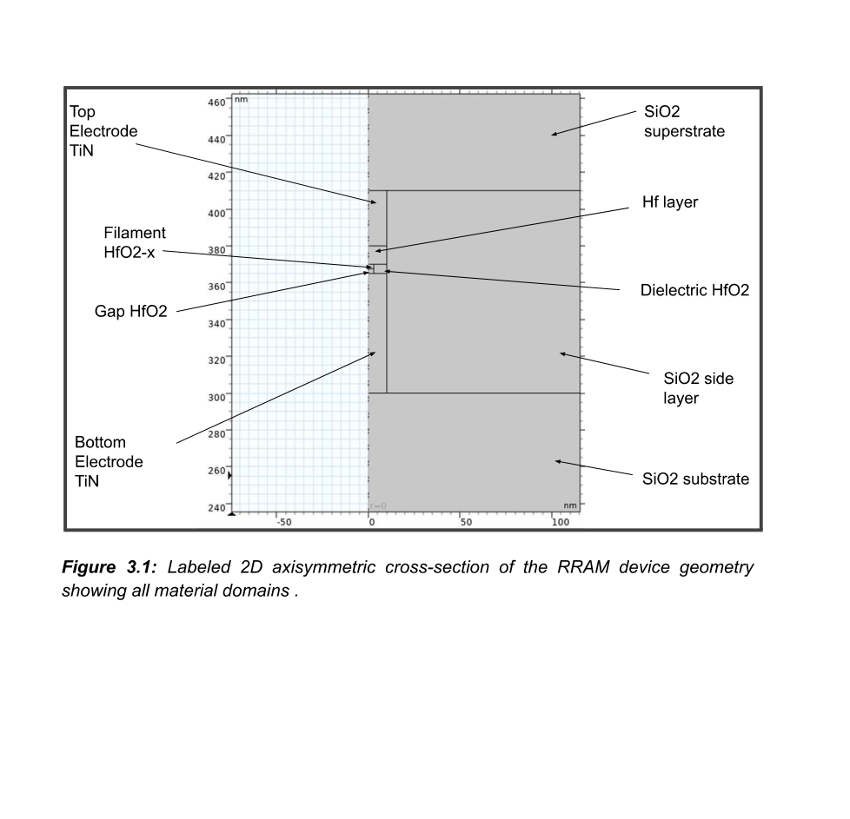
4. COMSOL Device Model
05
2D axisymmetric geometry, materials and multiphysics
• 2D axisymmetric model constructed in COMSOL Multiphysics 6.0.
• Device stack includes TiN electrodes, HfO₂ dielectric, Hf layer, HfO₂−x filament and an insulating gap.
• The geometry was parameterized so filament radius and gap length could be varied during the switching calculations.
MODEL DOMAINS
Top TiN
→
HfO₂ / Hf
→
Filament + gap
→
Bottom TiN
SN Bose Internship Program 2026 • RRAM Device Modelling

Slide 6
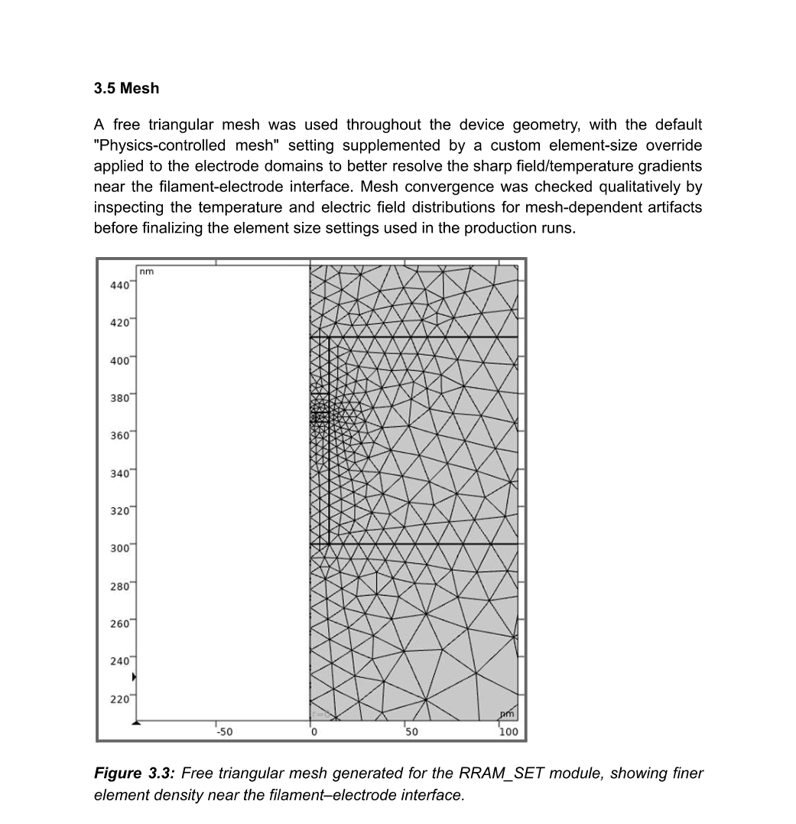
5. Multiphysics Setup
06
Coupling heat, electric current and circuit physics
Heat Transfer in Solids
Electric Currents
Solves device temperature using heat conduction and Joule-heating input.
Computes electric potential and current density in conductive domains.
Electrical Circuit
Electromagnetic Heating
Represents the external drive circuit and voltage/current source behaviour.
Feeds Joule heating from the electrical model into the thermal model.
• A free triangular mesh was used, with finer element density near the filament–electrode interface.
• The report also defines surface-to-ambient radiation on exposed surfaces.
SN Bose Internship Program 2026 • RRAM Device Modelling

Slide 7
6. MATLAB–COMSOL LiveLink Workflow
07
From parameter sweeps to automated switching-cycle data
MATLAB
parameters
→
COMSOL
model build
→
Solve
multiphysics
→
Extract
fields
→
Free-energy
minimization
→
Store
MAT data
• Four COMSOL model states were organized as RRAM_OFF, RRAM_ON, RRAM_SET and RRAM_RESET.
• MATLAB LiveLink was used to rebuild/run models, override parameters, extract quantities and aggregate results.
• The workflow was designed to execute a complete switching cycle rather than isolated manual simulations.
POST-PROCESSING
• Saved .mat tables preserve stage-wise data for later I–V plotting and analysis.
SN Bose Internship Program 2026 • RRAM Device Modelling

Slide 8
6. MATLAB–COMSOL LiveLink Workflow
08
How MATLAB controls the COMSOL simulation
1. MATLAB
2. COMSOL
3. MATLAB
Sets parameters such as voltage, material values and switching conditions.
→
Builds and solves the coupled electrical + thermal device model.
→
Reads current, temperature, filament radius and free-energy data for analysis.
AUTOMATION LOOP
Why LiveLink is useful
• The process is repeated for the OFF, SET, ON and RESET stages.
• This reduces manual parameter changes and result collection in COMSOL.
• The extracted data are saved in MATLAB for plotting and analysis.
It connects MATLAB scripting with the COMSOL solver, making repeated simulations, parameter changes and result extraction easier to automate.
MATLAB = CONTROL & ANALYSIS | COMSOL = PHYSICS SOLVER
SN Bose Internship Program 2026 • RRAM Device Modelling

Slide 9
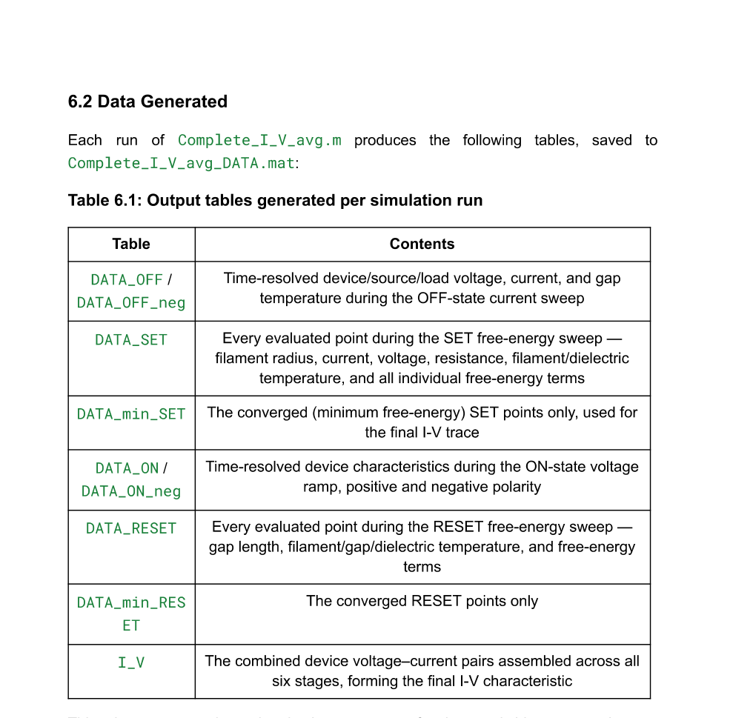
8. Simulation Status & Generated Data
09
What was successfully achieved
Pipeline status
All four COMSOL modules build and solve successfully inside MATLAB–COMSOL LiveLink after debugging.
Automated cycle
The driver runs OFF → SET → ON → RESET, including free-energy minimization and data aggregation.
Output data
Stage-wise tables capture voltage, current, temperature, filament/gap parameters and free-energy terms.
SN Bose Internship Program 2026 • RRAM Device Modelling

Slide 10
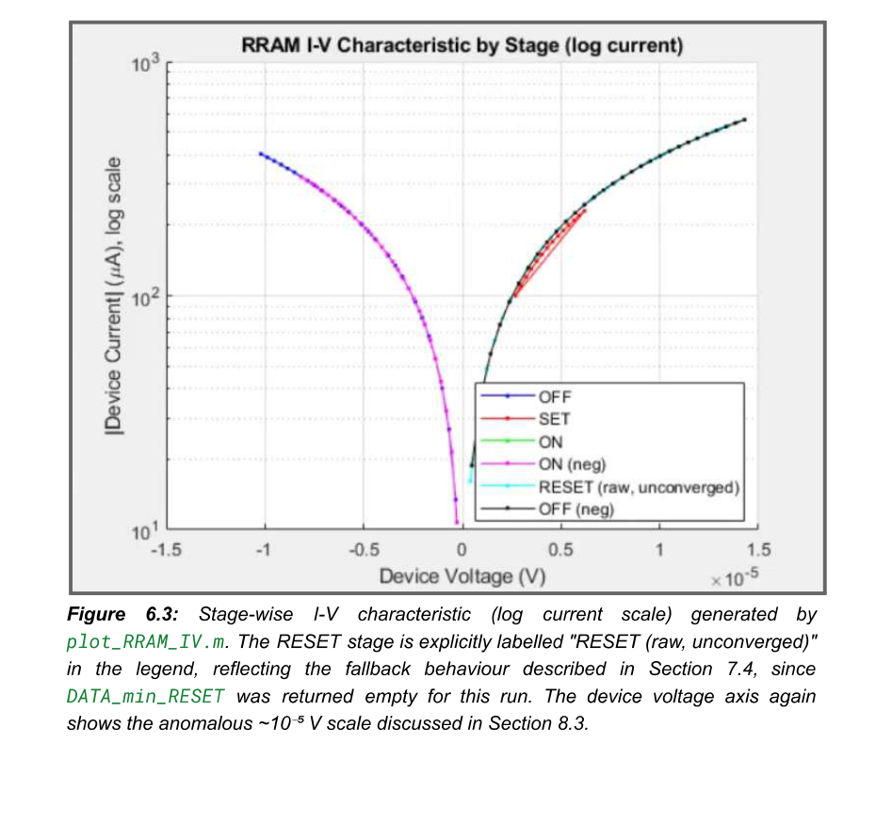
9. Data Processing & I–V Characterization
10
Separate simulation from plotting for reproducible analysis
• A dedicated MATLAB post-processing script, plot_RRAM_IV.m, loads saved .mat data.
• Three complementary views were implemented: combined I–V, stage-wise I–V, and logarithmic-scale I–V.
• The plotted data currently reveal numerical/model issues that must be resolved before physical validation.
IMPORTANT OBSERVATION
• The report identifies an anomalous device-voltage scale and a non-convergent RESET free-energy minimization in the examined run.
SN Bose Internship Program 2026 • RRAM Device Modelling

Slide 11
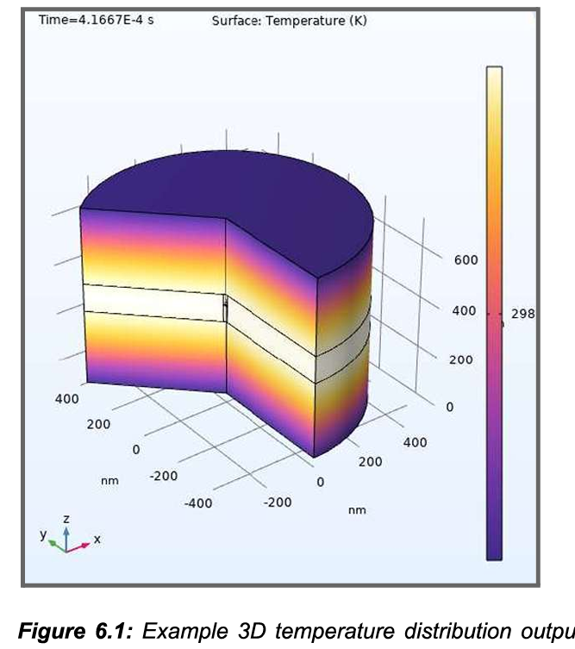
9. Preliminary Results & Current Status
11
What the present simulation workflow produces
What is working
The COMSOL models run through the MATLAB–LiveLink workflow and return stage-wise simulation data.
What the temperature plot shows
The device develops a non-uniform temperature distribution, demonstrating the electro-thermal part of the model.
What still needs improvement
RESET minimization and the extracted device-voltage scale require further investigation before quantitative I–V validation.
EXAMPLE COMSOL TEMPERATURE OUTPUT
SN Bose Internship Program 2026 • RRAM Device Modelling

Slide 12
11. Limitations & Current Scope
12
What the internship did—and did not—establish
Established during internship
Not yet established
A working, automated COMSOL–MATLAB modelling infrastructure; systematic debugging; data extraction and I–V post-processing.
Physically validated switching curves, ramp-rate dependence, cycle-to-cycle variation and quantitative agreement with literature.
• RESET free-energy minimization remains non-convergent in the examined run.
• Device-voltage scaling is anomalous and requires investigation of the COMSOL circuit configuration.
• The report explicitly treats the model as a working, debugged simulation infrastructure rather than a completed validated device model.
NO EXPERIMENTAL FABRICATION
The internship work was computational; no experimental device fabrication was performed.
SN Bose Internship Program 2026 • RRAM Device Modelling

Slide 13
12. Technical Learning Outcomes
13
Skills developed through the internship
Multiphysics FEM
MATLAB LiveLink
Translated physical RRAM geometry into coupled Heat Transfer, Electric Currents and Electrical Circuit models.
Programmatic control of COMSOL: model building, parameter sweeps, solving and result extraction.
Systematic debugging
Simulation architecture
Learned to isolate errors across MATLAB syntax, COMSOL parameters, selections, mesh, tables and server state.
Separated model-building, simulation, data aggregation and plotting into reusable stages.
• Most importantly: intermediate quantities and stage-wise data should be inspected before trusting a final I–V result.
SN Bose Internship Program 2026 • RRAM Device Modelling

Slide 14
13. Future Scope & Conclusion
14
Path from a functional pipeline to validated RRAM characteristics
NEXT STEPS
CONCLUSION
• Resolve RESET free-energy convergence and identify the stable gap-length solution.
• Resolve the device-voltage scaling / circuit-terminal configuration issue.
• Generate and validate the baseline I–V curve after the above fixes.
• Run ramp-rate and cycle-to-cycle studies and compare against reference literature.
• Quantitatively benchmark SET/RESET ON/OFF states, current ratios and switching behaviour.
• The internship established a COMSOL–MATLAB framework for numerical RRAM modelling.
• The main practical contribution was making the inherited simulation pipeline executable and systematically debugging it.
• The work provides a foundation for completing physical validation in the next stage.
Takeaway
A reliable simulation workflow is the prerequisite for trustworthy device-level conclusions.
SN Bose Internship Program 2026 • RRAM Device Modelling

Slide 15
Thank You
Sweta Maurya • Scholar ID 2315080
Selected references
• D. Niroula & V. G. Karpov, “Comprehensive numerical modeling of filamentary RRAM devices…” (2018).
• COMSOL Multiphysics 6.0 documentation and COMSOL LiveLink for MATLAB documentation.
• RRAM literature cited throughout the internship report on HfO₂ switching and filamentary behaviour.
SN Bose Internship Program 2026 • National Institute of Technology Silchar

