Slide 1
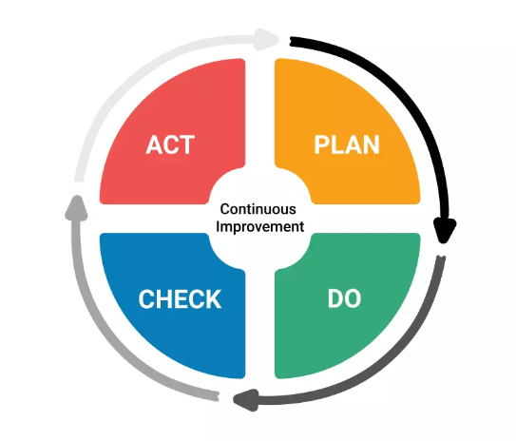
Introduction
Test Monitoring
Process in test execution is a process in which the testing activities and testing efforts are evaluated in order to track current progress of testing activity, finding and tracking test metrics, estimating the future actions based on the test metrics and providing feedback to the concerned team as well as stakeholders about current testing process.
Ensures that specific targets are met at every stage of testing, so they meet objectives.
Monitoring works by comparing the current status of tasks against the established plan and evaluating whether the process is yielding the expected results.
Formula : “ Estimated – Actual = Remaining ”
Test Control
Process in test execution is a process of taking actions based on results of the test monitoring process.
In the test control phase below activities are performed to improve the quality and efficiency of future testing process.
test activities are prioritized
test schedule is revised
test environment is reorganized
other changes related to testing activities

Slide 2
Definitions
Test Case: is collection of Test Case Title, Summary, Preconditions, Test Procedure, Test Estimation and other parameters which are necessary in testing activity.
Test Step: is a single step in Test Procedure that contains action to be performed by Tester and expected result.
Test Estimation: is the approximate time (in minutes/hours) involved to perform a testing activity.
Actual Execution Time: is the amount time (in minutes/hours) spent on the planned testing activity.
Remaining Estimation: is the difference in Estimated time and Actual time in a testing activity.
Burndown report: is a run chart of outstanding work. It is useful for predicting when planned activity will be completed.
Test Progress Report: is a document summarizing the testing activities and test results.
Product Progress Test Report: is a document that provides an overview of the product performance towards testing activities
Product Comparison Report: is document that provides comparison of the test report on versions/revisions.

Slide 3
Test Reports
Test Report is a document which contains a summary of test activities and test results of a testing project.
Test report is an assessment of how well the Testing is performed ?
Based on the test reports, stakeholders can evaluate the quality of the tested product and decide how to proceed for product release.
Test reports:
Burndown chart : Provides an overview of the test process from start to end of milestone
Test Progress Report How the test process is proceeding ?
In units of Number of Test Cases
In units of Number of Test Steps
Product Progress Report : How good is the Product ?
In units of Number of Test Cases
In units of Number of Test Steps
Product Revision/Build comparison report

Slide 4
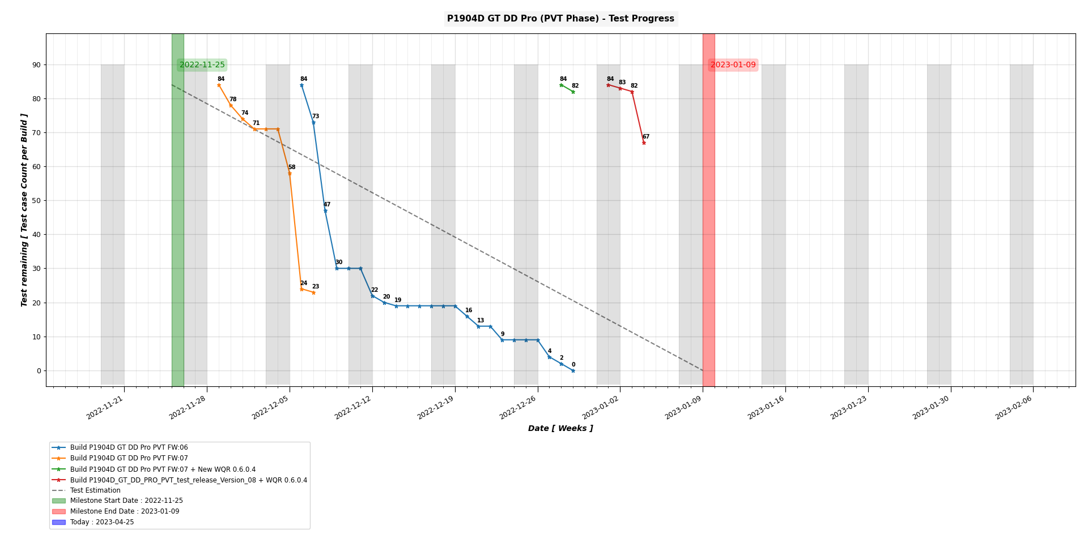
Burndown Chart
A sample Burndown Chart from Project.
Displaying the tests performed with 4 different firmware versions
Green Band “Milestone Start Date”
Red Band “Milestone End Date”
Grey Bands “Weekends”
Grey dot line “Testing Planned”
Colored lines “Test Progress” for different Firmware versions
The numbers are: How many test cases are remaining to be executed at that particular date ?

Slide 5
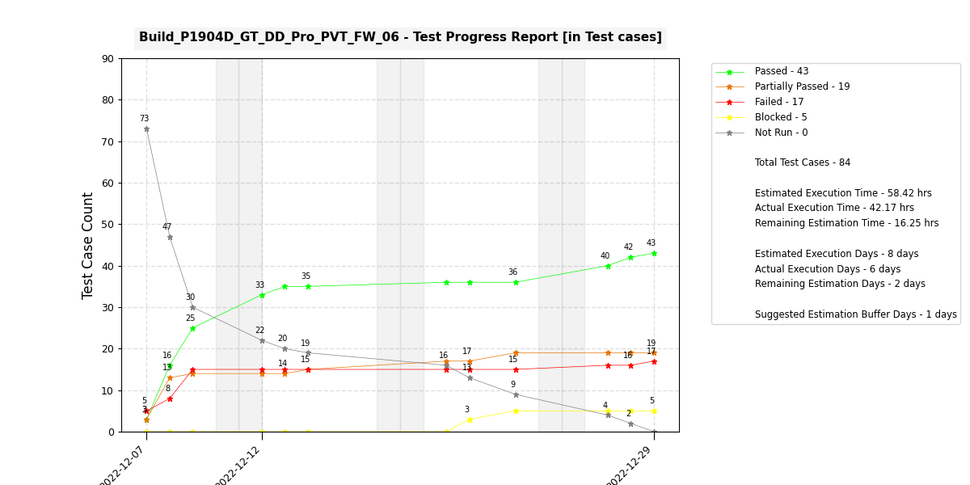
Test Progress Report
A sample Test Progress Report from Project.
Displaying the status of the Test case for each days and number of remaining test cases to be executed.
Green “Number of Passed Tests”
Orange “Number of Partially Passed Tests”
Red “Number of Failed Tests”
Yellow “Number of Blocked Tests”
Grey “Number of Tests to be Executed” – “Not Run”
The numbers represent the “Number of Test cases”
Uses: With this representation one can have an overview of the Test Progress and plan future testing activities. Note: Similar report can also be provided in unit of Test Steps.

Slide 6
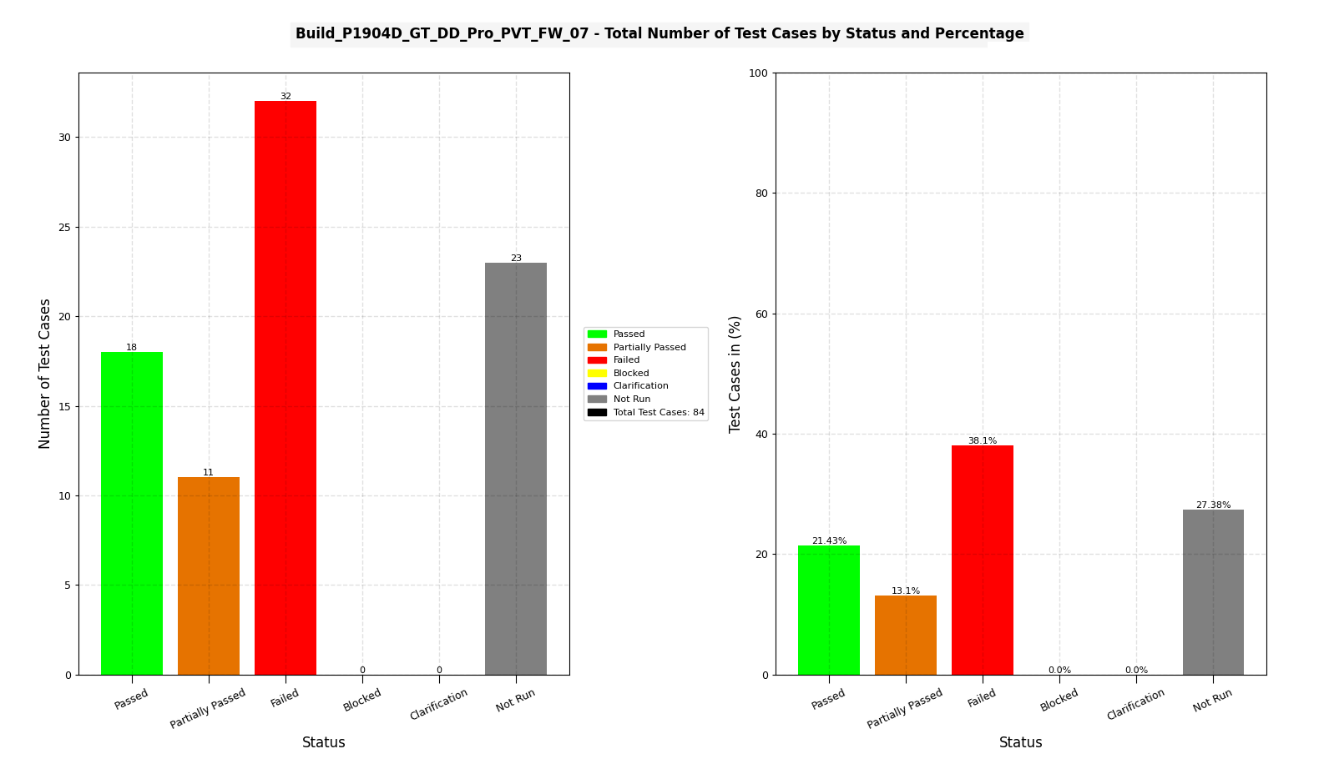
[Product Performance Test Report]
A sample Product Performance Report from Project.
Displaying the status of the Product.
Green “Number of Passed Tests”
Orange “Number of Partially Passed Tests”
Red “Number of Failed Tests”
Yellow “Number of Blocked Tests”
Grey “Number of Tests to be Executed” – “Not Run”
The numbers represent total “Test cases”
Uses: With this representation one can have an overview of the Product Performance and can plan and prepare for risks. Note: Similar report can also be provided in unit of Test Steps.

Slide 7
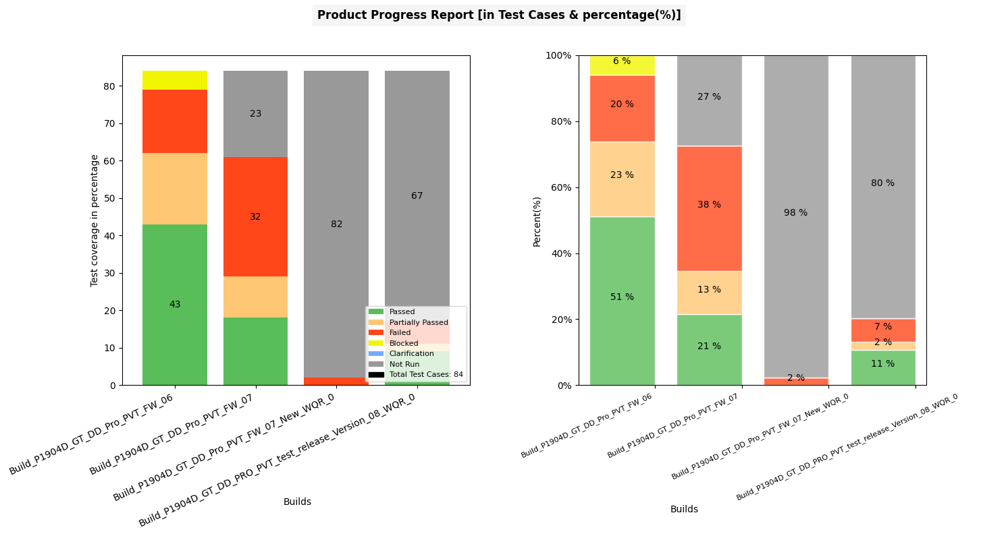
Product Comparison Test Report
A sample Product Progress Report from Project.
Displaying the Performance of the Device Under Test (DUT) with 4 different firmware versions. Here the product is Wheelbase.
Green Band “Number of Passed Tests”
Orange Band “Number of Partially Passed Tests”
Red Band “Number of Failed Tests”
Yellow “Number of Blocked Tests”
Grey Band “Number of Tests to be Executed” – “Not Run”
The numbers on the left are representing Number of Test cases
The numbers on the Right chart are representing the percent of tests
Uses: With this representation it can clearly distinguished that which Revision of Product or which Version of the Firmware is performing better.
Comparison of versions of same product/software Note: Similar report can also be provided in unit of Test Steps.

Slide 8
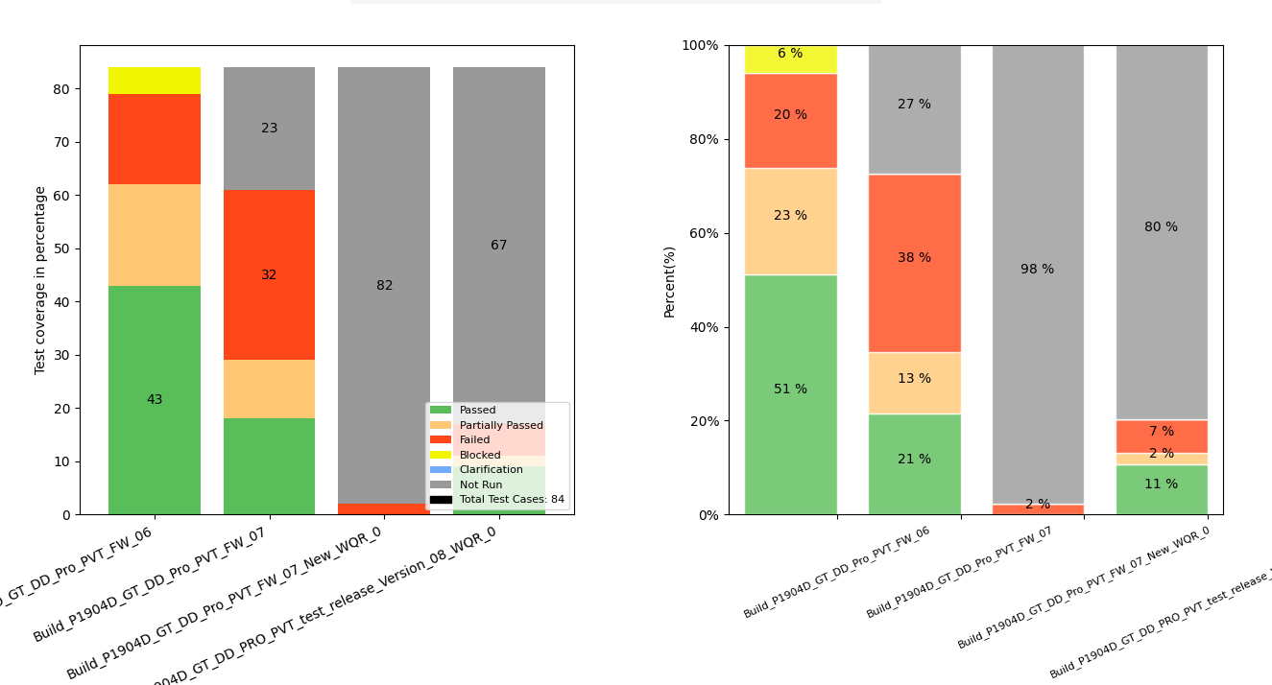
Overview of Test Reports
Burndown chart
Test Progress Report
Product Progress Report
Product Comparison Report

Slide 9

Thank you

